Slide 1
What is Dabbler AI Orchestration?
A VS Code extension that runs AI coding sessions to one lifecycle — and checks the work with a second provider before it lets the session close.
You keep your own AI CLI. The framework does not replace it, spawn it, or read your chat; it owns the list of what happens next.
The extension bundles the router and puts the `dabbler` command on the integrated terminal's PATH. Inside VS Code there is nothing else to install.
Needs VS Code 1.135 or newer and Node.js 22.18 or newer.
Install it from the Marketplace once it is published. Until then, install the .vsix built from the repository:
code --install-extension dabbler-ai-orchestration.vsix
# Outside VS Code — another editor, a bare shell, or VS Code's
# Source Control panel, whose git does not inherit the terminal:
npm i -g dabbler-ai-router
Dabbler AI Orchestration
github.com/darndestdabbler/dabbler-ai-orchestration
1

Slide 2
Why use Dabbler?
Four things you would otherwise have to remember to do, every session, forever.
Cross-provider verification runs itself. A different provider than the one that wrote the code reviews the diff, and a round that finds something buys another round. There is no flag to skip it.
One lifecycle, every session: register, declare the work, do it, run the tests the change makes necessary, verify, run the complete suite as the run of record, close. The framework holds the list — the engine asks it what is next.
A cross-repository view of what your repositories build and what they take from each other, with a consumer's pin shown against the producer's version when the two have drifted apart.
A decision the framework cannot make arrives as one question with a recommendation and the consequence of each option — instead of an engine quietly choosing for you.
Dabbler AI Orchestration
2

Slide 3
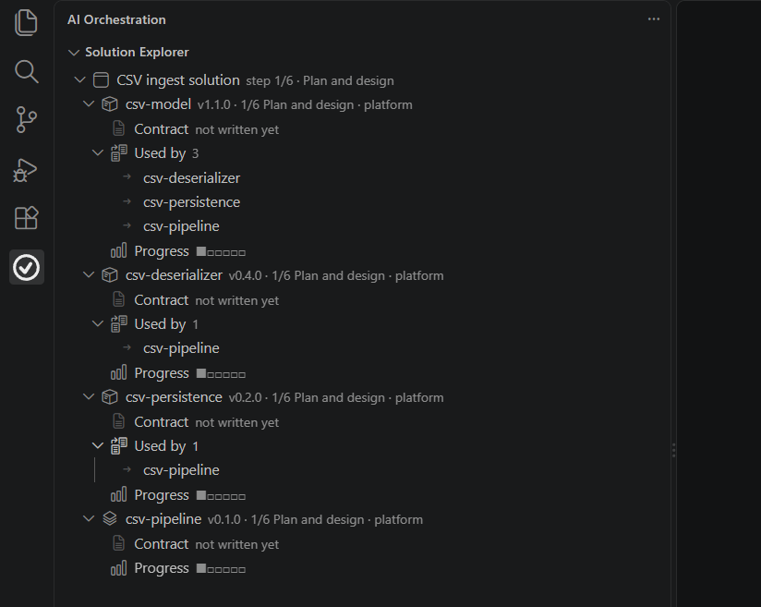
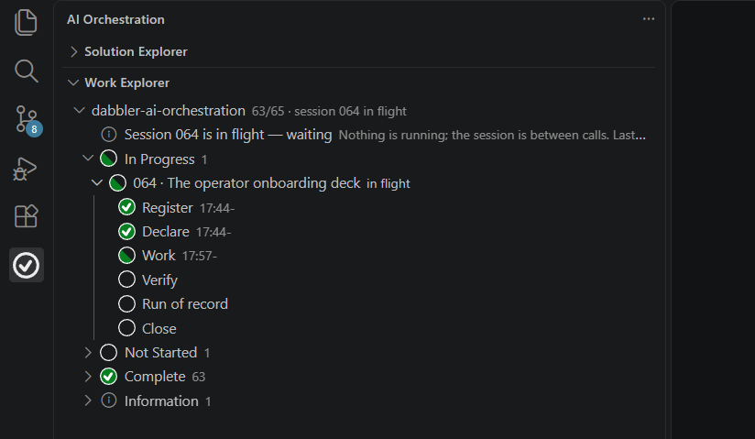
The AI Orchestration Explorer
SOLUTION EXPLORER — what the project is built FROM.
A component row carries its version and which of the six steps it has reached; Contract opens what it promises; Used by is derived from everyone else's declaration, never written by hand; Progress is the six steps.
Clicking a component's Contract row opens the contract. Clicking a consumer under Used by opens that repository.
WORK EXPLORER — the work itself.
The repository row carries how many sessions are done and which one is in flight. Under it: rows for anything waiting on you, then the status buckets — In Progress open, the rest collapsed with their counts.
A session's own rows are the six lifecycle phases. Each is done the moment the verb that IS that phase writes its record; nothing is ticked by hand.
Clicking a session row opens its block in the session plan.
Dabbler AI Orchestration
3

Slide 4
Getting started with Copilot
The shipped default: your GitHub Copilot seat, through the Copilot CLI.
You need VS Code 1.135+, Node.js 22.18+, a GitHub Copilot seat, and the Copilot CLI installed and signed in.
Setup settles the transport when it finds a seat and remembers it for every new shell. Force it either way with DABBLER_TRANSPORT.
Name the model on the first call, the one that registers the session: a seat's own label is not trusted, so identity resolves through the model registry.
Run it from the repository you are working in — the sessions root is derived from where you stand, so no command has to name it.
What it costs: driving from your own CLI has no invocation bound — your seat, your bill. Only the unattended mode spends on the framework's behalf: one premium request per invocation, bounded by driver.max_invocations in dabbler.yaml (default 24).
# PowerShell
$env:DABBLER_TRANSPORT = "copilot-cli"
# bash, zsh
export DABBLER_TRANSPORT=copilot-cli
dabbler session next --engine copilot --provider openai --model gpt-5-6-luna
Dabbler AI Orchestration
4

Slide 5
Getting started with Claude Code
Your own CLI, and direct provider accounts.
You need VS Code 1.135+, Node.js 22.18+, and Claude Code installed and signed in.
Two providers at minimum. Verification is cross-provider by design — the reviewer is never the provider that wrote the code — so one key is not enough.
The keys live in environment variables and nowhere else: never in dabbler.yaml, never in local-overrides.yaml, never in a file you might commit. Configuration names a credential; it never holds one.
Set them where new shells inherit them — on Windows with setx or System Properties, elsewhere in your shell profile.
# The three the verifier reads, one per provider:
# DABBLER_ANTHROPIC_API_KEY, DABBLER_OPENAI_API_KEY,
# DABBLER_GEMINI_API_KEY
# PowerShell, for this session; setx for every session after it
$env:DABBLER_ANTHROPIC_API_KEY = "<your key>"
# bash, zsh
export DABBLER_ANTHROPIC_API_KEY=<your key>
dabbler session next --engine claude-code --provider anthropic
Dabbler AI Orchestration
5

Slide 6
Project setup
Once per repository, then two sessions that set the project up.
Run Set Up New Project from the Explorer, or the command below from your project root.
It writes the managed instructions into AGENTS.md, with CLAUDE.md and GEMINI.md importing that one copy; adds .dabbler/ to .gitignore; scaffolds dabbler.yaml, solution.yaml and the first two sessions — and commits them, because a declaration is refused while the files it describes sit uncommitted.
It may raise two questions it cannot answer for you: where this repository should push when it has no remote, and how its tests run when nothing at the root says. Each arrives as a row you answer.
Then session 1 asks you what the project is and writes the project plan — it does not guess it from the folder name. Session 2 breaks that plan into the numbered sessions the repository runs.
Never hand-author sessions.json. The first session start writes it from the plan.
dabbler bootstrap --project-dir .
Dabbler AI Orchestration
6

Slide 7
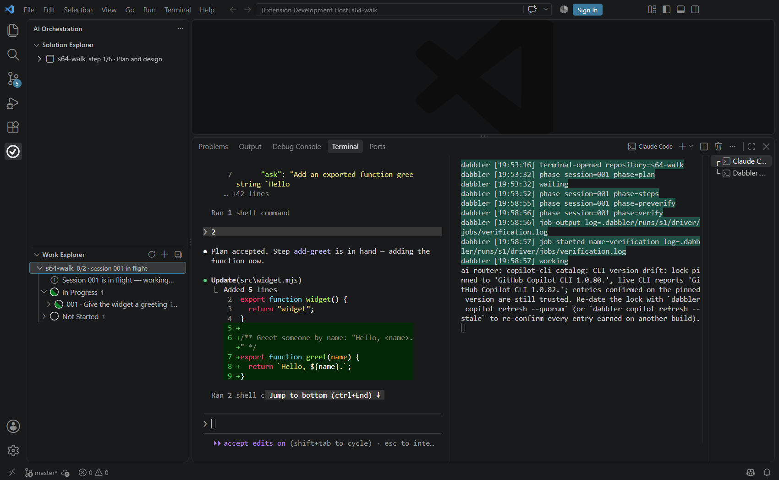
Driving a session
Start Session on the repository row asks which engine, then opens that engine's own CLI at the repository root — the opening sentence already in its arguments, or typed at its prompt for you to send.
That sentence is the whole instruction: call `dabbler session next` and do what it says until it says `done`.
The Dabbler terminal opens beside it: the phase the run moved to, the jobs it starts, and each job's output exactly as the runner wrote it.
It never carries a line of engine chat. Chat in your CLI; work in the Dabbler terminal.
Interrupting is your own CLI's Esc.
dabbler [11:31:20] run-started session=001
dabbler [11:31:22] instruction-issued seq=2 step=widget
dabbler [11:31:30] job-started name=affected tests
Dabbler AI Orchestration
7

Slide 8
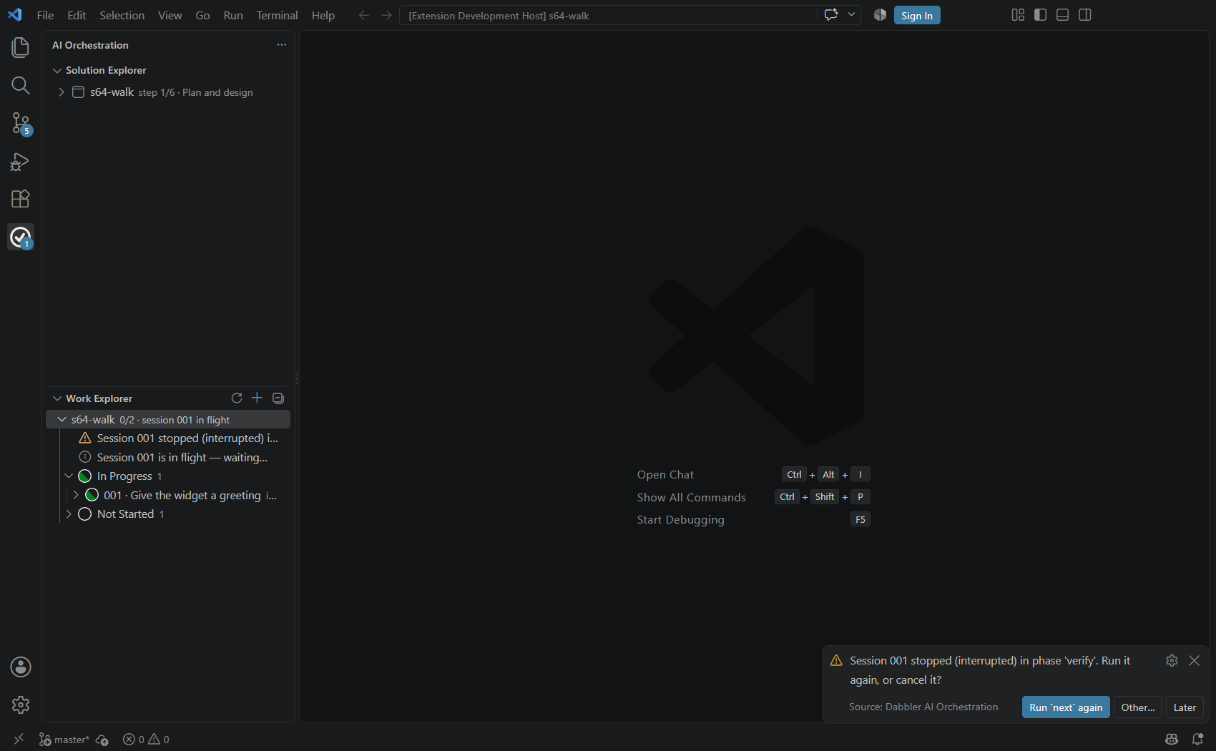
When it stops
A halt is raised as a decision: the toast offers the recommended answer, the row sits above the session buckets, the badge carries the count.
Later records nothing — dismissing a toast is not a decision, and the row stays.
Other… , or a click on the row, opens a picker, and every item carries its consequence:
Run `next` again (recommended) — the session resumes from the phase it stopped in, and the steps it has already accepted are not asked for again.
Cancel the session — `dabbler session cancel` ends it with a reason on the record, and what the working tree already carries stays where it is.
Nothing is lost either way: the phase, the accepted steps and any running job are on the record.
Ask your engine for help and it follows the guide's protocol: read the framework's own account first, never the scrollback; verify the claim before acting; then work out whose it is to fix.
For a second opinion — engine-error, framework-defect or plan-defect — from a provider that is not the working engine's:
dabbler triage --sessions-dir docs/sessions
The engine alone does not know when it is stuck. That is why the framework is in the room.
Dabbler AI Orchestration
8

Slide 9
A solution across four repositories
Each repository declares what it builds in its own solution.yaml: the component, its kind, its version, and which of the six steps it has reached.
dependsOn is the only direction anyone writes. Used by is derived from everyone else's declaration — two directions kept by hand disagree eventually, and the disagreement is silent.
csv-model sits under everything. csv-deserializer and csv-persistence each depend on it; csv-pipeline depends on all three.
Drift is the producer's version held against the pin in the consumer's build file — read from the .csproj on every check, never copied. The row says which repository owns the upgrade.
A pin a build file cannot express is reported as undetermined, never guessed: a false drift report costs more than a missing one, because someone acts on it.
The screen is real; the four repositories are designed, not built.
Dabbler AI Orchestration
9

Slide 10
csv-model
A library. First Name, Last Name, Date of Birth — and nothing else.
Its contract: the shape of one record. It says what a date of birth means and what a missing name is; it says nothing about where a record came from or where it goes.
It depends on nothing, which is what makes it the contract that costs the most to change: csv-deserializer populates it, csv-persistence stores it, and csv-pipeline holds all three.
Its sessions live in its own repository under docs/sessions, numbered from 1. Session 1 asks the operator what the project is and writes the project plan; session 2 breaks that plan into the numbered sessions; the rest are the work.
A change to the model is a version, and every consumer's pin is measured against it — so the Explorer shows who has not picked it up yet.
Dabbler AI Orchestration
10

Slide 11
csv-deserializer
A library that fills csv-model from a CSV string or a stream.
Its contract: given CSV text or a stream, it yields models — and it says plainly what it does with a row it cannot read, because a row silently dropped is a defect nobody sees until the numbers are wrong.
It depends on csv-model and on nothing else. csv-pipeline is what breaks when it changes.
Planned in the order the six steps run: the contract first, then a stand-in that satisfies the contract and nothing more, then the real reader, then its failure vocabulary.
It is built against csv-model's stand-in before csv-model is finished, which is what the stand-in step is for — the contracts have to compose before the code does.
Dabbler AI Orchestration
11

Slide 12
csv-persistence
A library that stores csv-model with Entity Framework Core, into SQLite.
Its contract: given a model, it persists it, and it says what happens when the same record arrives twice — the question every store has to answer out loud.
It depends on csv-model and on nothing else. csv-pipeline is what breaks when it changes.
Planned as: the schema and its migration, then the type a caller actually holds, then the round trip that proves a model written is the model read back.
Its sessions are its own, in its own repository. Nothing about it is coordinated by hand with the other three — the declaration is what joins them.
Dabbler AI Orchestration
12

Slide 13
csv-pipeline
The integration: a Quartz.NET-scheduled reader that puts the other three to work.
Its contract: on a schedule, it takes the files that have arrived in a directory, hands each to csv-deserializer, and gives what comes back to csv-persistence. It owns the schedule, the directory, and what happens to a file it has already read.
It depends on all three, which is why it is declared kind: integration — it is the component that is the whole thing running.
Planned last and finished last: the schedule, then the reader, then the end-to-end run on stand-ins alone. What that run proves is that the contracts compose; a gap it papers over is a contract that is wrong.
Only then are the stand-ins replaced by the real libraries, one at a time.
Dabbler AI Orchestration
13

Slide 14
The day-to-day loop across the four
One repository at a time, in dependency order, each with its own sessions.
Work happens in one repository at a time. You run the same command from that repository's root, and its sessions root is the one it derives from where you are standing.
csv-model's contract changes: you work in csv-model, and its session closes with the new version out. Nothing else is touched in that session.
The Solution Explorer then shows the consumers behind it — the drift row per repository, with the pin each one still carries. Each upgrade is its own session in the repository that owns the pin.
Pick them up in dependency order: csv-model first; csv-deserializer and csv-persistence in either order; csv-pipeline last, because it is the one that proves the other three still compose.
Nothing here is bookkeeping you maintain. The pins are read from the build files on every check, Used by is derived, and the Explorer is the join.
dabbler session next --sessions-dir docs/sessions
Dabbler AI Orchestration
14

