Slide 1
AI Orchestration
Overview and Tutorial Walkthrough

Slide 2
What is this?
A Visual Studio Code Extension called Dabbler AI Orchestration
The main purpose of the extension is to improve AI-facilitated development in a few ways:
  Cross-Provider Verification – make it easier to verify work (with potentially multiple feedback/fix rounds) by a second, independent AI Provider. AI makes mistakes, but a second AI provider (with a well-crafted prompt) often catches those mistakes, reducing the burden on human operators.
  Standardized Work Across Sessions – organize AI project work into sessions with uniform lifecycles.
    Except for very simple projects, AI cannot do all of its work in a single session; so, it is helpful to have AI organize its project work into multiple sessions, where additional sessions can be added at any time for bug fixes or enhancements
    The same exact AI model will do things in very different ways on different occasions. By forcing AI to follow a uniform session lifecycle, the result will be more consistent and predictable.
  Cost Savings – prevent AI from doing things that non-AI code can do at no cost and faster. Implementing #1 and #2 improves quality but also cost. The extension helps offset this extra cost by handling things like project lifecycle governance and tracking, launching tests, remediation loops, disputes between AI engines, and git operations.

Slide 3
What if I don’t want to use it?
At any time, you can stop using the extension and just use AI directly.
  The extension just creates markdown (.md) and JSON files to organize and govern its work.
  If you ever want to stop using the extension permanently, you can keep or delete those files.
But if you just want the benefit of sometimes using AI directly, do it this way:
  Fire up a separate (ad-hoc) chat window instance of Copilot or Claude
  If you have an in-flight session, make sure that you tell AI not to make any changes in the repo until the in-flight session lands (the session closes and all changes have been pushed to the remote)
  Have the independent AI read AGENTS.md so that it doesn’t mess up the extension’s markdown files and JSON documents.
  NOTE: An ad-hoc chat window is often a good approach for the following:
    Doing additional planning work while AI is busy implementing things
    Doing a real-time evaluation if you are concerned that AI is doing something wrong

Slide 4
Getting Started – Installation and Accounts
You need to have the following installed:
  Visual Studio Code, including
    Git client (often installed with VS Code)
    Dabbler AI Orchestration Extension
  AI Command-Line AI Tool(s) – at least one of the following:
    Copilot CLI
    Claude CLI
You need AI Accounts
  If using Copilot, you need a GitHub Copilot account
  If using Claude CLI, you need both
    An Anthropic AI account
    At least one AI API account with either OpenAI or Google (Gemini)
If using AI APIs, you need to set the Dabbler environment variables
  DABBLER_OPENAI_ API_KEY and DABBLER_GEMINI_API_KEY

Slide 5
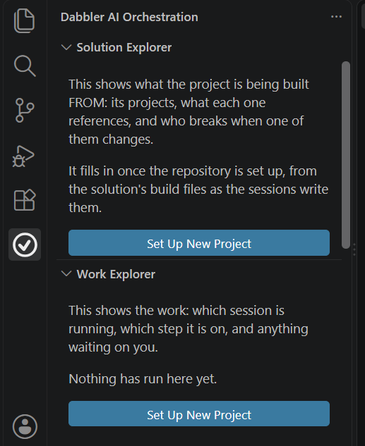
Getting Started – Project Set Up
Create a remote repo in either GitHub or Azure DevOps. Don’t add anything to the remote repo (not even the README file)
Fire up Visual Studio Code or open a new window (if VS Code is already open) – without selecting a folder.
Click on the AI Orchestration’s Checkmark Icon,
Click one of the blue “Set Up New Project” blue buttons (They both do the same thing)
You will be prompted for a folder location (it’s the parent folder for the repo – so perhaps … source/repos), project name, and remote repo URL.

