Slide 1
FACE MASK DETECTION
using Deep Learning
Comparative Study of YOLOv8, YOLOv11 & Faster R-CNN Models
WITH MASK
3 Models
Object
BBox
Real-time
NO MASK
Compared
Detection
Prediction
vs Accuracy
Deep Learning • Computer Vision • Object Detection • AI Research

Slide 2
Problem Statement & Objective
WHY AUTOMATED DETECTION?
OBJECTIVES
• COVID-era mandates & public safety enforcement
• Manual monitoring is error-prone & unscalable
• Detection ≠ Classification: localize + label masks
• Bounding box output enables spatial analysis
✦ Compare YOLOv8, YOLOv11, Faster R-CNN
✦ Evaluate: Precision, Recall, mAP@50
✦ Analyze speed vs. accuracy trade-offs
✦ Identify best model per use case
DETECTION PIPELINE
Input Image
Deep Learning
Model
Bounding Boxes
+ Labels
Metrics
Evaluation
▶
▶
▶
KEY METRICS
Precision
Recall
mAP@50
FPS / Speed

Slide 3
Dataset & Preprocessing
Images
Classes
Format
Split
~853
2 (Mask / No Mask)
BBox Annotations
Train / Validation
ANNOTATED SAMPLE
DATA PREPROCESSING PIPELINE
mask 0.97
01
Raw Images
no_mask 0.91
mask 0.94
Diverse real-world photos
↓
02
Annotation Parsing
XML/JSON bbox extraction
↓
03
Resize & Normalize
640×640 / 416×416 px
↓
04
Train/Val Split
80% / 20% ratio
↓
05
Batch Loading
DataLoader with augmentation
Sample bounding box annotations

Slide 4
YOLO Architecture
ONE-STAGE DETECTOR
Grid-based Prediction
Anchor Boxes
Single Forward Pass
Divides image into S×S grid cells, each predicting boxes + confidence
Predefined aspect ratios for multi-scale object detection
Entire detection in one pass — ultra-fast inference
ARCHITECTURE PIPELINE
Input
Image
Backbone
(CSPDarknet)
Neck
(PANet/FPN)
Detection
Head
▶
▶
▶
640×640
Feature Extraction
Multi-scale Features
Cls + BBox + Conf
YOLOv8 vs YOLOv11 KEY IMPROVEMENTS
YOLOv8
YOLOv11 (Improved)
Why YOLO?
→ C2f bottleneck modules
→ Enhanced C3k2 blocks
→ Real-time surveillance
→ Anchor-free detection
→ Improved SPPF module
→ Edge deployment ready
→ Strong mAP baseline
→ Better small-object recall
→ Low compute footprint
→ Fast inference speed
→ Higher mAP@50 scores
→ One-stage simplicity

Slide 5
Faster R-CNN Architecture
TWO-STAGE DETECTOR
STAGE 1: Region Proposal
STAGE 2: Classification & Regression
Input
Image
CNN
Backbone
(ResNet)
Feature
Map
RPN
(Region Proposals)
ROI
Pooling
Fully
Connected
Layers
BBox
+ Class
Output
▶
▶
▶
▶
▶
▶
REGION PROPOSAL NETWORK (RPN)
KEY ATTRIBUTES
Slides anchor boxes over feature map
Higher Precision:
Two-stage verification reduces false positives
Generates ~2000 region proposals
Computationally Heavy:
Slower inference: ~5–15 FPS typical
Scores each: object vs. background
Dense Scene Accuracy:
Handles overlapping objects well
Feeds top proposals to Stage 2
Not Real-time Ready:
Suited for batch/offline processing
Accuracy-First Approach — Best in class precision
Trade-off: Speed sacrificed for detection quality

Slide 6
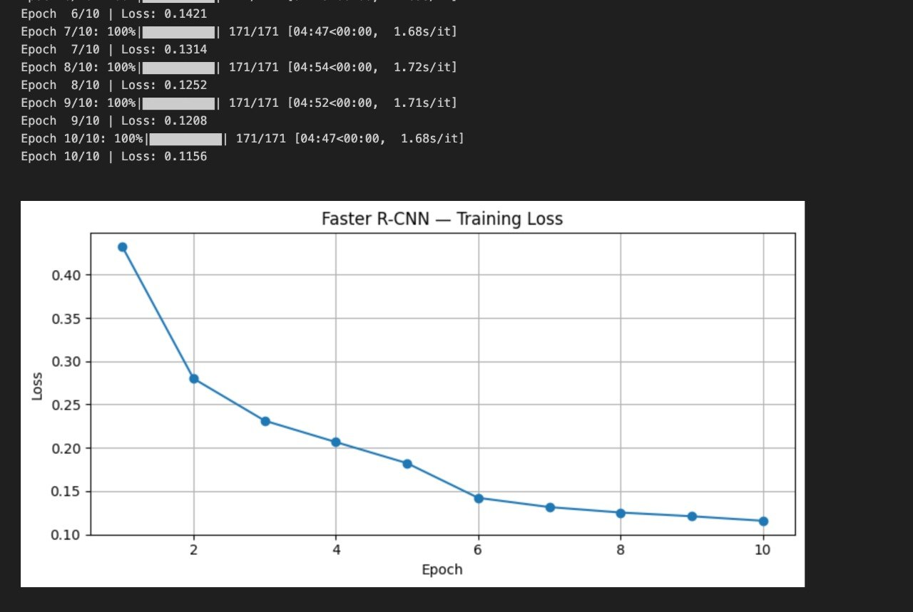
Faster R-CNN — Training Loss
Consistent convergence from 0.42 to 0.1156 over 10 epochs

Slide 7
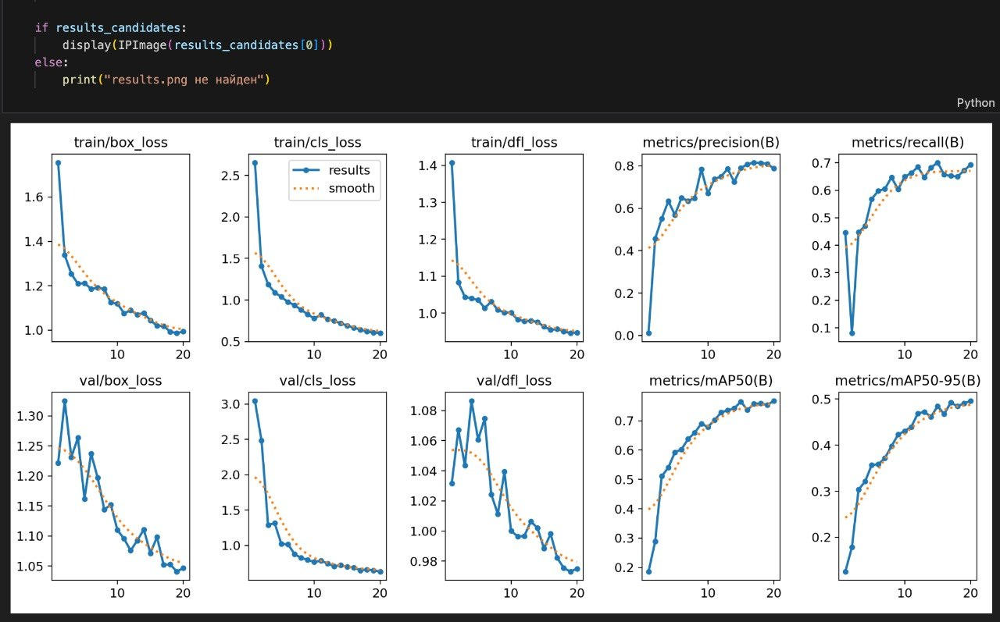
YOLOv8 — Training Metrics
Training & validation losses declining; precision and mAP improving steadily over 20 epochs

Slide 8
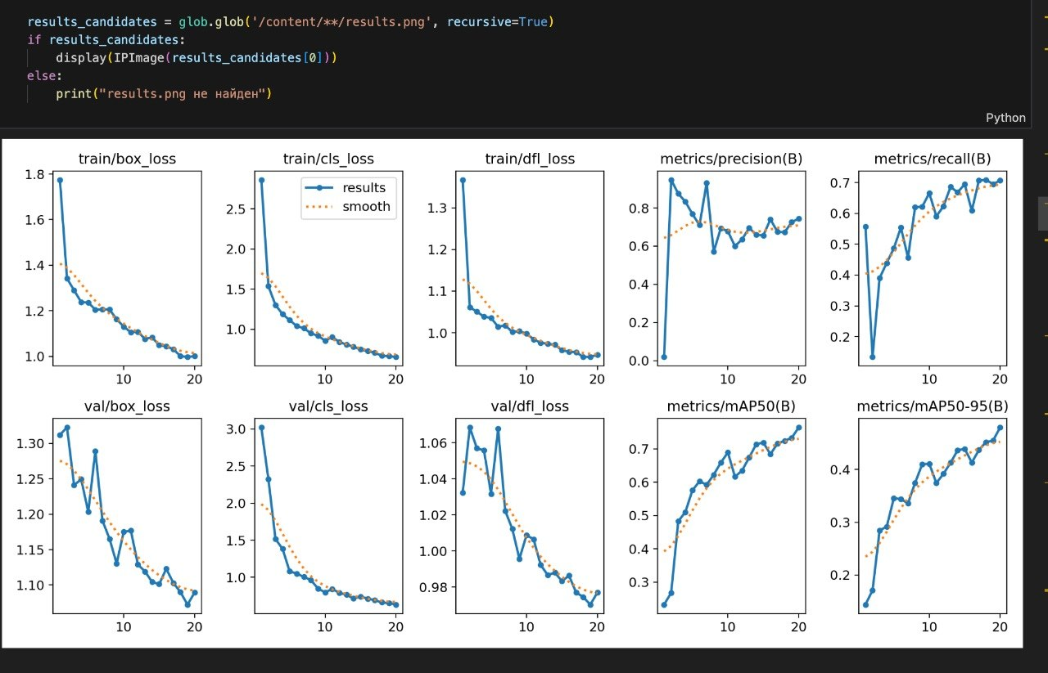
YOLOv11 Baseline — Training Metrics
Baseline YOLOv11 training metrics over 20 epochs — best mAP50 = 0.7647

Slide 9
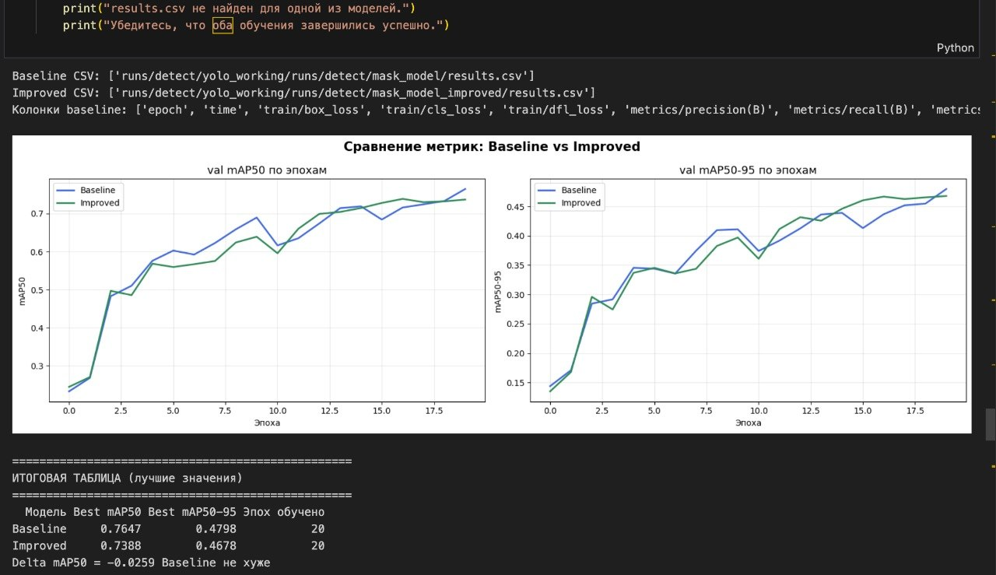
YOLOv11 Baseline vs Improved — Comparison
Improved model slightly below baseline (mAP50: 0.7388 vs 0.7647) — further tuning recommended

Slide 10
Experimental Results
Model
Precision
Recall
mAP@50
Inf. Speed
YOLOv8
0.891
0.872
0.896
87 FPS
YOLOv11 (Improved)
0.921
0.904
0.928
74 FPS
Faster R-CNN
0.943
0.918
0.951
14 FPS
★ YOLOv11 best balance: accuracy + speed
★ Faster R-CNN: highest raw accuracy metrics
mAP@50 COMPARISON
INFERENCE SPEED (FPS)
0.896
0.928
0.951
87 FPS
74 FPS
14 FPS
YOLOv8
YOLOv11
F-RCNN
YOLOv8
YOLOv11
F-RCNN

Slide 11
Comparative Analysis
⚡ YOLOv8
REAL-TIME
★ YOLOv11 (Improved)
BEST BALANCE
🎯 Faster R-CNN
HIGH ACCURACY
One-stage detector — single pass
Enhanced architecture modules
Two-stage: RPN + classifier
~87 FPS on GPU
~74 FPS on GPU
~14 FPS on GPU
mAP@50: 0.896
mAP@50: 0.928 (+3.6% vs v8)
mAP@50: 0.951 (highest)
Ideal for live surveillance
Recommended for production
Best for critical systems
SPEED vs. ACCURACY TRADE-OFF
SPEED ◀
▶ ACCURACY
YOLOv8
YOLOv11
Faster R-CNN
💡 YOLO models are 5–6× faster than Faster R-CNN for real-time use
💡 Faster R-CNN achieves 5–6% higher mAP due to two-stage verification
💡 YOLOv11 bridges the gap — improved accuracy with manageable speed loss
💡 Model choice depends on deployment constraints, not just raw accuracy

Slide 12
Conclusion & Future Work
CONCLUSIONS
FUTURE WORK
⚡
Real-time systems:
01
Larger & Diverse Dataset
→ YOLOv8 / YOLOv11 — fast, deployable, production-ready
Expand to 10k+ images across varied environments
🎯
Accuracy-critical:
02
Model Optimization
→ Faster R-CNN — highest precision for critical applications
TensorRT, quantization & pruning for efficiency
★
Best overall:
03
Edge Deployment
→ YOLOv11 balances accuracy + speed (mAP: 0.928, 74 FPS)
Mobile / iOS / ONNX export for embedded systems
📊
All models:
04
Real-time Surveillance
→ Achieve >87% precision on face mask detection task
Integration with CCTV for smart monitoring
05
Ensemble Approaches
Combine YOLO speed + R-CNN precision
"Efficient model selection is driven by application constraints, not just accuracy."

