Slide 1
Enhancing Monitoring with Spatial Data and Maps
Derek Arnold
d.arnold7@gmail.com

Slide 2
About me
Twitter handle: @darnold0714
LinkedIn URL: https://www.linkedin.net/in/derek-a-arnold
Github: https://www.github.com/darnold76
Last position: Sr. Systems Engineer at a fiber/wireless ISP in Northeastern Ohio
Interests: Linux, Python, maps (of course), cities (big and small), mathematics, systems of various kinds
Number of wives: 1, also named Lisa
Number of kids: 1
Number of four legged stepchildren: 1
Number of days on Jeopardy!: 1

Slide 3
Roadmap*
Why this talk?
What Is Spatial Data?
Storage Considerations for Spatial Data
Collecting / Acquiring Spatial Data
Integration with Current Data
Visualization of Spatial Data (Maps!)
Conclusion
* Slight pun intended

Slide 4
Why am I Here?
Convergence of multiple personal interests:
Math / Problem Solving
Maps
Data / Computers
Professionally: learned about spatial data during web internship at the Greater Cleveland Regional Transit Authority (GCRTA) (1999-2000)

Slide 5
Why This Subject?
Metrics are our friends
Measures come from stationary objects...but that isn’t a limitation
The use cases where location needs to be known, tracked and integrated are growing (more on that later)
Enter spatial data

Slide 6
Why Does Spatial Data Matter?
Storage is cheap and plentiful
Bandwidth is (nearly) ubiquitous*
Lots of free (gratis and/or libre) and non-free (paid and/or proprietary) software to manipulate data
The world is a lot smaller and the population is more mobile
Examples
Smart Phones
Intelligent Transportation
Internet of Things
* There are lots of exceptions…it is an issue that needs to be addressed but it’s beyond the scope of this tutorial.

Slide 7
What is Spatial Data?
GIS – Geographic Information System
Coined by Dr. Roger Tomlinson (Geographer – UK) – 1968
System for capturing, storing, manipulating, analyzing, managing and presenting spatial data
Current day examples of spatial data include:
Borders of political divisions (city, state, country, etc.)
A jogger’s path taken by a phone app
A route used by a delivery service
Real-time data from buses in a transit system

Slide 8
What is Spatial Data?
How do we describe data?
Latitude
From the Latin latus meaning breadth
Lines running east to west at varying angles from the center of the earth (parallels).
0° Latitude = the Equator
Latitudes > 0 = Northern Hemisphere, Latitudes < 0 = Southern Hemisphere
Longitude
Lines running north to south at varying angles from the center of the earth (meridians)
0 ° Longitude = the Prime Meridian (runs through Greenwich, UK)
Longitudes > 0 = Eastern Hemisphere, Longitudes < 0 = Western Hemisphere

Slide 9
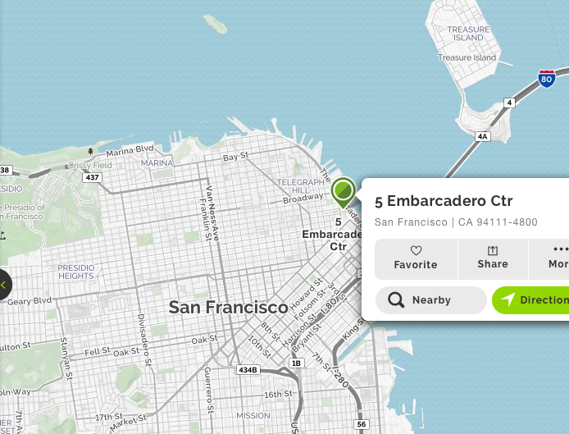
You Are Here
Source: Mapquest
37.7942211,-122.397855

Slide 10
What is Spatial Data?
Addresses -> Coordinates?
Geocoding...and reverse geocoding (Coordinates->Addresses)
Tools exist:
Nominatum
Google Geocoding API

Slide 11
Demo Time
Nominatum

Slide 12
Demo Time
Google Geocoding API

Slide 13
Storage of Spatial Data
Where does it go?
The same databases already in production can store and manipulate spatial data
PostgreSQL (with PostGIS)
MariaDB and MySQL
Oracle Spatial
Microsoft SQL Server 2008+

Slide 14
Storage of Spatial Data
Spatial data != just points
Points
Lines
Roads, network connections
Polygons
Borders of political divisions, land
Operations on all of these are included in spatial-aware DBs
Will discuss in depth later

Slide 15
Acquisition of Spatial Data
You may already have data
Business data
In-house GIS staff
Many different formats
CSV
XLS
JSON
ESRI SHP
“Shapefile” – format created by ESRI
KML
Keyhole Markup Language – default of Google Earth
SQL
\

Slide 16
Monitoring and Spatial Data
Add spatial data to your devices
Nagios & Nagios XI – define host lat/long with custom object variables
Custom code to update host definition files in the case of moving hosts
Data doesn’t have to live together to work together

Slide 17
Visualization of Spatial Data
Many spatial data tools for manipulation of spatial data
Software
Quantum GIS (QGIS)
QGIS:ESRI ArcGIS::GIMP:Photoshop
Boundless Desktop (based on QGIS)
Frameworks
GDAL – Geospatial Data Abstraction Library(command-line library)
OpenLayers (web-based JavaScript library)

Slide 18
Visualization of Spatial Data
Sharing With Teams
Google Earth (1 – 2 people)
ArcGIS Online (public and private sharing options)
Boundless Suite
Custom solutions using aforementioned frameworks

Slide 19
Conclusion
Spatial data == organized way to say where things are
Unlimited usefulness when aligned with business need
Provides insight into the spatial world around us through a wealth of usable data
Spatial data has more applications than pretty maps

Slide 20
More Information
PostGIS: https://www.postgis.org
MariaDB: https://www.mariadb.com/kb/en/library/geographic-geometric-features/
What is a Spatial Database?: http://workshops.boundlessgeo.com/postgis-intro/introduction.html
ArcGIS: https://www.arcgis.com/features/index.html
MS SQL Server: https://docs.microsoft.com/en-us/sql/relational-databases/spatial/spatial-data-sql-server
OpenLayers: http://openlayers.org/en/latest/apidoc/
GDAL: http://www.gdal.org

Slide 21
Questions?
Q/A

Slide 22
The End
Thank you all for your time and attention.
Please do not forget to fill out an evaluation of this tutorial.

