Slide 1
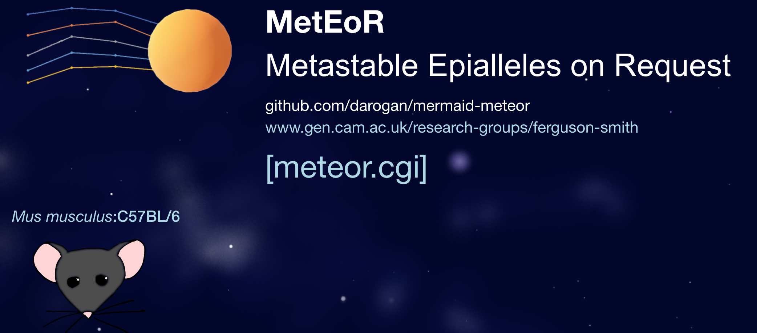
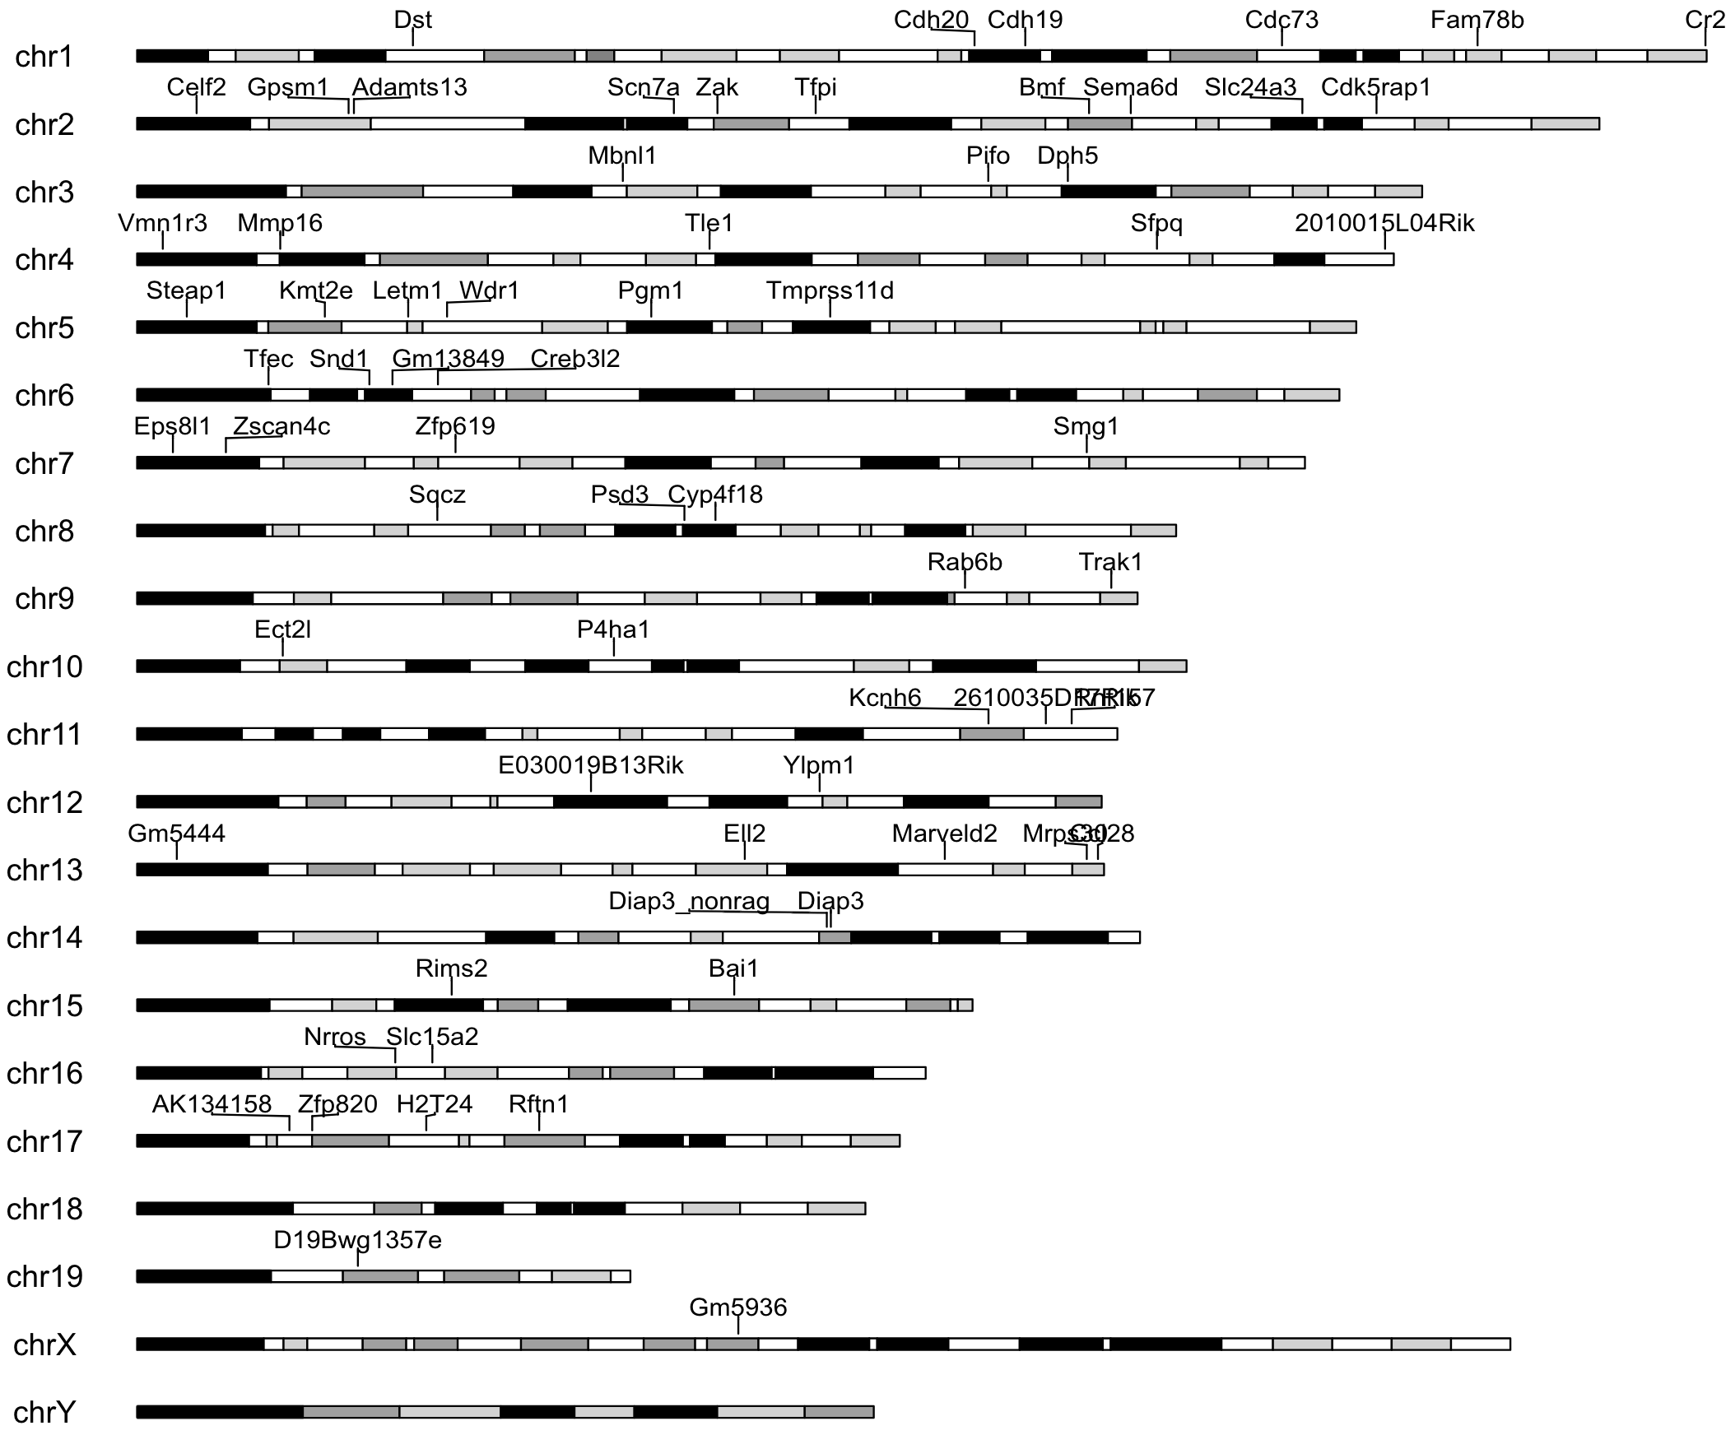
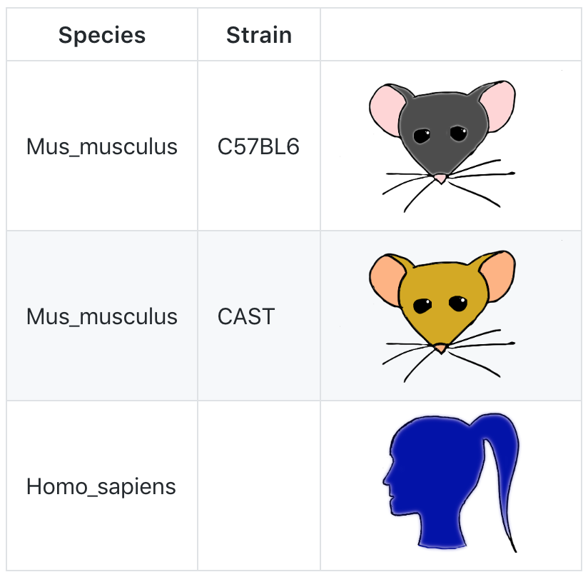
Cambridge Bioinformatics Hackathon 2018
Ferguson-Smith Lab
Department of Genetics
University of Cambridge
Carol Edwards
Russell Hamilton
Noah Kessler
Catrin Lloyd
Jenni Westoby
Public GitHub Site: https://github.com/darogan/MetEor_Project

Slide 2

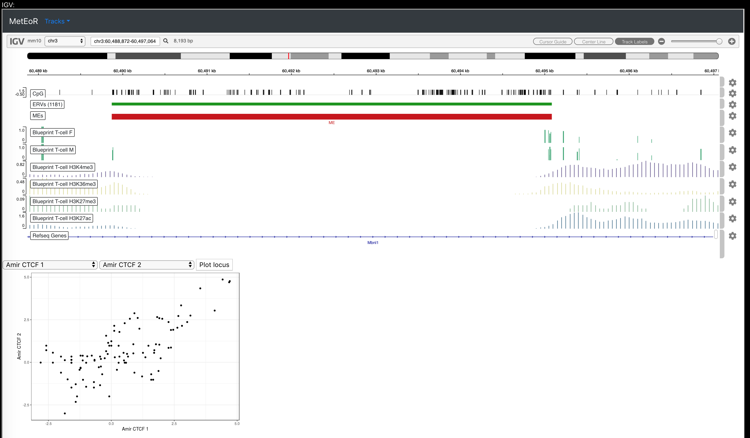
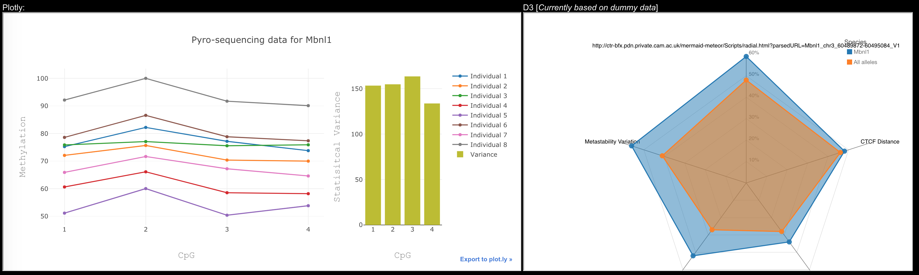
https://github.com/darogan/MetEor_Project

