Slide 1
REPRODUCIBLE RESEARCH
library(dplyr)
rladies_global %>%
filter(city == 'Munich')
With Rmarkdown; Git+GitHub+RStudio

Slide 2
1.
Why reproducible research?

Slide 3
Reproducible Research
Why?
To improve trust in science
Transparency: to allow others to verify our work
To keep track of our procedure as future reference (especially for ourselves)
To have a local or online backup, sorted by history.

Slide 4
2.
Rmarkdown

Slide 5
Rmarkdown what is it?
Markdown language
Rmarkdown
Chunks of R code

Slide 6
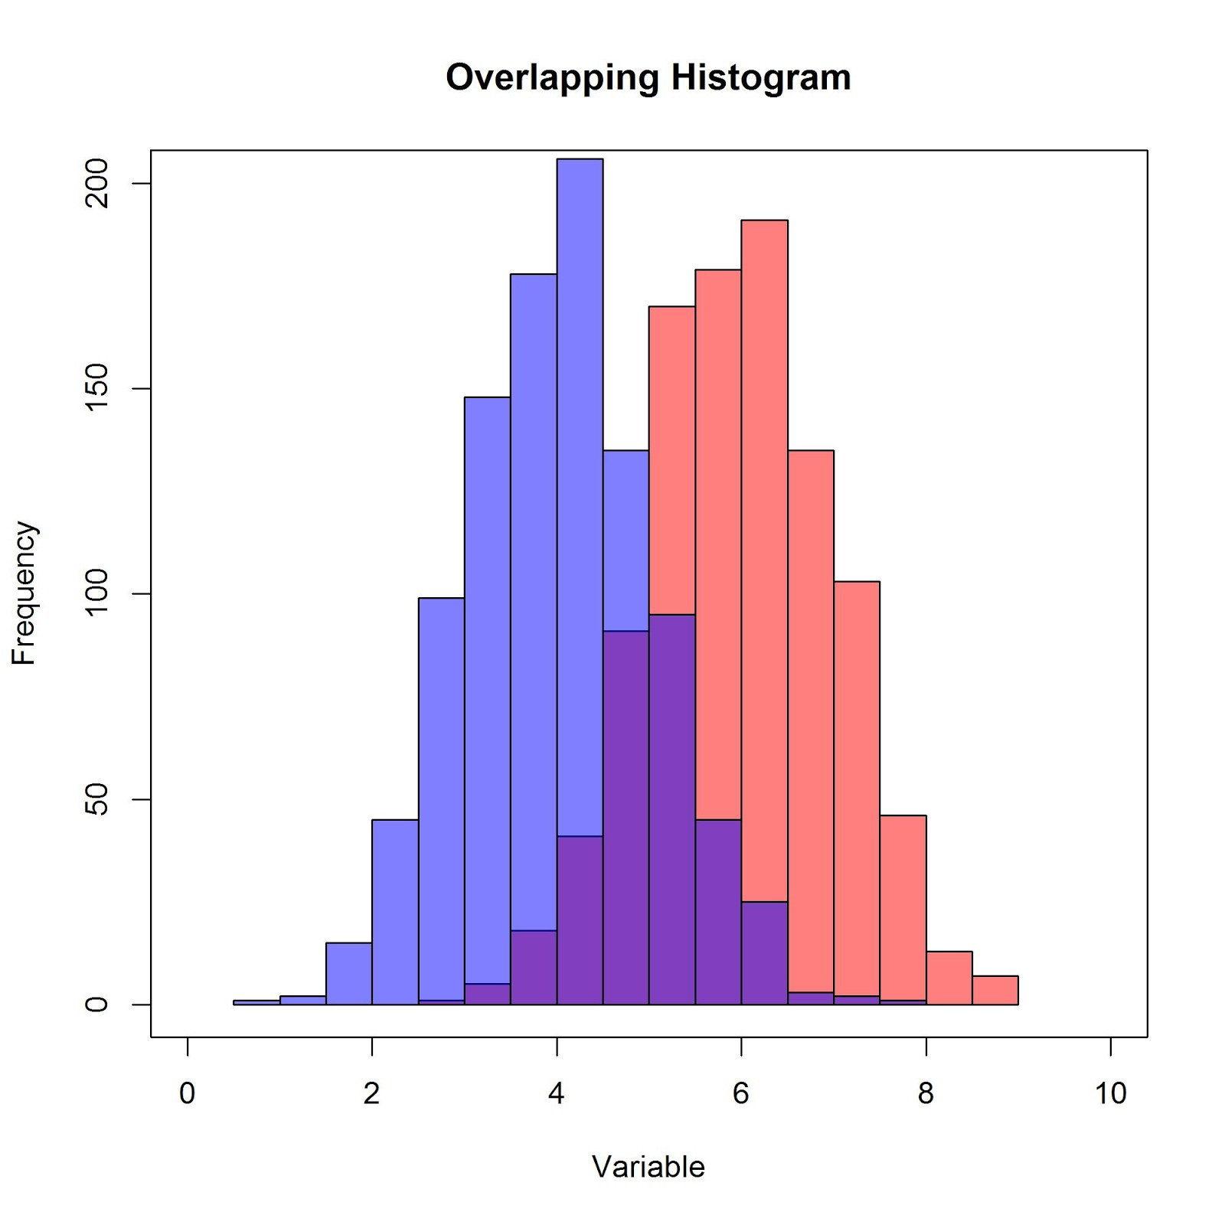
Rmarkdown what is it?
Html 5
Pdf (Latex)
Word document
Slides
My Report
This is the text of my report. I have some words and data here.
I’d also like to add a plot:
```{r}
Hist(data$myhist) ```
My Report
This is the text of my report. I have some words and data here.
I’d also like to add a plot:

Slide 7
Rmarkdown
Why should I use it?
It’s easy to write and easy to read (even for humans)
Different outputs: html, pdf, word, slides, etc.
Includes both text and R code
It is possible to apply LaTeX templates

Slide 8
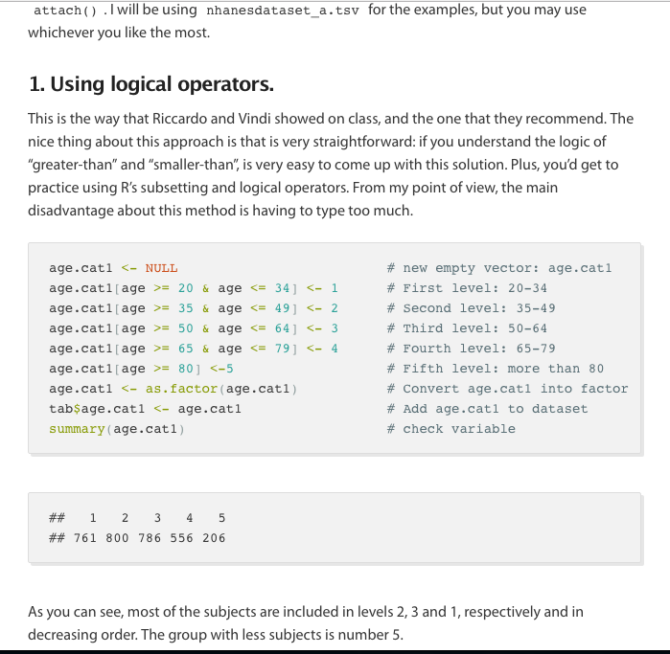
Examples
from real life

Slide 9
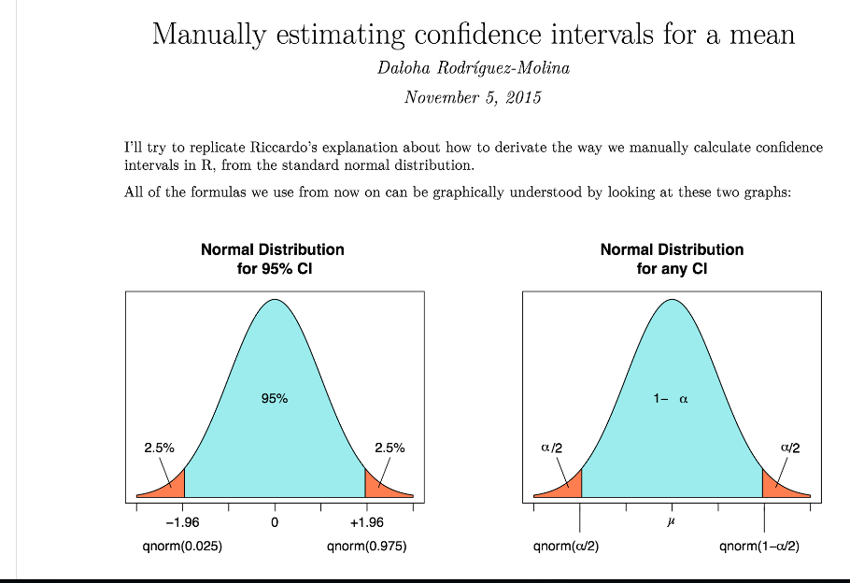
Examples
from real life

Slide 10
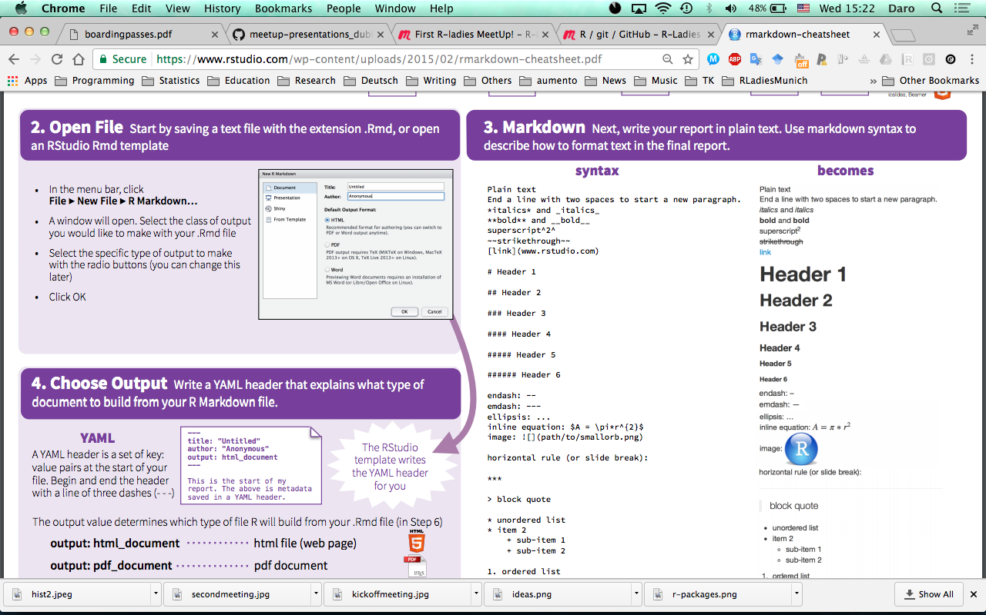

Rmarkdown
How do I do it?
# Header 1
### Header 3
**bold**
*italics*
inline equation: $A = \pi*r^{2}$
Image: ![](path/to/rladieslogo.png)
[link](www.rladies.org)
bold
Italics
image:
link

Slide 11
3.
Next steps

Slide 12
What do I do with my report?
We want to keep track of our work
We want to make it accessible for others to increase transparency
We want others to collaborate, while we’re able to keep track of changes.
It’ll probably change or improve after revisions

Slide 13
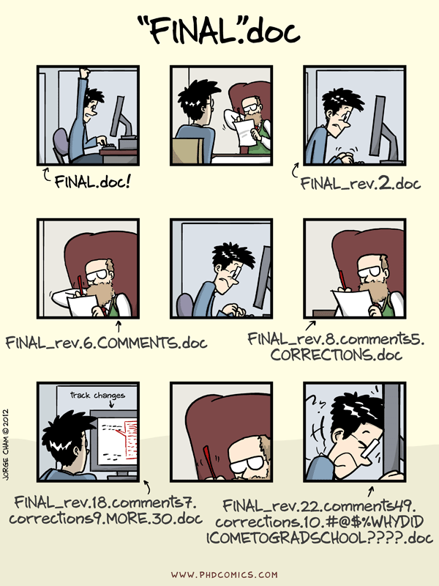

Slide 14



Proposed solution
Curious? Check out: http://happygitwithr.com/

Slide 15
Now it’s YOUR turn!
Convert the provided document into an Rmarkdown document following the indications.
Link: http://bit.ly/2pltahB
Use the Rmarkdown cheat sheet or ask me if you have any questions.
If you want feedback, send your R code to daloha@rladies.org (optional)

Slide 16
THANKS!
Twitter: @darokun
@RLadiesMunich
Email: daloha@rladies.org

