Slide 1
R-Ladies Munich First meetup
library(dplyr)
rladies_global %>%
filter(city == 'Munich')

Slide 2
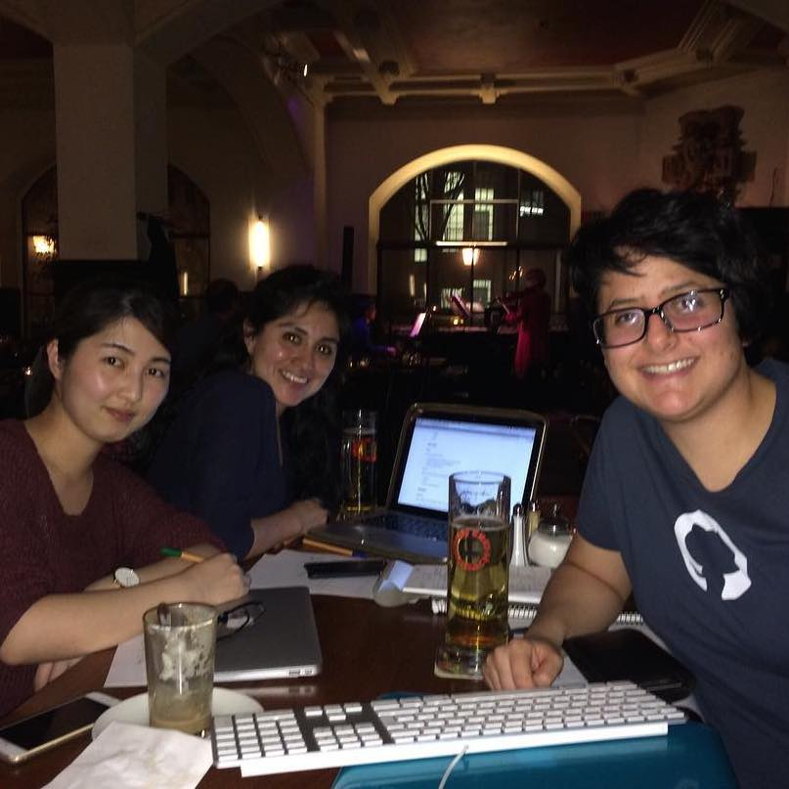
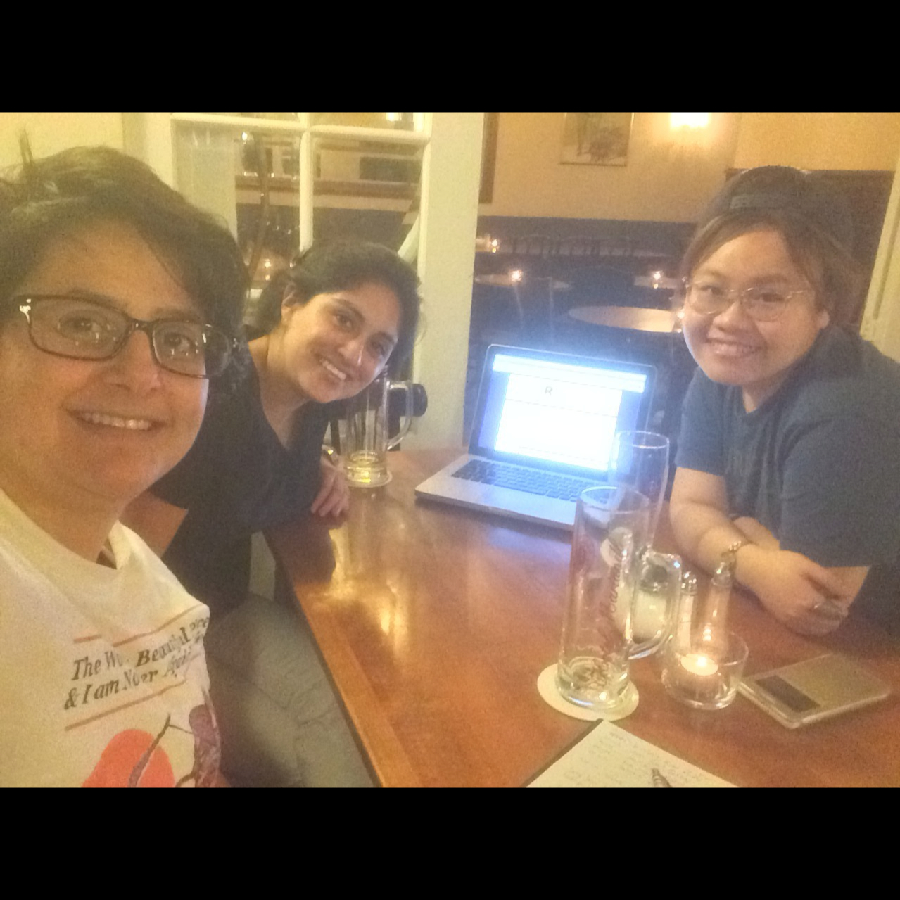
Servus!
🍻
We’re R-Ladies Munich!
We’re part of a worldwide organization to promote gender diversity in the R statistical computing community.

Slide 3
1.
R-Ladies Global
History | Mission Statement | Code of Conduct
Set of slides courtesy of R-Ladies Dublin

Slide 4
History
Gabriela de Queiroz, Data Scientist
San Francisco, Oct 2012
770 members, 30+ past meetups
London, Jan 2016
694 members, 15 past meetups
47 chapters as of Apr 2017 (including Paris, Melbourne, Istanbul, Tbilisi, Barcelona, Buenos Aires, Taipei, Berlin, and across the US)
Set of slides courtesy of R-Ladies Dublin

Slide 5
14%
30%
41%
R package developers are women
Female participants at useR! 2016
Scientific/Analytical Occupations (American Community Survey 2014)
Data provided by R Women Taskforce http://rpubs.com/hturner/useR2016
Set of slides courtesy of R-Ladies Dublin

Slide 6
Mission
To improve the participation and experience of women in the R community.
To achieve a proportionate gender representation in the R community
To support R enthusiasts who identify as female to help them achieve their programming potential by building a collaborative network of R leaders, mentors, learners and developers to facilitate individual and collective progress worldwide.
Set of slides courtesy of R-Ladies Dublin

Slide 7
Code of Conduct
R-Ladies is dedicated to providing a harassment-free experience for everyone. We do not tolerate harassment of participants in any form.
This code of conduct applies to all R-Ladies spaces, both offline and online, including: meetups, Twitter, Slack, mailing lists. Anyone who violates this code of conduct may be sanctioned or expelled from these spaces at the discretion of the Founding Members (…)
If you are being harassed by a member/guest/participant of/at R-Ladies, notice that someone else is being harassed, or have any concerns, please contact the Founding Members via reporting@rladies.org
Set of slides courtesy of R-Ladies Dublin

Slide 8
2.
R-Ladies Munich
When | Who | Why
Set of slides courtesy of R-Ladies Dublin

Slide 9
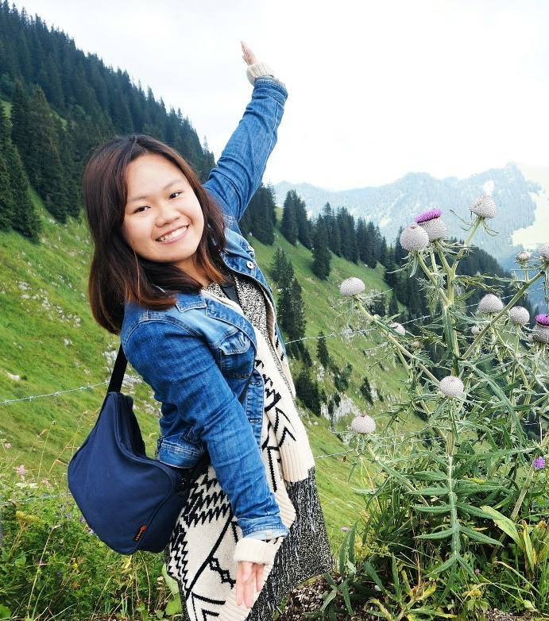
Maggie Chak
Originally from Hong Kong
Studies Epidemiology at the LMU

Slide 10
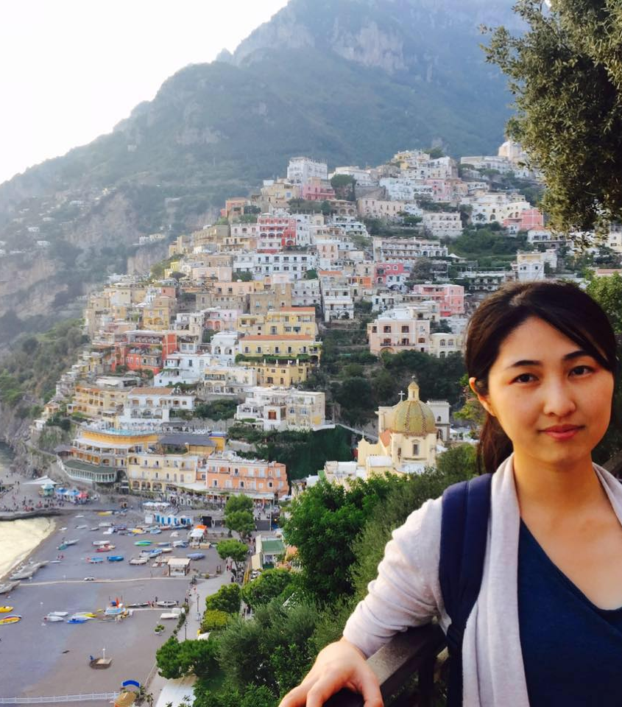
Dan Huang
Originally from China
Studies Epidemiology at the LMU

Slide 11
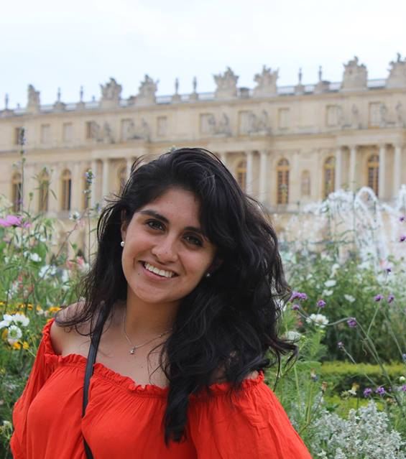
Pamela Matías
Originally from Mexico
Studies Epidemiology at the LMU

Slide 12
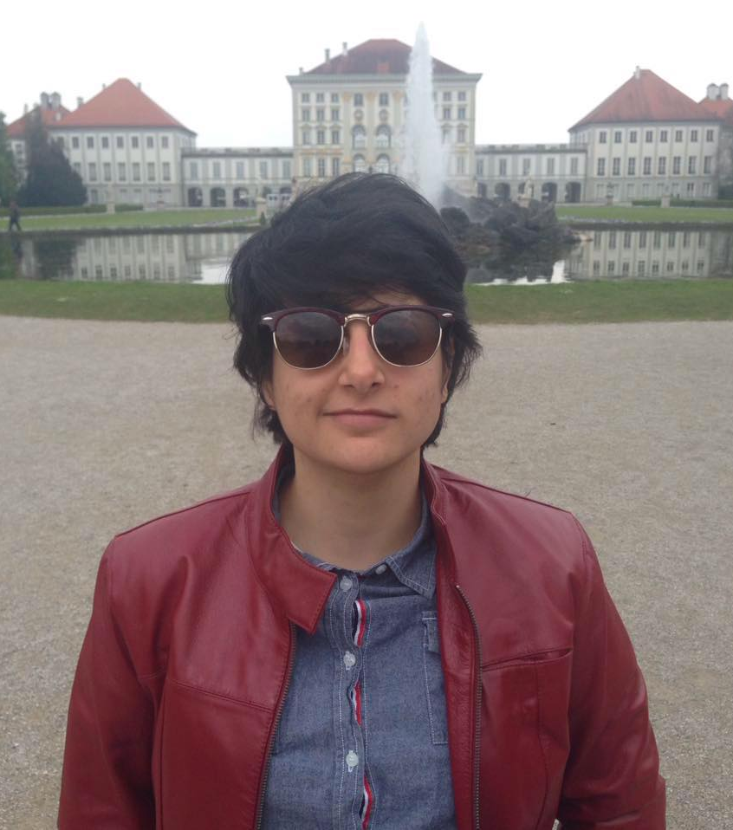
Daloha Rodríguez Molina
Originally from Venezuela.
PhD candidate in the Epidemiology program at the LMU.

Slide 13
These are
our main objectives:
To make R more popular and accessible (especially for women living in Munich).
To promote R as a programming and statistical software and language.
To exchange ideas and knowledge.
To create a friendly network among women who use R.
To create a safe environment for women to learn R or improve their R skills.

Slide 14
R-Ladies Munich
Why are we here
To improve R knowledge To meet new people
To expand our professional network
To get involved in the R community in general
What we expect
Presentations and or workshops every two months
Informal networking
Set of slides courtesy of R-Ladies Dublin

Slide 15
OUR SPONSORS

Slide 16


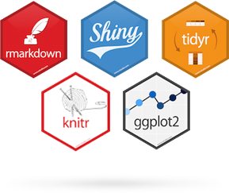
Financial Support Grant: R User Group Support Program at the vector level
Stickers!!!
yay!!!
Image source: http://www.r-consortium.org and http://www.rstudio.com

Slide 17
3.
Action plan
Ideas | Engage online & offline
Set of slides courtesy of R-Ladies Dublin

Slide 18

Share your ideas! :D
Image source: https://www.ebsco.com/files/blog/img/uploads/FlipsterWomensHistory_Blog-Post-Graphic_800x350_030917.png

Slide 19
Online presence
Website: http://www.rladies.org
R-Ladies directory: https://rladies.org/ladies
E-mail: info@rladies.org and munich@rladies.org
Twitter: @RLadiesGlobal and @RLadiesMunich
GitHub: http://github.com/rladies

Slide 20
THANK YOU

