Slide 1
Microsoft® Expression® Encoder
Daron Yöndem
Deveload

Slide 2
Microsoft Expression Encoder
Microsoft Silverlight için profesyonel video sıkıştırma ve yayınlama aracı.
Audio ve Video dosyalarınızı veya canlı kaynakları VC-1 formatına çevirerek Silverlight Oynatıcı şablonları ile yayınlamanızı sağlar.
Metadata, Logo ve Script eklemenize olanak tanır.

Slide 3

Ürün Özellikleri
Esnek Sıkıştırma İş Akışı
Zengin Medya Seçenekleri
Kolay Video Yayınlama Deneyimi
Notes:
Expression Encoder provides a complete set of tools for encoding and enhancing media files and live sources for publishing to Microsoft Silverlight.
The product’s features can be grouped into the following categories.
Flexible Encoding Workflows
Expression Encoder can import AVIs, QuickTime movies, MPEG files and WMV clips.
You can also use live sources such as DV camcorders or USB webcams to stream live VC-1 content, mixed with file-based sources.
All of the features of Expression Encoder are accessible through the designer-friendly Expression-standard user interface or from the command line for batch processing large volumes of assets.
Richer Media Enhancement
Expression Encoder lets you enhance your media assets. Add pre-roll or post-roll clips to your files, use a graphic image as a watermark for your video.
Add the Silverlight media player supported DVD-style chapter navigation to your movie.
Add script commands to trigger events in a Silverlight experience or to display captions with your video.
Publish Perfect Experiences
Use A/B Compare tool to make sure your encoding settings provide the perfect compromise between image quality and bandwidth.
Encode your content to the industry standard VC-1 codec using presets to ensure consistent results.
Color management profiles are preserved throughout, or you can quickly adjust levels, sharpness, brightness or color balance yourself.
Finally, output your Expression Encoder project to one of 14 Silverlight media player templates that are ready for the web.

Slide 4
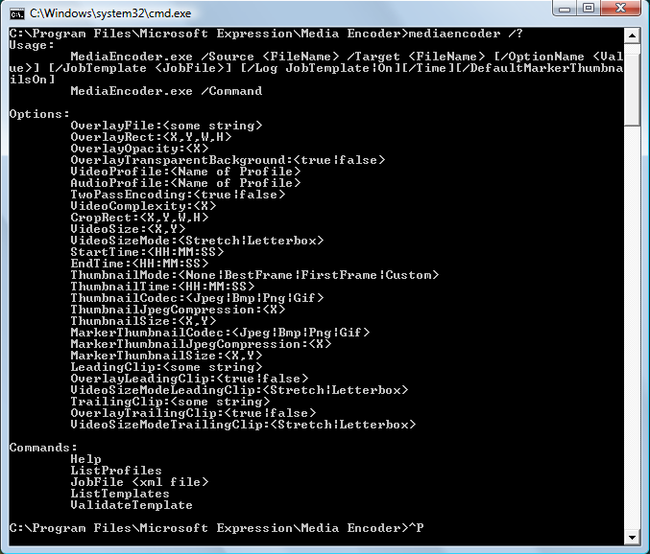
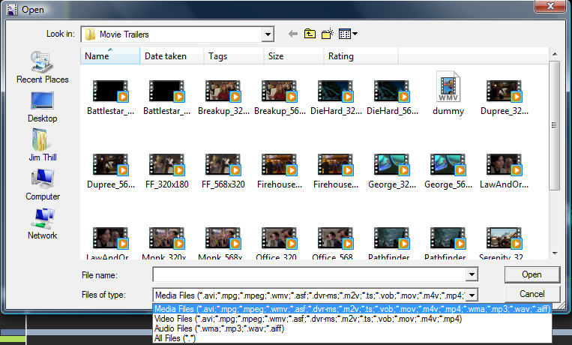
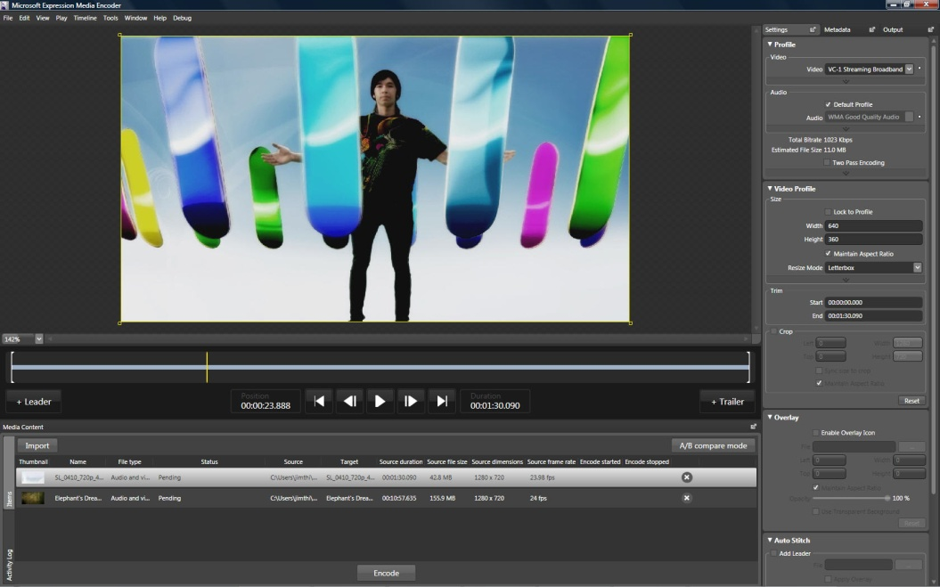
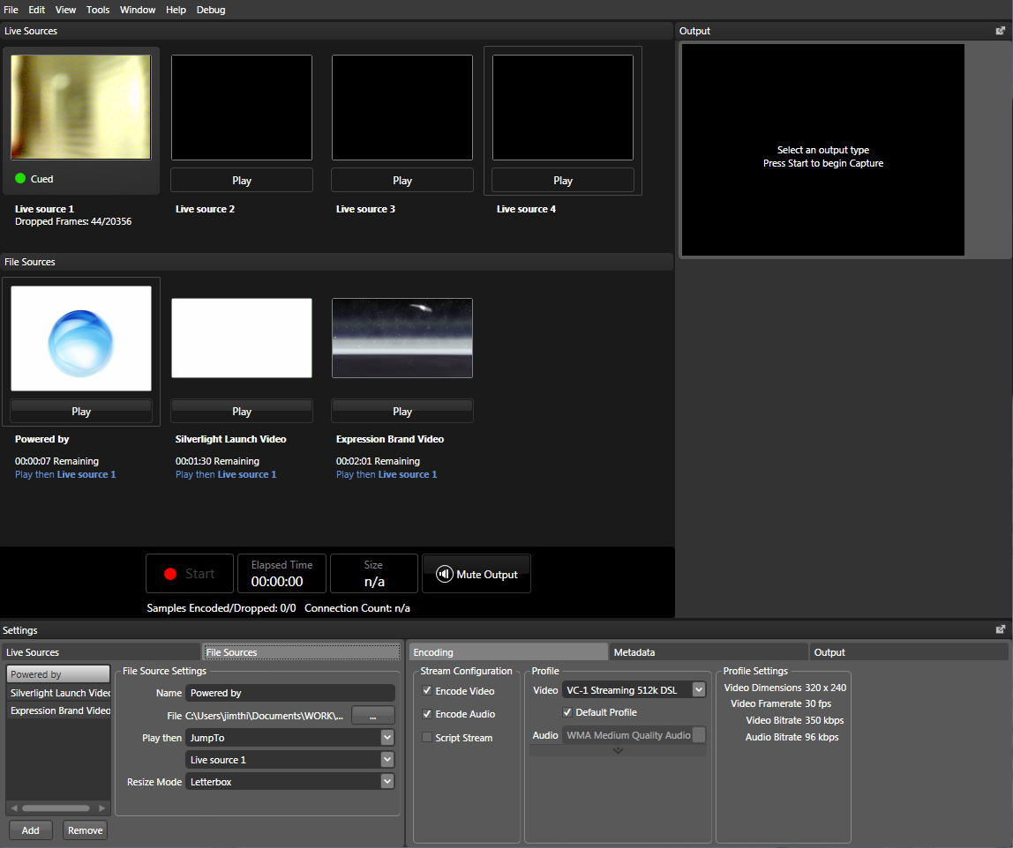
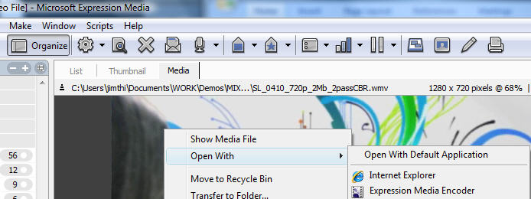
Esnek Video Sıkıştırma İş Akışı
Zengin Video Formatları Desteği
Canlı Yayın
Expression-standard UX
Command-line aracı
Expression Media Entegrasyonu
Notes:
Encode a wide array of file-based media content, including QuickTime, AVI, MPEG, WMV and more using the designer friendly Expression-standard user interface. You can also control the Expression Encoder engine from the command line.
Produce live webcasts with multiple live and file-based sources that can be mixed and switched in real-time for streaming and simultaneous archive.
Robust File Import Support Expression Encoder imports the most common digital media file formats including QuickTime, AVI and MPEG. You can also import more esoteric formats if you have a DirectShow decoder installed.
Live Streaming Stream live sources including DV camcorders and USB webcams from Expression Encoder. It’s easy to mix file-based sources with live streams and wrap your show’s archive in a Silverlight experience for on-demand viewing.
Expression-standard UX
Expression-standard user experience gives designers access to professional encoding tools. With a designer-friendly interface, video editors, web designers and producers can feel comfortable using Expression Encoder. With encoding and job presets, you can output a high-quality Silverlight experience without having to learn the science of video compression.
Command-line Control
Expression Encoder can be run from the command line giving developers the ability to encode vast libraries of media content as a batch process.
Asset Management Integration
After searching through your media assets and previewing clips in Expression Media, you can drag and drop clips directly into Expression Encoder.

Slide 5
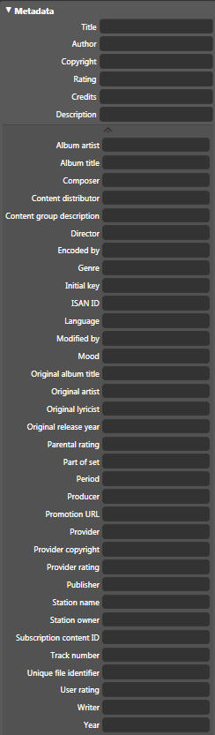
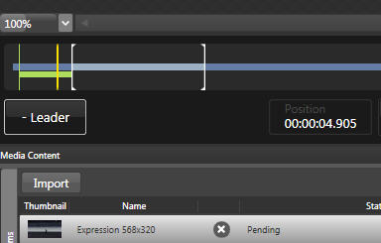
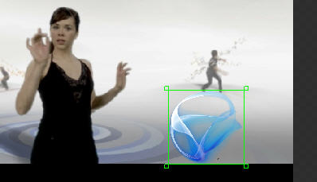
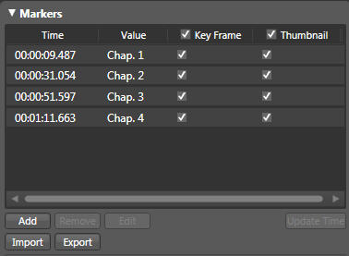
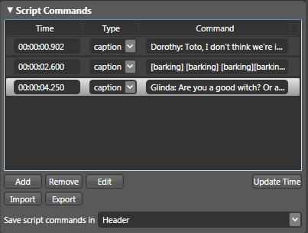
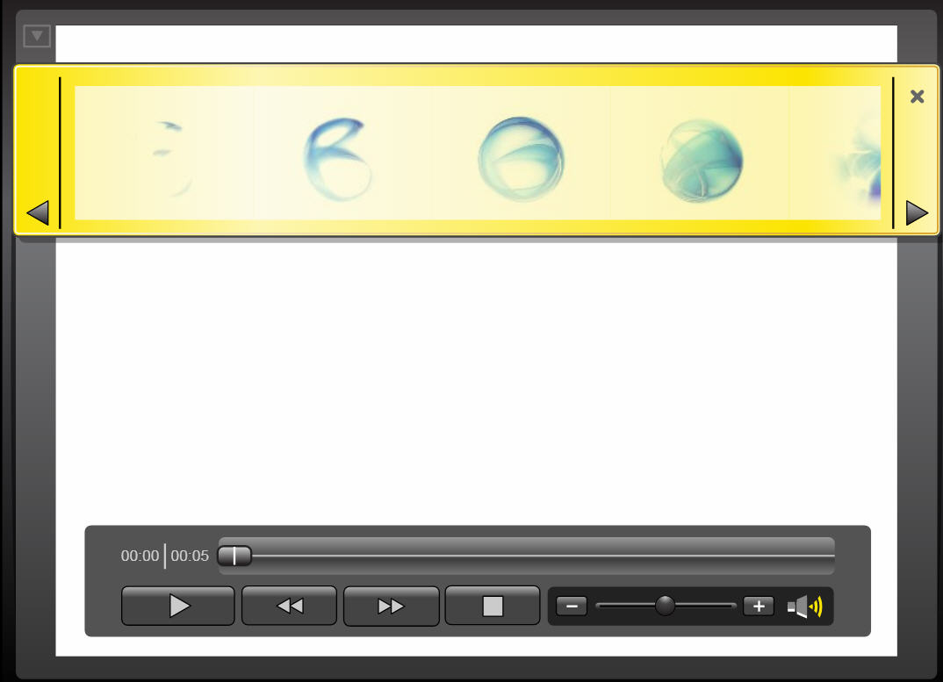
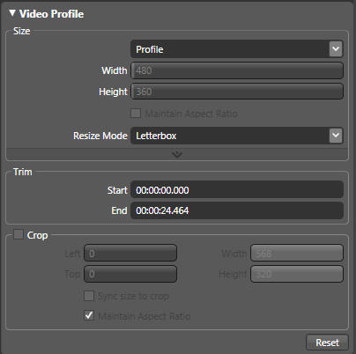
Zengin Medya Düzenlemeleri
Ön ve Son video klipleri
Logo yerleşimi
Zengin Metadata desteği
Altyazılar
DVD-benzeri navigasyon
Notes:
With Expression Encoder you can customize your media assets to match your brand or target your audience. Add leading and trailing clips, watermarks, crop, scale and trim. Add metadata and enhance your content with chapter markers, event markers and captions.
Pre-roll and Post-roll clips
Add media content such as pre-roll advertisements, station identification, or credits to deliver content with context for your audience.
Watermarks
Add logos and graphics to watermark video content with transparency to define or attribute media ownership.
Rich Metadata support
Add a wide range of standard metadata and customizable meta tagging including industry standards such as ISAN for asset tracking, search, and management. [Note: ISAN is a broadcast video standard to give unique identification to television shows and movies. ISBN is the equivalent for books]
Caption support
Use SAMI or Timed Text (DFXP) to synchronize text with media, enabling subtitles, captions or text feeds which can be incorporate into a Silverlight application.
DVD-style Navigation
Add chapters and bookmarks to media content providing end users choices for navigating through long form content.
Frame Adjustments
Trim, crop and scale video to deliver the right content at the right size to end users.

Slide 6
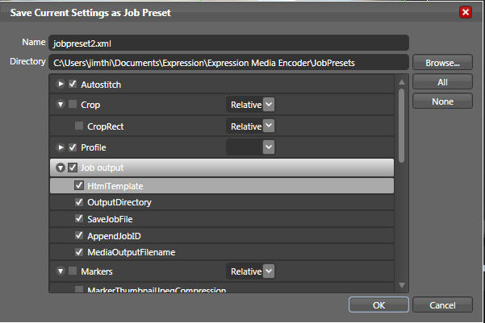
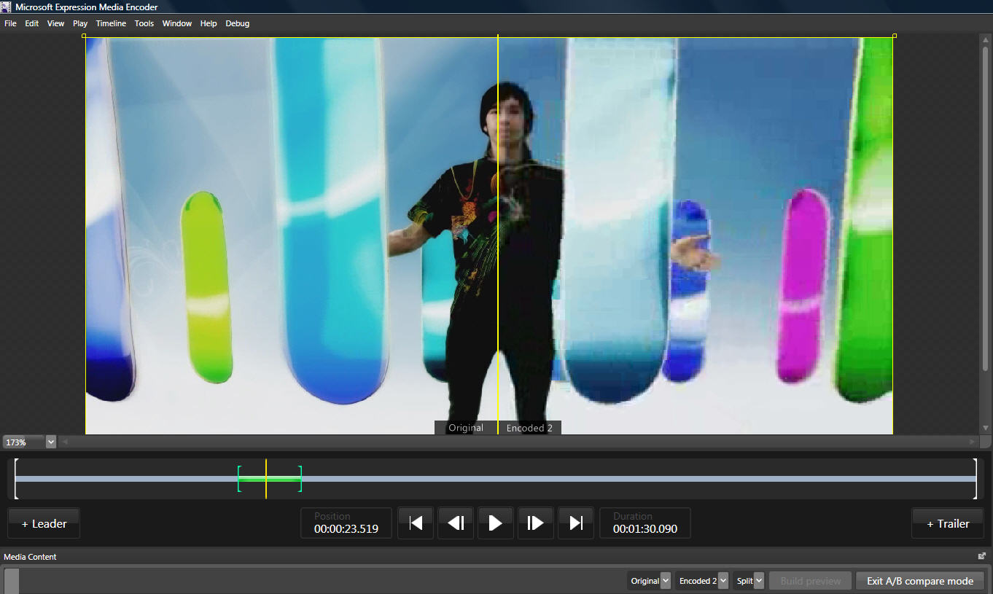
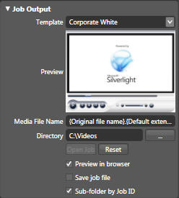
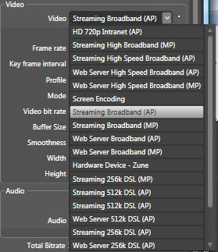
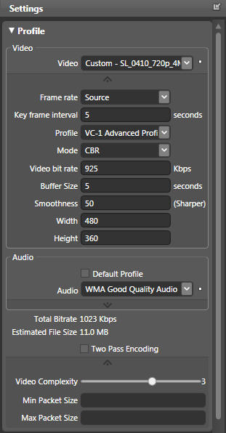

Kolay Yayın Seçenekleri
VC-1 Formatı
Silverlight Şablonları
A/B Karşılaştırma Modu
Özelleştirilebilir Codecler
İş Şablonları
Donanım Destekli Sıkıştırma
Notes:
Deliver high quality VC-1 encoded content wrapped in a Silverlight player template directly from Expression Encoder. Tweak custom encoding settings and save every aspect of an Expression Encoder job as a preset. When you are ready to encode take advantage of third party hardware acceleration to get the highest quality result in a hurry.
Windows Media Video & VC-1 Encoding
Using the industry standard VC-1 codecs guarantees that Expression Encoder will output the cleanest, compressed content possible whether publishing to high definition optical disc, the web or handheld devices using industry standard codecs. [NOTE: WMV 9 is Microsoft’s implementation and branding of the SMPTE standard VC-1 codec.]
Silverlight Template Support
Choose from one of 14 media player skins, encode a file and Expression Encoder outputs all the necessary files for publishing a Silverlight media experience to your website.
A/B Compare
A/B Compare lets you preview various encoding options against the original video to help find the sweet spot when choosing between image quality and bandwidth.
Hardware Accelerated Encoding
Support for hardware accelerated encoding provides up to a 15X speed increase over software encoding. Use the extra processing power of Tarari accelerator cards to improve quality or increase the volume of media encoded.
Customizable Codec Profiles
Control media encoding options. Tweak a range of encoding parameters for both the audio and video to provide the best possible result for specific scenarios and content.
Job Presets
Guarantee consistent output. Every aspect of a job can be stored in a template and applied repeatedly to file after file to ensure the end user experience matches job after job.

Slide 7
Pricing and Availability
Localized Versions
How can I buy?
How can I try?
Notes:
Here are some details on how you can purchase or test drive Expression Encoder.

Slide 8
Localized Versions
Expression Encoder is available in English
Additional languages coming for v1.0:
Korean
Japanese
French
Notes:
Expression Encoder 1.0 shipped on September 5 in English. Support for Korean, Japanese and French will be available in the near future.

Slide 9
How Can I Buy?
Expression Encoder is included with the Windows version of Expression Media.
No box. Download only.
Notes:
An Expression Encoder license is included with each box of Expression Media for Windows. There is no standalone version of Expression Encoder for sale.
Customers who have purchased Expression Media and Expression Studio will receive instructions in their retail software on how to download and activate their license of Expression Encoder.
Expression Media is available through all the usual sales channels, from resellers, online from Microsoft’s store and through the range of volume and academic licensing programs.

Slide 10
How Can I Try?
Download the fully featured 180 day trial version from
www.microsoft.com/expression
Notes:
A fully featured trial version is available to try for 180 days before purchase.

Slide 11
DEMO

Slide 12
Kaynaklar
www.microsoft.com/expression
http://daron.yondem.com
http://www.nedirtv.com
Notes:
To learn more about Expression Encoder, you can check out the microsoft.com/expression website. This has the latest product information, links to the trial versions of all of the Expression apps and most importantly product training.
Specifically, you can find 30 minutes of training videos on Expression Encoder.
Links to the Expression Encoder newsgroup where you can ask questions about the program and get answers from the product team and expert users.
As always Channel 9 has great content and interviews with the product team and additional videos showing practical examples of Expression Encoder in action.

