Slide 1
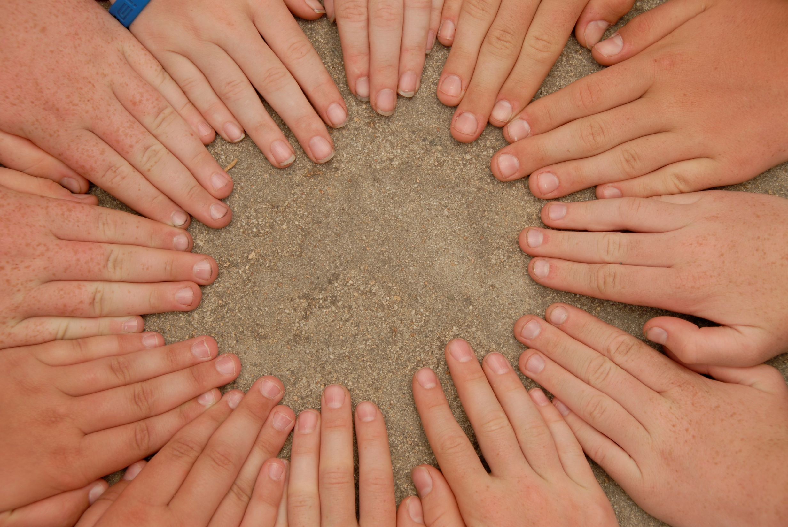


Multipoint programlama
Daron Yöndem
INETA Türkiye Başkanı, MVP
daron@yondem.com
http://daron.yondem.com

Slide 2
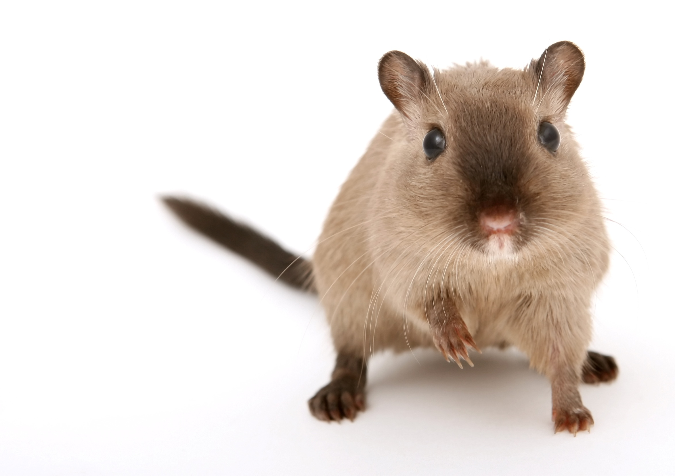
Bu nedir?

Slide 3

1 Mouse
Kaç kişi?

Slide 4
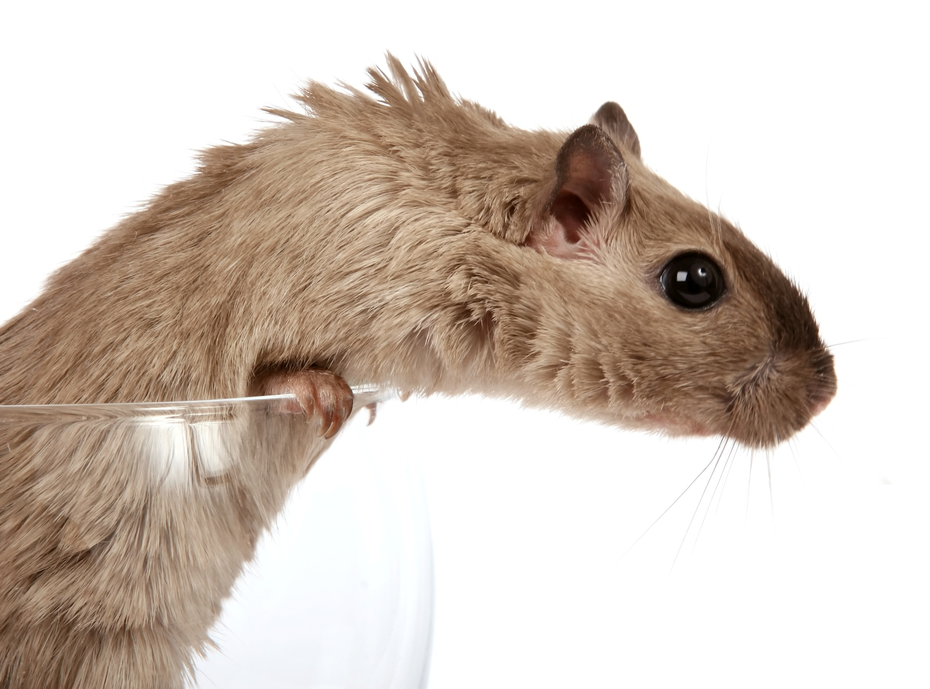
Problemler
Her fiziksel farenin bir imleci olmalı.
Donanım olarak farelere bizim ulaşmamız gerek.
Program içerisinde yapılan işlemlerin hangi imleçlerin kimliğini tanıması gerekir.
Notes:
[Justify why we had to start with ethnography.]
[ask open question to audience]
So many probs – not just one problem – water, electricity, teachers,
Can u think of ways in which computers can aid rural education?
Context is very important!
Isolated kiosks to large scale installations
Due to these open broad questions we decided to take up ethnography
No deifined questions etc

Slide 5
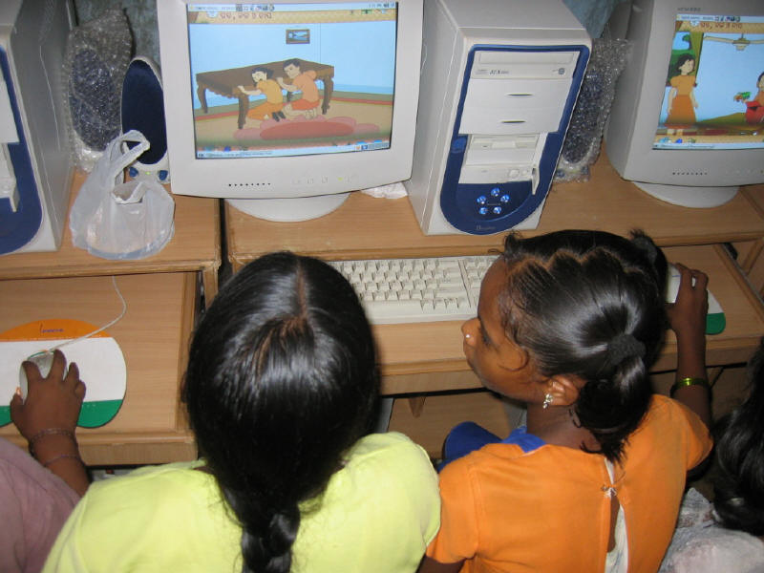
Multipoint SDK
Bizim yerimize donanımla ilgileniyor.
MultiPoint sınıflarını kullanarak sisteme USB üzerinden takılı 30’a kadar fareyi tanıyabiliyoruz.
Bu fareleri kullanmak bize kalmış ☺
Standartl Winforms veya WPF kontrollerini kullanamazsınız.
Inherit edip kendi MultiPoint, yani birden çok fareyi tanıyan kontrollerinizi yazmalısınız.
Notes:
[Explain the depth of ethnographic research we’ve done. Mention some of the things we discovered.
Teacher multitasking
Repeated anecdotal evidence that the presence of PCs in a school raises attendance and retention rates.
Even some of the poorest schools already have PCs.
Finally, lead up to the one common element. “what most caught our attention”, usage pattern
Explain – those are all very interesting answers that are being looked at. But which of them are working, which are not and why. At MSRI we are interested in understanding that. One project in this regard was a survey of computers in education program in rural schools in four states in India. This was conducted by our intern from UCB, Joyojeet Pal. He conducted a comprehensive ethnographic survey of 18 school in Karnataka, Kerala, Mahr, and Orissa. He found in short..
In Baripada, Mayurbhanj district in Orissa, the local school has three computers, to be spread over 500 students – this numerical equation is not uncommon, consequently, as many as 10 students can be using one computer simultaneously – notice the interactive work here

Slide 6
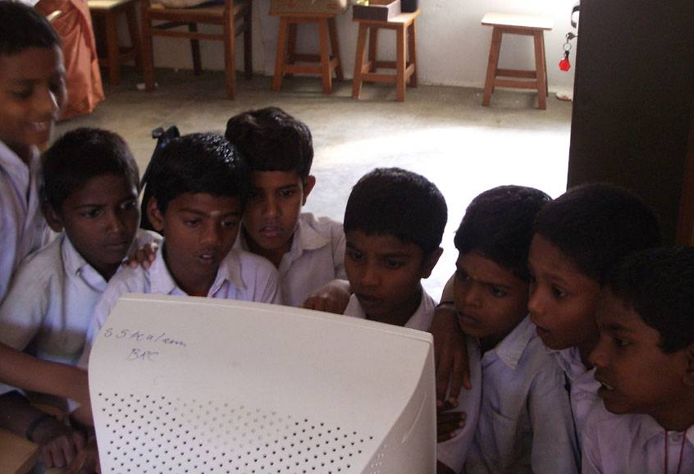

Slide 7
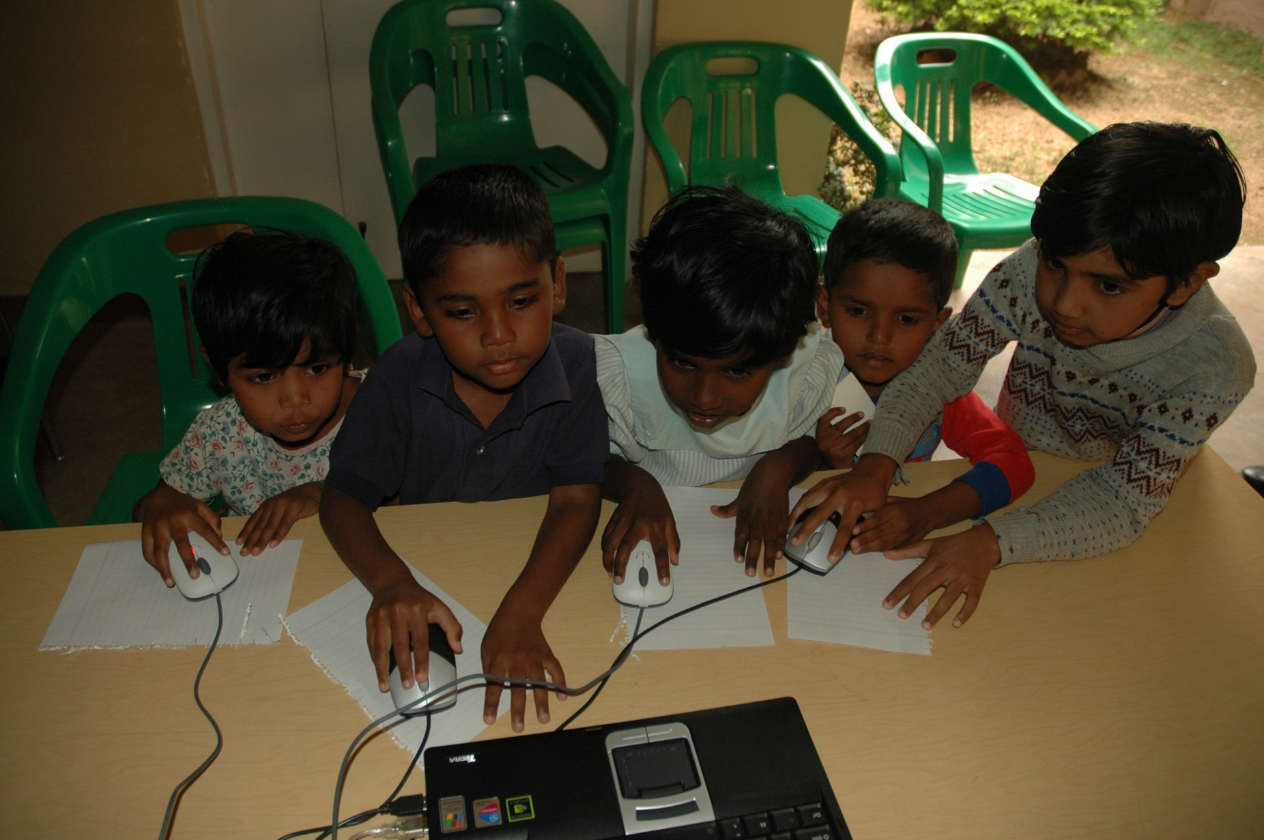
Çözüm Basit

Slide 8
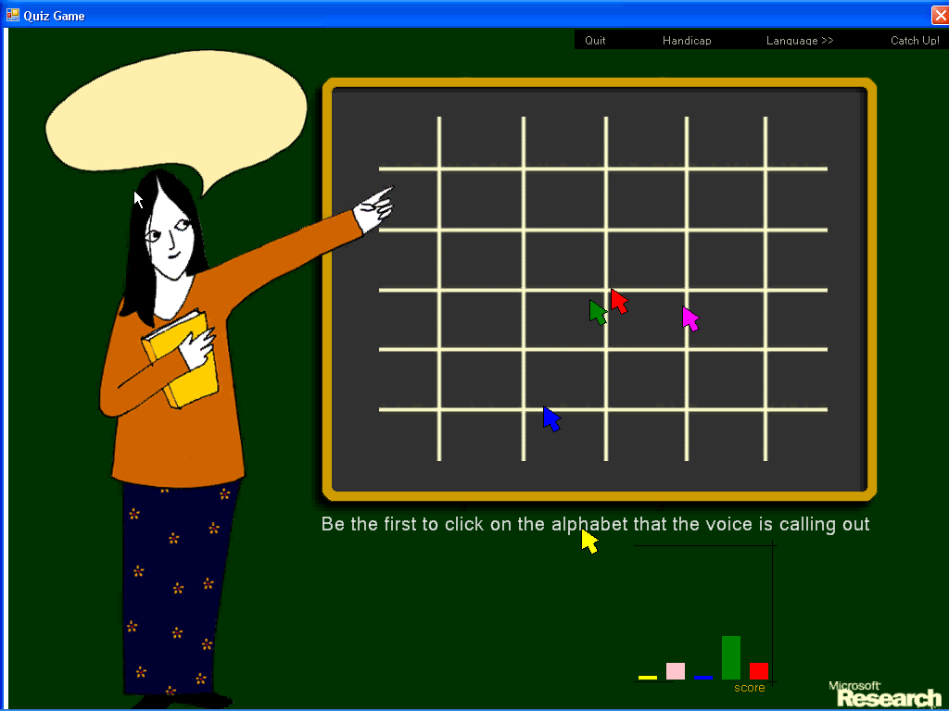

Slide 9
Sorular?

Slide 10
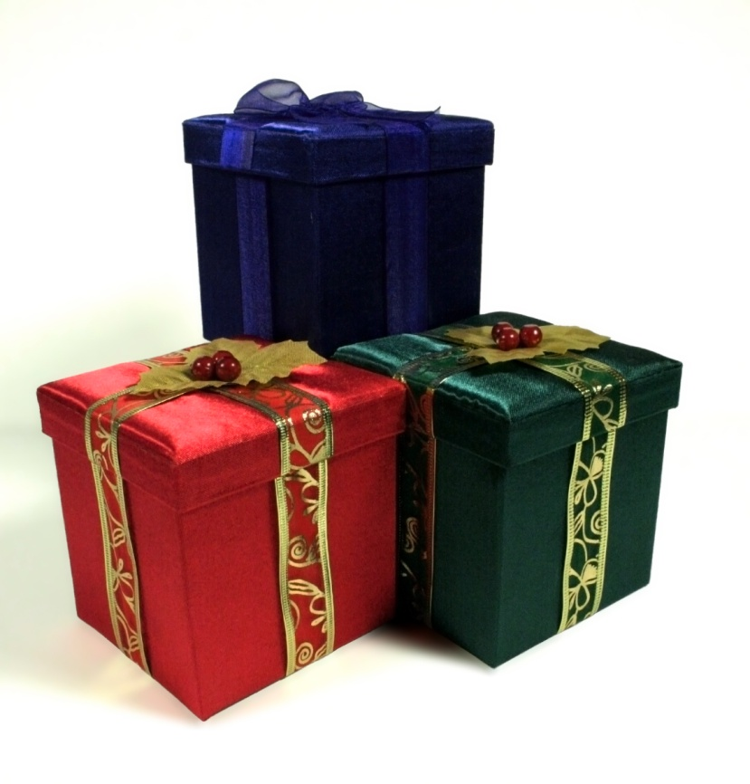

Teşekkürler! daron@yondem.com
http://daron.yondem.com
Notes:
Even if technically simple.. Yet no one doing it!!!

