Slide 1







Interfaces, Models, and Monitoring for Resource-aware Transformations that Augment the Lifecycle of Systems (IMMoRTALS)
BBN Site Visit

Slide 2
Agenda
Program Review Presentation
Demonstration
Discussion

Slide 3
Outline of the Program Review Presentation
Programmatics
Goals, Assumptions, Key Concepts
Phase 1 CPs
Discovery and Analysis Technologies
Representation
Program analysis
Resource DSL
Change tracking
DAS Development
LL Interaction
Next Steps and Conclusion

Slide 4
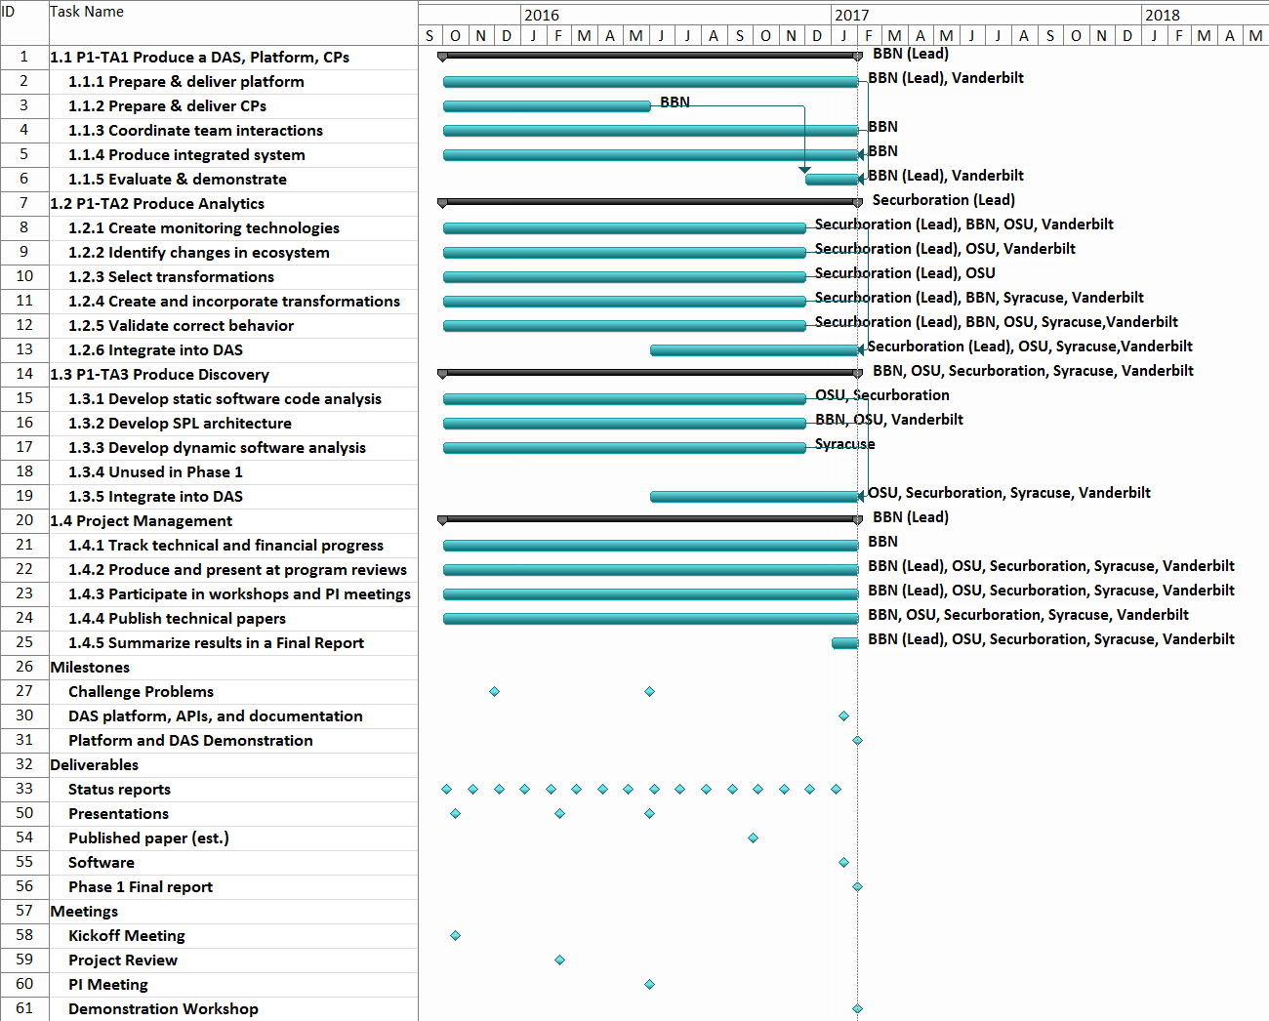
Programmatics
We are here

Slide 5
Summary of Progress (TBD)
IMMoRTALS Tactical SA Platform
Phase 1 CPs (initial versions)
Component Capabilities
DAS realization
Papers/Talks
OSU
Any other?

Slide 6
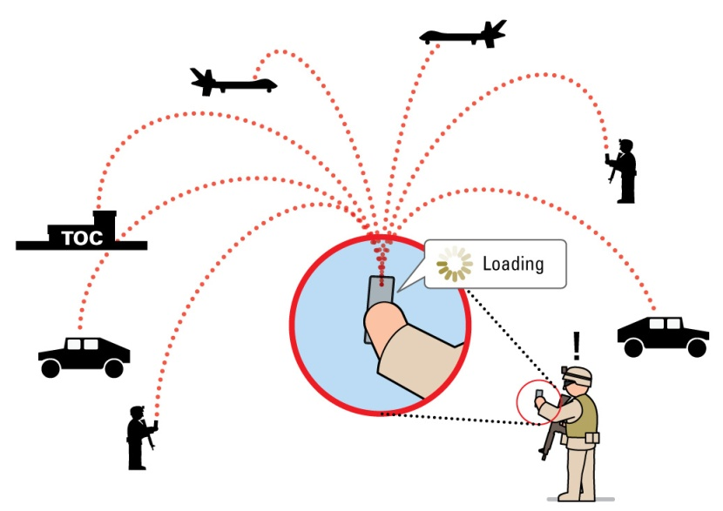
IMMoRTALS Goals
Develop, demonstrate and evaluate technology to make tactical situational awareness (information management) application evolve
Evolve (accommodate ecosystem changes) by
Substitution
Modification
Substitution requires
Existence of the substitute
Ability to identify the substitutable and a matching substitute
Modification requires
A change prescription
Ability to translate prescription into code change– guidance, template etc.
Modification produces potential substitutes
Modified function f of a class C → new class C→ new component that uses C
Our initial focus is “substitution,” where substitutes already exist

Slide 7
Assumptions (TB refined)
Software Product Line (SPL)– applications are architected as SPL
Structure of the application
Abstraction of the features/functional components
Semantics/Annotation
Functional specification of code is not derived automatically
Extra-functional specification (e.g., resource specification, dependencies) will be
Deployment environment and mission requirement description
Capabilities of a deployment environment and mission requirements are not derived automatically- they are provided manually in a form prescribed by IMMoRTALS
This is one of the current weaknesses– need to work on this next

Slide 8
Key Concepts (TBD)
DFUs
IMMoRTALS Knowledge Repository
Resource DSL

Slide 9
IMMoRTALS Solution Overview
Initial Intake
Specification
Other models
Program Analysis
Program Synthesis
Program
TA1 product
Ecosystem
TA2 product
KR artifacts
TA3 product
Runtime Management
In use during mission
code artifacts
In use off line from the mission
Deploy,
redeploy
Test & Validate
Build
Iterative refinement of SPL variant for a given specification
Monitor
Specification of a new variant
Adaptation of running application
Changes in runtime system
(resource availability, anticipated changes)
Ecosystem changes,
Mission requirement changes

Slide 10
Phase 1 CPs
CP1: External service dependency (e.g. GPS)
CP2: Mission requirement dependency (number of clients, message rate, message size)
Each CP has various progressions:
Change requested before deployment
DFUs needed to configure an alternate product exists
DFUs needed to configure the alternate does not exist
Change detected at runtime/in-mission
Deployed system is not capable to handle (fails)→ trigger (A)
Deployed system is (has evolved, due to A and/or B, to be) able to handle
Absorbs within (e.g., executes appropriate branches of code)- we have demonstrated technologies to program and manage this kind of adaptive applications in the past
Evolves (changes configuration or code, may download)
Our initial focus is (A), and then (B)
In (B) – not claiming that we will be able to synthesize arbitrary programs, the goal is guided instrumentation or transformation of existing code (ordering of arguments, inserting a pipeline element,…)
We will get into CP1 a bit more deeply in this presentation

Slide 11
CP1: Spiral 0
Summary:
Start with baseline SA system
Change deployment device (which varies hardware capabilities) or mission requirements
Adapt the baseline application for the new operating environment
Complexity is low for first iteration
Can enumerate entire state-space in a spreadsheet

Slide 12
Ecosystem Aspects Covered in CP1- Operating Environment
External Resources:
GPS satellite availability (e.g. can receive GPS radio signals) [GPS-Sat]
Hardware availability:
GPS chipset on android device [GPS-Dev]
Bluetooth chipset on android device (e.g. for external bluetooth-based GPS device) [Ext-BT]
Available USB connection (e.g. for external usb-based GPS device) [Ext-USB]
Client device has a display for user-interface [Has-UI]
Could also represent high-level notion regarding screen accessibility during mission (a chest-mount android vs. throwing it in a backpack)
Mission Requirements:
Mission requirement for SAASM GPS [Req-SAASM]
Could also be specified in terms of properties (e.g., accuracy) instead of name

Slide 13
The Platform and Application
Elements of the operating environment (the aspects described in the last slide) affect a particular functionality of the application
Providing location information
In our SPL parlance
Location Provider component
Its use in the product (application)
The control point assumption: the product architecture decorated with functional spec (at least the functionality we would like to evolve) is available
Skeletal representation of the application, Functional spec to fill
In CP 1, key locations in the application code that could be filled in by components whose functional spec is LocationProvider
LocationProvider is an ontological term describing the abstract concept of location provider functionality (more later about ontology/representation)

Slide 14
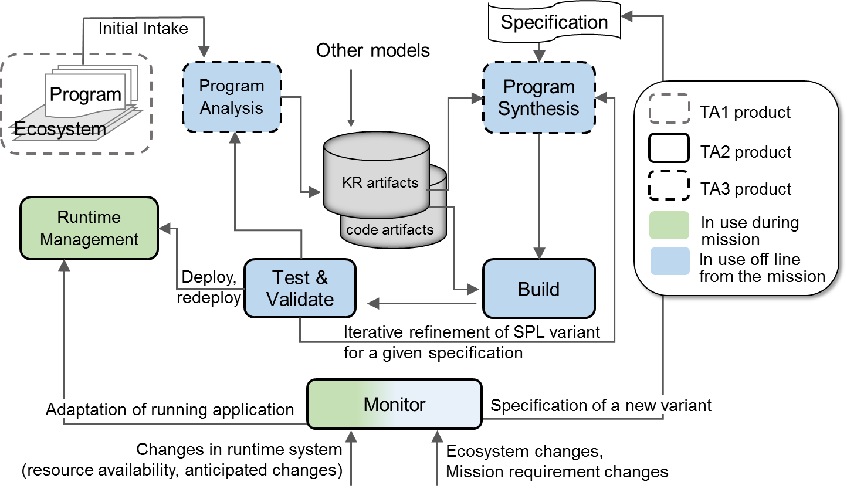
Knowledge Representation
Still to be addressed
Cover the following at least:
What purpose does it serve, could be a voice overlay– would like a text box or something though as a prop or reminder
Highlights indicate which parts of the solution is covered/plays a role…

Slide 15
Concepts and relations currently modeled
Basics/Core
Application (Product), Component, ProductArchitecture, Class, Field, Function
Additional concepts related to Java and Bytecode
SA Domain specifics
Image, Location, LocationProvider, ImageProvider
Ecosystem
Device, Platform, Service, Library, Host, Network, CPU, Memory, GPSSignal
Mission
SADataSize, NumClients, ReportingFreq
Immortals specific
DFU, DFUID, Functionality, FunctionalAspect, ResourceDependency, ResourceType (consumed as well as provided), ControlPoint
Notes:
This is how we are thinking– the ontology is currently generated bottom up (i.e., do what we need and when we need)

Slide 16
IMMoRTALS artifact view
WebGME artifacts
Code artifacts
Deployment Model (DM)
Src (annotated)
Feature Model (FM)
Bytecode
(JAR/.class)
Build script
Analysis artifacts
Binary repo (m2)
CFG
Execution profile
Program slices
Notes:
This is how we are thinking– the ontology is currently generated bottom up (i.e., do what we need and when we need)

Slide 17
IMMoRTALS model view
WebGME models
Code models
Resource availability
Execution environment desc
Fine-grained structures (method, class, field)
JVM/bytecode abstractions (classpath, JAR, WAR)
Programmer-provided annotations
DFU-level decomposition (semantic signature)
Library dependencies
Objectives
Performance constraints
Feature view
Analysis models
Method-level CFG,
Intra-method CFG
Relationships between fine-grained structures
(methods, classes)
Real-world resource usage
Resource utilization/input sensitivity
Hotspots/optimization points
Notes:
This is how we are thinking– the ontology is currently generated bottom up (i.e., do what we need and when we need)

Slide 18
Bootstrapping vs iterative workflows
Provided artifacts
Deployment Model (DM)
Src (annotated)
Bootstrapping
Triple store
Parse, vocabulary alignment, ingest into knowledge store
Feature Model (FM)
Bytecode
(JAR/.class)
Binary repo (m2)
Build script
Derived artifacts
CFG
Iterative analysis
DAS
Execution profile
Program slices

Slide 19
Knowledge Repository Architecture
SPARQL
DAS
REST/JSON
Repository management service
REST/JSON
Fuseki
triple store
A
B
Unsolicited flow of data from A to B
A
B
Solicited flow of data from A to B

Slide 20
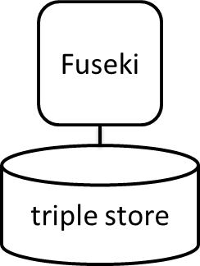
Knowledge repository scaleout
Fundamental unit of scalability is the named graph (g1…g5 below)
Takeaway: large, complex or long-running queries can be split into parallel queries spanning multiple graphs and executed in parallel
g1
g2
g3
Graph partitioning
Parallel query
g4
g5
Sequential query

Slide 21
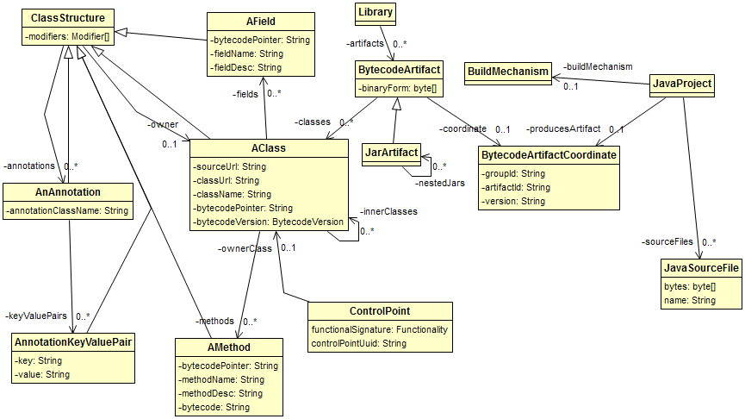
Model view: bytecode model

Slide 22
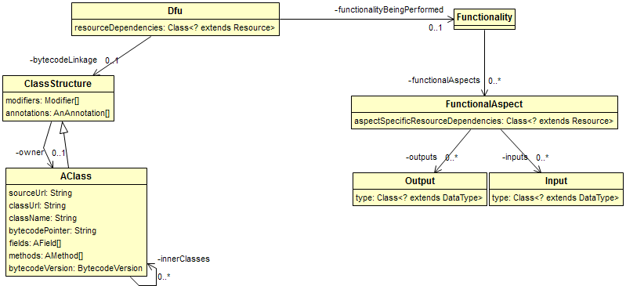
Model view: DFUs

Slide 23
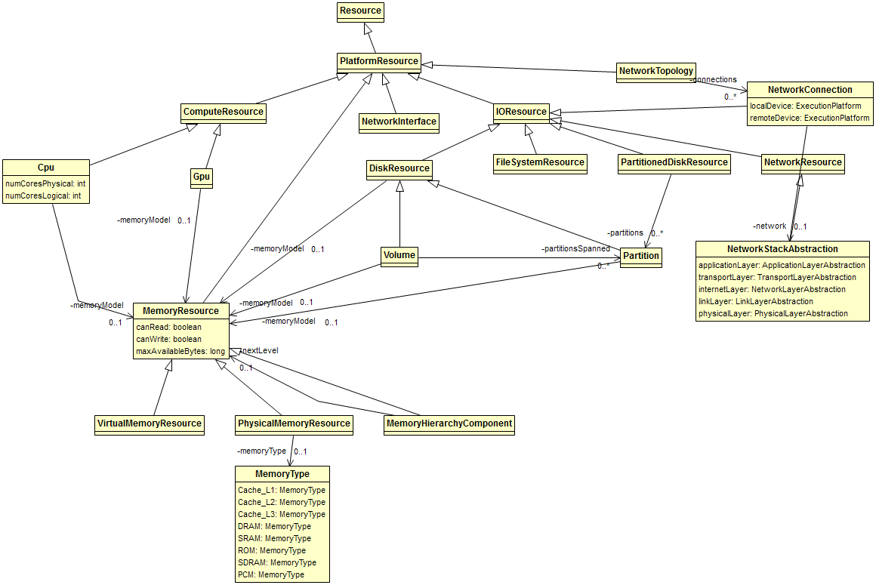
Model view: Resources (general-purpose)

Slide 24
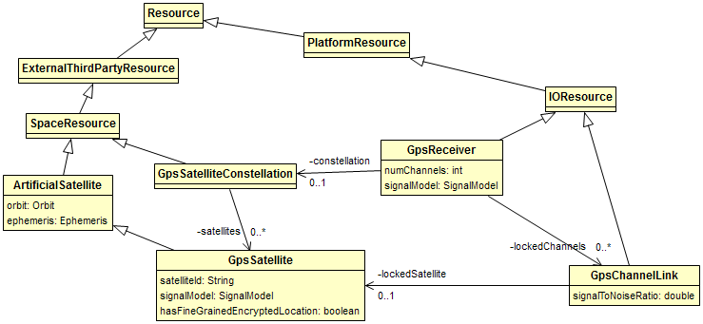
Model view: Resources (domain-specific)

Slide 25
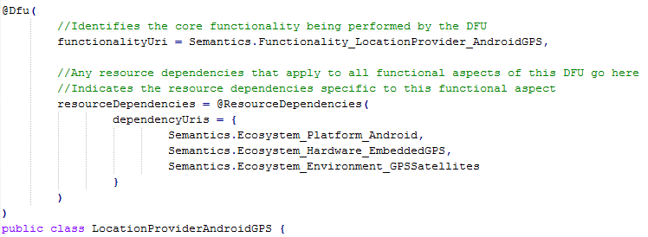
Annotation DSL
This gets parsed and converted into triples during the bootstrapping process

Slide 26
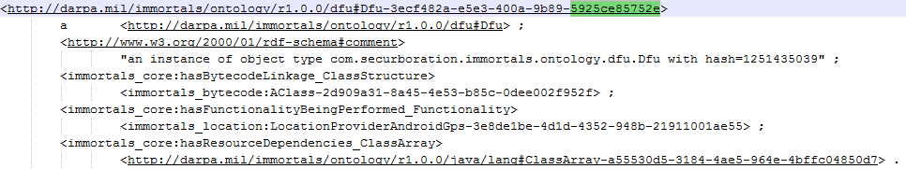
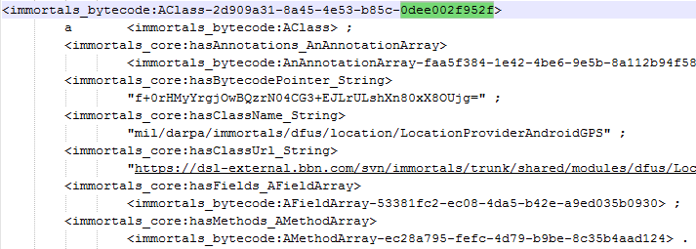
Triple view: DFU linkage to bytecode
DFU
GetLastKnownLocation (functional aspect)
base64(sha256(bytecode))

Slide 27
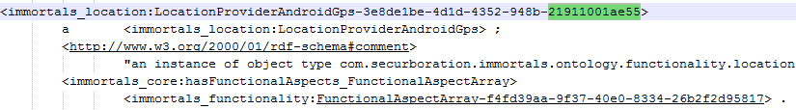
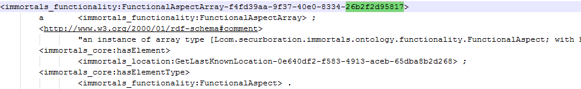
Triple view: DFU linkage to Functionality
DFU
LocationProviderAndroidGps (functionality)
GetLastKnownLocation (functional aspect)

Slide 28
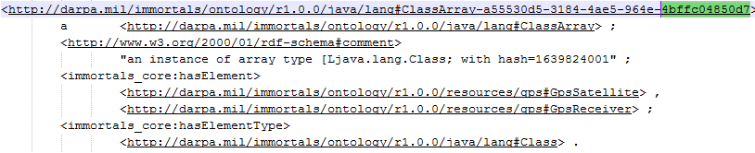
Triple view: DFU linkage to Resources
DFU
Ecosystem resource dependencies

Slide 29
Ontology statistics
# triples: 36118
# classes: 325
# properties:
164 object properties
67 datatype properties
# individuals: 2349

Slide 30
Component, DFU, Models – Part 1
DFUs are the fundamental code units IMMoRTALS manipulates. The simplest evolution is substitution of PLA components, in which case component == DFU
…
x = new X (…);
x.init(…);
…
y= new Y(…);
y.init(…);
…..
x.setNext(y);
….
Nontrivial code span
No single way to point to a “DFU”
No easy way to represent resource description
Class X {
…
…
}
A
B
X
Class Y {
…
…
}
Y
IMMoRTALS uses
JAVA annotation to define the DFUs (e.g., semantic spec is captured as an annotation)
Triple store to catalog DFUs
Resource DSL to describe resource spec
Triple store to store the relationships (models)
Product (Arch Model)
Codebase
Component
DFU
Notes:
Where we are in terms formalizing the proposed concepts and implementing them

Slide 31
Component, DFU, Models – Part 2
DFUs that are not PLA components– code units that can be evolved to accommodate ecosystem change, e.g., a function in a class
Library or user defined classes
Class X {
M1 m1;
M2 m2;
…
…
M2 f1(…) { … } ;
void f2(…) {
m2 = f1(…);
};
}
Basic type
m1
m2
Output (M2)
Output (void)
Easier to point to a DFU, but not enough for modifying f1
Need functional (semantics) and extra-functional (resource) spec (obvious)
May need some representation and dependency of f1’s internal and f1’s relationship in its container (e.g., class) as well (can potentially be on-demand)
uses
f1
f2
Inputs
Inputs
Input types (basic, library or
user defined)
Arch model of class
Code base
Function
Corresponding DFU

Slide 32
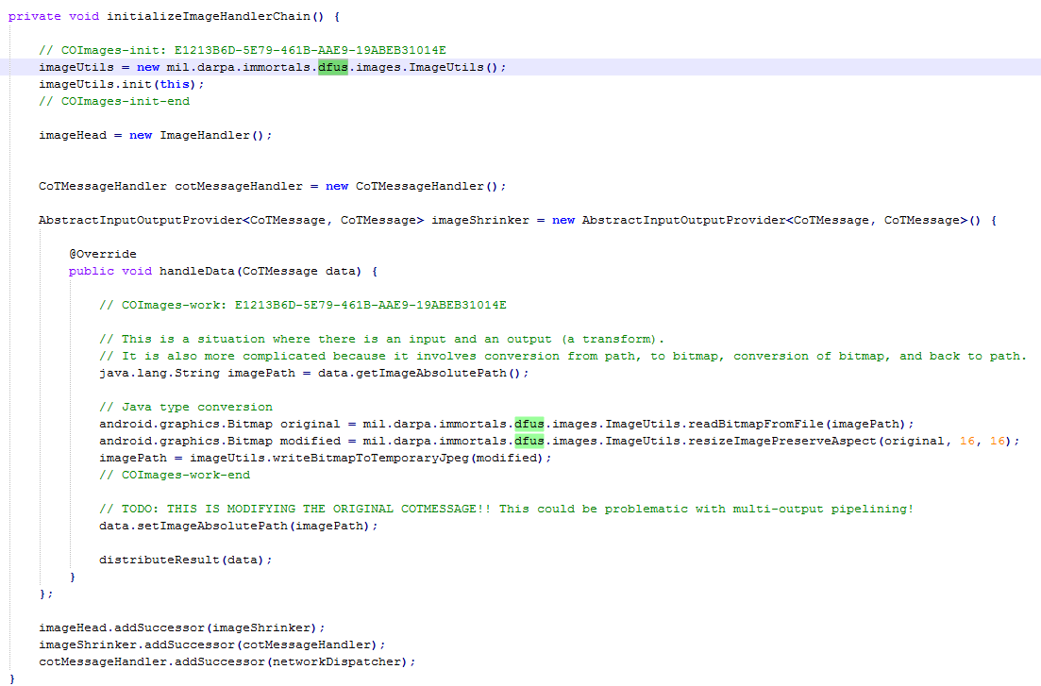

Slide 33
Program Analysis
Goal: extract program information via static & dynamic analysis

Slide 34
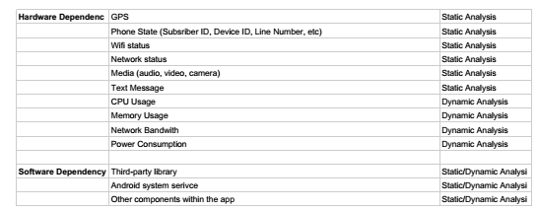
Program Analysis
Information to be extracted
program structure
dependency among structural elements
Input dependency
software resource dependency
hardware resource dependency

Slide 35
Program Analysis
Analyses performed:
Call-graph analysis
Data-flow analysis
Dynamic analysis
The output of these analyses is consumed:
Constructing the application model
Creating the resource descriptions for DFUs

Slide 36
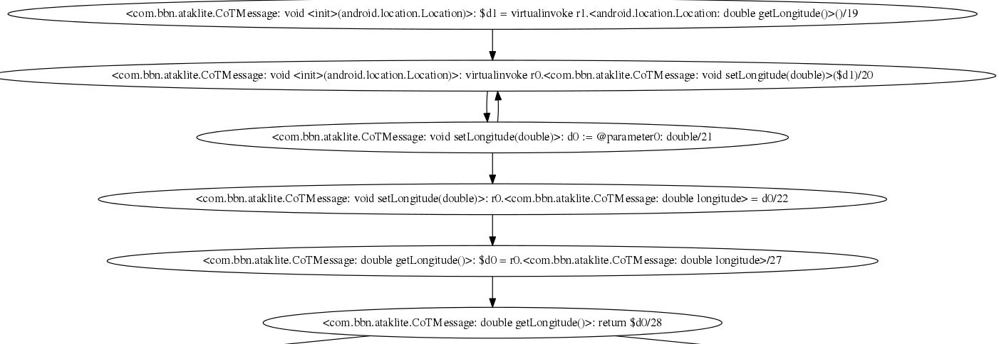
Program Analysis
Forward Data-flow Analysis is performed on sensitive API calls such as <android.location.Location: double getLongitude()>.

Slide 37
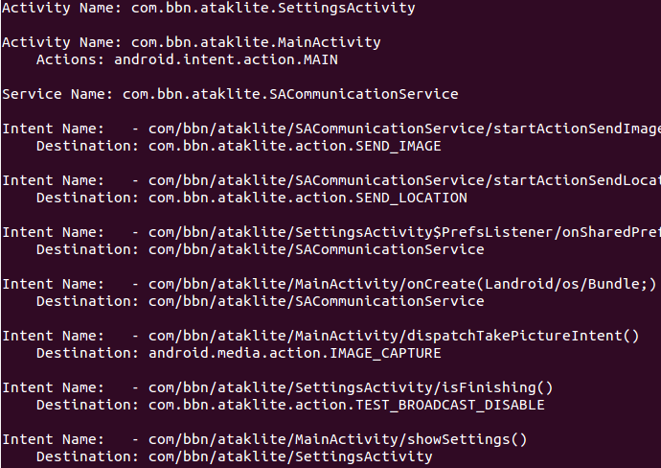
Program Analysis
Inter-component communication (ICC) is handled by using epicc(http://siis.cse.psu.edu/epicc/).
We then parse the epicc result and utilize the ICC information for a more complete data-flow analysis.
Figure on the right shows some ICC information we extract from ATAKLITE client app.

Slide 38
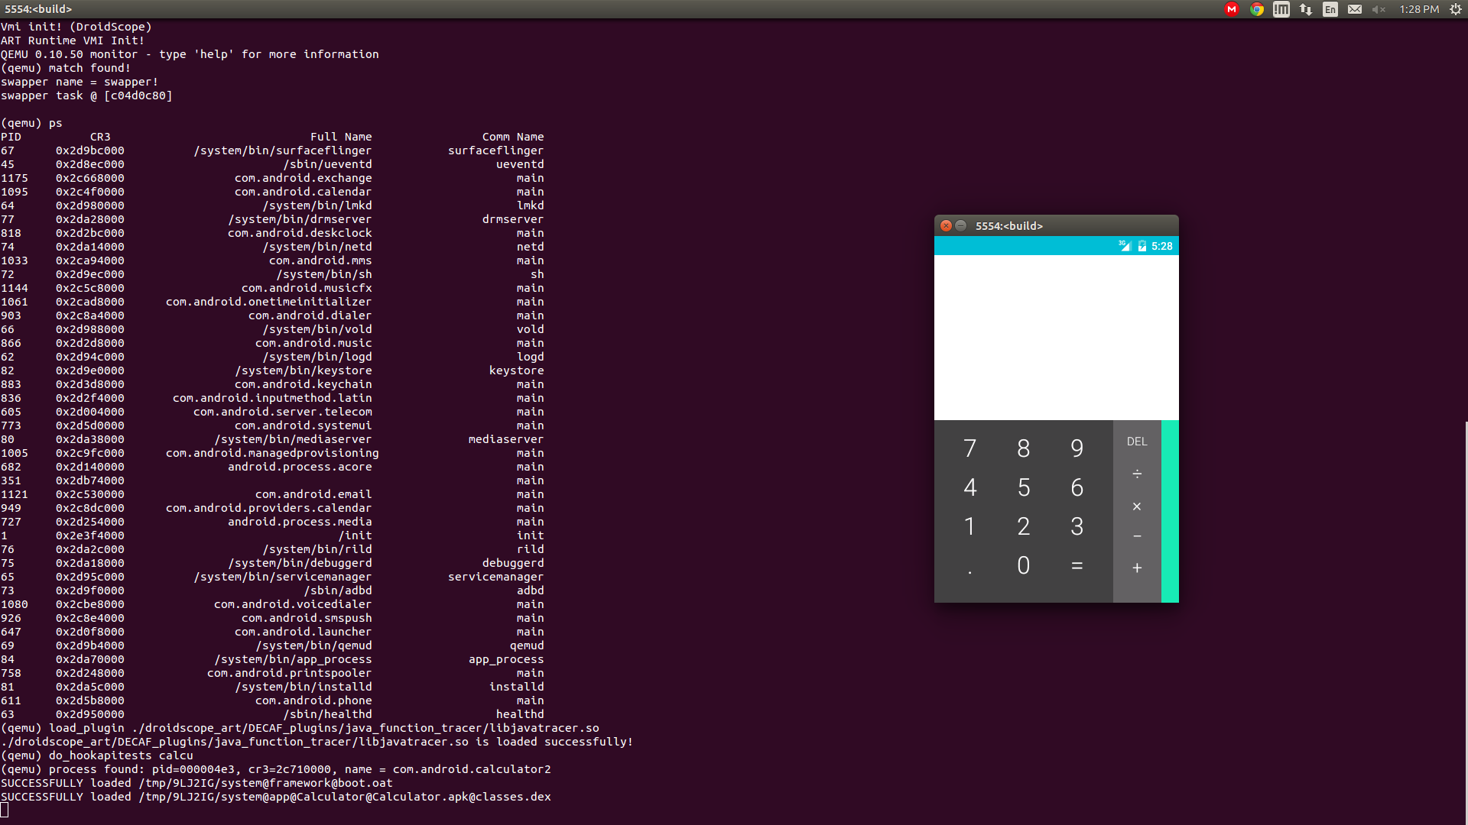
Program Analysis
For dynamic analysis, we use DroidScope which is an emulation-based Android application analysis engine.

Slide 39
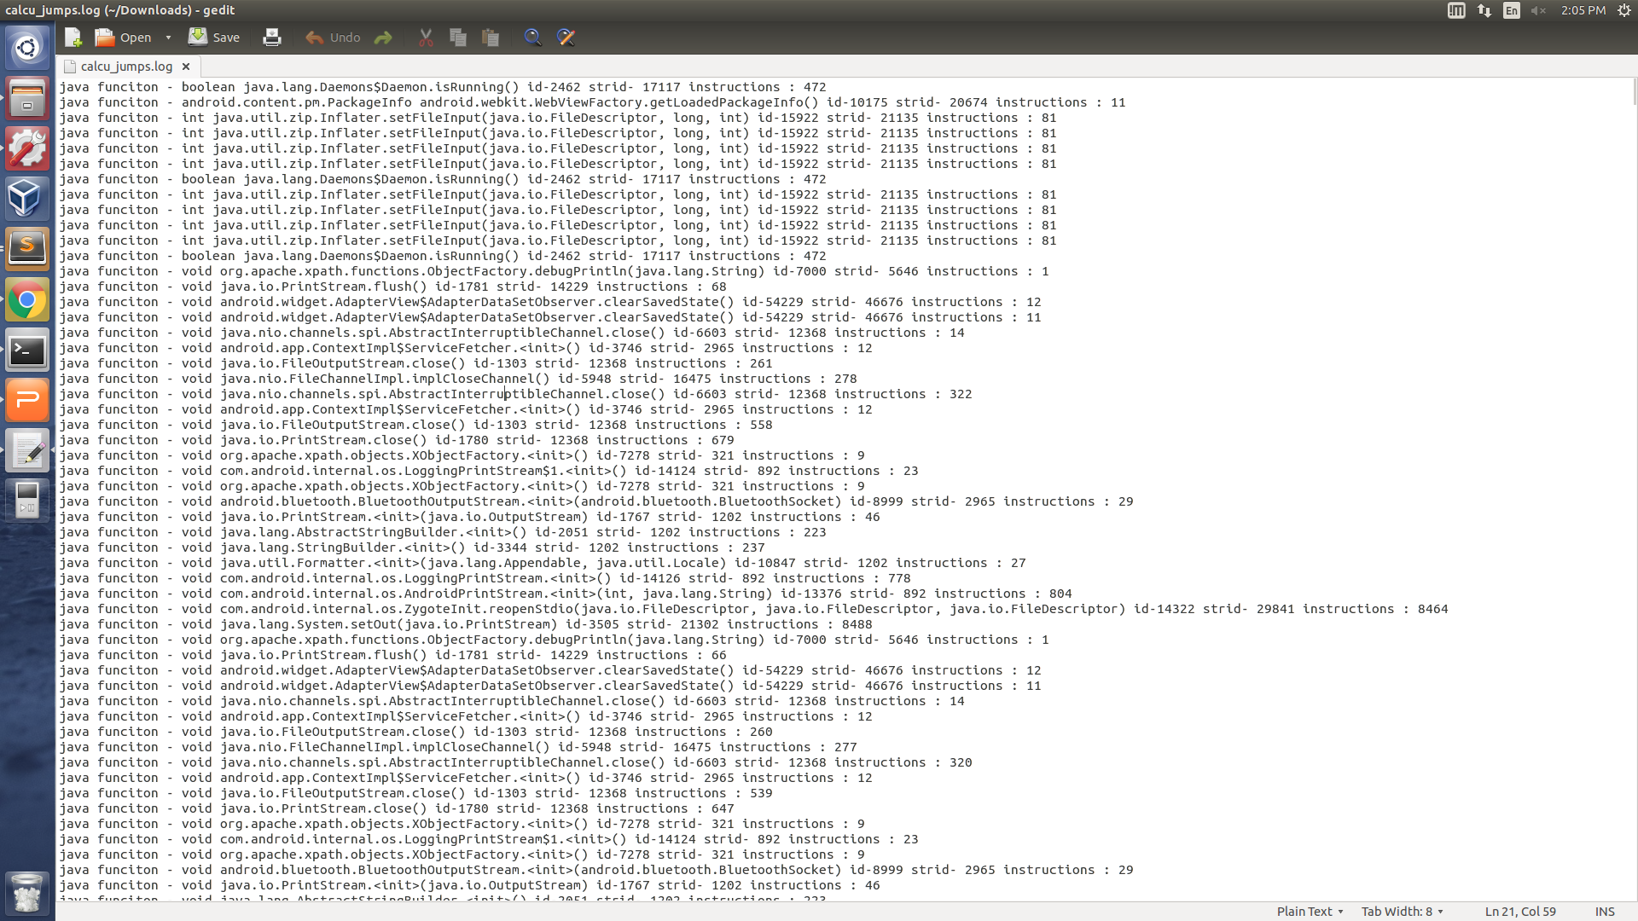
Program Analysis
Result file includes the function names and their CPU instruction counts.

Slide 40
OSU– Alex/Aarash
Anything to add from mutation and schema evolution?

Slide 41
DSL (Eric to Refine)
Highlights indicate which parts of the solution is covered/plays a role…

Slide 42
Resource Specification DSL
Overall goal: language to specify, type system to check fitness of EFS
Conceptual overview
Atomic DFU: a constant with a resource type A B
DFUs can be composed, a component or a product can thus have a resource type
Application model: function that composes DFUs and applies DFUs to resources
Application instance: value produced by application model (after supplying all args)
Deployment model: inputs to application model + expected type of output – inputs: parameters and initial environment – outputs: resulting environment w/ services required by the mission requirements
DFU requires resources/services A, provides B
Can be used to answer these questions:
Does this application instance satisfy the deployment model (type checking)
How do we configure the model to produce a valid instance (type inference)
What is the best configuration for a deployment model (inference + valuation)
Novel combination of three theories:
Linear types: resources are consummable
Refinement types: express constraints on quantities of resources
Variational types: synchronize configuration points across DFUs
Also: use records / row polymorphism for representing and abstracting over resource environments

Slide 43
DSL Example (Part 1)
Needs memory
Dependent variable
Needs GPS sig (non consumable)
DFU Id
Other resources unaffected (row poly.)
LocationProviderAndroidGPS : { Mem: m@Int, !GPSSatSig | r }
{ Mem: [v | v = m - 128 & v ≥ 0], !GPSSatSig, !LocData | r }
Refined
type
Consumes 128 units of memory to run
Provides location data
Resource type of a DFU (e.g. a substitutable component)
Notes:
These are current thoughts, and may evolve. Shortcomings involve global variables, and what if not all clients get all SA messages (different subscriptions)

Slide 44
DSL Example (Part 2)
A client requires a connection to the hub and consumes uplink and downlink according to the size and frequency of its SA messages, and in the case of downlink also the number of other clients
client: n@Nat → size@Nat → freq@Nat → { Hub, UL: u@Nat, DL: d@Nat | r } { !Hub, UL: [v | v = u - size*freq], DL: [v | v = d - n*size*freq] | r } Client
A server requires a connection to the hub and consumes uplink and downlink according to number of clients and the size and frequency of its SA messages
server: n@Nat → size@Nat → freq@Nat → { !Hub, UL: u@Nat, DL: d@Nat | r } { !Hub, UL: [v | v = u – n*(n-1)*size*freq], DL: [v | v = d - n*size*freq] | r } Server
Resource type of a larger unit (e.g. a client or server application)
Notes:
These are current thoughts, and may evolve. Shortcomings involve global variables, and what if not all clients get all SA messages (different subscriptions)

Slide 45
DSL Example (Part 3)
A sample deployment model for a network with 10 clients and a server:
– Input parameters: { n = 10, size = 20, freq = 1 }
– Input environment: { !Hub, UL = 5000, DL = 5000 }
– Output type: { !Hub, UL: [v | v ≥ 0], DL: [v | v ≥ 0] } Server Client¹⁰
Application model:
app = λ n size freq env₀ .
let (env₁, s) = server n size freq env₀ in
let clients (env_{i}, cs) =
let (env_{i+1}, c) = client n size freq env_{i} in (env_{i+1}, c :: cs) in
let (env_{n}, cs) = foldr (∘) id (replicate n clients) (env₁, nil)
in (env_{n}, s, cs)
Helper function: generate a client and add it to a list
Generate the server
Generate n clients, accumulating results
Manually thread environment through:
– linear types ensure we get it right
– can abstract away with monad pattern
Notes:
Once again– current thoughts

Slide 46
DSL Status
Plan of attack:
Get known technologies working together first (records, linear types, refinements)
Then mix-in variability (past experience: complex, cross-cutting concern)
Already know the theorems we want w/r/t variability: configuration commutes with semantics, type checking, type inference, etc.
Working: semantics (interpreter / big-step), type checking values
Enables checking if a particular configuration satisfies the deployment model
In progress: checking explicitly typed terms
Enables checking if an application model is type-correct
TODO: unification + type inference + variability
Enables efficiently identifying configurations that satisfy deployment model
Biggest research challenge: integrating refinements + variability
Naive integration may not scale if it produces big variational SMT problems
Keys (prev. work): share context (split late), aggressively reduce (join early)
Smaller formulas = more sharing, try to achieve with slicing, refactoring, etc.
Notes:
Once again– current thoughts

Slide 47
Change Requests (Fred to update)
What is it, what purpose
GME model
Other interfaces

Slide 48
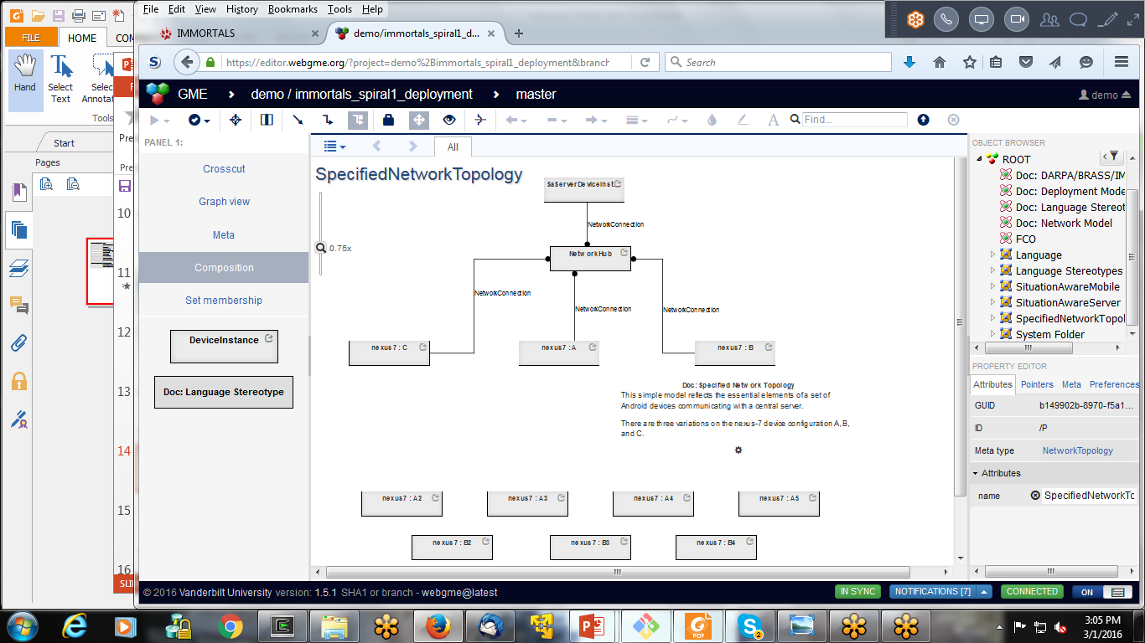
Specifying the Target Environment and Mission Requirement
Notes:
These models are used to test and evaluate and also provides the parameters for our queries (i.e., find a DFU that match)

Slide 49
DAS (Matt to provide)
Workflow
Implementation

Slide 50

Build System (DAS) (1)
Baseline Application Code
DFU implementations (annotations + code artifacts)
…
GPSLoc gps = new GPSLoc(…)
while(true) {
r = gps.getLocation();
sendReport(r);
sleep(x);
}
…
+ GPSLoc & other classes
@func_spec:LocProv
Class GPSLoc
@init
GPSLoc()
…
@doWork
Location getLocation() {…};
…
@cleanup
@func_spec:LocProv
Class SAASMLoc
@init
SAASMLoc()
…
@doWork
Location getSAASMLoc() {…};
…
@cleanup
Compilable
Arch Template
(Control Point assumption)
Triple Store
…
//init- LocProv
while(true) {
//doWork-LocProv
sendReport(r);
sleep(x);
}
//cleanup-LocProv
Application model
Control Points:
in Client.java,
template id CP-1
DFU Descriptions
DFU ID 1
Name: SAASMLoc
@f_s: LocProv
Source: ….java
Dependencies:
DSL File:
DFU ID 2
….
Using LocProv as a shorthand for LocationProvider in this slide
Mission Requirements
Call Freq: 1Hz
Target (deployment) Ecosystem
No GPS Sat, Bandwidth: x
Notes:
Current thought– mission req and target environment description may also be stored in the triple store.

Slide 51
CP-1 Problem Space
We have 6 elements in our operating environment that can change (boolean)
GPS-Sat, GPS-Dev, Ext-BT, Ext-USB,Has-UI, Req-SAASM
2^6 (64) possible environment configurations
Not all environment configurations are self-consistent: for example a Mission requirement for SAASM location, but the absence of GPS satellites.
We have 5 DFUs that satisfy LocationProvider (functional spec)
A-GPS, BT-GPS, USB-GPS, SAASM-GPS, Dreck
Considering our initial focus on substitution, removing any of our basic 5 DFUs might make scenarios unsolvable
Different flavors of CP1 (start with m<5 of DFUs)

Slide 52
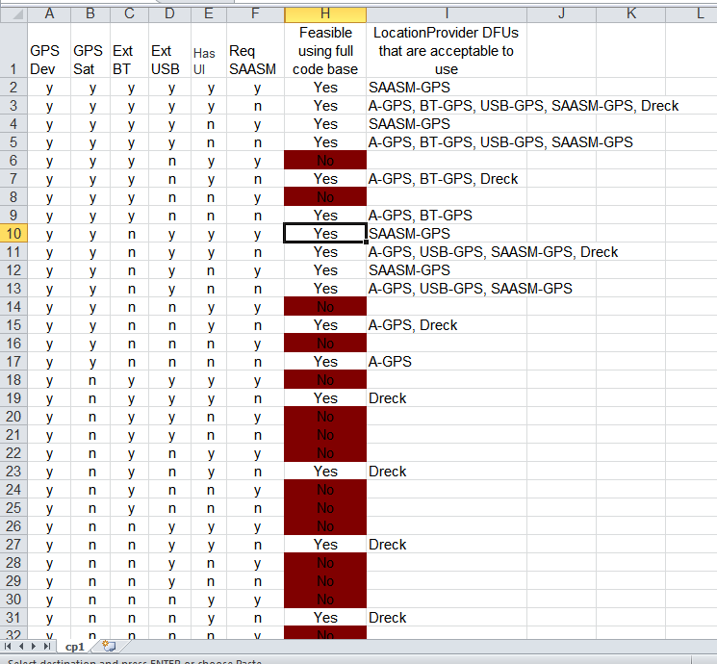
Enumerated State Space
Manually analyzed state space for feasibility
Given a full set of settings for env, determine if scenario is solvable, and if so, which DFUs are acceptable answers
Provided to LL as a ‘cheat sheet’
Still need to figure out how to deal with this issue in general.

Slide 53
Solving Multi-Constraint Knapsack
Just make sure we have the problem name right- Suresh is an academic!
Current DAS workflow/implementation breaks the problem into 2 phases
Find the list of DFUs that satisfy the functionality requirements of the defined application Control Points, typically restricted by the mission requirements
Spiral 0 implementation does this via SPARQL query
Filter the set of DFUs based on resource requirements vs. availability until we find a complete set that works.
Spiral 0 implementation uses OSU DSL
This needs more set up/explanation
Think of a better presentation of this slide– is the division (functional+ mission) and (EFS) always?

Slide 54
Build System (DAS) (2) Workflow
Is this workflow still valid?
Given changes in mission/deployment target
Look up from the RDF store to identify the CPs in the product
which parts of the product can we evolve
Look up from the RDF store which DFU can be used to substitute the existing DFU at that CP (if any) based on semantics (functional spec)
Check if the selected DFUs violate any mission requirement
Check the inferred Java/Bytecode signatures match (programming language semantics)
Invoke the DSL check to see if the resource descriptions fit (i.e., 1 hz for the SAASMLoc is less than the available bw)
Build the new product, compile, and test

Slide 55
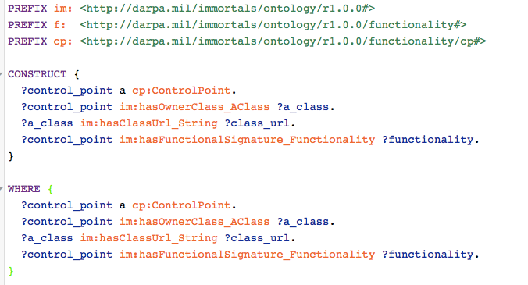
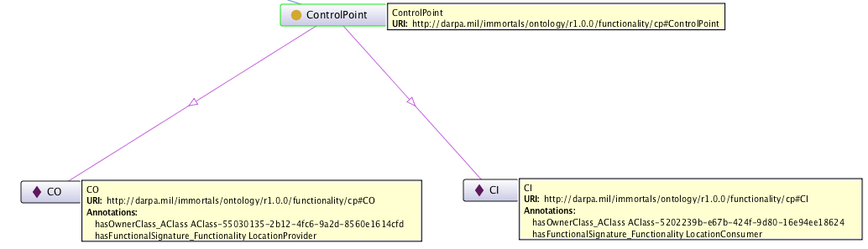
Example Queries (1)
Query the triple store for control points, to retrieve their source files and functionality
Results (shown as an RDF Graph)

Slide 56
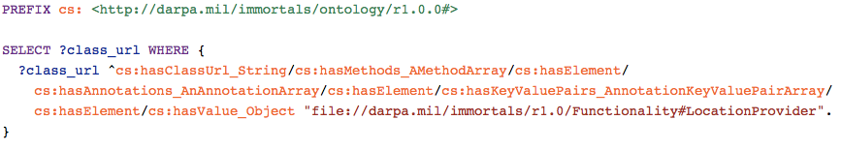
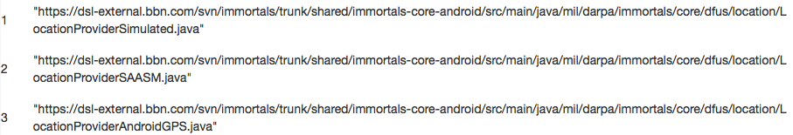

Example Queries (2)
Query the triple store to retrieve the DFUs offering a given functional spec
query
result
The triples/RDF graph that is being queried are created by Bytecode analysis, for example, the annotation below leads to the triple on the right:
LocationProviderAndroidGPS
hasFunctionality
LocationProvider

Slide 57
Synthesis
Once we have a set of DFUs that satisfy both the operational constraints, we need to integrate those DFUs into the application.
Start with a baseline source file that is annotated to identify control points
Control points have initialize, work, and cleanup specifications.
We transform the baseline source into a template

Slide 58
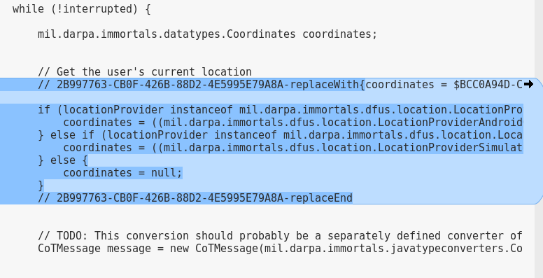
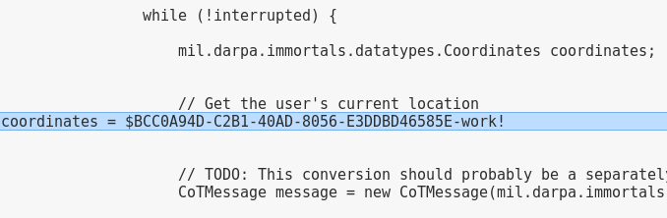
Synthesis Contd.
Annotated baseline
Explain and realign with slide 33
Template

Slide 59
Synthesis Contd.
DFU specification gives us information about what is needed to instantiate, call, and clean up a DFU instance
Control Point specification tells us where to put that code in the application
We use the Velocity Template Engine to facilitate adding the DFU-specific code to each Control Point.

Slide 60
Capabilities and Limitations of Current Synthesis
DFUs do not need to implement a common java-level interface; in our example the ‘do work’ function of each location provider had a different function name
Can deal with various scopes for DFUs by controlling where the initialization happens
e.g. a member var of a parent object vs. inside a loop
Current implementation doesn’t deal with varying function signatures, though we have much of the foundation in place (e.g., the semantic annotations for function parameters)
Do we have a mitigation/plan forward?

Slide 61
Build
The DFU specification, partially specified by hand, partially coming from Syracuse tools, will inform the DAS as to additional third-party dependencies for each DFU
The code repository provides a jar that implements the DFU, and a list of that DFU’s library dependencies
Build file is updated to include both the DFU implementation and the other dependencies

Slide 62
Validate and Deploy
Validation consists of a series of whole-application tests
Deploy currently consists of scripting to push the APK into Android Emulator instance(s).
Directly usable by LL
In the future, will need to utilize deployment model to know where to send individual artifacts produced from the build step.

Slide 63
LL Interactions (Partha to update)
DAS and System Under Test
The IMMoRTALS backend server is the DAS?
The backend server + runtime system (the Marti server and the android clients/emulators) is the DAS?
What is the system under test
When we are dealing with offline adaptation– i.e., responding to new mission requirements
When we are responding to runtime changes
LL Interface and Perturbation Language
LL State machines
start
s2
start
s
s1
s3
s
s1
s2
e
error
Build time
e
Run time
error
s: start eval → s1
s1: new mission req/deployment model C → s2
s1: no matching DFU found → e
s2: new app is built and tested → s3
s2: failed to build and test → e
s: start eval → s1
s1: a client publishes SA update U → s2
s2: all subscribed clients receive U → s1
s2: not all subscribed clients receive U→ e

Slide 64
Summary/Conclusion (Partha to provide)

Slide 65
Backups
2017
2018
2015
2016
2017
01 | 02 | 03 | 04 | 05 | 06 | 07 | 08 | 09 | 10 | 11 | 12 | 13 | 14 | 15 | 16

