Slide 1







Interfaces, Models, and Monitoring for Resource-aware Transformations that Augment the Lifecycle of Systems (IMMoRTALS)
BBN Site Visit

Slide 2
Agenda
Program Review Presentation
Demonstration
Discussion

Slide 3
Outline of the Program Review Presentation
Programmatics
Goals, Assumptions, Key Concepts
Phase 1 CPs
Discovery and Analysis Technologies
Representation
Program analysis
Resource DSL
Change tracking
DAS Development
LL Interaction
Next Steps and Conclusion

Slide 4
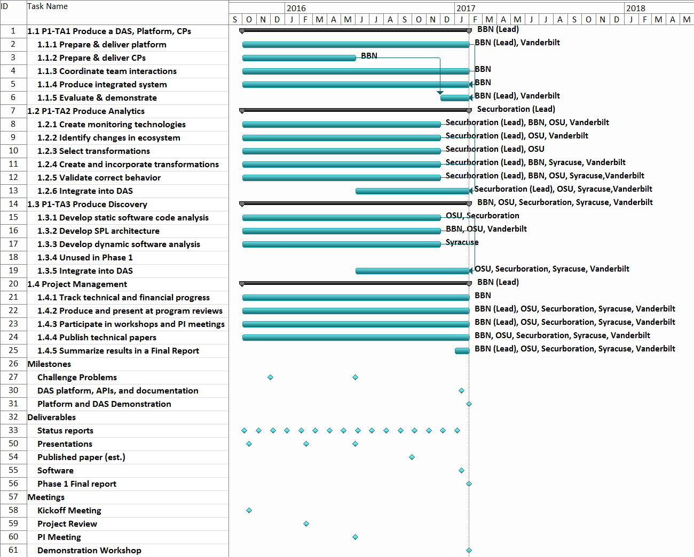
Programmatics
We are here

Slide 5
Summary of Progress
IMMoRTALS Tactical SA Platform
Phase 1 CPs (initial versions)
Component Capabilities
DAS realization
Back burner tasks
Mutation testing
Schema evolution
Papers/Talks
1 so far, more in the works

Slide 6
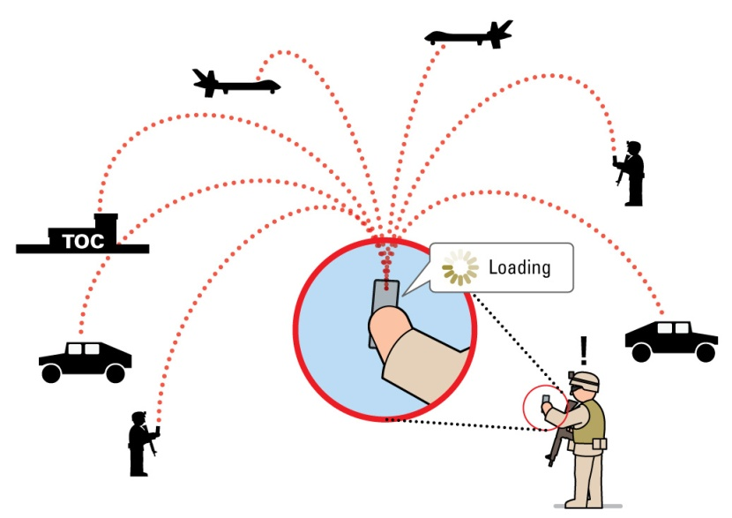
IMMoRTALS Goals
Develop, demonstrate and evaluate technology to make tactical situational awareness (information management) application evolve
Evolve (accommodate ecosystem changes) by
Substitution
Modification
Substitution requires
Existence of the substitute
Ability to identify the substitutable and a matching substitute
Modification requires
A change prescription
Ability to translate prescription into code change– guidance, template etc.
Modification produces potential substitutes
Modified function f of a class C → new class C→ new component that uses C
Our initial focus is “substitution,” where substitutes already exist

Slide 7
Assumptions
Applications are architected as Software Product Line (SPL)
Structure of the application
Abstraction of the features/functional components
Semantics/Annotation
Functional specification of code is not derived automatically
Extra-functional specification (e.g., resource specification, dependencies) will be
We are early in this task, not quite there yet
Deriving some dependency by tools
Ingesting some manually annotated information by tools
Deployment environment and mission requirement description
Capabilities of a deployment environment and mission requirements are not derived automatically- they are provided manually in a form prescribed by IMMoRTALS

Slide 8
Key Concepts
DFUs
IMMoRTALS Knowledge Repository
Resource DSL
Each of these will be touched in later subsections, but the concept of DFUs is key to IMMoRTALS approach, hence…

Slide 9
Discrete Functional Units
DFUs are the fundamental code units IMMoRTALS manipulates.
The simplest evolution is substitution of PLA components, in which case component == DFU
…
x = new X (…);
x.init(…);
…
y= new Y(…);
y.init(…);
…..
x.setNext(y);
….
Nontrivial code span
No single way to point to a “DFU”
No easy way to represent resource description
Class X {
… //<do_init>
…//<do_work>
}
A
B
X
Class Y {
… //<do_init>
…//<do_work>
}
Y
IMMoRTALS uses
JAVA annotation to define the DFUs (e.g., semantic spec is captured as an annotation)
Triple store to catalog DFUs
Resource DSL to describe resource spec
Triple store to store the relationships (models)
Product (Arch Model)
Codebase
Component
DFU
Notes:
Where we are in terms formalizing the proposed concepts and implementing them

Slide 10
Discrete Functional Units (2)
DFUs are the fundamental code units IMMoRTALS manipulates.
The simplest non-substitute evolution is evolution of a function
…
x = new X (…);
x.init(…);
…
y= new Y(…);
y.init(…);
…..
x.setNext(y);
….
Nontrivial code span
Class X {
… //<do_init>
…//<do_work>
}
void f(int x, String y) {
… //stmt1
…//stmt2
…
}
A
B
X
Modifying a single line in the function definition can change the semantics, signature as well as EFS of that function
Operate at function granularity
Make use of DFU’s annotation to refer to the functions
We can evolve functions only if they are declared (semantics) functionality provider (implementer) of a DFU component (i.e., functional aspects in our models)
Y
Product (Arch Model)
Codebase
Component
DFU
Notes:
Where we are in terms formalizing the proposed concepts and implementing them

Slide 11
IMMoRTALS Solution Overview
Initial Intake
Specification
Other models
Program Analysis
Program Synthesis
Program
TA1 product
Ecosystem
TA2 product
KR artifacts
TA3 product
Runtime Management
In use during mission
code artifacts
In use off line from the mission
Deploy,
redeploy
Test & Validate
Build
Iterative refinement of SPL variant for a given specification
Monitor
Specification of a new variant
Adaptation of running application
Changes in runtime system
(resource availability, anticipated changes)
Ecosystem changes,
Mission requirement changes

Slide 12
Phase 1 CPs
CP1: External service dependency (e.g. GPS)
CP2: Mission requirement dependency (number of clients, message rate, message size)
Each CP has various progressions:
Change requested before deployment
DFUs needed to configure an alternate product exists
DFUs needed to configure the alternate does not exist
Change detected at runtime/in-mission
Deployed system is not capable to handle (fails)→ trigger (A)
Deployed system is (has evolved, due to A and/or B, to be) able to handle
Absorbs within (e.g., executes appropriate branches of code)- we have demonstrated technologies to program and manage this kind of adaptive applications in the past
Evolves (changes configuration or code, may download)
Our initial focus is (A), and then (B)
In (B) – not claiming that we will be able to synthesize arbitrary programs, the goal is guided instrumentation or transformation of existing code (ordering of arguments, inserting a pipeline element,…)
We will get into CP1 a bit more deeply in this presentation

Slide 13
CP1: Spiral 0
Summary:
Start with baseline SA system
Change deployment device (which varies hardware capabilities) or mission requirements
Adapt the baseline application for the new operating environment
Complexity is low for first iteration
Can enumerate entire state-space in a spreadsheet

Slide 14
Ecosystem Aspects Covered in CP1- Operating Environment
External Resources:
GPS satellite availability (e.g. can receive GPS radio signals) [GPS-Sat]
Hardware availability:
GPS chipset on android device [GPS-Dev]
Bluetooth chipset on android device (e.g. for external bluetooth-based GPS device) [Ext-BT]
Available USB connection (e.g. for external usb-based GPS device) [Ext-USB]
Client device has a display for user-interface [Has-UI]
Could also represent high-level notion regarding screen accessibility during mission (a chest-mount android vs. throwing it in a backpack)
Mission Requirements:
Mission requirement for SAASM GPS [Req-SAASM]
Could also be specified in terms of properties (e.g., accuracy) instead of name

Slide 15
Placeholder for CP-2
Matt to create this slide

Slide 16
The Platform and Application
Elements of the operating environment (the aspects described in the last slide) affect a particular functionality of the application
Providing location information
In our SPL parlance
Location Provider component
Its use in the product (application)
The control point assumption: the product architecture decorated with functional spec (at least the functionality we would like to evolve) is available
Skeletal representation of the application, Functional spec to fill
In CP 1, key locations in the application code that could be filled in by components whose functional spec is LocationProvider
LocationProvider is an ontological term describing the abstract concept of location provider functionality (more later about ontology/representation)

Slide 17
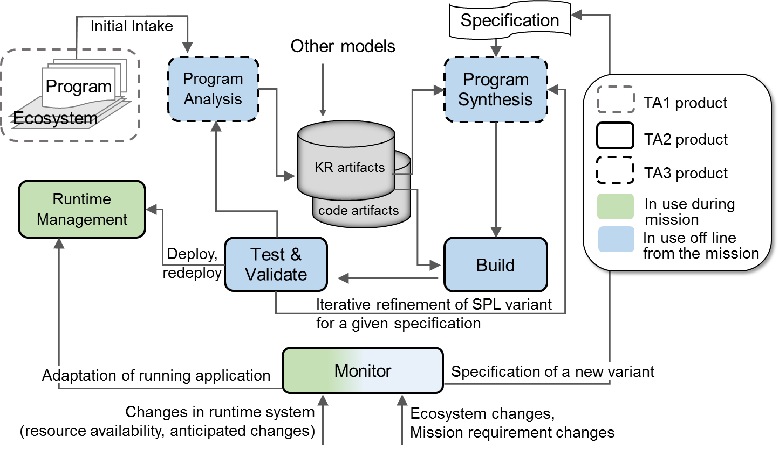
Knowledge Repository
Provides scalable infrastructure for storing and retrieving knowledge
Knowledge presented in terms of common vocabulary whose properties are formally modeled in linked ontologies
Common mechanisms to retrieve knowledge
Various avenues for inferring new knowledge
Provides an integration point within the team but also with other efforts
Highlights indicate which parts of the solution is covered/plays a role…
Notes:
Purpose of the knowledge repository is primarily to provide a scalable infrastructure for storing and retrieving the knowledge needed to adapt at machine time
Key points:
Knowledge is ingested, normalized, and subsequently presented in terms of common vocabulary whose properties are formally modeled in linked ontologies
The repository provides common mechanisms to retrieve knowledge (SPARQL queries)
Various avenues for inferring new knowledge (e.g., SPIN inferences, reasoner plugins)
Provides an integration point not only within the team but with other efforts (e.g., MUSE) and possibly other teams (e.g., unintegrated BRASS performers)

Slide 18
Concepts and relationships
Application
Application (Product), Component, ProductArchitecture, Class, Field, Function
Additional concepts related to Java and Bytecode
SA Domain specifics
Image, Location, LocationProvider, ImageProvider
Ecosystem
Device, Platform, Service, Library, Host, Network, CPU, Memory, GPSSignal
Mission (not fully modeled/captured in triple store yet)
QoS, SADataSize, NumClients, ReportingFreq
Immortals specific
DFU, DFUID, Functionality, FunctionalAspect, ResourceDependency, ResourceType (consumed as well as provided), ControlPoint
Notes:
We have constructed a set of ontologies for handling our challenge problems
The vocabulary defined in these ontologies is outlined here.
Basics/Core
Contains concepts related to Java, the JVM, and bytecode
Contains information about the application itself, components of the application, and its architecture
SA domain specifics
Contains concepts related to the situational awareness domain
Images, locations, things providing locations, things providing images
Ecosystem
Describes the software’s dependencies on its environment
Mission
Not currently implemented but we plan to describe the mission-centric requirements of the CPs. For example, the number of clients, their reporting frequency, etc.
IMMoRTALS
Describes concepts specifically relevant to adaptation. DFUs, DFU identifiers, functionality, functional aspects, resources, control points

Slide 19
Bootstrapping
Parse, vocabulary alignment, ingest
into knowledge store
Provided artifacts
Deployment Model (DM)
Src (annotated)
Bootstrapping
Triple store
Bytecode
(JAR/.class)
1…1
Repository management service
Feature Model (FM)
Binary repo (m2)
Build script
1…∞
Iterative knowledge
ingest
Derived artifacts
Control Flow Graph (CFG)
Dependency analysis
DAS
Resource analysis
Mut. testing results
Notes:
This slide shows how primary artifacts are conceptually ingested into the knowledge store in a process we call bootstrapping (which happens once per CP). A separate process exists for creating and ingesting derived artifacts (those that result from analyzing parts of the software that may change over time).
From the WebGME artifacts (DM, FM) we extract:
Resource availability
Execution environment desc
Objectives
Performance constraints
Feature view
From an analysis of the bytecode we extract:
Fine-grained structures (method, class, field)
JVM/bytecode abstractions (classpath, JAR, WAR)
Programmer-provided annotations
DFU-level decomposition (semantic signature)
Library dependencies
From detailed static analysis/dynamic analysis/mutation testing we extract:
Control flow graphs, call graphs
Dependency analysis
Resource use and resource/input sensitivity

Slide 20
Knowledge Repository Architecture
Ontology-aligned
triples
SPARQL
DAS
REST/JSON
Repository management service
REST/JSON
Fuseki
Unprocessed
artifacts
Ontology-aligned
triples
triple store
A
B
Unsolicited flow of data from A to B
A
B
Solicited flow of data from A to B
Notes:
This slide depicts the KR architecture and shows how bootstrapping works in practice
The DAS pushes artifacts into the Repository Management Service, which returns named identifiers for graphs resulting from ingesting the provided knowledge.
For example, the DAS pushes GME JSON models into the RMS, which ingests, aligns to semantic concepts, normalize and injects into a Fuseki triple store. It returns to the DAS a unique identifier for the resulting graph of triples.

Slide 21
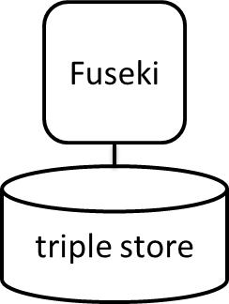
Knowledge repository scaleout
Fundamental unit of scalability is the named graph (g1…g5 below)
Takeaway: large, complex or long-running queries can be split into parallel queries spanning multiple graphs and executed in parallel
g1
g2
g3
Graph partitioning
Parallel query
g4
g5
Sequential query
Notes:
This slide simply illustrates the scaleout of Fuseki nodes.
The fundamental unit of scalability here is the named graph. The takeaway is that we can support arbitrarily large datasets so long as the data is partitioned horizontally across named graphs. The RMS manages this partitioning.
I.e., fuseki trivially supports horizontal scaleout (adding more nodes to handle more data).
More nodes can result in better query performance, but only if the graphs are partitioned properly (horizontal vs vertical in the figure above).

Slide 22
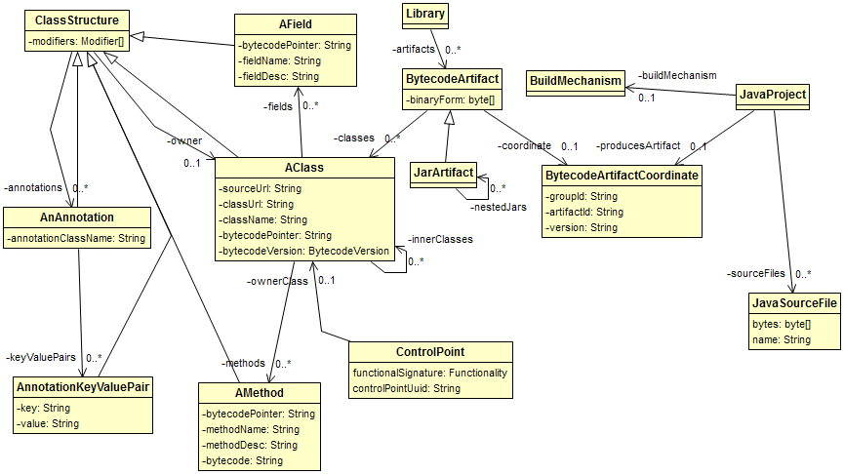
Model view: bytecode model
Notes:
UML view of ontology concepts related to bytecode. We instantiate these concepts by analyzing our CP source code, project layout, and bytecode.
Classes have fields, methods, annotations
Methods have annotations, bytecode, signatures
Fields have annotations, descriptors
Jars have various classes and possibly contain nested jars

Slide 23
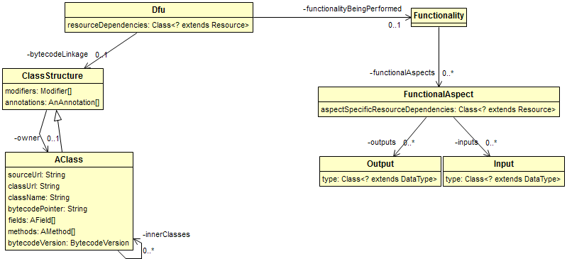
Model view: DFUs
Notes:
UML view of DFUs. We extract these by parsing annotations bound to source code.

Slide 24
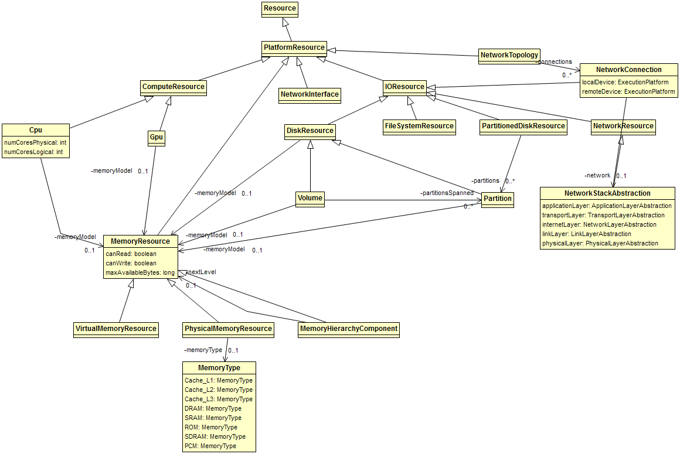
Model view: Resources (general-purpose)
Notes:
UML view of resources. Instantiation of these components comes from WebGME models.

Slide 25
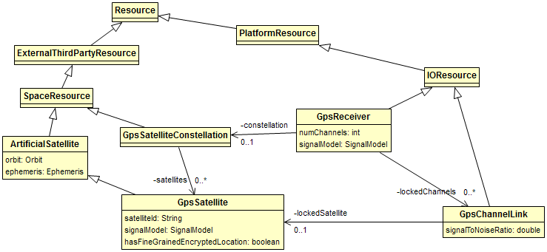
Model view: Resources (domain-specific)
Notes:
UML view of GPS domain-specific concepts

Slide 26
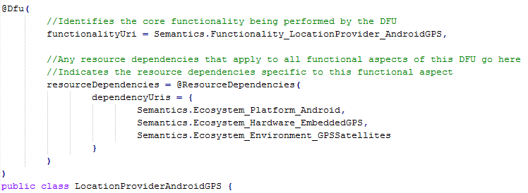
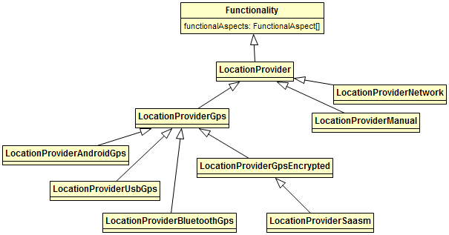
Annotation DSL part I
Notes:
This slide shows the source code annotation DSL, which is parsed and converted into triples during the bootstrapping process.
The annotation DSL provides code-level semantics that are linked during bootstrapping to semantic concepts. This is an example of an annotation for an Android location provider (uses onboard GPS to retrieve the device’s location).
Because it’s a LocationProviderAndroidGps, we know that it provides the LocationProvider functionality by examining the inheritance tree above.
A functional specification can have various functional aspects. For example, location provider has a functional aspect called getLastKnownLocation, implemented by a method in the class above. This is shown on the next slide.

Slide 27
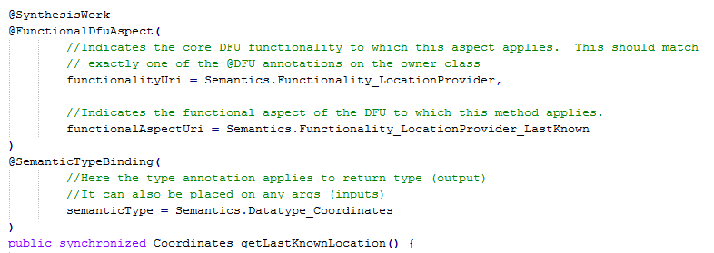
Annotation DSL part II
Notes:
This slide shows the functional aspect annotation for getLastKnownLocation.

Slide 28
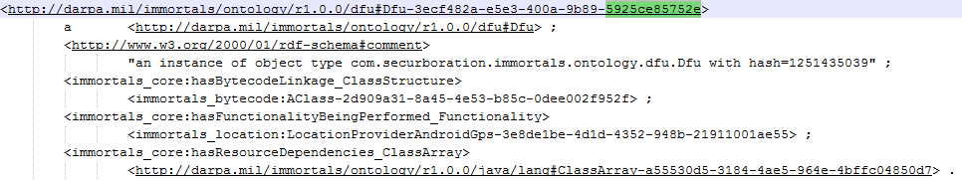
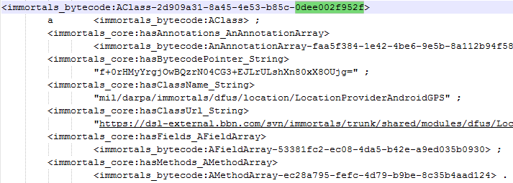
Triple view: DFU linkage to bytecode
DFU triples
Bytecode class triples
base64(sha256(bytecode))
subject
predicate
object
Notes:
Here are some of the triples actually generated during bootstrapping (from the previous annotation).
Triples are simply data normalization taken to the extreme. Each triple has a subject, predicate, and object node.
You can observe the linked/graph nature of the triples by following elements of a {subject,predicate,object} tuple to other triples. For example, the subject of the hasBytecodeLinkage DFU triple above is a class structure whose name is LocationProviderAndroidGPS.

Slide 29
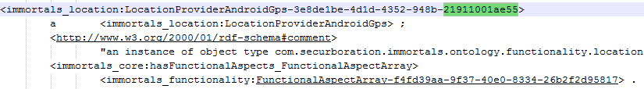
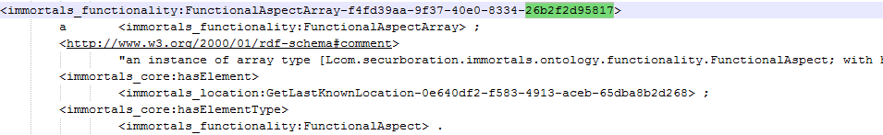
Triple view: DFU linkage to Functionality
DFU
LocationProviderAndroidGps (functionality)
GetLastKnownLocation (functional aspect)
subject
predicate
object
Notes:
A similar view of the DFU triples showing its linkage to functionality and eventually to a functional aspect, in this case a functional aspect that provides the last known location of the device. Triples about the actual functional aspect (e.g., linking it to a specific method in the class) are not shown.

Slide 30
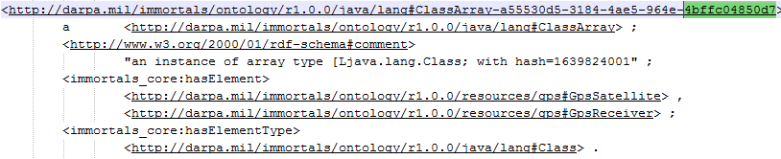
Triple view: DFU linkage to Resources
DFU
Ecosystem resource dependencies
subject
predicate
object
Notes:
A similar view of the DFU triples showing its linkage to resource dependencies. Here the location provider depends on GPS satellites and on the presence of a GPS receiver.

Slide 31
Ontology statistics
# triples: 36118
# classes: 325
# properties:
164 object properties
67 datatype properties
# individuals: 2349
Notes:
Some quick stats about the ontolgy

Slide 32
Program Analysis
Goal: extract program information via static & dynamic analysis

Slide 33
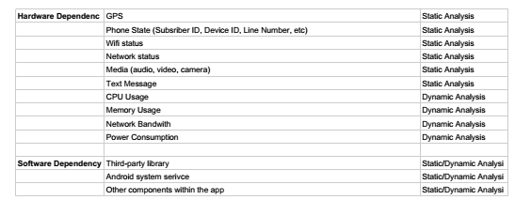
Program Analysis
Information to be extracted
program structure
dependency among structural elements
Input dependency
software resource dependency
hardware resource dependency

Slide 34
Program Analysis
Analyses performed:
Call-graph analysis
Data-flow analysis
Dynamic analysis
The output of these analyses is consumed:
Constructing the application model
Creating the resource descriptions for DFUs

Slide 35
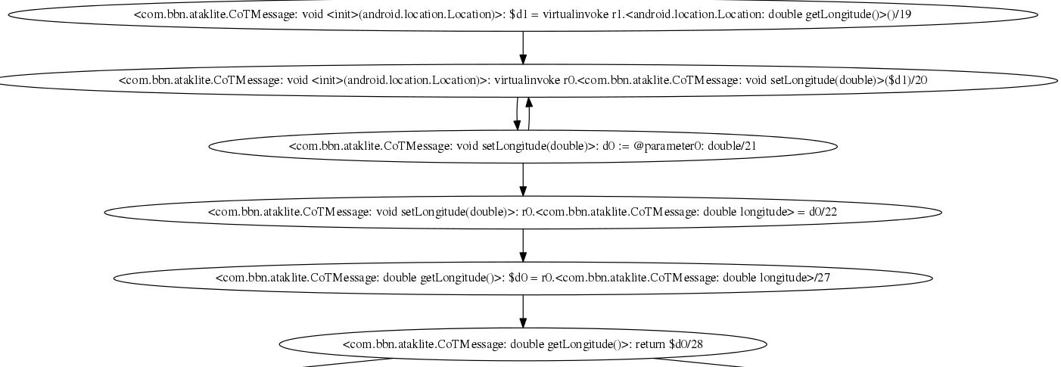
Program Analysis
Forward Data-flow Analysis is performed on sensitive API calls such as <android.location.Location: double getLongitude()>.

Slide 36
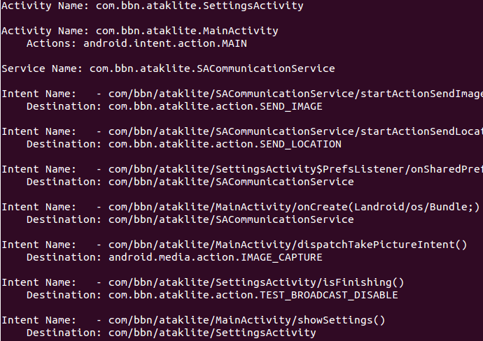
Program Analysis
Inter-component communication (ICC) is handled by using epicc(http://siis.cse.psu.edu/epicc/).
We then parse the epicc result and utilize the ICC information for a more complete data-flow analysis.
Figure on the right shows some ICC information we extract from ATAKLITE client app.

Slide 37
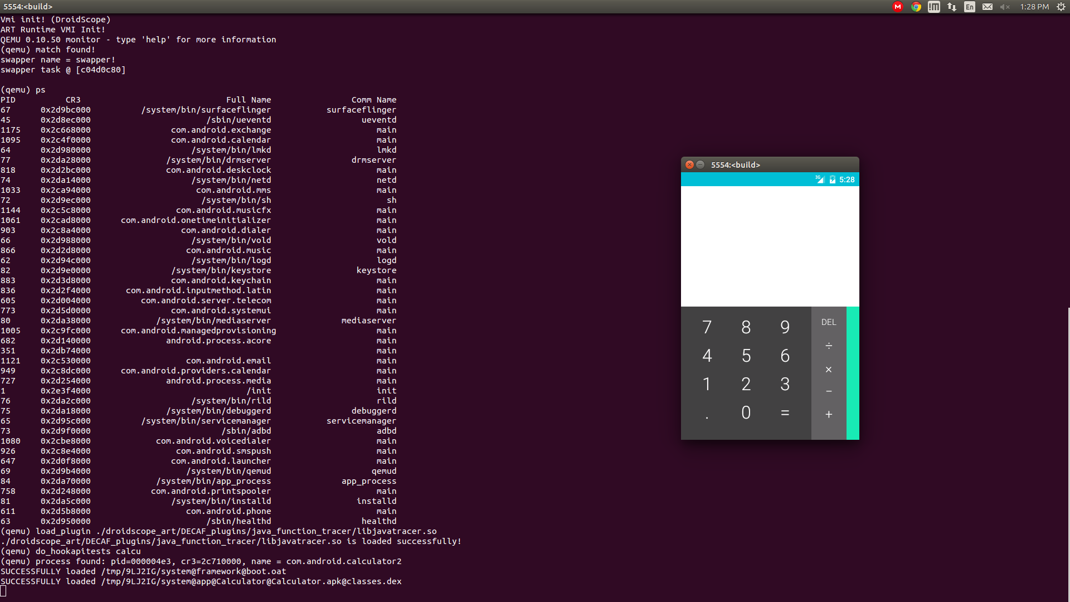
Program Analysis
For dynamic analysis, we use DroidScope which is an emulation-based Android application analysis engine.

Slide 38
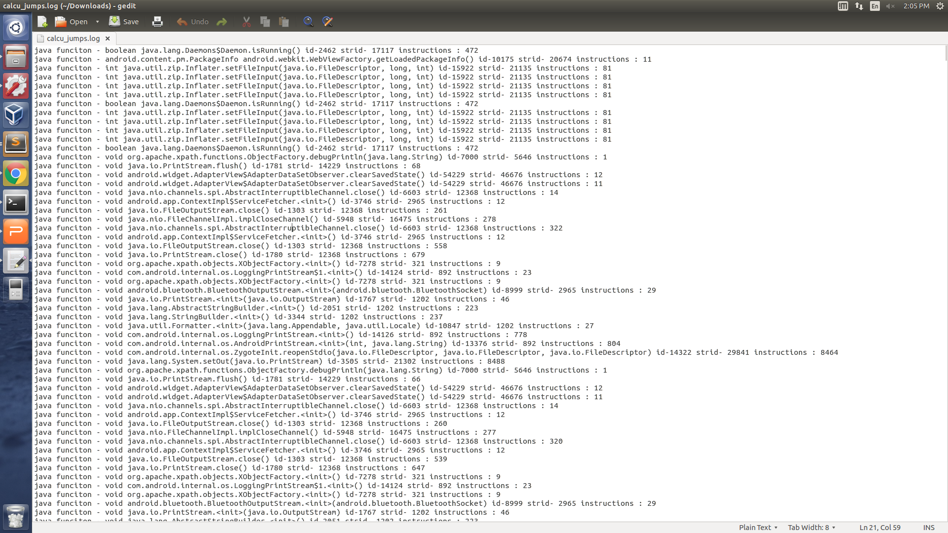
Program Analysis
Result file includes the function names and their CPU instruction counts.

Slide 39
DSL (Eric to Refine)
Highlights indicate which parts of the solution is covered/plays a role…

Slide 40
Resource Specification DSL
Overall goal: language to specify, type system to check fitness of EFS
Conceptual overview
Atomic DFU: a constant with a resource type A B
DFUs can be composed, a component or a product can thus have a resource type
Application model: function that composes DFUs and applies DFUs to resources
Application instance: value produced by application model (after supplying all args)
Deployment model: inputs to application model + expected type of output – inputs: parameters and initial environment – outputs: resulting environment w/ services required by the mission requirements
DFU requires resources/services A, provides B
Can be used to answer these questions:
Does this application instance satisfy the deployment model (type checking)
How do we configure the model to produce a valid instance (type inference)
What is the best configuration for a deployment model (inference + valuation)
Novel combination of three theories:
Linear types: resources are consumable
Refinement types: express constraints on quantities of resources
Variational types: synchronize configuration points across DFUs
Also: use records / row polymorphism for representing and abstracting over resource environments

Slide 41
DSL Example (Part 1)
Sugar for non-linear unit type:
!GPSSatSig => GPSSatSig: !Unit
Needs memory
Dependent variable
Needs GPS sig (non-consumable)
DFU Id
Other resources unaffected (row poly.)
LocationProviderAndroidGPS : { Mem: m@Int, !GPSSatSig | r }
{ Mem: [v | v = m - 128 & v ≥ 0], !GPSSatSig, !LocData | r }
Refined
type
Consumes 128 units of memory to run
Provides location data
Resource type of a DFU (e.g. a substitutable component)
Notes:
These are current thoughts, and may evolve. Shortcomings involve global variables, and what if not all clients get all SA messages (different subscriptions)

Slide 42
DSL Example (Part 2)
A client requires a connection to the hub and consumes uplink and downlink according to the size and frequency of its SA messages, and in the case of downlink also the number of other clients
client: n@Nat → size@Nat → freq@Nat → { !Hub, UL: u@Nat, DL: d@Nat | r } { !Hub, UL: [v | v = u - size*freq], DL: [v | v = d - n*size*freq] | r } Client
A server requires a connection to the hub and consumes uplink and downlink according to number of clients and the size and frequency of its SA messages
server: n@Nat → size@Nat → freq@Nat → { !Hub, UL: u@Nat, DL: d@Nat | r } { !Hub, UL: [v | v = u - n*(n-1)*size*freq], DL: [v | v = d - n*size*freq] | r } Server
Resource type of a larger unit (e.g. a client or server application)
Notes:
These are current thoughts, and may evolve. Shortcomings involve global variables, and what if not all clients get all SA messages (different subscriptions)

Slide 43
DSL Example (Part 3)
A sample deployment model for a network with 10 clients and a server:
– Input parameters: n = 10, size = 20, freq = 1
– Input environment: { !Hub, UL = 5000, DL = 5000 }
– Output type: { !Hub, UL: [v | v ≥ 0], DL: [v | v ≥ 0] } Server Client¹⁰
Application model:
app = λ n size freq env₀ .
let (env₁, s) = server n size freq env₀ in
let clients (env_{i}, cs) =
let (env_{i+1}, c) = client n size freq env_{i} in (env_{i+1}, c :: cs) in
let (env_{n}, cs) = foldr (∘) id (replicate n clients) (env₁, nil)
in (env_{n}, s, cs)
Helper function: generate a client and add it to a list
Generate the server
Generate n clients, accumulating results
Manually thread environment through:
– linear types ensure we get it right (e.g. can’t reuse the same memory for two clients)
– can abstract away with monad pattern
Notes:
Once again– current thoughts

Slide 44
DSL Status
Plan of attack:
Get known technologies working together first (records, linear types, refinements)
Then mix-in variability (past experience: complex, cross-cutting concern)
Already know the theorems we want w/r/t variability: configuration commutes with semantics, type checking, type inference, etc.
Working: semantics (interpreter / big-step), type checking values
Enables checking if a particular configuration satisfies the deployment model
In progress: checking explicitly typed terms
Enables checking if an application model is type-correct
TODO: unification + type inference + variability
Enables efficiently identifying configurations that satisfy deployment model
Biggest research challenge: integrating refinements + variability
Naive integration may not scale if it produces big variational SMT problems
Keys (prev. work): share context (split late), aggressively reduce (join early)
Smaller formulas = more sharing, try to achieve with slicing, refactoring, etc.
Notes:
Once again– current thoughts

Slide 45
Change Requests & Tools
Descriptive (measured)
Prescriptive (specification)
(current focus)
Change causes inconsistencies, DAS aims to resolve them
Some are resolved in an automated manner
Some in semi-automated manner
Model editors (such as GME) backed by code generators/package managers etc.
Notes:
Changes can arise from the runtime environment or for changes in mission properties.
In either case, there is a model reflecting these changes.
For this challenge problem we confine ourselves to changes in the specification.

Slide 46
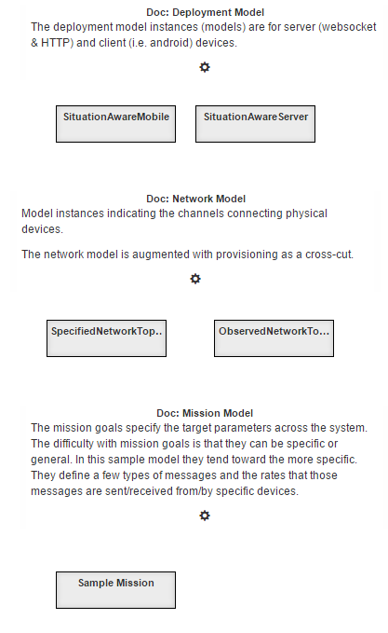
Mega-Modeling
Primary
DFU
Deployment Network Topology
Messages and Topics
Secondary (cross-cut)
Mission
System conflict resolution
DFU selection (now)
DFU modification (later)
Notes:
Primary
DFU
Deployment (compose software artifacts)
Network Topology (design computer network)
Messages and Topics
Secondary (cross-cut)
Provisioning (install software on devices)
Mission (specification of metrics)
System conflict resolution
DFU selection
Conventionally model-based approaches generate some product (source code, analysis reports) and are forgotten.
These systems; models, generated-source-code, hand-written-source-code, analysis-reports, etc., are all valuable and will be retained.
We act providently, retaining all of these systems and their associations.
In this way any change in the running system produces a cascade in the associated systems ultimately resolved due to the system design or by conflict.
These models are used to test and evaluate and also provides the parameters for our queries (i.e., find a DFU that match)

Slide 47
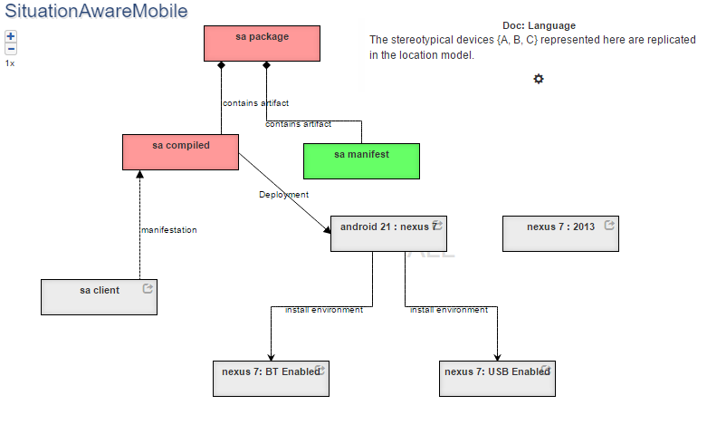
Modeling : Deployment (Build)
Notes:
The deployment-model describes how the components, DFU, compose the Execution-Platform.
These Execution-Platform then target specific Execution-Devices.
In this image we a simple example for the composing Android-Components for the Google Nexus 7 tablet.
Currently we produce a export file from this model and the other models suitable for import into the Knowledge-Base-Triple-Store.
We are in the process of making this interactive with the K-B-T-S.

Slide 48
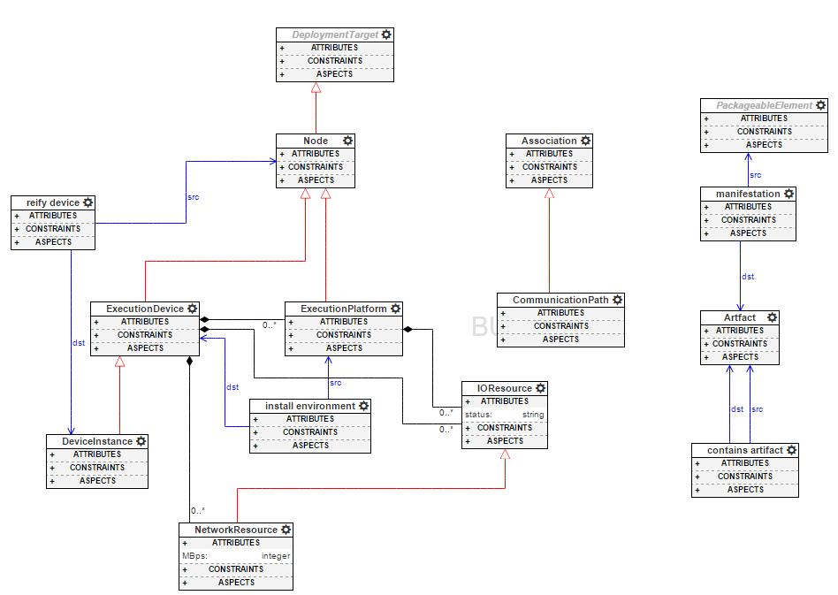
Modeling: Deployment Meta-Model
Notes:
The meta-data for this model is also part of the model.
As such it can be dynamic or weakly typed as part of the implementation.
(This is only a portion of the schema. The remaining diagrams do include a depiction of the schema, these will be left to the live demo.)

Slide 49
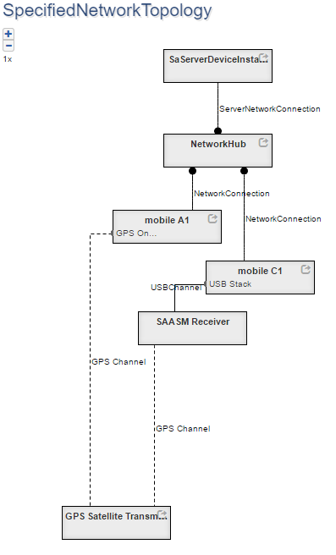
Modeling: Network
Notes:
The network model describes the configuration of the computer hardware onto which the Execution-Devices will be provisioned.

Slide 50
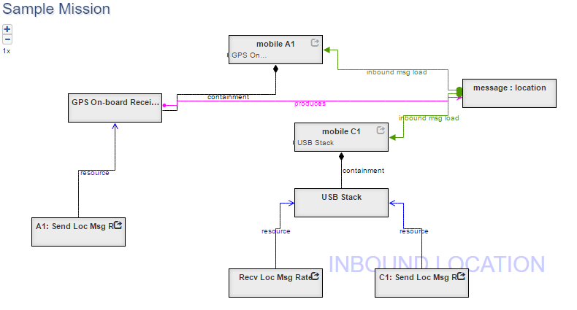
Modeling: Mission
Notes:
There are other models (such as Message) that will be left for the live demo.
The mission-model describes the metrics expected for the system elements.
Here we see the production and consumption rates for location messages by specific devices.

Slide 51

Build System (DAS) (1)
Baseline Application Code
DFU implementations (annotations + code artifacts)
…
GPSLoc gps = new GPSLoc(…)
while(true) {
r = gps.getLocation();
sendReport(r);
sleep(x);
}
…
+ GPSLoc & other classes
@func_spec:LocProv
Class GPSLoc
@init
GPSLoc()
…
@doWork
Location getLocation() {…};
…
@cleanup
@func_spec:LocProv
Class SAASMLoc
@init
SAASMLoc()
…
@doWork
Location getSAASMLoc() {…};
…
@cleanup
Compilable
Arch Template
(Control Point assumption)
Triple Store
…
//init- LocProv
while(true) {
//doWork-LocProv
sendReport(r);
sleep(x);
}
//cleanup-LocProv
Application model
Control Points:
in Client.java,
template id CP-1
DFU Descriptions
DFU ID 1
Name: SAASMLoc
@f_s: LocProv
Source: ….java
Dependencies:
DSL File:
DFU ID 2
….
Using LocProv as a shorthand for LocationProvider in this slide
Mission Requirements
Call Freq: 1Hz
Target (deployment) Ecosystem
No GPS Sat, Bandwidth: x
Notes:
Current thought– mission req and target environment description may also be stored in the triple store.

Slide 52
CP-1 Problem Space
We have 6 elements in our operating environment that can change (boolean)
GPS-Sat, GPS-Dev, Ext-BT, Ext-USB,Has-UI, Req-SAASM
2^6 (64) possible environment configurations
Not all environment configurations are self-consistent: for example a Mission requirement for SAASM location, but the absence of GPS satellites.
We have 5 DFUs that satisfy LocationProvider (functional spec)
A-GPS, BT-GPS, USB-GPS, SAASM-GPS, Dreck
Considering our initial focus on substitution, removing any of our basic 5 DFUs might make scenarios unsolvable
Different flavors of CP1 (start with m<5 of DFUs)

Slide 53
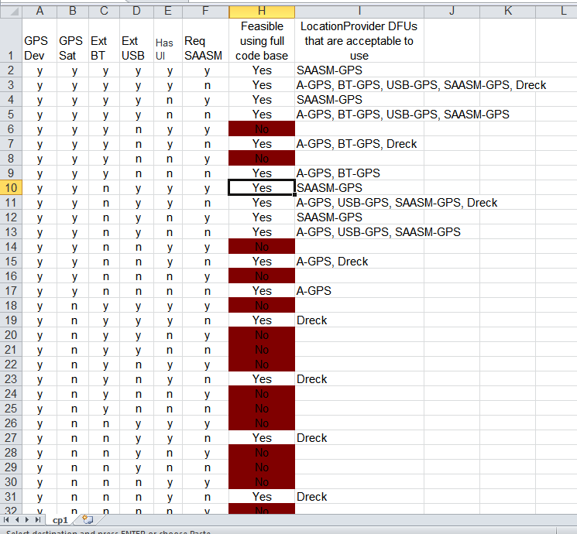
Enumerated State Space
Manually analyzed state space for feasibility
Given a full set of settings for env, determine if scenario is solvable, and if so, which DFUs are acceptable answers
Provided to LL as a ‘cheat sheet’
Still need to figure out how to deal with this issue in general.

Slide 54
Solving Multi-Constraint Knapsack
Just make sure we have the problem name right- Suresh is an academic!
Current DAS workflow/implementation breaks the problem into 2 phases
Find the list of DFUs that satisfy the functionality requirements of the defined application Control Points, typically restricted by the mission requirements
Spiral 0 implementation does this via SPARQL query
Filter the set of DFUs based on resource requirements vs. availability until we find a complete set that works.
Spiral 0 implementation uses OSU DSL
This needs more set up/explanation
Think of a better presentation of this slide– is the division (functional+ mission) and (EFS) always?

Slide 55
Build System (DAS) (2) Workflow
Is this workflow still valid?
Given changes in mission/deployment target
Look up from the RDF store to identify the CPs in the product
which parts of the product can we evolve
Look up from the RDF store which DFU can be used to substitute the existing DFU at that CP (if any) based on semantics (functional spec)
Check if the selected DFUs violate any mission requirement
Check the inferred Java/Bytecode signatures match (programming language semantics)
Invoke the DSL check to see if the resource descriptions fit (i.e., 1 hz for the SAASMLoc is less than the available bw)
Build the new product, compile, and test

Slide 56
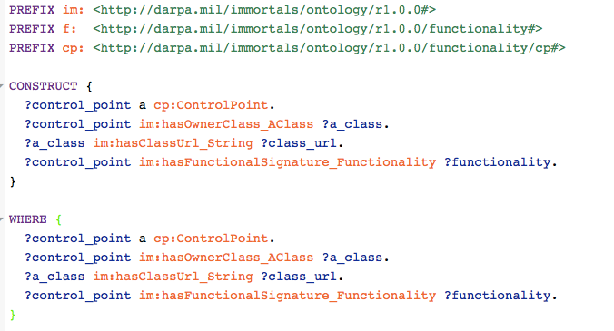
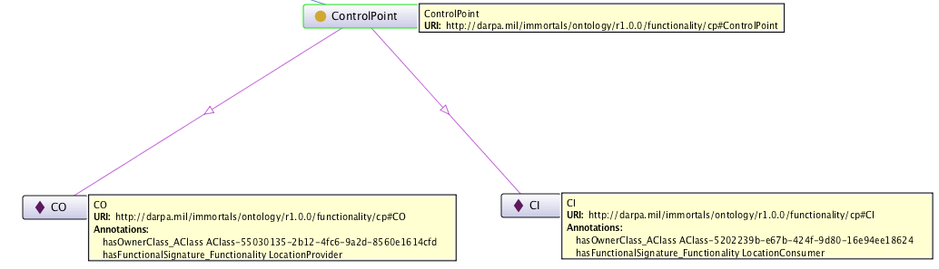
Example Queries (1)
Query the triple store for control points, to retrieve their source files and functionality
Results (shown as an RDF Graph)

Slide 57
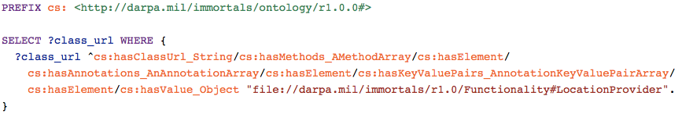
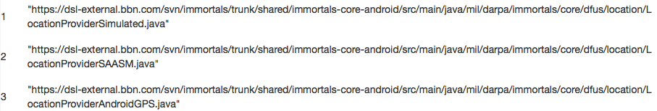

Example Queries (2)
Query the triple store to retrieve the DFUs offering a given functional spec
query
result
The triples/RDF graph that is being queried are created by Bytecode analysis, for example, the annotation below leads to the triple on the right:
LocationProviderAndroidGPS
hasFunctionality
LocationProvider

Slide 58
Synthesis
Once we have a set of DFUs that satisfy both the operational constraints, we need to integrate those DFUs into the application.
Start with a baseline source file that is annotated to identify control points
Control points have initialize, work, and cleanup specifications.
We transform the baseline source into a template

Slide 59
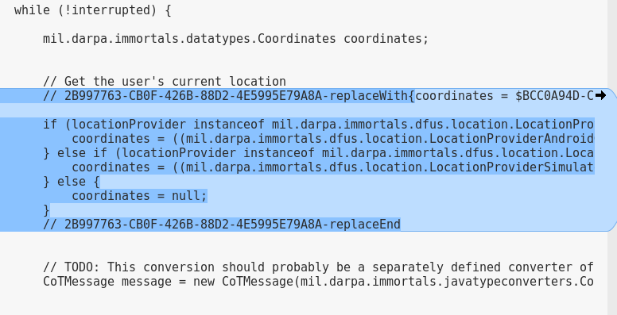
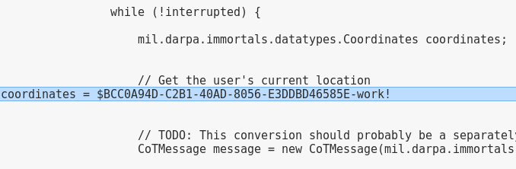
Synthesis Contd.
Annotated baseline
Explain and realign with slide 33
Template

Slide 60
Synthesis Contd.
DFU specification gives us information about what is needed to instantiate, call, and clean up a DFU instance
Control Point specification tells us where to put that code in the application
We use the Velocity Template Engine to facilitate adding the DFU-specific code to each Control Point.

Slide 61
Capabilities and Limitations of Current Synthesis
DFUs do not need to implement a common java-level interface; in our example the ‘do work’ function of each location provider had a different function name
Can deal with various scopes for DFUs by controlling where the initialization happens
e.g. a member var of a parent object vs. inside a loop
Current implementation doesn’t deal with varying function signatures, though we have much of the foundation in place (e.g., the semantic annotations for function parameters)
Do we have a mitigation/plan forward?

Slide 62
Build
The DFU specification, partially specified by hand, partially coming from Syracuse tools, will inform the DAS as to additional third-party dependencies for each DFU
The code repository provides a jar that implements the DFU, and a list of that DFU’s library dependencies
Build file is updated to include both the DFU implementation and the other dependencies

Slide 63
Validate and Deploy
Validation consists of a series of whole-application tests
Deploy currently consists of scripting to push the APK into Android Emulator instance(s).
Directly usable by LL
In the future, will need to utilize deployment model to know where to send individual artifacts produced from the build step.

Slide 64
LL Interactions (Partha to update)
DAS and System Under Test
The IMMoRTALS backend server is the DAS?
The backend server + runtime system (the Marti server and the android clients/emulators) is the DAS?
What is the system under test
When we are dealing with offline adaptation– i.e., responding to new mission requirements
When we are responding to runtime changes
LL Interface and Perturbation Language
LL State machines
start
s2
start
s
s1
s3
s
s1
s2
e
error
Build time
e
Run time
error
s: start eval → s1
s1: new mission req/deployment model C → s2
s1: no matching DFU found → e
s2: new app is built and tested → s3
s2: failed to build and test → e
s: start eval → s1
s1: a client publishes SA update U → s2
s2: all subscribed clients receive U → s1
s2: not all subscribed clients receive U→ e

Slide 65
Summary/Conclusion (Partha to provide)

Slide 66
Backups
2017
2018
2015
2016
2017
01 | 02 | 03 | 04 | 05 | 06 | 07 | 08 | 09 | 10 | 11 | 12 | 13 | 14 | 15 | 16

Slide 67
For Brainstorming session
Candidate ideas/slides
Alex’s mutation testing→ dep/EFS
Eric/Matt– disk space/CP2?
Eric– type theory conflicts/soundness questions Suresh asked before (if any back up slides needed)
Going beyond simple substitution
Things that need code modification
Things that are unrealistic/simple engg
Things that are hard/R&D

