Slide 1







Interfaces, Models, and Monitoring for Resource-aware Transformations that Augment the Lifecycle of Systems (IMMoRTALS)
Matt Gillen (BBN)

Slide 2
Outline
Program status
The IMMoRTALS Tactical SA Information Sharing Platform
Challenge Problems
IMMoRTALS DAS Concept of Operation
Initialization/bootstrapping
Deriving resource dependency
Representation and Use of resource dependency
Detecting and Responding to Changes
Putting it together
TA4 Interface
Plans for the next quarter
Conclusion

Slide 3
Program Status
Award date: 11/23
ACA status: in process
Sub contract status: Letter of authorization, subcontract in process
Team intro/attendees
BBN- Matt Gillen, Partha Pal (Platform, CP, Integration + TA2, TA3)
Securboration- Lee Krause, Jacob Staples (TA2, TA3)
OSU- Eric Walkingshaw, Arash Termehchy (TA2, TA3)
Vanderbilt- Doug Schmidt, Fred Eisele (TA2, TA3)
Syracuse- Heng Yin (TA2, TA3)

Slide 4
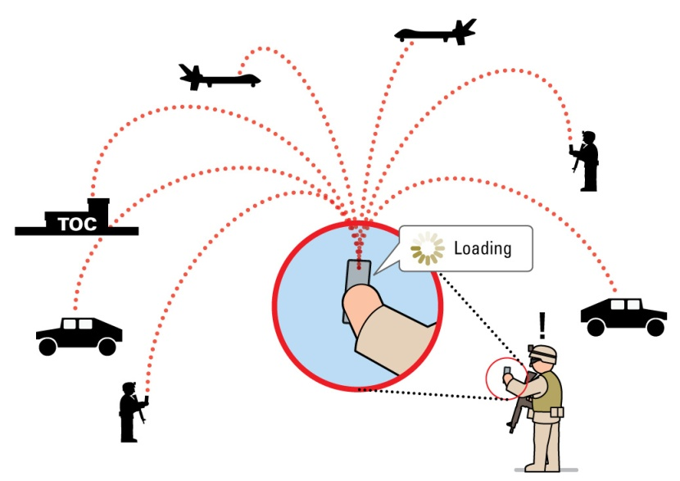
IMMoRTALS Goals and Motivation
Tactical Situation Awareness (SA) is a key part of modern warfare, law enforcement, humanitarian missions, etc.
SA is characterized by
Diverse and changing use cases and requirements
Many and changing operating environments
Long lifecycle in a fast evolving ecosystem
IMMoRTALS will develop, demonstrate and evaluate technology to make software evolve in this context
Notes:
Changing env:
Fully networked high bandwidth
No built-in infrastructure

Slide 5
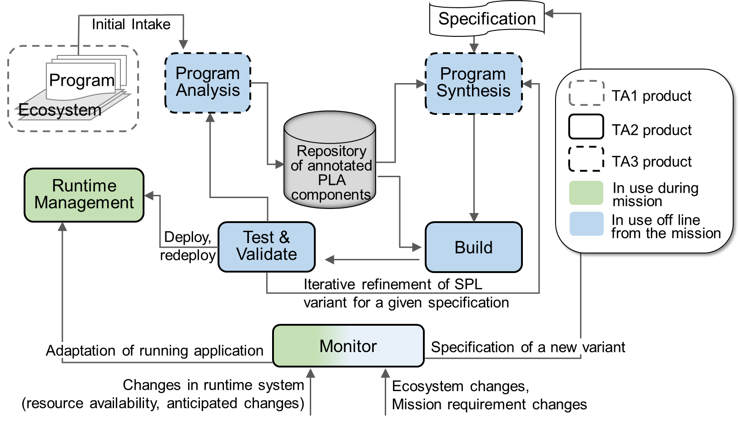
IMMoRTALS Solution Overview

Slide 6
IMMoRTALS (Tactical SA) Platform
IMMoRTALS code base, build and test environment
Error report, deploy/update SW
IMMoRTALS Management Network
Host
Ecosystem
SA producer & consumer
Brokering and Storage
IMMoRTALS back end
Operational Network
Server Host
Android
Ecosystem
Ecosystem
Deployed/running platform application
Android Clients
Linux/Java Server
Backend
Change detection tools
Runtime management tools
Program synthesis tools
Build tools
Validation tools
Program analysis tools
Repo
y

Slide 7
IMMoRTALS Platform and Ecosystem
“Application”– whose shelf life we are trying to extend (as an exemplar), which is what we are going to adapt, as opposed to rewrite by hand.

Slide 8
Unique Applicability to BRASS
Good fit for the program goals (BRASS)
High-level goals stay the same
Android/sub-laptop computing is the future
Android ecosystem is fast evolving
Good fit for executing the proposed work (IMMoRTALS)
Range/scope of the technologies in the ecosystem
Mobile Devices
Servers, ranging in hardware from Raspberry Pi to Big Iron
Any kind of network you can find
The evolution the IMMoRTALS team has observed
ATAK
TransApps
Transition path for IMMoRTALS technologies

Slide 9
Example Scenario: Baseline Use
The SA application is designed to support a specific workflow
Take picture
Share with team
Application assumes an IP network, and also assumes a server in the loop to facilitate sharing
Full image + metadata to large number of clients who subscribed
Android Client
Android Client
Android Client
Server
Android Client
IP Network

Slide 10
Example Scenario: New Context
A new mission requirement came in
Collect pictures and field of view (FoV)
Deployment network has only SMS, no data (so no way to send pictures)
Share location and FoV of picture now, sneakernet raw picture later
This is a pre-deployment change
How to automatically adapt the existing application for the new mission?
Android Client
Android Client
Telephone Network
Android Client
SMS to small number of other clients

Slide 11
Key Enablers for Automated Adaptation
Yes, we need to detect the change (i.e., Discovery) and the ability to adapt the application (i.e., Analytics)
But these need to happen within the bounds of a framework that acts as a scaffolding
E.g., different implementations of a feature can be used to put together a product
Models (of various aspects) of the software can provide such a framework
Implicit models based on analysis of the code proper
Explicit models may be obtained from those annotations retained in the code
And, (if we are lucky) some models might have used to generate (some) code

Slide 12
Deficiency in the State of the Art
Feature Model in a PLA explains how features can be combined in product
Interfaces and signature provide a lower-level model
MUSE will provide another perspective (functional specification) of the semantics of program
But what about resource dependency and usage (i.e., Extra Functional Requirements (EFS))?
These two cover syntactic specification and a level of semantic specification

Slide 13
Discrete Functional Units (DFUs)
DFUs are an IMMoRTALS concept that links together functional requirements (Features), code (Implementation) and extra functional specification (Resource dependency and usage)
DFUs are annotated code elements
Linked with FM and semantic models: contributes to Features, has a specific semantics, relationship with other DFUs are explicitly captured
Linked with resource models: a DFU’s resource dependency, usage and provisions are explicitly captured
More about DFU’ization and various models later…

Slide 14
Thoughts on Challenge Problems
Our chosen platform/ecosystem is rich with change drivers
Environmental changes
Differences in network capabilities
E.g., multicast capable vs. unroutable IPs behind NAT
Third party libraries update
E.g., additional parameters needed in API, fix ‘bugs’/security holes that you unwittingly depended on
Third party libraries cease to be supported
High level mission requirements change
Need to interoperate with another system
E.g., convert data to another format
Security model
E.g., going from transport-level security to a prescribed scheme

Slide 15


Candidate CP
Mobile app (client): upload a picture to a server, receive a picture from the server
Server: match the image metadata with the interest registered by (other) client(s), and send the image to the matching clients
Change drivers: variable client platform (device configurations); changing software requirements; uncertain network environment
network
server
image database
app
Easy to grasp
Covers a number of change drivers
Devices, Sensors, Mission, Library
Change may impact the server side as well
Has resource dependency on network, memory, and CPU (as we explore adaptations to fix– e.g., compress)

Slide 16
IMMoRTALS DAS CONOPS
Bootstrapping
Discovery features
Analytics features
TA4 Interfaces

Slide 17
Bootstrapping

Slide 18
Functional Specification Abstractions
Functional spec is provided in the form of code annotations. Two core abstractions:
Data types: semantic model of structures manipulated by DFUs
File path (used by many applications)
Image (used by a smaller subset of applications)
base64 encoded image (even more fine grained)
Application-specific XML image wrapper
Functionality: semantic model of DFU operations on data types
Compress an array of bytes
Send a datagram to a server
Example of subtype Transforms: convert one datatype to another
Convert a byte[] to a base64-encoded String

Slide 19
Datatype Hierarchy Example
dt:DataType
dt:Encoding
Generic concepts
(Shared between apps)
dt:content
dt:image
dt:archive
dt:Base64
dt:compressed
dt:tar
dt:a
dt:zip
dt:gz
dt:lzma
dt:uncompressedImage
dt:compressedImage
dt:png
dt:raw
dt:lossy
dt:lossless
dt:bmp
dt:jpg
dt:gif
Application-specific
Concepts
dt:gz_image
myApp:b64_jpg

Slide 20
Functionality Hierarchy Example
f:Functionality
Generic concepts
(Shared between apps)
f:Transform
f:hasDomain dt:byte[] f:hasRange dt:String
f:hasRangeEncoding dt:Base64
f:b64Encode
lib:commons-codec b64Encode
lib:java.util.Base64 b64Encode
lib:mutuallyExclusiveProperty
lib:android.util.Base64 b64Encode
myApp:b64Encode
Application-specific concepts

Slide 21
Repository of Annotated PLA Components

Slide 22
Repository of Annotated PLA Components
Ontologies provide common vocabulary for FS, EFS
immortals.rdf
sw.rdf
alg.rdf
application-agnostic
hw.rdf
lib.rdf
constraints.rdf
dependencies.rdf
Triple store
application-specific
functionality
ExampleApp.rdf
datatypes
Models useful for adaptation
conversion
@dfu1
@dfu2
@dfu3
EFS DSL model
Analysis
libraries
FS annotated
code
Feature Model (FM)
Notes:
Contains application-agnostic knowledge
Common algorithms, procedures, implementations
Filter, FFT, convolution, SVD, compress, decompress
Commons-math, FFTW, commons-codec, ImageJ
The knowledge store contains enough information to translate from one component to another as needed
E.g., a datatype:image_rgb can be converted to a datatype:image_2dRGB using a method in the lib:ImageJ library
May not be obvious, requires a combination of semantic inferencing and bytecode analysis
Describes various application-specific behaviors and constructs
Dependencies on physical and logical computing resources
Memory, disk, network
Constraints in time and space
QoS, computation limits
Ontology lives in a query-able triple store
Knowledge store would ultimately be populated by a program like MUSE, but we will manually pre-populate with information sufficient to demo our system

Slide 23
Using Repository for Adaptation
f:Functionality
Generic concepts
(Shared between apps)
f:Transform
f:hasDomain dt:byte[] f:hasRange dt:String
f:hasRangeEncoding dt:Base64
f:b64Encode
lib:commons-codec b64Encode
lib:java.util.Base64 b64Encode
lib:android.util.Base64 b64Encode
Example: find an alternate base64 encoding impl
SELECT ?x
WHERE
{
?x a dt:Transformer
?x hasDomain dt:byte[]
?x hasRange dt:String
?x hasRangeEncoding dt:Base64 }
myApp:b64Encode
Application-specific concepts

Slide 24
DFU-ization
Mobile app:
DFU1: read image from the phone’s file system
DFU2: encode the binary image using base64
DFU3: create XML document containing the base64 string
DFU4: Transmit the XML document to a remote server
DFU5: Update the display upon receipt of a reply message
Server:
DFU1: deserialize an XML message received from client
DFU2: base64 decode the image
DFU3: extract image
DFU4: extract embedded image metadata
DFU5: check metadata with registered interest
DFU6: return image to matching client(s)
Server
Mobile app
3
2
1
2
4
4
3
1
5
6
5

Slide 25
DFU-ization
Mobile app:
DFU1: read image from the phone’s file system
DFU2: encode the binary image using base64
DFU3: create XML document containing the base64 string
DFU4: Transmit the XML document to a remote server
DFU5: Update the display upon receipt of a reply message
Server:
DFU1: deserialize an XML message received from client
DFU2: base64 decode the image
DFU3: extract image
DFU4: extract embedded image metadata
DFU5: check metadata with registered interest
DFU6: return image to matching client(s)
Graph is a “free” result of static/dynamic analysis
Note: edges may transcend JVM instances
Server
Mobile app
3
2
1
2
4
4
3
1
5
6
5

Slide 26
DFU Example
Vocabulary for intent
android.util.Base64.class
datatype.rdf
lib.rdf
exampleApp.rdf
public static byte[] encode(
byte[] input, int flags) { return encode(
input, 0, input.length, flags); }
method
References to vocab
IMMoRTALS analysis
ExampleApp.class
Code ref
Triple store
Models useful
for adaptation
@DfuAnnotations.Transform( inputTypeConceptUri = "datatype:binaryByteArray", outputTypeConceptUri = "datatype:base64Encoding") private static String convertBytesToString(byte[] input){ return new String(Base64.encode(input,Base64.DEFAULT)); }
Transform
method
Mobile app
3
2
4
1
5
Notes:
Note: the actual app uses a class in java

Slide 27
Inferring Resource Dependency and Usage

Slide 28
Discovering Resource Dependency and Requirements
The goal is to fill in the EFS annotations for DFUs
EFS is identified/inferred by the following:
Static analysis
Whole system analysis
Data format and shape analysis
Mutation testing
EFS is represented by OSU Typed DSL

Slide 29
DFU Static + Dynamic Analysis
@DFU{
sw:hasFunctionality alg:compressLossy
sw:hasArg name=“data” type:image
}
Reflective call not visible until
Runtime
Similar issue may arise with transitive dependencies into libraries
f
f
f
f
f
f
m()
m()
m()
f
f
f
f
Dependencies visible in
bytecode at build time
f
f
m()
m()
m()
m()
m()
m()

Slide 30
DFU Static + Dynamic Analysis
@DFU{
sw:hasFunctionality alg:compressLossy
sw:hasArg name=“data” type:image
}
f
f
f
f
f
f
m()
Reflective call not visible until
runtime (requires dynamic
analysis)
m()
m()
f
f
f
f
Dependencies visible in
bytecode at build time
f
Camera IO
f
m()
m()
m()
m()
m()
m()
Network IO

Slide 31
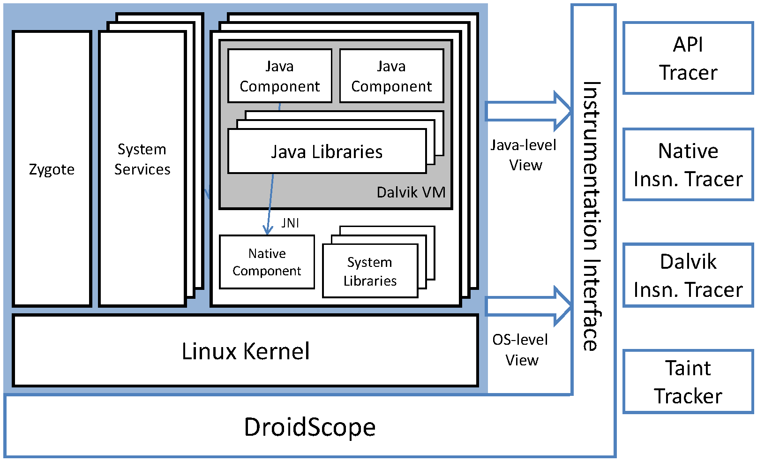
Whole-System Analysis
Hook Memory Allocators to Reason Input-Dependent Memory Usage
Differential Trace Analysis to Discover Resource Change Point
Track Resource Dependency throughout SW stack
Based on DECAF [ISSTA’14] and DroidScope[USENIX Security’12]
Can see everything!
Can infer resource dependency and requirement in framework, libraries, OS kernel and hardware (e.g., CPU, memory)

Slide 32
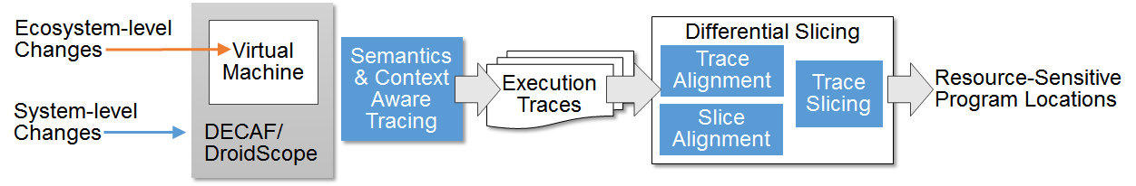
Whole-System Differential Analysis
When an introduced change causes a change in program behavior, we need to:
Diagnose the problem via differential analysis
Find out root cause: resource-sensitive program locations
Provide suggestions for program adaptation

Slide 33
Whole-System Differential Analysis (2)
Collect two traces (one with change, and the other without)
Semantics/context-aware trace alignment to detect divergence points

Slide 34
Whole-System Differential Analysis (3)
Backward dependency analysis to pinpoint root cause (resource-sensitive program locations)

Slide 35
Evolution of Data Representation
SA stores the information in a database
Schema defines
the meta-data and
structure of the DB.
DB schema often changes.
E.g., more DB access ➔ merge entities to preserve the query running time.
Queries that are written for the old schema will not over the new one.
resource
version
id | name
r1 | t1.png
r2 | rt34.png
vid | resource | size | date
p1 | r1 | 20 K | 1/2/2012
p2 | r1 | 15 K | 4/3/2012
p3 | r2 | 200 K | 5/6/2014
resource
id | name | vid | size | date
r1 | t1.png | p1 | 20 K | 1/2/2012
r1 | t1.png | p2 | 15 K | 4/3/2012
r2 | rt34.png | p3 | 200 K | 5/6/2014

Slide 36
Detect and Analyze the Schema Changes
Check if the new schema provides the same information as the old one. Otherwise, it is not possible to transform queries.
The problem is not generally decidable.
We focus on the practical and popular changes
Changing schema to improve performance.
Data partitioning, entity specialization.
Adding/removing DB constraints, e.g., key constraints.
Compute schema mapping and transform queries
Discover queries that should be transformed.
The transformation preserves the intent of the query.

Slide 37
Handling New Information
One may modify the schema to store new information.
e.g., new attributes.
Check if the new schema contains at least as much information as the old one.
The change should not cause queries to lose information.
Analyze the impact on queries
The values of new attributes are not known for many existing entities.
DBMS uses NULL values, which may break existing queries.
Analyze the impact of NULL values on queries.
version
version
vid | resource | size | date | v_data
p1 | r1 | 20 K | 1/2/2012 | blob
p2 | r1 | 15 K | 4/3/2012 | blob
vid | resource | size | date | v_data | geo_info
p1 | r1 | 20 K | 1/2/2012 | blob | (102,209,30)
p2 | r1 | 15 K | 4/3/2012 | blob | (203,30.412)

Slide 38
Mutation Analysis for Discovery
Typical mutation analysis:
Mutate source to represent potential faults
Used to determine test suite adequacy
Our strategy: mutation for pre-emptive adaptation
Mutate source to represent potential resource changes
May cause: test failure, performance change, no effect
Example resource mutations:
Remove all calls to an “unavailable” library
Remove a privilege, disable a device or interface
Tweak attribute of a resource (e.g. bandwidth, buffer/packet size)
Artificially degrade a resource or use an old library version

Slide 39
Using Mutation Analysis Results
Test failures
Resource cannot be unilaterally removed
Can use as success/fail pair for more expensive trace analysis
Performance changes
Measure performance impact of resources
Introduce variability to PLA: trade-off performance vs. robustness
No observable effect
Candidate for removal – reduce resource requirements
Likely a common case (see: Qi et al. ISSTA 2015)
Requesting unneeded permissions
Copy and paste errors, dead code

Slide 40
Resource Dependency- Representation and Use

Slide 41


Elements of Component Repository
Resource Interfaces (DSL)
Feature Model
r₁ {…} r₂ {…}
Knowledge Store
Repository of
Annotated PLA
Components
@dfu
Source Code (DFUs)
Ontologies

Slide 42
Resource Specification DSL
Declarative resource requirements & provisions
Links DFUs to feature model and knowledge base
A “resource type” for each DFU
Variational: conditional constraints linked to configuration opts + PLA
Composable: infer types of larger component from DFUs
Builds on work on variational type inference:
Efficiently infer types for all possible configurations of PLA
Adds records + row polymorphism, generalizes constraints
requires
sw:writeImageToXML(in=datatype:base64image, out=w3:exif)
if (fm:compression)
sw:zip(version >= 6.3.1)
provides
sw:saveImage

Slide 43
During Discovery and Synthesis
Efficiently, for all configurations
Infer most-general variational resource types
Minimal requirements to use a component
Maximal provisions offered by the component
Use typing results to guide PLA configuration
Filter for products consistent with an environment spec
Optimize for minimal resource requirements (robustness) or least costly resources (performance)

Slide 44
During Analysis and Adaptation
High-level impact analysis
Type against variational environment specs
Help predict what changes will be breaking
Fast/pre-emptive recovery from breaking changes
Quickly find products that work in new environment
Use knowledge base links to guide program transformations
Find products that almost work in new environment
Fast turnaround when manual changes are unavoidable
Builds on work on counterfactual typing

Slide 45
Detecting and Responding to Change

Slide 46
Responding to Changes
Various relationships this DFU is in
Essentially a collection of assorted models of our platform
@ annotations…
DFU
IMMoRTALS repository of annotated PLA components
Code
One of these is the EFS of this DFU
DFU’s resource dependency and usage
Ontologies
Ecosystem
DSL
Monitoring
New DSL “spec”
Discovery
Synthesis
Products
Resource
DFUs
who is affected in the product
do we have a DFU that works
New DFUs (if needed)
New product assembled
Tested
Iterated
Changes- deviation from the model view

Slide 47
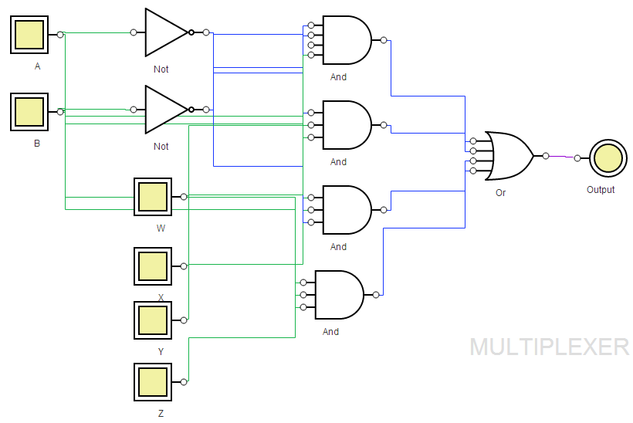
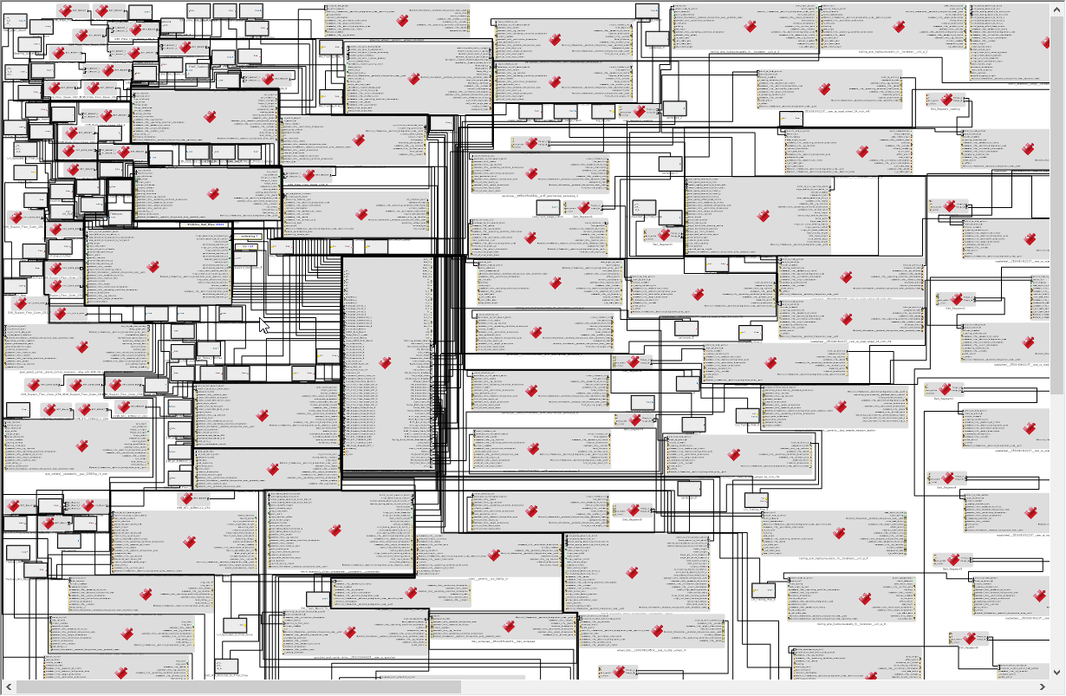
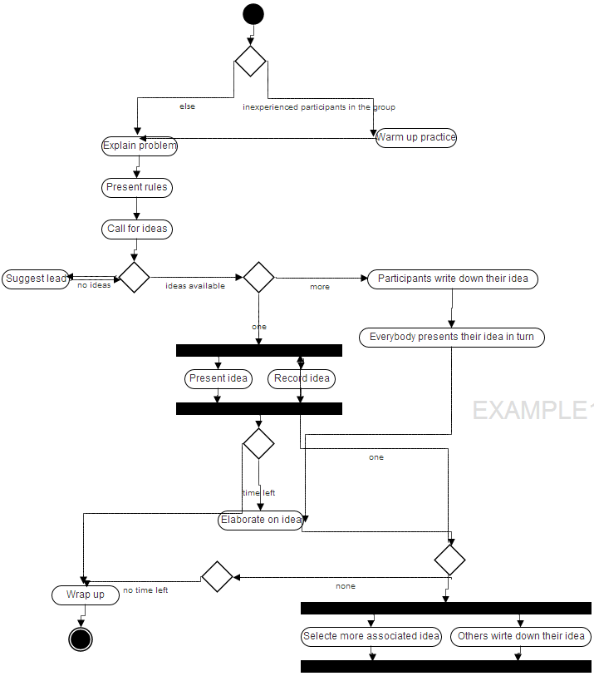
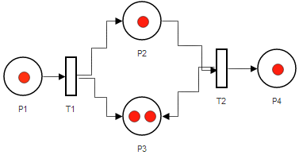
Paint Clear(er) Pictures
Straightforward representations of system structure & functionality (for instance, domain-specific visualization)
Familiar languages to engineers working in different domains
Notes:
Looking at the whole system and all of its interrelations is impractical for mortals.

Slide 48
Putting It Together- An Example
Baseline Scenario
SA application is designed to support a workflow involving real-time response
Take picture
Share with team
Application assumes an IP network, and assumes a server in the loop to facilitate communication
Full image + metadata to large number of clients who subscribed
Android Client
Android Client
Android Client
Server
Android Client
IP Network

Slide 49
Example Scenario: New Context
A new mission requirement came in
Collect pictures and field of view (FoV)
Deployment network has only SMS, no data (so no way to send pictures)
Share location and FoV of picture now, raw picture is sneaker netted later
This is a pre-deployment change
Assume the new requirement is given to us manually
Assume that DFUs that meet the new requirement exists
Assume the bootstrapping step is completed
Android Client
Android Client
Telephone Network
Android Client
SMS to small number of other clients

Slide 50
In the IMMoRTALS Repo
DFU1: read image from the phone’s file system
DFU2: encode the binary image using base64
DFU3: create XML document containing the base64 string
DFU4: Transmit the XML document to a remote server
DFU5: Update the display upon receipt of a reply message
DFU4 has a direct dependence on IP network and DFUs 1, 2 and 3 have dependencies as illustrated in figure
In addition
DFU2_X extracts location and FoV from image EXIF
DFU3_X is responsible for formatting the location and FoV in an SMS
DFU4_X is responsible for sending SMS and implementing reliability
DFU5_X is responsible for receiving SMS and sending ACK
Mobile app
3
2
4
1
5

Slide 51
Detection
An operator creates a semantic constraint specifying the unavailability of IP network
Constraint described in the resource DSL
Current product configuration fails this constraint. Furthermore
DFU4 is the initial culprit, and
DFU4 has other dependencies…

Slide 52
Adaptation Mechanics
Take 1: Reconstruct the path using DFU*_X
Test fails: not sure whether the SMS is received
Take 2: Modify the receive path (replace DFU5 by DFU5_X)
Success!
Mobile app
3
2
4
1
2X
4X
3X
SMS
5
Mobile app
3
2
4
1
2X
4X
3X
5
5X

Slide 53
Other Variations
Version 2: At runtime we detect that we lost IP networking
But our deployed package includes the DFUs that could be swapped.
This is a post-deployment/in mission change, illustrating anticipated change. The app is instrumented with detection and ability to dynamically load the appropriate implementation
Version 3: Need to support both IP and SMS
Another pre-deployment change but now both DFUs need to coexist
New dependencies and interferences

Slide 54
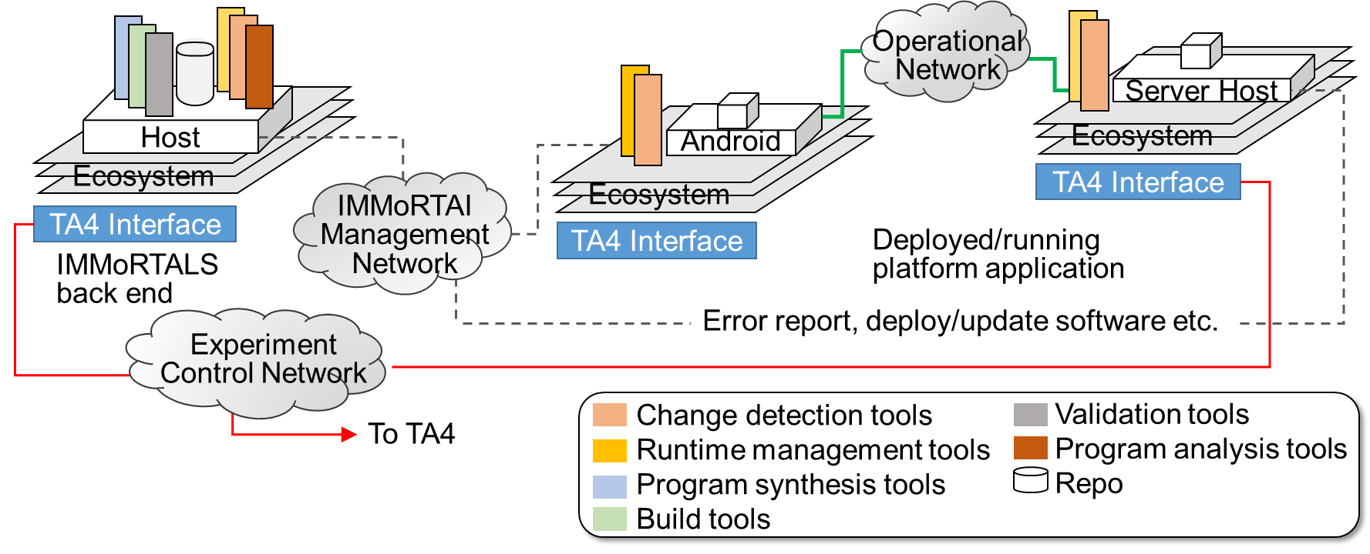
IMMoRTALS DAS and TA4 Interface
We have some ideas about the interface/API to cause runtime resource changes
The interface to introduce mission or other non-runtime ecosystem changes are currently manual: need at least the changed resource (new protocol to use, the library upgrade etc) and some sort of diff (of code, and/or functional spec)

Slide 55
Plans for Next Steps
Set up the platform integration test bed
Publish platform (APP + Server) v1 and CPs
Refine the lightweight ontology and DSL primitives
Infer models (static analysis, whole system analysis, mutation, schema)
Populate the DFU repository
Build Phase 1 CP change detectors
Build Phase 1 CP transforms
Integrate and Test
Refine
Next 5 moths
In 5 months after that
Last 6 months

Slide 56
Conclusion
Off to a rolling start
Platform offers lots of possibilities and is near and dear to our heart
Collection of innovative ideas that fit together nicely
Team of motivated experts from industry and academia, covering a wide swath of technology areas

Slide 57
Backups

