Slide 1
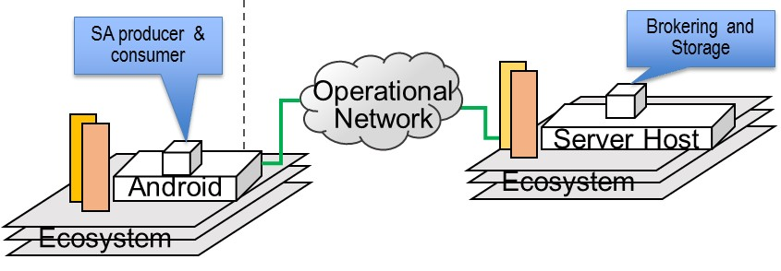
Deployment
Development
Program
Initial Intake
Ecosystem
Specification
Program Analysis
Program Synthesis
TA1 product
TA2 product
Repository of annotated PLA components
TA3 product
In use during mission
In use off line from the mission
Runtime Management
Test & Validate
Build
Deploy, redeploy
Iterative refinement of SPL variant for a given specification
Adaptation of running application
Monitor
Specification of a new variant
Changes in runtime system
(resource availability, anticipated changes)
Ecosystem changes,
Mission requirement changes

Slide 2
IMMoRTALS (Tactical SA) Platform
IMMoRTALS code base, build and test environment
Error report, deploy/update SW
IMMoRTALS Management Network
Host
Ecosystem
SA producer & consumer
Brokering and Storage
IMMoRTALS back end
Operational Network
Server Host
Android
Ecosystem
Ecosystem
Deployed/running platform application
Android Clients
Linux/Java Server
Backend
Change detection tools
Runtime management tools
Program synthesis tools
Build tools
Validation tools
Program analysis tools
Repo
y

Slide 3
ATAK SA producer & consumer
Marti Brokering and Storage
ATAK/Marti code base, build and test environment
Operational Network
Host
Server Host
Ecosystem
Android
Ecosystem
Ecosystem
(a) Development/Build view
(b) Deployment view
SA producer & consumer
Brokering and Storage
Operational Network
Server Host
Android
Ecosystem
Ecosystem

Slide 4


Candidate CP
Mobile app (client): upload a picture to a server, receive a picture from the server
Server: match the image metadata with the interest registered by (other) client(s), and send the image to the matching clients
Change drivers: variable client platform (device configurations); changing software requirements; uncertain network environment
network
server
image database
app
Easy to grasp
Covers a number of change drivers
Devices, Sensors, Mission, Library
Change may impact the server side as well
Has resource dependency on network, memory, and CPU (as we explore adaptations to fix– e.g., compress)

Slide 5

Responding to Changes
Various relationships this DFU is in
Essentially a collection of assorted models of our platform
@ annotations…
DFU
IMMoRTALS repository of annotated PLA components
Code
One of these is the EFS of this DFU
DFU’s resource dependency and usage
Ontologies
Ecosystem
DSL
Monitoring
New DSL “spec”
Discovery
Synthesis
Products
Resource
DFUs
who is affected in the product
do we have a DFU that works
New DFUs (if needed)
New product assembled
Tested
Iterated
Changes- deviation from the model view

Slide 6
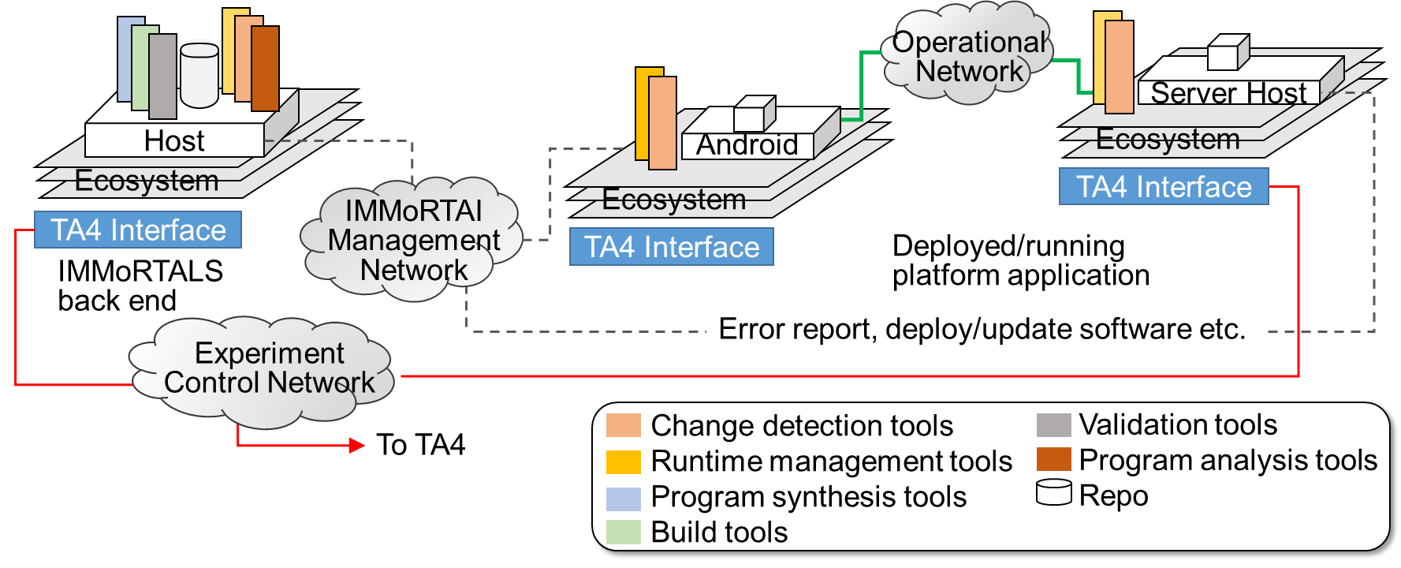
IMMoRTALS DAS and TA4 Interface
We have some ideas about the interface/API to cause runtime resource changes
The interface to introduce mission or other non-runtime ecosystem changes are currently manual: need at least the changed resource (new protocol to use, the library upgrade etc) and some sort of diff (of code, and/or functional spec)

