Slide 1


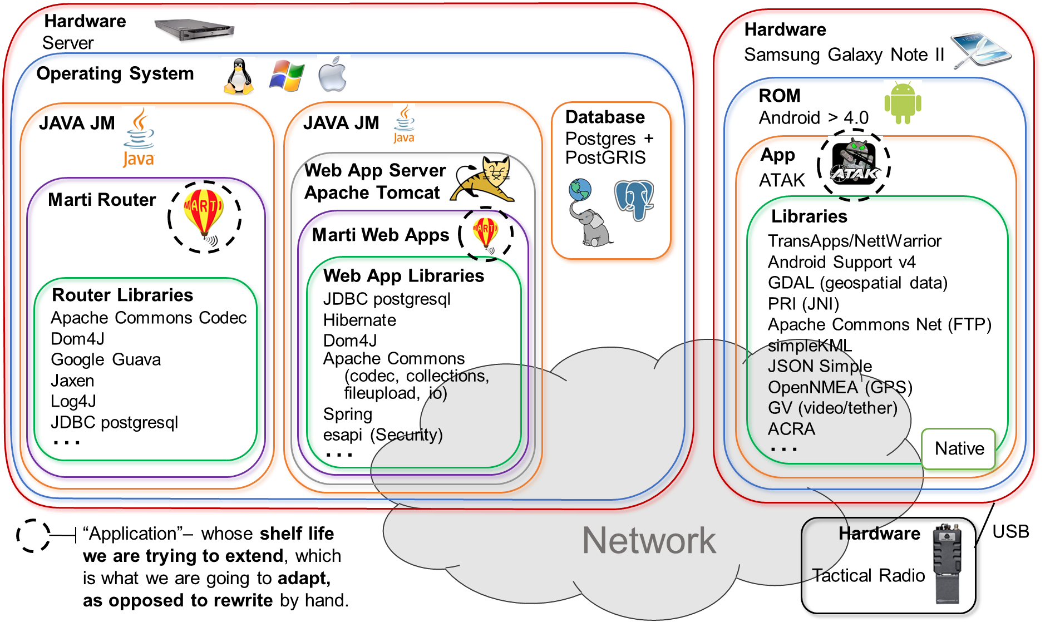
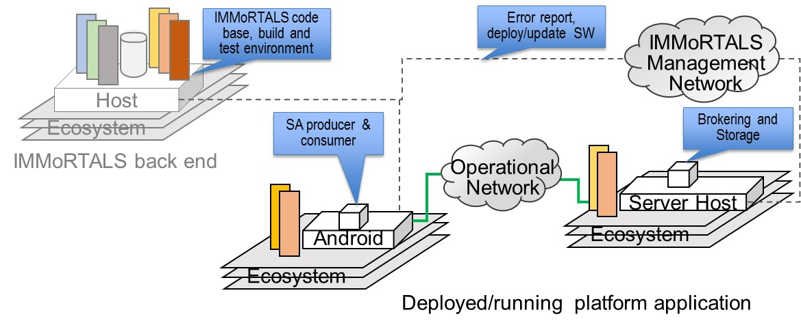
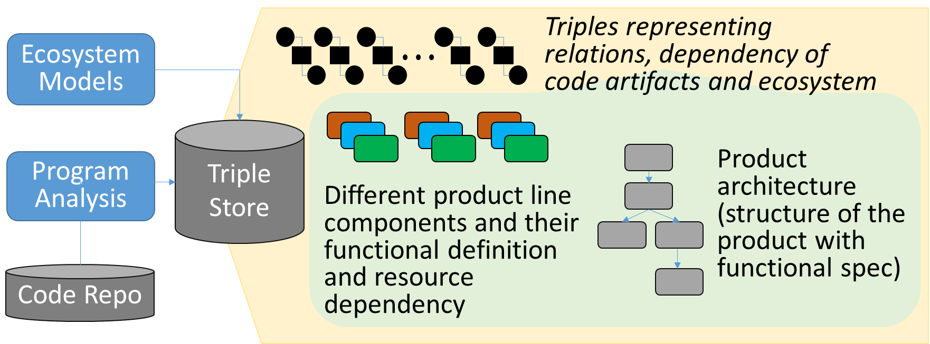
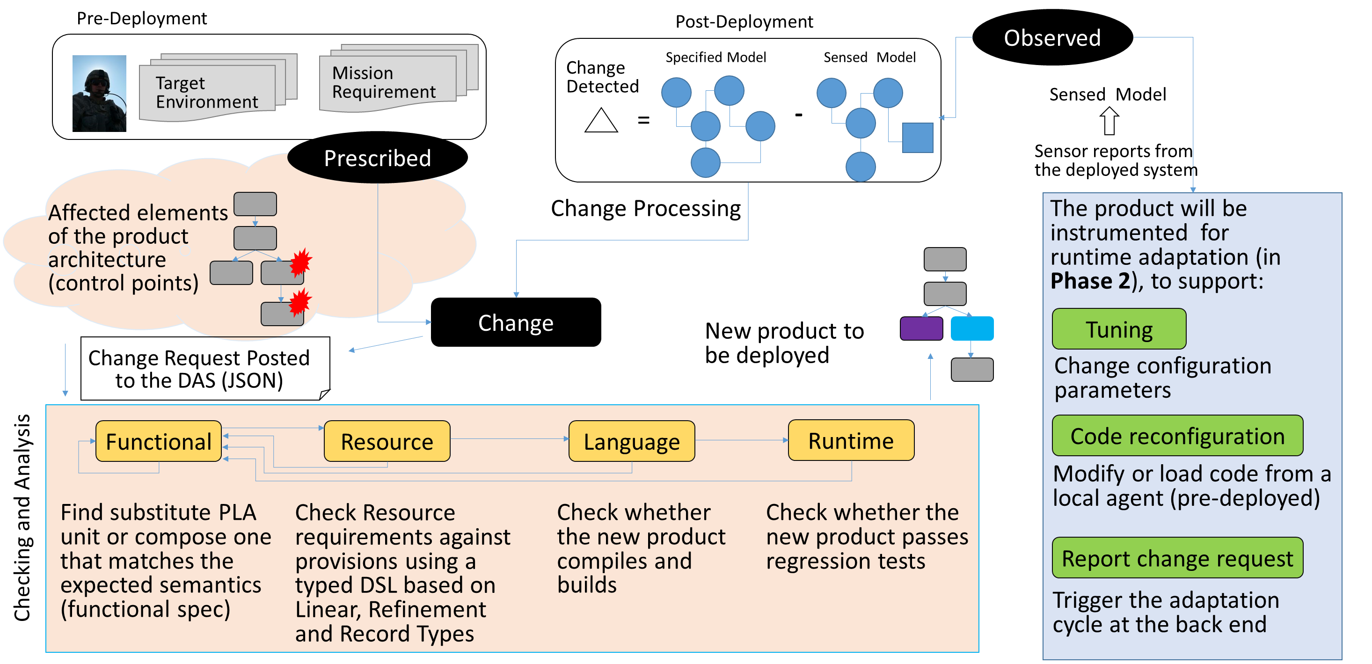


Interfaces, Models and Monitoring for Resource Aware Transformations that Augment the Lifecycle of Systems (IMMoRTALS)
IMMoRTALS PLATFORM
IMMoRTALS ASSUMPTIONS
Functional specification is provided
Extra functional dependency and specification is inferred
Not every line of the application is evolvable, only the point of use of PLA components are
Any more to add??
IMMoRTALS DAS
IMMoRTALS DAS Initialization
IMMoRTALS DAS Workflow
Phase I Challenge Problems
CP2: Handling the effect of deployment scale
Baseline application is sharing images for situational awareness
Sample perturbations
Number of clients, resolution requirement, frequency
Available bandwidth
Adaptation: Offline and online (Phase 2); change parameters, composition
Possible extensions: Add encryption requirement→ composition
CP1: Mission requirement about location data collection changes
Baseline used GPSLocation
Sample perturbations in the new mission
New environment does not have GPS signal
New hardware does not have GPC receiver
New mission requires trusted location info
Adaptation: Offline/pre-deployment; find substitute component
Possible extensions: Data at rest requirements→ composition
OSU
Vanderbilt
Syracuse

Slide 2
Scratch Pad

Slide 3
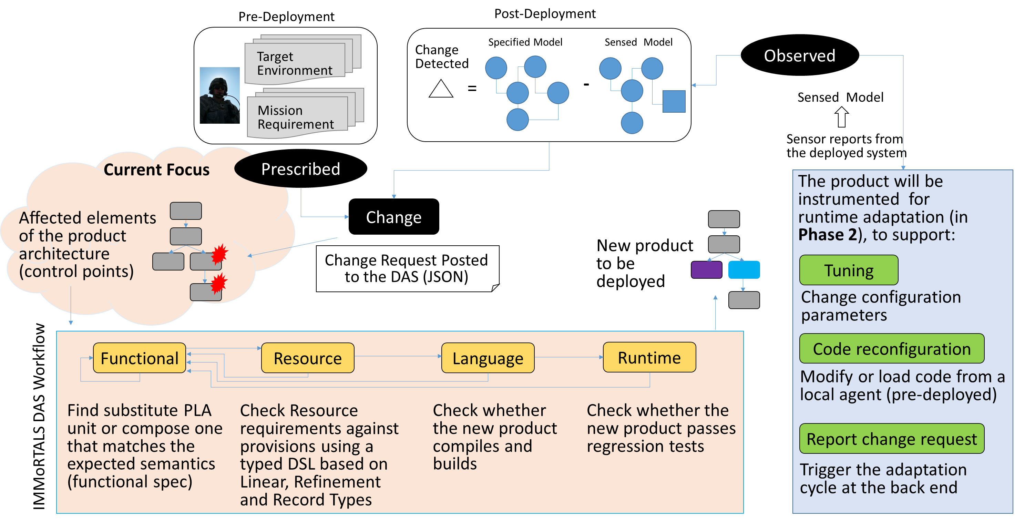
Interfaces, Models and Monitoring for Resource Aware Transformations that Augment the Lifecycle of Systems (IMMoRTALS)
Functional specification is provided
Extra functional dependency and specification is inferred
Not every line of the application is evolvable, only the point of use of PLA components are
Ecosystem Models
Triples representing relations, dependency of code artifacts and ecosystem
Program Analysis
Knowledge Repository
Different product line components and their functional definition and resource dependency
Product architecture (structure of the product with functional spec)
Code Repo
Benefits
Challenge Problems
Benefit 1
Benefit 2
Benefit 3
OSU
Vanderbilt
Syracuse

Slide 4
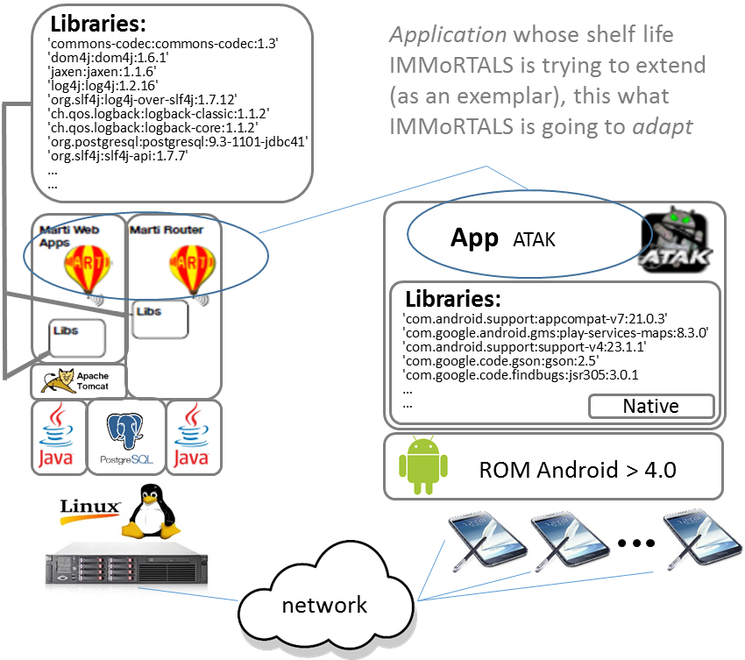
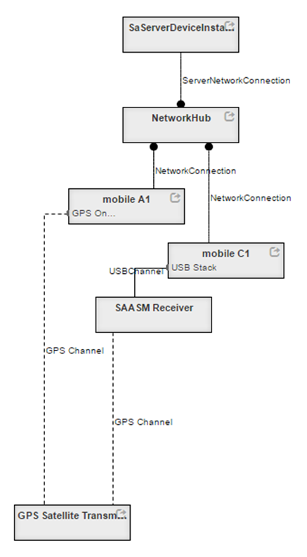
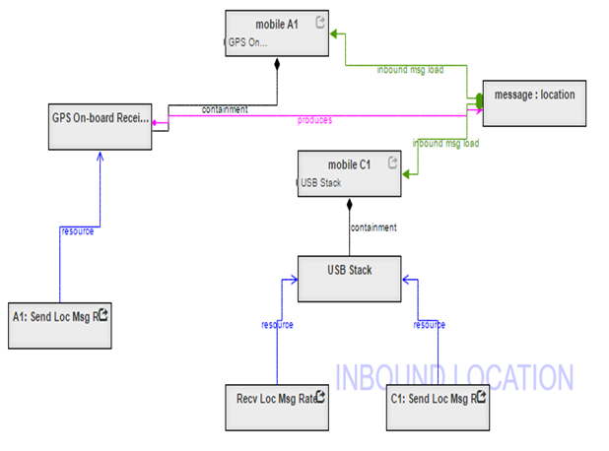
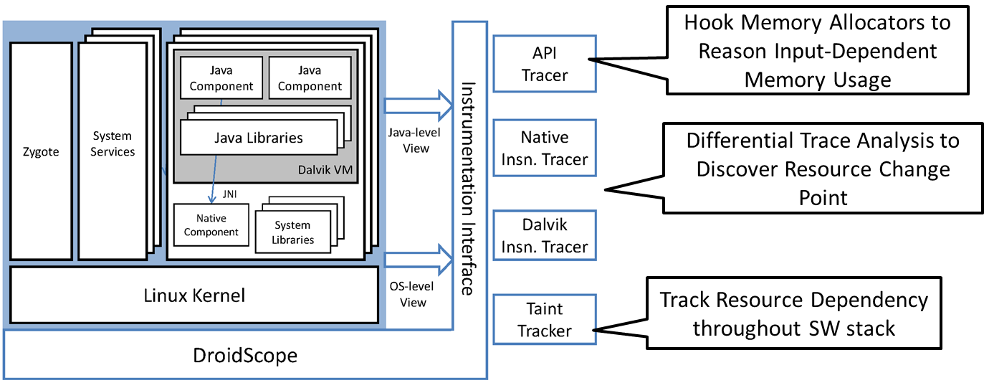
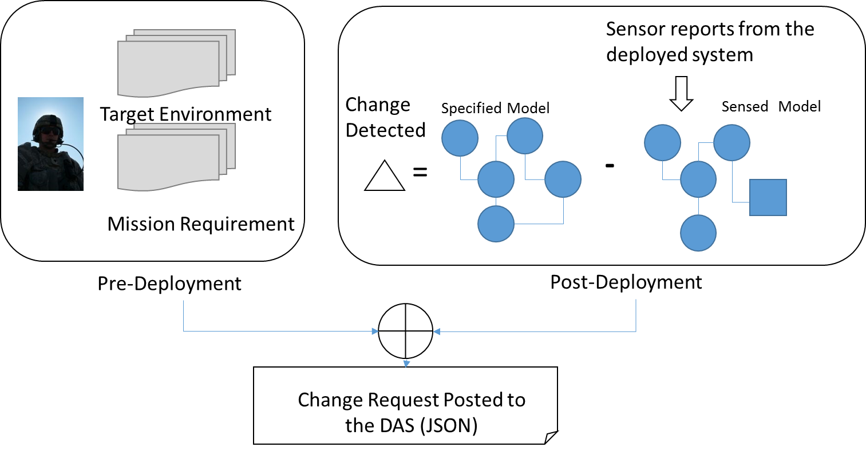
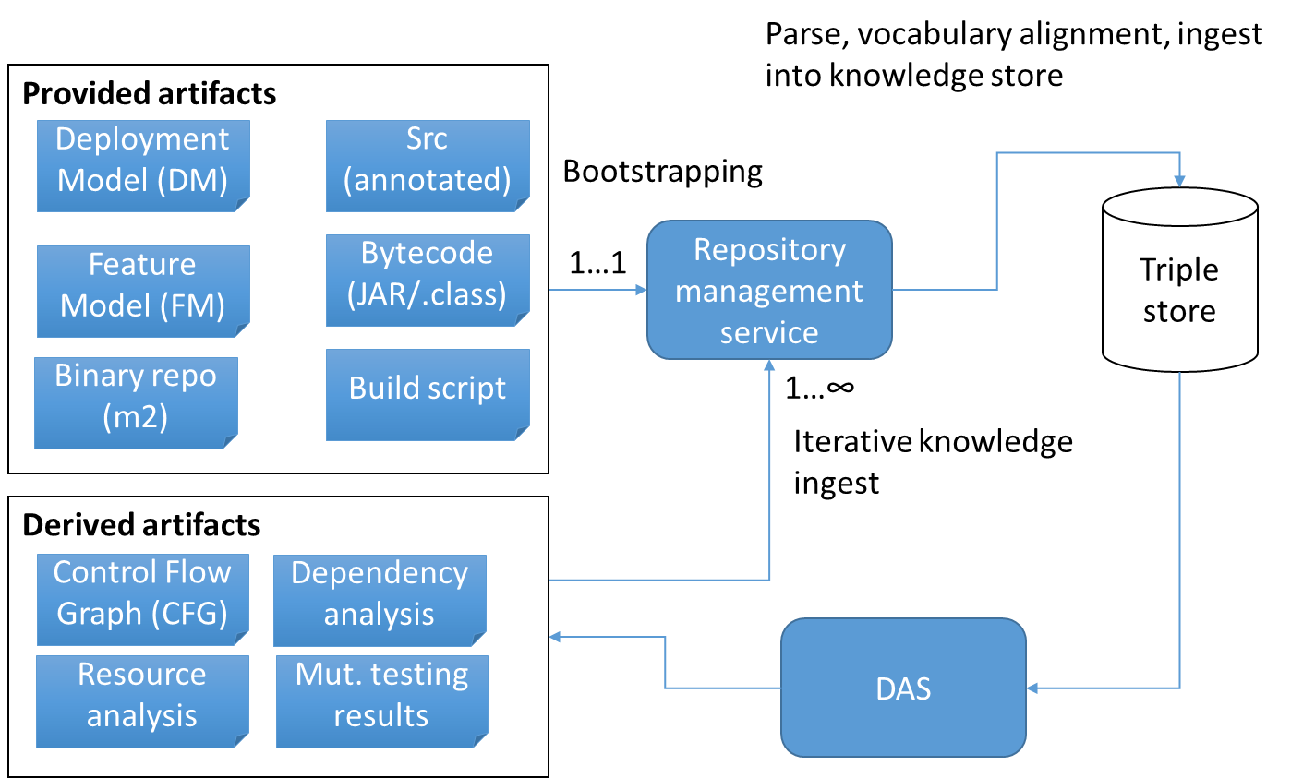
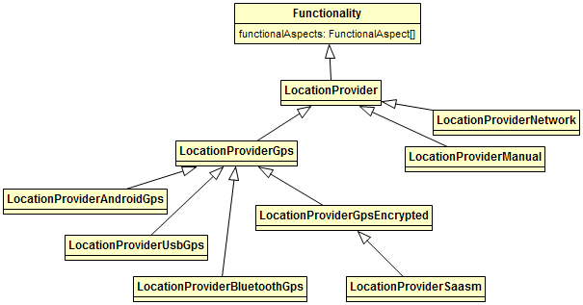
Interfaces, Models and Monitoring for Resource Aware Transformations that Augment the Lifecycle of Systems (IMMoRTALS)
Platform
Model of the Ecosystem
(See Poster X )
Assumptions
Functional specification is provided
Extra functional dependency and specification is inferred
Not every line of the application is evolvable, only the point of use of PLA components are
Approach
Program Analysis to Discover Extra-Functional Dependencies and Resource Requirements
The IMMoRTALS DAS
(see Poster Y)
Ontology backing and knowledge ingestion
(see Poster Z)
Mutation analysis to detect dependency and resource
DAS work flow:
Sparql match
DSL
Compile
Build
Recycle
(see Poster A)
Benefits
Challenge Problems
Benefit 1
Benefit 2
Benefit 3
OSU
Vanderbilt
Syracuse

Slide 5
Interfaces, Models and Monitoring for Resource Aware Transformations that Augment the Lifecycle of Systems (IMMoRTALS)
Platform
Assumptions
Model of the Ecosystem
Functional specification is provided
Extra functional dependency and specification is inferred
Not every line of the application is evolvable, only the point of use of PLA components are
(See Poster X )
Program Analysis to Discover Extra-Functional Dependencies and Resource Requirements
Approach
(see Poster Y)
The IMMoRTALS DAS
Ontology backing and knowledge ingestion
(see Poster Z)
Mutation analysis to detect dependency and resource
(see Poster A)
Benefits
Challenge Problems
Benefit 1
Benefit 2
Benefit 3
OSU
Vanderbilt
Syracuse

Slide 6
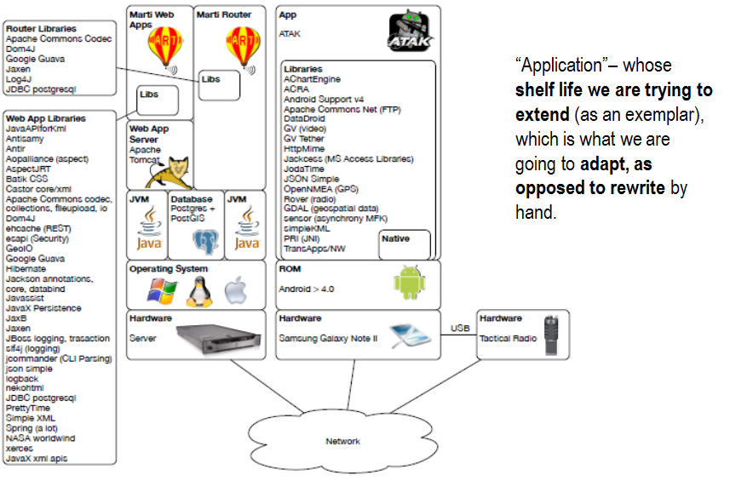






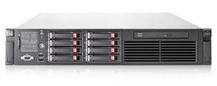
















Libraries:
Application whose shelf life IMMoRTALS is trying to extend (as an exemplar), this what IMMoRTALS is going to adapt
'commons-codec:commons-codec:1.3' 'dom4j:dom4j:1.6.1' 'jaxen:jaxen:1.1.6' 'log4j:log4j:1.2.16' 'org.slf4j:log4j-over-slf4j:1.7.12' 'ch.qos.logback:logback-classic:1.1.2' 'ch.qos.logback:logback-core:1.1.2' 'org.postgresql:postgresql:9.3-1101-jdbc41' 'org.slf4j:slf4j-api:1.7.7' …
…
App ATAK
Libraries:
'com.android.support:appcompat-v7:21.0.3' 'com.google.android.gms:play-services-maps:8.3.0' 'com.android.support:support-v4:23.1.1' 'com.google.code.gson:gson:2.5' 'com.google.code.findbugs:jsr305:3.0.1
…
…
Native
ROM Android > 4.0
network
Provided artifacts
Parse, vocabulary alignment, ingest
into knowledge store
Deployment Model (DM)
Src (annotated)
Bootstrapping
Feature Model (FM)
Bytecode
(JAR/.class)
1…1
Repository management service
Triple store
Binary repo (m2)
Build script
1…∞
Iterative knowledge
ingest
Derived artifacts
Control Flow Graph (CFG)
Dependency analysis
DAS
Resource analysis
Mut. testing results
Resources | How to extract (Dynamic Analysis of Android Apps)
CPU | hook each instruction
Memory Usage | operator new
3rd Party libraries | parse java level function calls
Bluetooth | android.bluetooth.BluetoothAdapter.getDefaultAdapter()
GPS | android.location.LocationManager.requestLocationUpdates()
SMS | android.telephony.SmsManager.getDefault()
Wifi | android.net.wifi.WifiManager.setWifiEnabled()
Audio | android.media.AudioRecord.startRecording()
Camera | android.hardware.Camera.takePicture()
DeviceID | android.telephony.TelephonyManager.getDeviceId()
Hardware
Hardware
Server
Samsung Galaxy Note II
Operating System
ROM
JAVA VM
JAVA VM
Database
Postgres + PostGRIS
Android > 4.0
Web App Server Apache Tomcat
App
Marti Router
ATAK
Marti Web Apps
Libraries
Web App Libraries
TransApps/NettWarrior
Android Support v4
GDAL (geospatial data)
PRI (JNI)
Apache Commons Net (FTP)
simpleKML
JSON Simple
OpenNMEA (GPS)
GV (video/tether)
ACRA
…
Router Libraries
JDBC postgresql
Hibernate
Dom4J
Apache Commons (codec, collections, fileupload, io)
Spring
esapi (Security)
…
Apache Commons Codec
Dom4J
Google Guava
Jaxen
Log4J
JDBC postgresql
…
Native
“Application”– whose shelf life we are trying to extend, which is what we are going to adapt, as opposed to rewrite by hand.
Network
Hardware
USB
Tactical Radio

Slide 7


Target Environment
Sensor reports from the deployed system
Mission Requirement
Change Detected
Specified Model
Sensed Model
=
-
Pre-Deployment
Post-Deployment
Change Request Posted to the DAS (JSON)
Ecosystem Models
Triples representing relations, dependency of code artifacts and ecosystem
Program Analysis
Knowledge Repo
Product architecture (structure of the product with functional spec)
Different product line components and their functional definition and resource dependency
Code Repo
Pre-Deployment
Post-Deployment
Observed
Target Environment
Mission Requirement
Change Detected
Specified Model
Sensed Model
=
-
Sensed Model
Prescribed
Sensor reports from the deployed system
Affected components of the product architecture (control points)
Change Processing
The product will be instrumented for runtime adaptation (in Phase 2), to support:
Change
New product to be deployed
Tuning
Change Request Posted to the DAS (JSON)
Change configuration parameters
Functional
Resource*
Language*
Runtime*
Code reconfiguration
Modify or load code from a local agent (pre-deployed)
Checking and Analysis
Find substitute PLA components, compose one that matches the expected semantics (functional spec), insert adapters or translators
Check resource requirements against provisions using a typed DSL based on Linear, Refinement and Record Types
Check whether the new product compiles and builds
Check whether the new product passes regression tests
DAS failed
to find a solution
Report change request
These steps may need developer assistance
Trigger the adaptation cycle at the back end
* Feeds additional info back to left enabling different choices

