Slide 1


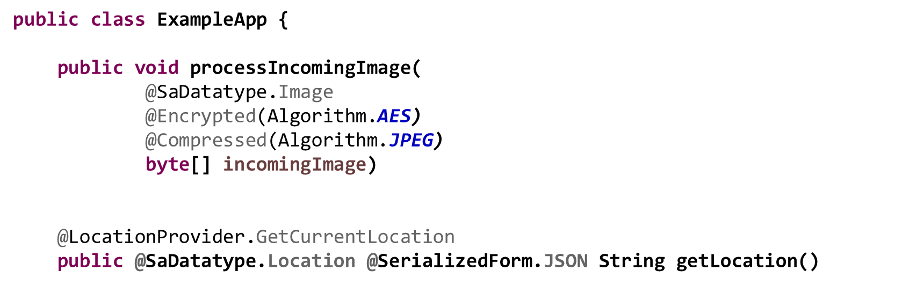
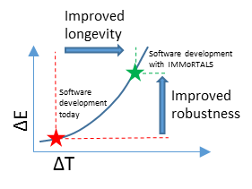
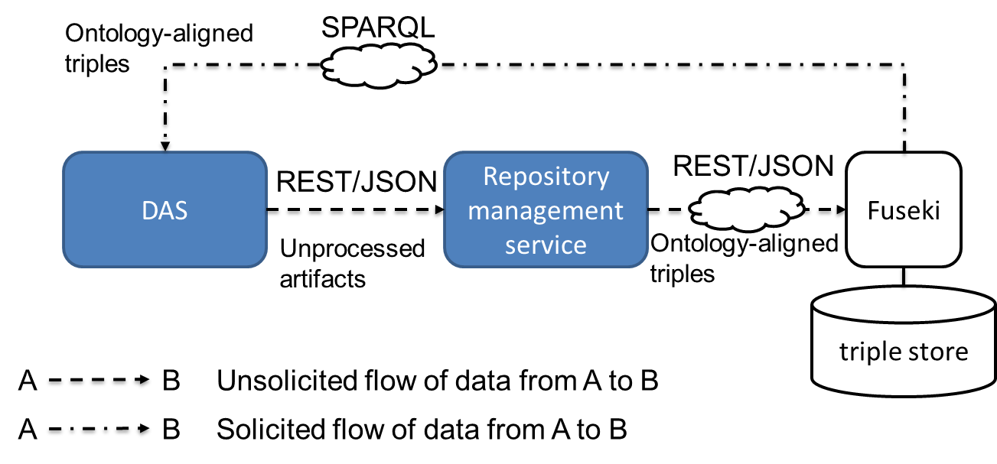
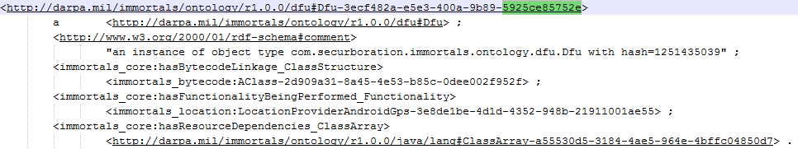


Semantic models for IMMoRTAL software [DRAFT]
TODO
TODO
Abstract
Context and goals
Technical challenges
We have developed a vocabulary and programming language bindings for describing the functional and extra-functional properties of software.
We have created a suite of tools that parse and manipulate linked, semantic models expressed in terms of this vocabulary to automatically adapt software to operate under conditions that manifest after development.
Software is fragile; maintenance is expensive and difficult to do properly
Vulnerabilities and bugs require continuous patching and maintenance
Ecosystem changes accumulate over time and degrade software
Mission requirements remain fixed at the state of the final software development iteration
Software is increasingly interconnected meaning and changes to shared services can unintentionally damage many other components
Goal of this work is to facilitate the creation of effectively immortal software by
modeling intended program functionality as Discrete Functional Units (DFUs)
modeling the ecosystem in which software is intended to execute
modeling DFU dependencies on the ecosystem
detect changes in the ecosystem and work backward to determine their impact on software
create mechanisms for automatically synthesizing patches and repair logic
Minimize programmer overhead
We require programmer inputs. We don’t want to burden developers unduly. How can we utilize few inputs for maximum effect?
Create a lint-like compiler plugin for alerting programmers when they have provided incomplete or erroneous abstractions
Augment programmer-provided inputs with static and dynamic analysis
Develop an expressive annotation-based DSL that can be autonomously mapped to and validated against our core modeling abstractions
Auto generate this DSL from the model schema
Parse annotations from compiled bytecode and use to instantiate model abstractions
Deal with changes in models
Abstractions change over time, how can we deal with this?
Create extensible models that will provide value to a variety of software domains
Modular models based on semantic web technologies
Create axioms sufficient to infer new knowledge. E.g., SPIN
TODO
ConOps
TODO
Annotation DSL
Bytecode inspection and
instrumentation
semantic
models
Results
TODO
Adaptation
Jacob Staples
Software Engineer, Securboration
jstaples@securboration.com
Lee Krause
Founder, Securboration
lkrause@securboration.com

