Slide 1


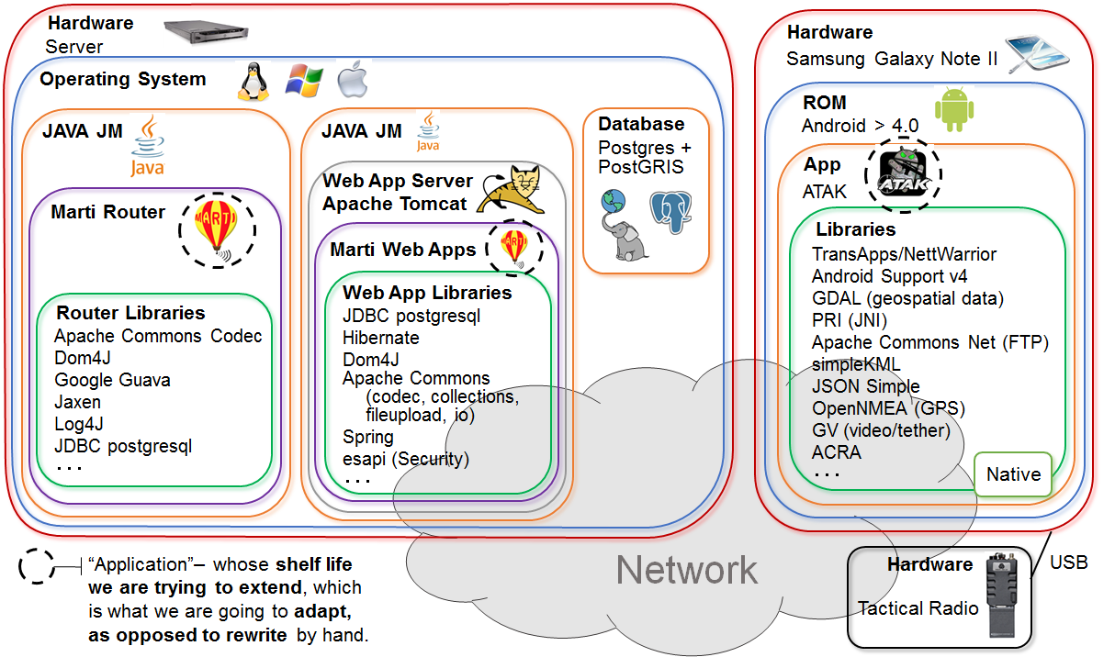
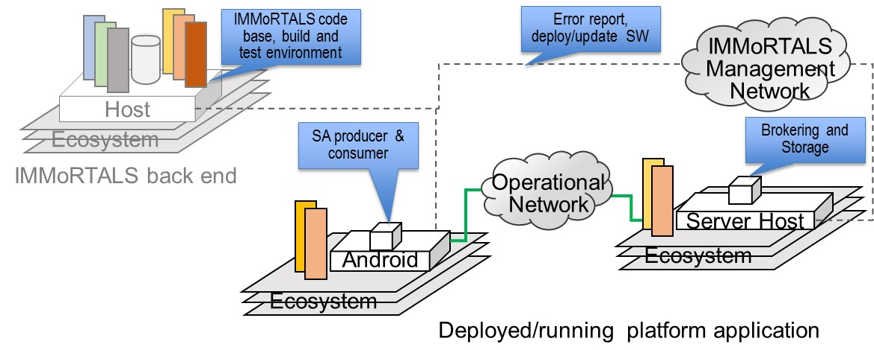
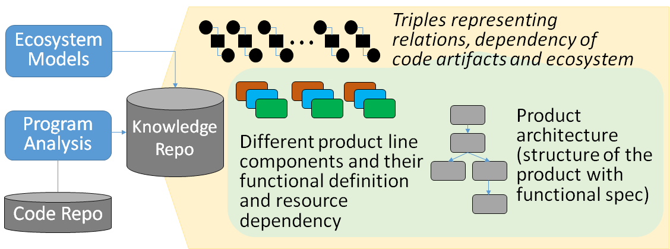
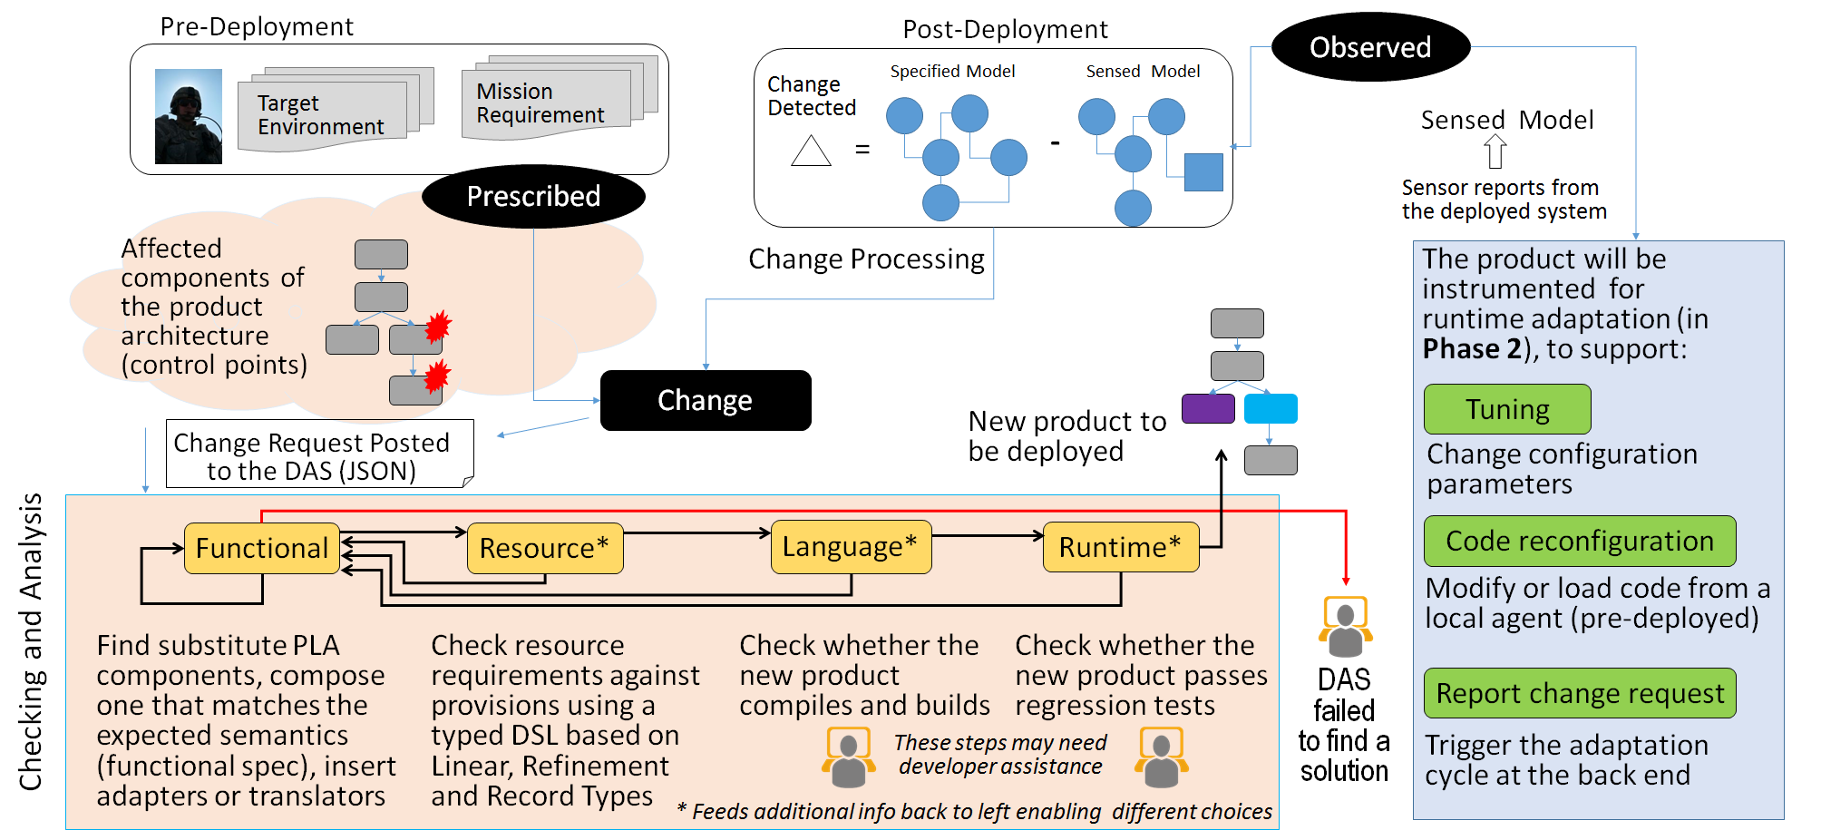






Interfaces, Models and Monitoring for Resource Aware Transformations that Augment the Lifecycle of Systems (IMMoRTALS)
IMMoRTALS PLATFORM
IMMoRTALS ASSUMPTIONS
Applications are built as a software product line (well-defined architecture and components)
Functional specification is provided
Extra functional dependency and specification is inferred
Not every line of the application is evolvable, only the point of use of PLA components are
IMMoRTALS DAS
IMMoRTALS DAS Initialization
IMMoRTALS DAS Workflow
Phase I Challenge Problems
CP2: Handling the effect of deployment scale
Baseline application is sharing images for situational awareness
Sample perturbations
Number of clients, resolution requirement, frequency
Available bandwidth
Adaptation: Offline and online (Phase 2); substitute or eliminate inefficient components, change parameters, composition
Possible extensions: Add encryption requirement→ composition
CP1: Mission requirement about location data collection changes
Baseline used GPSLocation
Sample perturbations in the new mission
New environment does not have GPS signal
New hardware does not have GPC receiver
New mission requires trusted location info
Adaptation: Offline/pre-deployment; find substitute component
Possible extensions: Data at rest requirements→ composition
Matt Gillen (PI), Austin Wellman, Peter Samouelian, Partha Pal 7/11/2016

