Slide 1
BBN Integration with MIT LL Test Harness
2017-1-10

Slide 2



Key IMMoRTALS System Components
B
TS
Baseline apps
Validation
tests
TH
Test Action Messages
TA
OR
Test Control Messages
Generated app
Summary
results
DAS
KB
Checker
TH Log
Test log
Test
Data
DASLog
FS
LL-provided component
Communication channel defined in this API
Performer-provided component
Not defined in this API
Challenge Problem system

Slide 3
Phase 1 CP1

Slide 4
Mission Scenario
Tactical situation awareness - Mission Requirements Regarding Location Collection
Supporting tactical situational awareness applications over changing mission requirements and availability of location providing services.

Slide 5
Perturbations
// mission requirement
trustedLocations: false, no_constraint;
// environment and hardware constraints
gpsSatellites: True, no_constraint;
bluetooth: True, no_constraint;
usb: True, no_constraint;
internalGps: True, no_constraint;
userInterface: True, no_constraint;

Slide 6
Test Data
None

Slide 7
Baseline Stage A (see communications API v1.1 for description)
DAS adaptation turned OFF for this stage
The TS will evaluate the system behavior by running the validation tests
Using the baseline client and server applications
Using the mission and location providers described in the TH validateBaselineApplication message (if specified)
This stage is invoked by calling validateBaselineApplication
URI: http://brass-ta/action/validateBaselineApplication
Body description of message = Optional, if None the system will use the “baseline parameters”
Baseline Stage A executes tests against the system with the original (non-adaptive) software running on the server and clients under in a mission and environment reflective of what was expected when the SW was written (baseline scenario)
Notes:
validateBaselineApplication
URI: http://brass-ta/action/validateBaselineApplication
Description : Submit a validation request to the for the baseline application.
Body Description: (optional) The deployment model to base the environment on. If omitted, the baseline environment will be used.
Body Example (From immortals_repo/harness/sample_submission.json):
{
"server": {
"bandwidth": 1000
},
"clients": [
{
"imageBroadcastIntervalMS": "2000",
"latestSABroadcastIntervalMS": "1000",
"count": 2,
"presentResources" : [
"bluetooth",
"usb",
"internalGps",
"userInterface",
"gpsSatellites"
],
"requiredProperties" : [
"trustedLocations"
]
}
],
"minimumRunTimeMS": 30000
}
Return Value: TA_STATE object containing the identifier. Additional POSTs will be made to the TH with an updated TA_STATE object updated as events occur.

Slide 8
Baseline Stage A Interaction Test Control and Test Action Messages
TH
TA
Test Control Messages
Defined in the communication API
Test Action Messages
Done – POST http://brass-th/action/done
alt
DAS_ERROR
DAS_READY
TH_ACK/TH_ERROR
validateBaselineApplication
TA_ACK/TA_ERROR
done
TH_ACK/TH_ERROR

Slide 9
Baseline Stage B (see communications API v1.1 for description)
DAS adaptation turned OFF for this stage
The TS will evaluate the system behavior by running the validation tests
Using the baseline client and server applications
Using the mission and location providers described in the TH validateBaselineApplication message
This stage is invoked by calling validateBaselineApplication
URI: http://brass-ta/action/validateBaselineApplication
Body description of message = should be configured by the TH to represent a specific test
Notes:
validateBaselineApplication
URI: http://brass-ta/action/validateBaselineApplication
Description : Submit a validation request to the for the baseline application.
Body Description: (optional) The deployment model to base the environment on. If omitted, the baseline environment will be used.
Body Example (From immortals_repo/harness/sample_submission.json):
{
"server": {
"bandwidth": 1000
},
"clients": [
{
"imageBroadcastIntervalMS": "2000",
"latestSABroadcastIntervalMS": "1000",
"count": 2,
"presentResources" : [
"bluetooth",
"usb",
"internalGps",
"userInterface",
"gpsSatellites"
],
"requiredProperties" : [
"trustedLocations"
]
}
],
"minimumRunTimeMS": 30000
}
Return Value: TA_STATE object containing the identifier. Additional POSTs will be made to the TH with an updated TA_STATE object updated as events occur.

Slide 10
Baseline Stage B Interaction Test Control and Test Action Messages
TH
TA
Test Control Messages
Defined in the communication API
Test Action Messages
Done – POST http://brass-th/action/done
alt
DAS_ERROR
DAS_READY
TH_ACK/TH_ERROR
validateBaselineApplication
TA_ACK/TA_ERROR
done
TH_ACK/TH_ERROR

Slide 11
Challenge Stage (see communications API v1.1 for description)
DAS adaptation turned ON for this stage
The DAS will analyze the mission and location service to see if there is a solution
If solution exists proceed to validation testing; If no solution exists send MISSION_ABORTED and quit
The TS will evaluate the system behavior by running the validation tests
Using the DAS generated client and server applications
Using the mission and location providers described in the TH adaptAndValidateApplication message
This stage is invoked by calling adaptAndValidateApplication
URI: http://brass-ta/action/adaptAndValidateApplication
Body description of message = should be configured by the TH to represent the same test previously described in Baseline Stage B

Slide 12
Challenge Stage Interaction Test Control and Test Action Messages
TH
TA
Test Control Messages
Defined in the communication API
Test Action Messages
Done – POST http://brass-th/action/done
alt
DAS_ERROR
DAS_READY
TH_ACK/TH_ERROR
adaptAndValidateApplication
TA_ACK/TA_ERROR
optional*
PERTURBATION_DETECTED
TH_ACK/TH_ERROR
alt
MISSION_ABORTED
ADAPTING and/or ADAPTION_COMPLETED
TH_ACK/TH_ERROR
done
* Only expected if the mission & environment parameters are different from the baseline
TH_ACK/TH_ERROR

Slide 13
API Functions
Test Control Messages
Fully defined in the MIT LL communications API
Test Action Messages (defined on MIT wiki and captured on next couple slides)
validateBaselineApplication
adaptAndValidateApplication
done
Test Data (configuration file)
None
DAS Log
Fully defined in the MIT LL communications API

Slide 14
API Test Action validateBaselineApplication
validateBaselineApplication
URI: http://brass-ta/action/validateBaselineApplication
Description : Submit a validation request to the for the baseline application.
Body Description: (optional) The deployment model to base the environment on. If omitted, the baseline environment will be used.
Body Example (From immortals_repo/harness/sample_submission.json):
{
"server": {
"bandwidth": 1000
},
"clients": [
{
"imageBroadcastIntervalMS": "2000",
"latestSABroadcastIntervalMS": "1000",
"count": 2,
"presentResources" : [
"bluetooth",
"usb",
"internalGps",
"userInterface",
"gpsSatellites"
],
"requiredProperties" : [
"trustedLocations"
]
}
]
}
Return Value: IM_TA_STATE object containing the identifier. Additional POSTs will be made to the TH with an updated IM_TA_STATE object updated as events occur.
See wiki for up to date description:
https://wikis.mit.edu/confluence/display/BRASS/ImmortalsTestAndEvaluation

Slide 15
API Test Action adaptAndValidateApplication
adaptAndValidateApplication
URI: http://brass-ta/action/adaptAndValidateApplication
Description : Submit an adaption request to the DAS and validate it in the corresponding environment configuration.
Body Description: (mandatory) The deployment model to submit to the DAS and base the environment on.
Body Example (From immortals_repo/harness/sample_submission.json):
{
"server": {
"bandwidth": 1000
},
"clients": [
{
"imageBroadcastIntervalMS": "2000",
"latestSABroadcastIntervalMS": "1000",
"count": 2,
"presentResources" : [
"bluetooth",
"usb",
"internalGps",
"userInterface",
"gpsSatellites"
],
"requiredProperties" : [
"trustedLocations"
]
}
]
}
Return Value: IM_TA_STATE object containing the identifier. Additional POSTs will be made to the TH with an updated IM_TA_STATE object updated as events occur.
See wiki for up to date description:
https://wikis.mit.edu/confluence/display/BRASS/ImmortalsTestAndEvaluation

Slide 16
API Test Action done
done
URI: http://brass-th/action/done
Description : Returns the results of the completed operations of the last TEST_ACTION message and indicates a terminal state for the associated TEST_ACTION
Body: IM_TA_STATE object
See wiki for up to date description:
https://wikis.mit.edu/confluence/display/BRASS/ImmortalsTestAndEvaluation

Slide 17
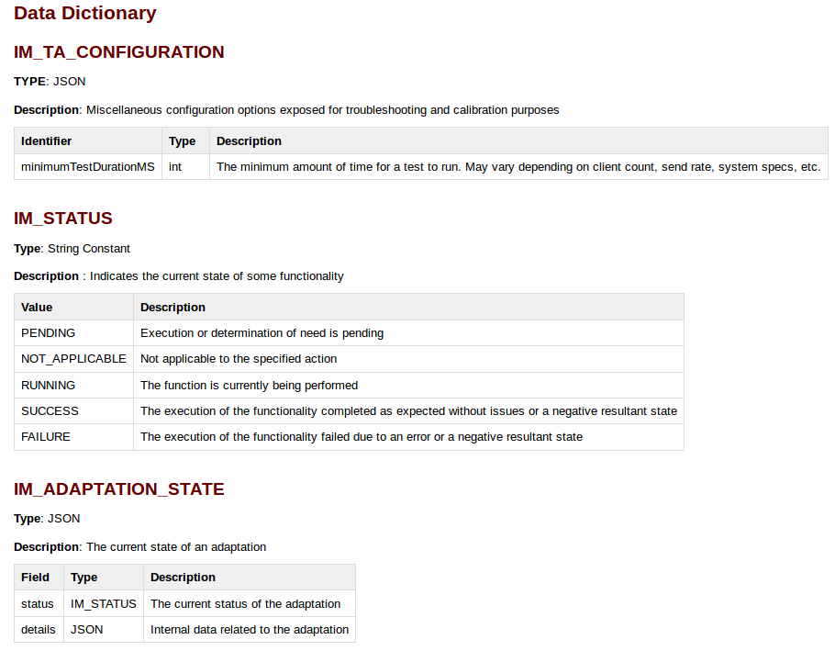
Data Dictionary
See wiki for up to date description:
https://wikis.mit.edu/confluence/display/BRASS/ImmortalsTestAndEvaluation
Based on context I interpret this as the state of running each validation test (IM_VALIDATION_STATE on slide 18)
Since you are only sending a single done message none of these should be PENDING, NOT_APPLICABLE or RUNNING
Confusing as it sounds like it represents DAS status which is defined as a test control message in the comm. API

Slide 18
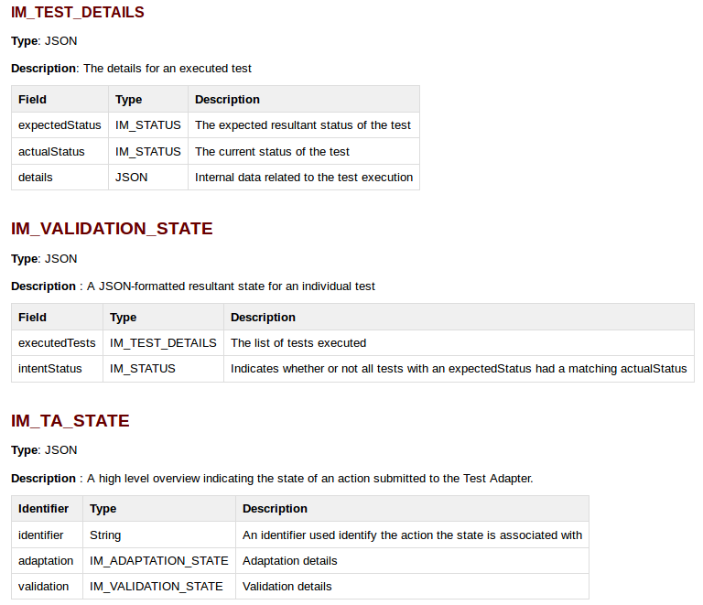
Data Dictionary
Yes, we need the key (expectedStatus) to understand what tests were run and whether they were meant to pass/fail.
See wiki for up to date description:
https://wikis.mit.edu/confluence/display/BRASS/ImmortalsTestAndEvaluation
I’m assuming intentStatus represents the overall computation of the verdict expression over all of the individual validation tests described in IM_TEST_DETAILS

Slide 19
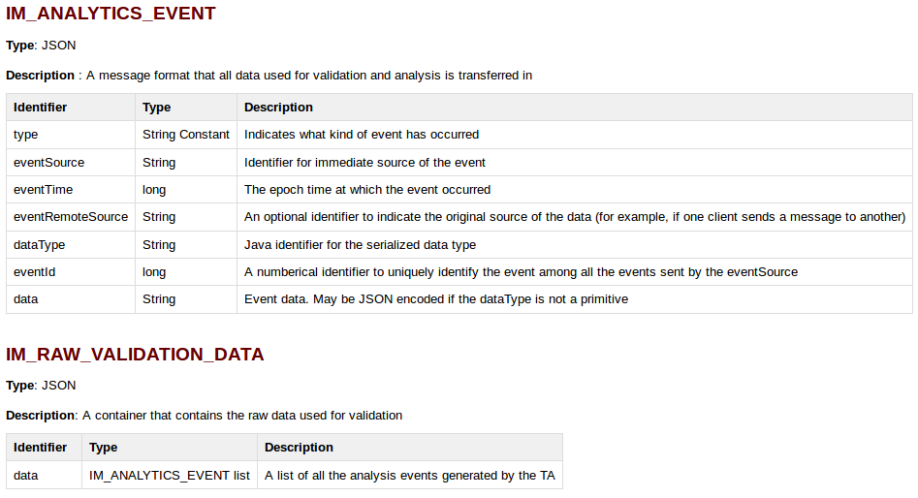
Data Dictionary
See wiki for up to date description:
https://wikis.mit.edu/confluence/display/BRASS/ImmortalsTestAndEvaluation
Yes, the raw data necessary to compute the verdict expression.
I’m assuming this will contain the raw bandwidth usage (and timing of SA messages relevant to the verdict expression calculation) for CP2.

Slide 20
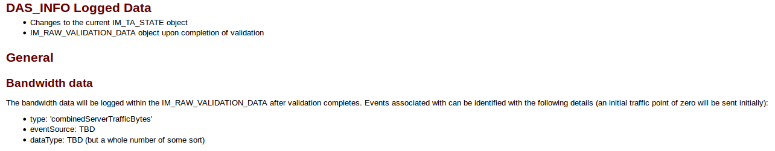
API Misc.
It is fine to log info listed here. However it is key that the same info is sent to the TH as part of the done message definition.
It is fine to log info listed here. However it is key that the same info is sent to the TH as part of the done message definition.
See wiki for up to date description:
https://wikis.mit.edu/confluence/display/BRASS/ImmortalsTestAndEvaluation

Slide 21
MIT LL Executing a Smoke Test
Bring up VM
Execute
Baseline Stage A
Baseline Stage A provides a smoke test for the system upon delivery and is expected to ALWAYS pass

Slide 22
MIT LL Executing Tests
Bring up VM
Execute
Baseline Stage B
Execute
Challenge Stage
Execute in parallel
or
serialize in another test enclave
Bring up VM
Execute
Challenge Stage
Baseline Stage B and Challenge Stage presented with the same test parameters
BBN currently believes we should be able to run a single instance in Baseline Stage B → Challenge Stage
However, they have not actually tested this way
LL can expect 100% reliability in running the Challenge Stage in parallel or serially (by starting up a new test enclave with same parameters after running Baseline Stage B)

Slide 23
Phase 1 CP2

Slide 24
Mission Scenario
Tactical situation awareness - Handling the impact of changes in deployment scale and other factors that impact resource consumption
Supporting tactical situational awareness applications over changing environment constraints, mission requirements (update rate and number of clients) are scaled.

Slide 25
Perturbations
// network capacity
bandwidth : 1000, range (0, 10000000)
// number of client devices
count: 2, range (2, 20)
// time between SA reports (in milliseconds)
latestSABroadcastIntervalMS: 2000, range(1000, 60000)
// time between image reports (in milliseconds)
imageBroadcastIntervalMS: 1000, range(1000, 60000)

Slide 26
Test Data
None

Slide 27
MIT LL Interactions
SAME interaction model as CP1
different perturbations
done message definition will be different than CP1

Slide 28
BBN Actions (to be resolved via email/phone prior to next call 1/12)
Verdict expressions for each CP need to be defined and shared with LL (posted on the wiki)
What the contents of the done messages should contain for both CPs
For CP1 this is likely a listing of the validation tests run and their PASS/FAIL criteria
Team will also provide LL with a comprehensive list of input variables mapping to expected PASS/FAIL criteria
For CP2 we discussed obtaining more than the output of the automated checker PASS/FAIL. You should also send us the raw products to calculate that the mission requirements (message rate) and environment constraints (max bandwidth) are being respected
In Baseline Stage B (slide 10) decide whether your system will analyze the mission/environment spec and immediately respond with MISSION_ABORTED or whether it will run the validation tests and report failures (respond in context of both CPs)
Fixed in slides
If there is any uncertainty that you cannot send all results in one message then plan on developing a done message to let the test harness when a particular stage of testing is finished
Decided to keep done message endpoint – removed results endpoint
Think more about Slide 14 – whether there should be any reset commands and/or if we should just plan on running the challenge stage in a different test enclave (i.e. different VM)
Tests will be serialized, no need to optimize this process in Phase 1

