Slide 1
Mutation testing work for IMMORTALS
Arpit Christi, Alex Groce
Oregon State University
Feb 2017

Slide 2
Mutation work
Program P -> Mutant P’
Different view of mutant for RASS work
Restricted functionality -> Reduction, Altered functionality -> Replacement
Intuition for RASS – P and P’ can’t be drastically different
Small changes happening at local level, empirical evidence
Annotated (labeled) test suite (manual vs automatic annotations)
Tool for reduction and replacement (only reduction currently)
Usage in both discovery and analytics
Notes:
Intution – Mutant P’ is still useful program that is going to replace original program, It will still execute most of the functionality in more or less similar way, When resource adaptation happens, they cannot be drastically different.

Slide 3
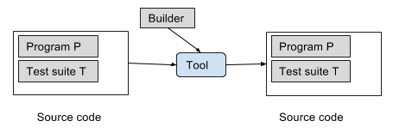
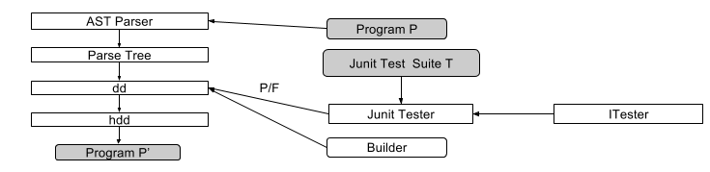
Tool - JReduce
Combines deletion mutation with Hierarchical Delta Debugging (HDD) algorithm
Annotated (labeled) test suite and Program as input
Multiple reduced version of program as output, based on test annotations (labels)
HDD – guarantees minimality and convergence
Leverage existing test suite, minimal pre processing
Factors intuition, early exit criteria possible
Empirical evaluation – tool is widely applicable, changes are small and local (other heuristics?)
Test suite annotations – developer provided or automatically generated
Notes:
Intution – Mutant P’ is still useful program that is going to replace original program, It will still execute most of the functionality in more or less similar way, When resource adaptation happens, they cannot be drastically different.

Slide 4
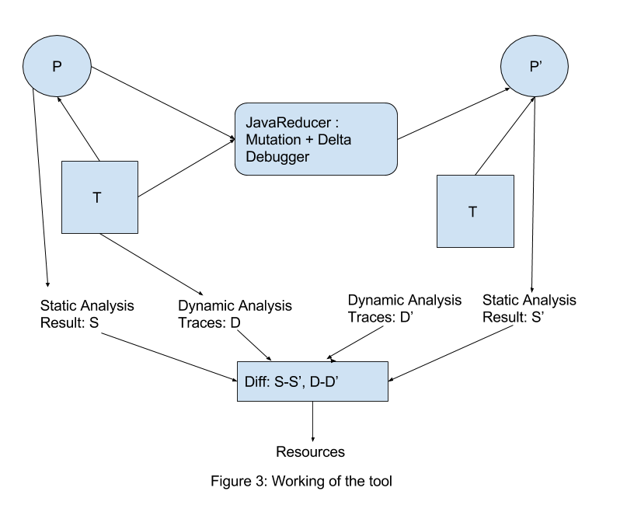
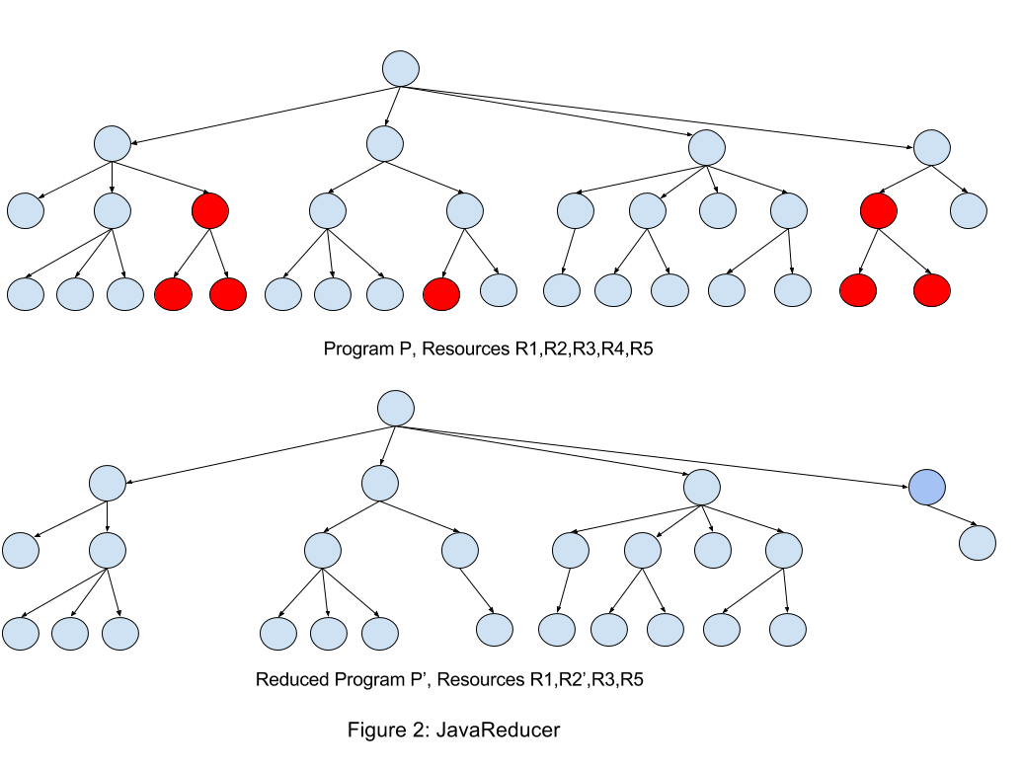
Discovery and analytics
Discovery – Diff of original and mutated Program, diff of static analysis and dynamic analysis results
Analytics – Annotated test suite, resource consumption of tests, Applies reduction and replacement to build new components
Tie everything back to the test suite
Keep pre-computed mutants or generate dynamically
Heuristics to quickly generate mutants
Notes:
Intution – Mutant P’ is still useful program that is going to replace original program, It will still execute most of the functionality in more or less similar way, When resource adaptation happens, they cannot be drastically different.

Slide 5
Research problems
Where does a small change in functionality (restriction or alteration) manifest itself in the program for RASS?
Automating reductions for RASS, leveraging existing test suites
Partially automating replacements
Heuristics: especially more heuristics to enable runtime adaptation.
Effective ways to capture restricted and altered functionality using test suite and empirical analysis.
Runtime testing of adaptations using annotated test suite, Towards Run-Time Testing of Dynamic Adaptive Systems – Fredrericks, Ramirez, Cheng.
Notes:
Intution – Mutant P’ is still useful program that is going to replace original program, It will still execute most of the functionality in more or less similar way, When resource adaptation happens, they cannot be drastically different.

Slide 6
Completed vs ongoing work
Completed
JReduce – tool for reduction
Empirical evaluation of reductions
Some heuristics
few levels from leaf node
Ongoing
Looking for more heuristics + leveraging other methods
Pruning of nodes based on analysis
Bytecode level runtime reductions
Planned
Automatic replacements
Enhancing test suite for adaptation testing
Notes:
Intution – Mutant P’ is still useful program that is going to replace original program, It will still execute most of the functionality in more or less similar way, When resource adaptation happens, they cannot be drastically different.

