Slide 1
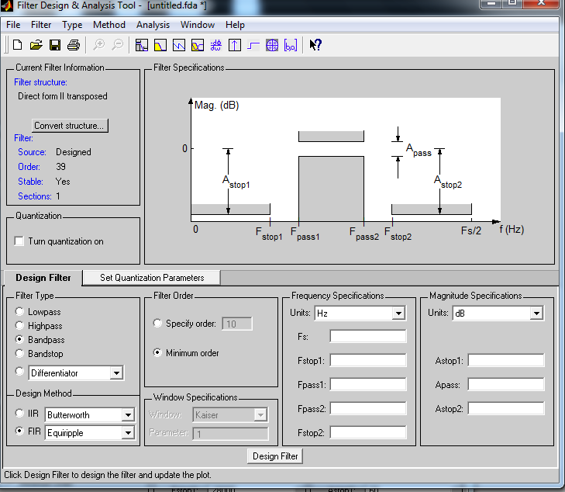
Describing Frequency Content of a Measurement
FrequencyContent
FrequencyBand
BandType: StopBand
EdgeFrequency:
<= 28000 Hertz
Attenuation:
>= 60 dB
FrequencyBand
BandType: PassBand
EdgeFrequency:
>= 29500 Hertz
<= 50500 Hertz
Attenuation:
>= -0.5 dB
<= 0.5 dB
FrequencyBand
BandType: StopBand
EdgeFrequency:
>= 52000 Hertz
Attenuation:
>= 60 dB

Slide 2
Describing Frequency Content of a Measurement
FrequencyContent
FrequencyBand
BandType: StopBand
EdgeFrequency:
<= 28000 Hertz
Attenuation:
>= 60 dB
FrequencyBand
BandType: PassBand
EdgeFrequency:
>= 29500 Hertz
<= 50500 Hertz
Attenuation:
>= -0.5 dB
<= 0.5 dB
FrequencyBand
BandType: StopBand
EdgeFrequency:
>= 52000 Hertz
Attenuation:
>= 60 dB

Slide 3
Describing Frequency Content of a Measurement
FrequencyContent
FrequencyBand
BandType: StopBand
EdgeFrequency:
<= 28000 Hertz
Attenuation:
>= 60 dB
FrequencyBand
BandType: PassBand
EdgeFrequency:
>= 29500 Hertz
<= 50500 Hertz
Attenuation:
>= -0.5 dB
<= 0.5 dB
FrequencyBand
BandType: StopBand
EdgeFrequency:
>= 52000 Hertz
Attenuation:
>= 60 dB

