Slide 1
Image Segmentation: Comparative Study
Team 15
Aaryan CO21BTECH11001
Aayush CO21BTECH11002
Darpan Gaur CO21BTECH11004
Varun Gupta CS21BTECH11060

Slide 2
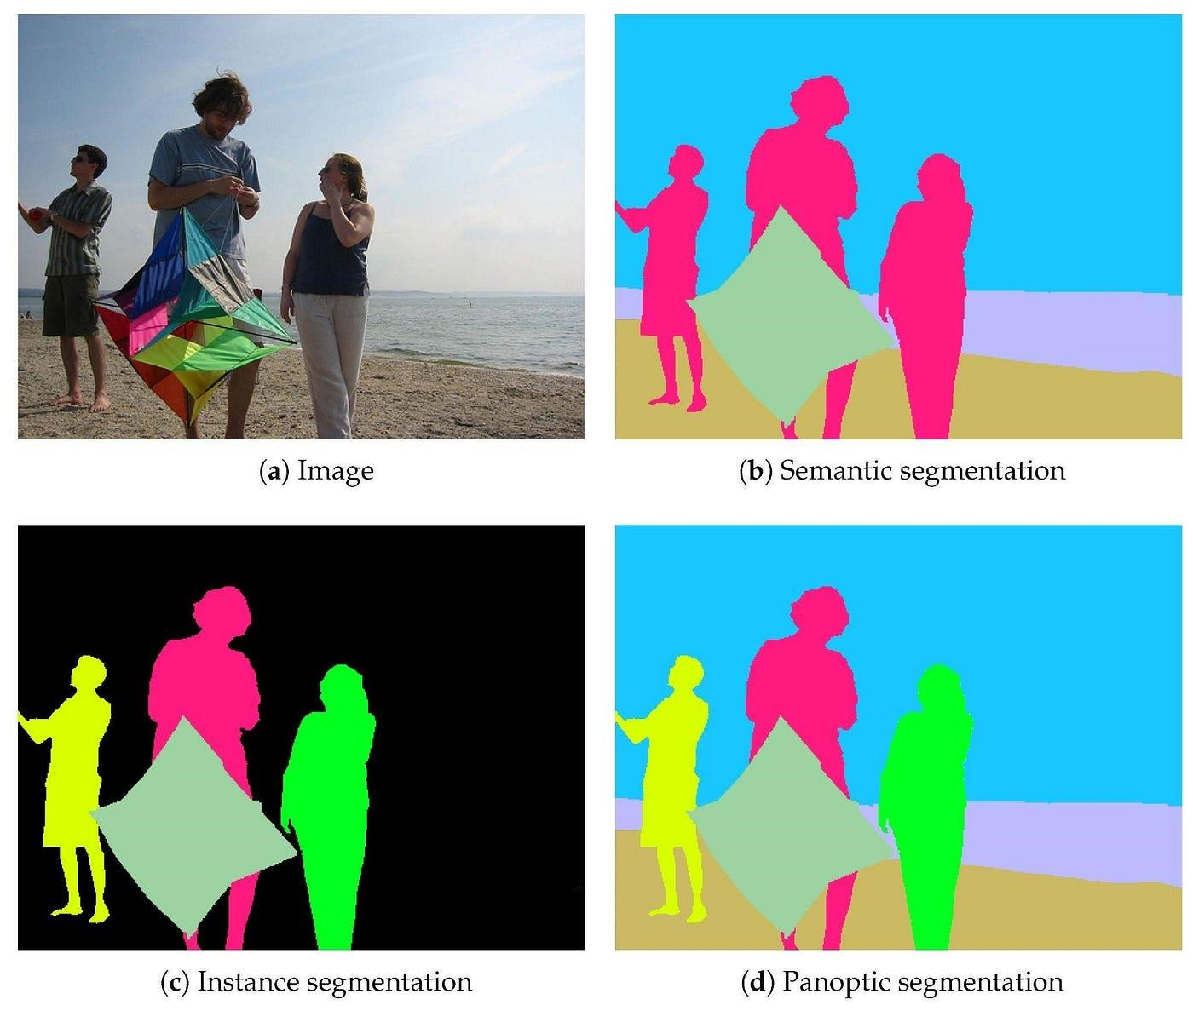
Introduction & Motivation
Image segmentation is a crucial task in computer vision, aiming to partition an image into meaningful regions or objects
Types of segmentation
Semantic Segmentation
Instance Segmentation
Paponic Segmentation
Use Cases:
Medical imaging
Autonomous driving
Satellite analysis
Jung, S.; Heo, H.; Park, S.; Jung, S.-U.; Lee, K. Benchmarking Deep Learning Models for Instance Segmentation. Appl. Sci. 2022, 12, 8856. https://doi.org/10.3390/app12178856

Slide 3
Problem Statement (1 or 2 slides)
Comprehensive comparative analysis of following for image segmentation:
CNN
GNN
Transformers
Task: Semantic Segmentation
Identify their respective advantages and shortcomings

Slide 4
CNN Architectures for Image Segmentation
Aspect | FCN | UNet++ | DeepLabV3+
Key Innovation | Fully convolutional | Nested dense skip connections | Atrous convolutions, ASPP
Strengths | Simple, flexible | Fine-grained segmentation | Multi-scale context
Weakness | Coarse output details | Slightly higher computation | Computationally expensive
Best Use Case | General segmentation | Medical imaging | Complex scenes
Jonathan Long, Evan Shelhamer, and Trevor Darrell. Fully convolutional networks for semantic segmentation. In Proceedings of the IEEE Conference on Computer Vision and Pattern Recognition, pages 3431–3440, 2015.
Zongwei Zhou, Md Mahfuzur Rahman Siddiquee, Nima Tajbakhsh, and Jianming Liang. Unet++: A nested u-net architecture for medical image segmentation. Deep learning in medical image analysis and multimodal learning for clinical decision support, 2019.
Liang-Chieh Chen, Yukun Zhu, George Papandreou, Florian Schroff, and Hartwig Adam. Encoder-decoder with atrous separable convolution for semantic image segmentation. In Proceedings of the European Conference on Computer Vision (ECCV), pages 801–818, 2018.

Slide 5
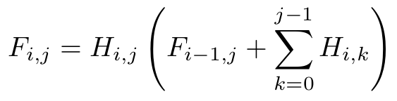
UNet++
Nested Skip Connections: Multiple intermediate nodes that refine and combine features from various paths
Deep Supervision: Attached output layers at multiple decoder levels, allows direct influence of loss function at different depths
Feature Fusion: Decoder node fuses information from preceding layers via up-sampling and skip connections from encoder
Advantages:
Captures detailed water boundaries
Performs well on smaller datasets, limitation in flood studies
Manageable computation cost compared to DeepLabV3+

Slide 6
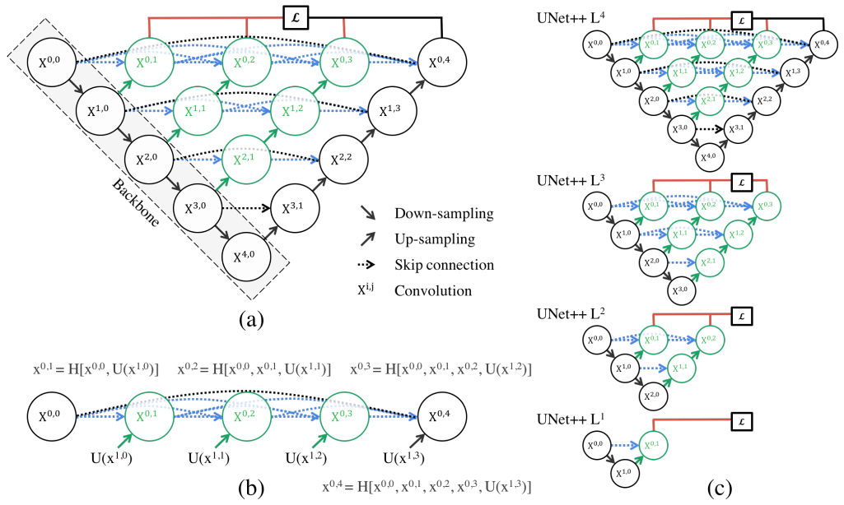
Zongwei Zhou, Md Mahfuzur Rahman Siddiquee, Nima Tajbakhsh, and Jianming Liang. Unet++: A nested u-net architecture for medical image segmentation. Deep learning in medical image analysis and multimodal learning for clinical decision support, 2019.

Slide 7
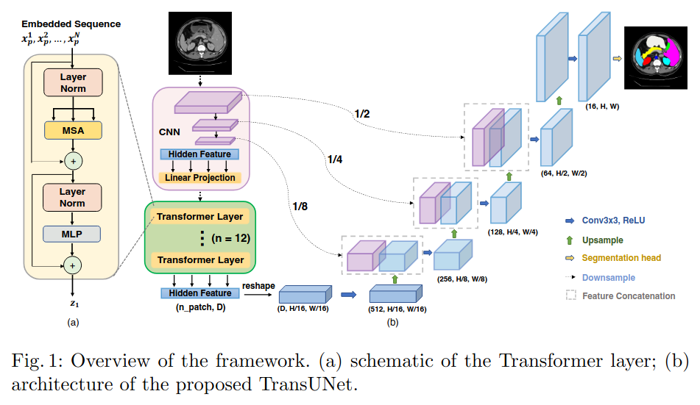
TransUnet
TransUNet employs a hybrid CNN-Transformer architecture to leverage both detailed high-resolution spatial information from CNN features and the global context encoded by Transformers.
Allows us to leverage the intermediate high-resolution CNN feature maps in the decoding path
Performs better than simply using pure Transformer block as encoder
Jieneng Chen, Yongyi Lu, Qihang Yu, Xiangde Luo, Ehsan, Adeli, Yan Wang, Le Lu, Alan L. Yuille, and Yuyin Zhou. Transunet: Transformers make strong encoders for medical image segmentation, 2021

Slide 8
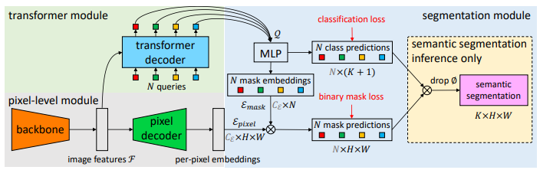
MaskFormer and Mask2Former
MaskFormer
Unified approach for both semantic and instance segmentation tasks
Instead of classifying each pixel into classes, it predicts N binary masks
For every binary mask, predict the category
CNN based backbone to get image features
Pixel embedding generated by CNN based decoder
Mask embeddings generated by Transformer decoder
Mask2Former
Claimed as a better version of MaskFormer
Uses masked attention
Few other specific optimizations
Bowen Cheng, Alexander G. Schwing, and Alexander Kirillov. Per-pixel classification is not all you need for semantic segmentation, 2021
Bowen Cheng, Ishan Misra, Alexander G. Schwing, Alexander Kirillov, and Rohit Girdhar. Masked-attention mask transformer for universal image segmentation, 2022
Notes:
Query: Learnable embeddings intialized to some value.
N: number of masks predicted. K: number of categories. Each mask is assigned a category.
N > K to ensure that each object gets a unique mask in case of instance segmentation.

Slide 9
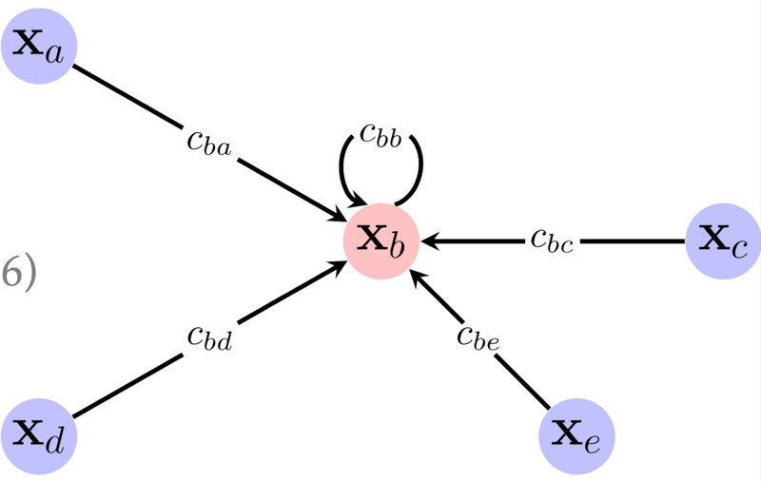
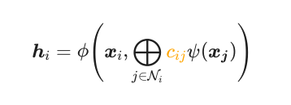
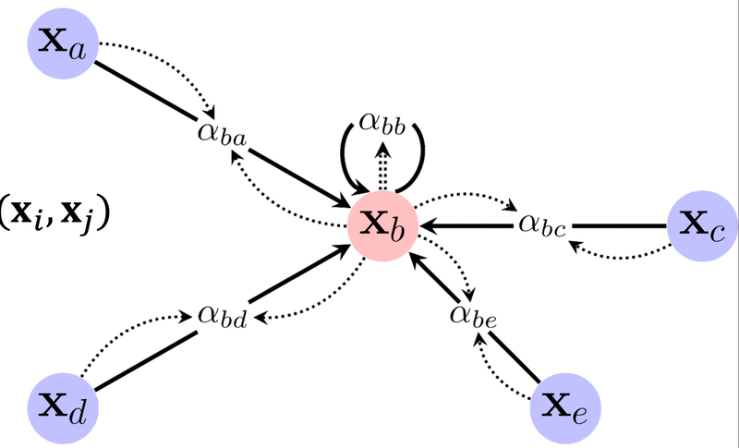
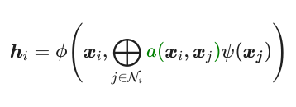
GCN
GAT
Assign predefined weights to neighbors, reflecting their relative importance to a node. Do a pointwise transformation to all of our node features.
Every node will compute a weighted combination of all of its neighbors based on the coefficients.
Replace c_{ij} constant coefficient with an attention function that takes features of x_{i} and x_{j} and produces a scalar.
https://a-j.gitbook.io/geometric-deep-learning/graphs-ii

Slide 10
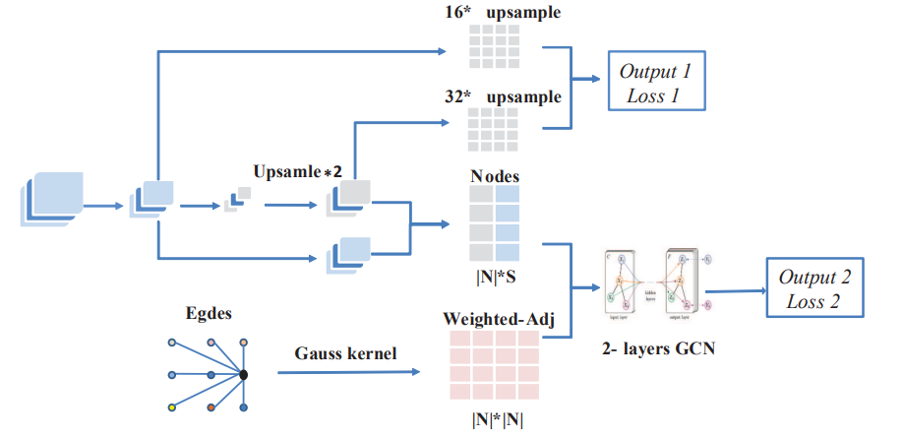
Graph-FCN
Graph-FCN combines Graph Convolutional Networks (GCNs) and Fully Convolutional Networks (FCNs) to capture local spatial relationships in images for semantic segmentation.
FCN generates feature maps, initializes node annotations using sampled maps and node locations, and pools raw label images for node labels during training.
Both outputs use cross-entropy loss for end-to-end training, with the graph model used only during training.
Dongbin Zhao Yi Lu, Yaran Chen and Jianxin Chen. Graph-fcn: Graph-fcn for image semantic segmentation

Slide 11
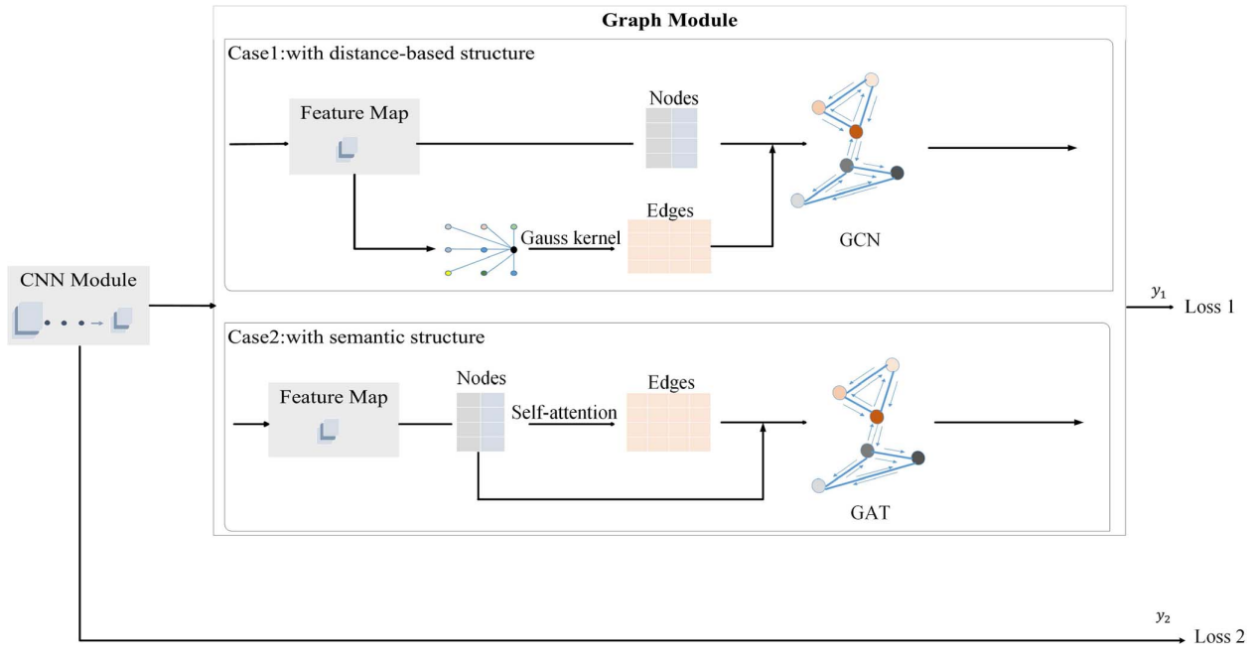
CNNG
Built on top of Graph-CNN.
Introduces integration of GAT in the overall network.
This process makes it possible for the model to combine structure learning and semantic relationships.
Since the graph structure is not known initially, we use attention mechanism to get top few nodes for generating the graph.
Dongbin Zhao Bao Liu Zhichao Lai Yi Lu, Yaran Chen and Jianxin Chen. Cnn-g: Convolutional neural network combined with graph for image segmentation with theoretical analysis

Slide 12

Dataset, Evaluation Metrics
We use the Flood Area Segmentation dataset
Total 280 images
Training: 200
Validation: 20
Testing: 60
Used data-augmentation techniques such as RandomCrop, Normalize etc.
Mean Intersection over Union (mIoU) metric
Md Faizal Karim, Krish Sharma, and Niyar R Barman. Flood area segmentation, 2022

Slide 13

UNet++
Trained model:
Epochs: 10
Learning Rate: 0.0001
Batch Size: 4
Optimizer: Adam (learning rate of 1e-4)
Loss function:
Combination of Binary Cross-Entropy and Dice Coefficient
Results:
Best Validation IoU: 0.8291
Test IoU: 0.8032

Slide 14
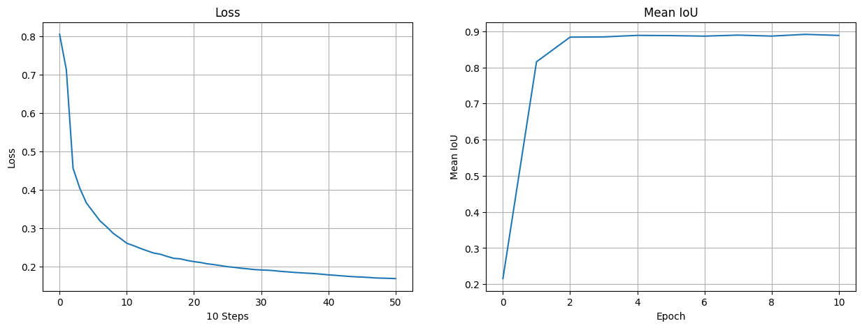
MaskFormer, Mask2Former fine-tuning
Fine-tuned each model:
For 10 epochs
Batch size of 4
Using Adam optimizer, learning rate of 5e-5 and 9e-5 resp.
Loss Function:
Classification Loss (cross-entropy)
Binary Mask Loss
MaskFormer
mIoU (validation) increased from 21.5% (pre-trained) to 89.5% (fine-tuned)
Mask2Former
mIoU (validation) increased from 37.7% (pre-trained) to 88.9% (fine-tuned)
Mask2Former didn’t boost performance in this task
Niels Rogge. Transformers Tutorials”, 2020.

Slide 15
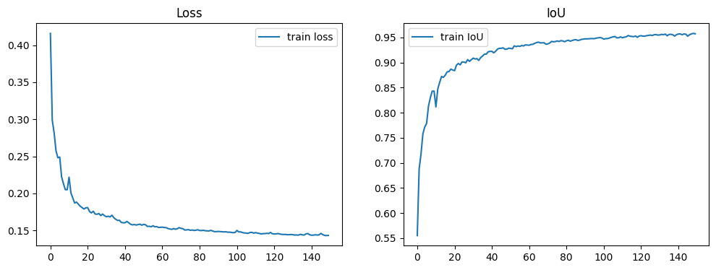
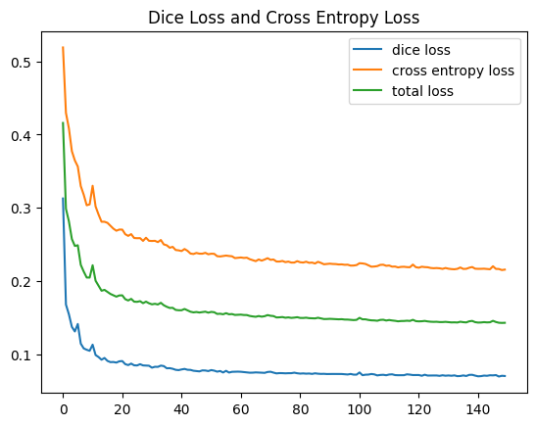
TransUnet
Trained model
Epochs:- 150
Learning rate: - 0.01
Batch size: - 4
Optimizer: - SGD ( momentum = 0.9, weight_decay = 1e-4 )
Loss function
0.5 * cross entropy + 0.5 * dice loss
Results (test set)
IoU : - 0.96789
Dice Score : - 0.98367

Slide 16
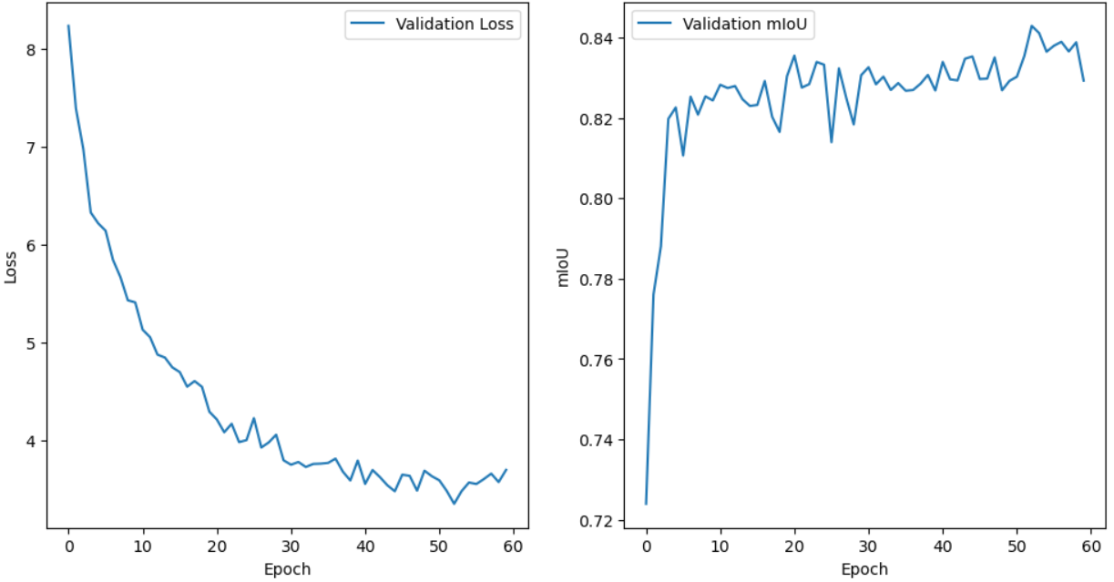

Graph-FCN & CNNG
Uses DeepLabV3 model as FCN.
Trained model:
Epochs:- 60
Batch SIze:- 4
Learning Rate:-
Graph-FCN:- 1e-4
CNNG:- 2e-5
Optimizer:- Adam
Loss: Cross Entropy
IoU:
Graph-CNN:- 83.45
CNNG:- 84.33
Graph-FCN
CNNG

Slide 17
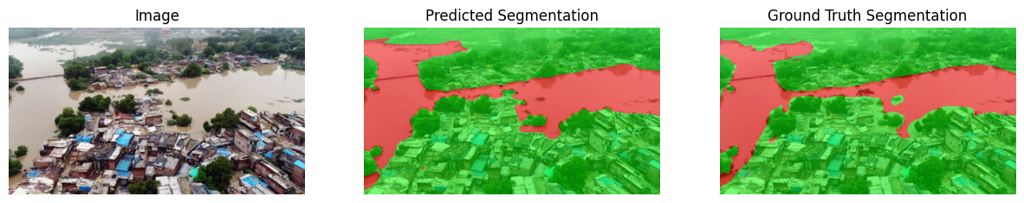
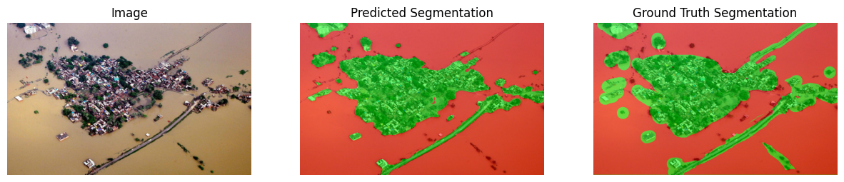
Visualization

Slide 18
Comparison
Model Name | mIoU (Validation) | mIoU (Test)
UNet++ (CNN) | 80.32 | 82.91
Graph-FC | 83.94 | 83.45
CNNG | 83.93 | 84.33
TranUnet | 96.71 | 96.78
MaskFormer | 88.85 | 86.11
Mask2Former | 88.70 | 86.16

Slide 19
Learnings
Creating data loader, augmentations
Use of optimizers: Adam, SGD
Metric for segmentation: - IoU, Dice Score
Learned to preprocess data and convert image grids into graph structures for GNN-based methods.
Fine tuning of models

Slide 20
Individual Contributions (1 slide)
Aaryan: - MaskFormer and Mask2Former
Aayush: -
Darpan: - TransUnet
Varun: - UNet++

