Slide 1

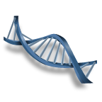
BIOCOMPUTERS
DARPAN PATEL
11101100010110000
(121008)

Slide 2
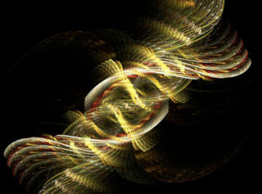
INTRODUCTION
Biocomputers use systems of biologically derived molecules—such as DNA and proteins—to perform computational calculations involving storing, retrieving, and processing data.
The idea behind blending biology with technology is due to the limitations faced by the semiconductor designers in decreasing the size of the silicon chips, which directly affects the processor speed. Biocomputers consists of biochips unlike the normal computers, which are silicon-based computers. This biochip consists of biomaterial such as nucleic acid, enzymes, etc.

Slide 3
Current Technology
Currently, biocomputers exist with various functional capabilities that include operations of "binary " logic and mathematical calculations.
Tom Knight of the MIT Artificial Intelligence Laboratory first suggested a biochemical computing scheme in which protein concentrations are used as binary signals that ultimately serve to perform logical operations
W.L. Ditto, who in 1999 created a biocomputer composed of leech neurons at Georgia Tech which was capable of performing simple addition
In March 2013. a team of bioengineers from Stanford University, led by Drew Endy, announced that they had created the biological equivalent of a transistor, which they dubbed a "transcriptor". The invention was the final of the three components necessary to build a fully functional computer: data storage, information transmission, and a basic system of logic.

Slide 4
Performs millions of operations at same time
Ability to use large amounts of working memory
Low power used to keep in original state
Lightweight
Good for
parallel
computing
1 gram of DNA can hold 1 x 10¹⁴ MB of data
Or 145 trillion CDs
1 CD is 800 MB
1 lb of DNA has more
computing power than
all computers ever made
Has ability to solve hardest problems in a matter of weeks
can be used to
solve NP-complete
problems with
higher efficiency
Clean, readily
available materials
Environmentally friendly
ADVANTAGE

Slide 5
Disadvantages
Molecular operations are not perfect
DNA computing involves a relatively large amount of error
As size of problem grows, probability of receiving incorrect answer eventually becomes greater than probability of receiving correct answer.
Sometimes there are errors in the pairing of DNA strands
Simple problems solved faster on electronic computers
Human assistance is required
Time consuming lab procedures
No universal method of data representation
Information can be untransmittable

Slide 6
Advanced Technology
Biochemical computers
Biochemical computers use the immense variety of feedback loops that are characteristic of biological chemical reactions in order to achieve computational functionality
Biomechanical computers
the mechanical shape of a specific molecule or set of molecules under a set of initial conditions serves as the output
Bioelectronic computers
measured output is the nature of the electrical conductivity that is observed in the bioelectronic computer. This output comprises specifically designed biomolecules that conduct electricity in highly specific manners based upon the initial conditions that serve as the input of the bioelectronic system.

Slide 7
References
http://en.wikipedia.org/wiki/Biocomputer
http://www.edufive.com/seminartopics/computer/CS14.html
https://www.google.com/imghp?gws_rd=ssl
Thank You

