Slide 1
JSF Framework
By: Darpan Subedi

Slide 2
Introduction:
JSF(JavaServer Faces) is a framework for building web applications.
It is a framework for developing, building server-side User Interface Components and using them in a web application.
It is based on the MVC archicture.

Slide 3
Features:
Component Based Framework
Implements Facelets Technology
Integration with Expression Language
Support HTML5
Ease and Rapid web Development.
Support Internationalization
Bean Annotations
Default Exception Handling
Templating
Inbuilt AJAX Support
Security

Slide 4
JSF Implementation of MVC
JSF follows the Model-View-Controller(MVC) design pattern. This makes JSF applications much more manageable because the user-interface code ( View) is cleanly separated from the application data and logic ( Model). To prepare the JSF context, which provides application data access to the pages, and to guard against unauthorized or improper access of the pages, all user interactions with the application are handled by a front-end "Faces" servlet ( Controller).

Slide 5
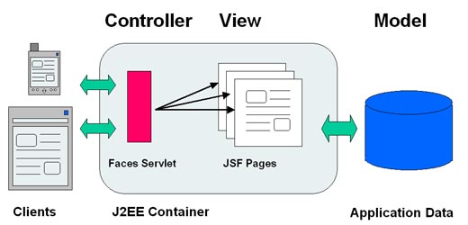

Slide 6
Scopes
@RequestScoped
Bean lives as long as the HTTP request-response lives. It gets created upon a HTTP request and gets destroyed when the HTTP response associated with the HTTP request is finished.
@NoneScoped
Bean lives as long as a single EL evaluation. It gets created upon an EL evaluation and gets destroyed immediately after the EL evaluation.

Slide 7
Scopes
@ViewScoped
Bean lives as long as the user is interacting with the same JSF view in the browser window/tab. It gets created upon a HTTP request and gets destroyed once the user postbacks to a different view.
@SessionScoped
Bean lives as long as the HTTP session lives. It gets created upon the first HTTP request involving this bean in the session and gets destroyed when the HTTP session is invalidated.

Slide 8
Scopes
@ApplicationScoped
Bean lives as long as the web application lives. It gets created upon the first HTTP request involving this bean in the application (or when the web application starts up and the eager=true attribute is set in @ManagedBean) and gets destroyed when the web application shuts down.
@CustomScoped
Bean lives as long as the bean's entry in the custom Map, which is created for this scope lives.

