Slide 1

Mobile Game
In-App Purchase
Behavior Analysis
Data Analytics Project Presentation
Daniel Arias • Weican Ye • Arjun Mod • Nikhilesh Iyer
Gaming Analytics
Purchase Behavior
Power BI
Notes:
Open the presentation by introducing the project topic and the focus on understanding what drives mobile gamers to spend money through in-app purchases.

Slide 2
Presentation Roadmap
From project idea to final delivery plan
1
Project context
What we are analyzing and why it matters
End-to-end
analytics
story
2
Data foundation
Dataset evaluation, selection, cleaning, and handover
3
Execution plan
Roles, tools, workflow, and project governance
Source: GitHub logs and readme
4
Dashboard direction
Power BI scope and executive insight plan
5
Status & next steps
What is done, in progress, and remaining
Mobile Game In-App Purchase Behavior Analysis
2
Notes:
Use this slide to preview the structure: business problem, dataset, team execution, dashboard plan, status, and next steps.

Slide 3
Project Objective
Understand purchase behavior and turn raw gaming data into business-ready insight
Core question
What factors influence mobile gamers to make in-game purchases?
Player profile
Engagement
Monetization
Age, gender, geography, device
Session behavior, activity, game genre
Purchase amount, segment, payment method
Data → Patterns → Business Decisions
Mobile Game In-App Purchase Behavior Analysis
3
Notes:
Explain that the project connects demographic, engagement, and payment data to uncover patterns that can support business decisions in the gaming industry.

Slide 4
Project Timeline
Key milestones recorded in the project logs
02 May
03 May
15 May
16–17 May
22–27 May
Late May
Team formation
Gaming domain selected
Repository setup
Problem statement
Planning
Gantt + workflow
Dataset evaluation
Repository alignment
Progress prep
60% target
Data handover
Visualization adjustment
The project evolved from domain selection into a structured analytics project with defined data, roles, tools, and deliverables.
Mobile Game In-App Purchase Behavior Analysis
4
Notes:
Walk through the sequence of milestones and emphasize that governance and reassignment happened as gaps were identified.

Slide 5
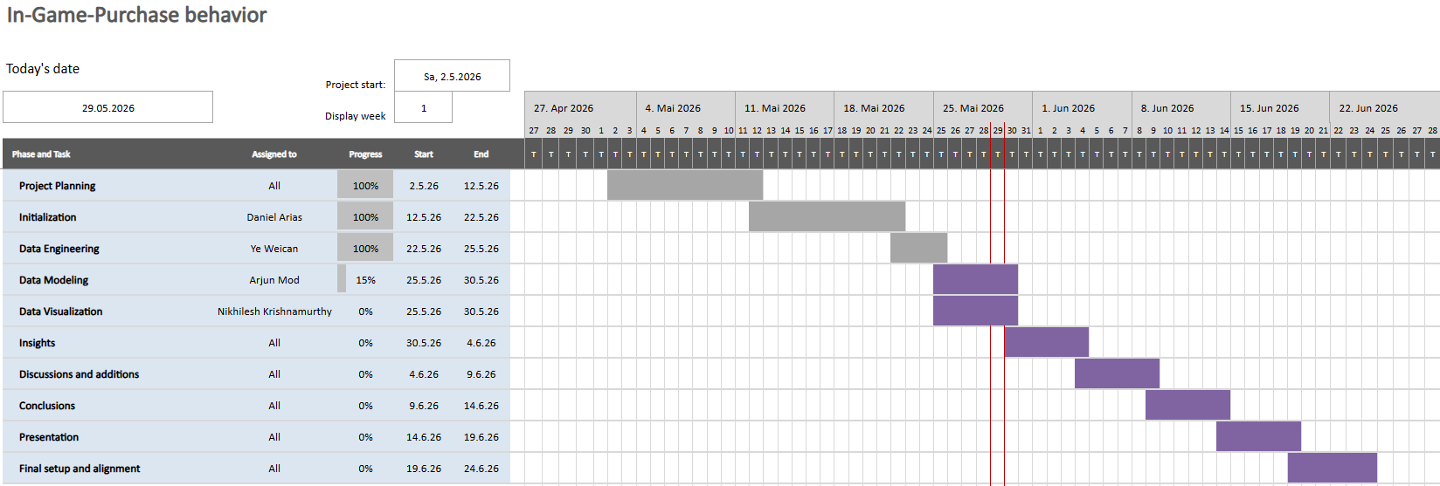
Project Gantt Chart
Mobile Game In-App Purchase Behavior Analysis
4
Notes:
Walk through the sequence of milestones and emphasize that governance and reassignment happened as gaps were identified.

Slide 6
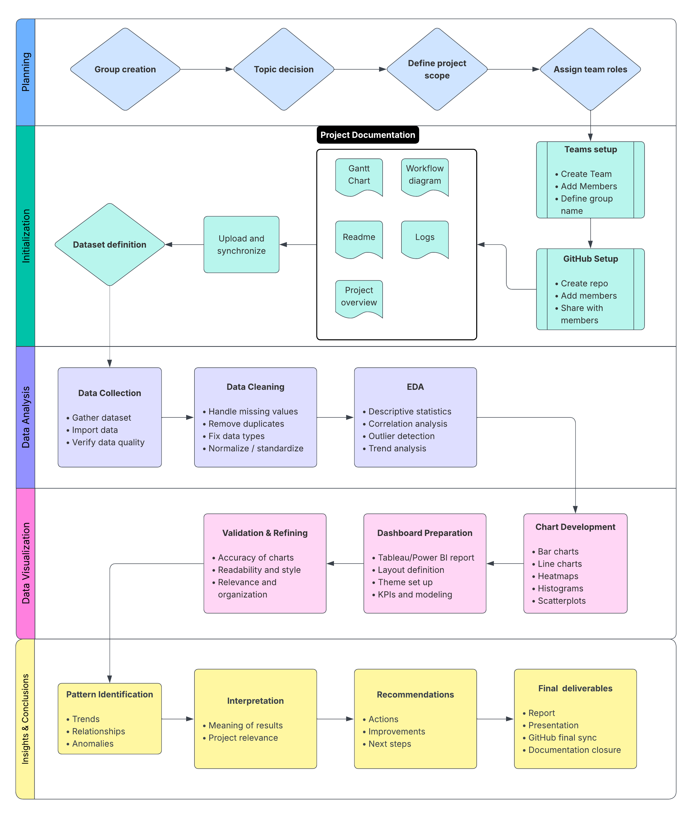
Project Workflow Diagram
Mobile Game In-App Purchase Behavior Analysis
4
Notes:
Walk through the sequence of milestones and emphasize that governance and reassignment happened as gaps were identified.

Slide 7
Dataset Selection
The team selected the dataset with the strongest analytical potential
Dataset considered
Strengths
Decision
Mobile Game In-App Purchases 2025
Rich purchase fields and monetization variables
Reference only
Mobile Game User Data Analysis
Behavioral focus and purchasing patterns
Not primary
Predict Online Gaming Behavior
~40,000 records; clean structure; big potential for analysis so far
Selected at initial stage
Mobile Game In-App Purchases 2025
~3,000 records; more important features like amount spent; player and purchase details included in the same dataset.
Selected after pre-processing
Selection criteria
Size
Quality
Missing values
Business relevance
Visualization potential
Mobile Game In-App Purchase Behavior Analysis
5
Notes:
Highlight that dataset quality and usefulness were more important than simply finding any available data. The selected dataset became the analytical foundation.

Slide 8
End-to-End Workflow
How the team moves from raw data to presentation-ready insight
1
2
3
4
5
Raw dataset
Data engineering
EDA & statistics
Power BI dashboard
Final story
Kaggle source + SQL scripts
Cleaning, transformation, grouping
Pattern discovery and interpretation
Interactive business views
Report + presentation
Project infrastructure: Microsoft Teams + GitHub + SQL + Power BI
Mobile Game In-App Purchase Behavior Analysis
6
Notes:
Describe the workflow as a pipeline. It starts with raw data, passes through cleaning and analysis, then becomes dashboards and final reporting.

Slide 9
Team Structure & Responsibilities
Final role assignment created clear ownership
Daniel Ricardo Arias Royo
Weican Ye
Project Manager
Documentation & Presentation Lead
Data Engineer
Coordination, deliverables, Teams/GitHub, dashboard reallocation
Data cleaning, transformation, grouping, analytical dataset generation
Arjun Meghanandbhai Mod
Nikhilesh Krishnamurthy Iyer
Data Analyst
Visualization Specialist
EDA, statistical analysis, pattern identification, result interpretation
Dashboard and visual design responsibility initially assigned
Key management lesson: role ownership must be reviewed regularly so deliverable gaps can be corrected early.
Mobile Game In-App Purchase Behavior Analysis
7
Notes:
Emphasize the final role structure and how ownership was clarified through the 27 May coordination meeting.

Slide 10
Data Preparation Completed
The engineering phase established the analytical foundation
Generated tables
player_cleaned
purchase_cleaned
Supporting files
raw_data.sql
seed.sql
SQL generation scripts
Outcome
Cleaned and standardized datasets were shared for analysis, visualization, and reporting.
SQL + Clean Tables
ready for analytics
Mobile Game In-App Purchase Behavior Analysis
8
Notes:
This is the handover slide: the dataset preparation phase was completed and provided clean tables plus SQL scripts for downstream work.

Slide 11
Planned Analysis Scope
EDA and statistical analysis focus on purchasing patterns
Demographics
Engagement
Revenue
Business insight
Age groups
Gender distribution
Country-level patterns
Session behavior
User activity
Genre preferences
Spending segments
Purchase amount
Payment methods
Who spends?
Where is revenue?
Which behaviors matter?
Important boundary
The logs record the analysis work as in progress, so this presentation avoids claiming final statistical findings that are not yet documented.
Mobile Game In-App Purchase Behavior Analysis
9
Notes:
Clarify that analysis categories are defined, but final results are not yet recorded in the logs, so the presentation is careful not to invent findings.

Slide 12
Visualization Development Adjustment
A review found that executive-ready visuals were still missing
Initial plan
Final decision
Tableau-ready Excel workbook
Power BI dashboard
Useful summary sheets, but not a complete interactive visualization solution.
Daniel assumed dashboard responsibility to align visuals, analysis, documentation, and presentation.
• Interactive dashboards
• Analytical visualizations
• Business insight visuals
• Executive reporting views
Mobile Game In-App Purchase Behavior Analysis
10
Notes:
Explain the governance decision: the visualization component was reassigned to maintain quality and consistency across all deliverables.

Slide 13
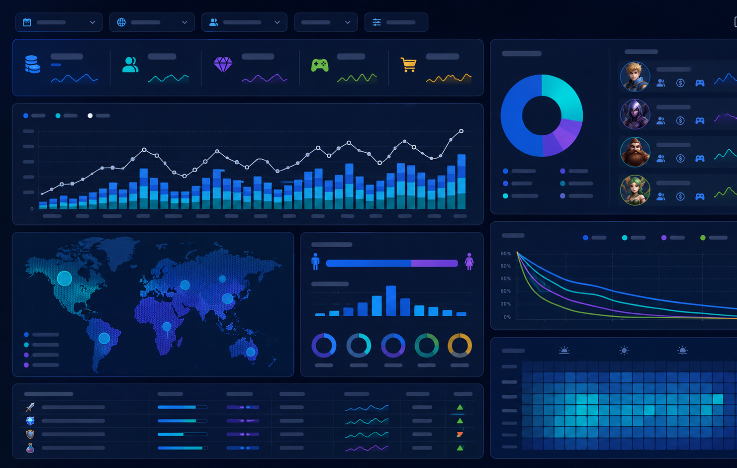
Power BI Dashboard Scope
Planned executive view for purchase behavior and revenue insight**
✓
Player demographic analysis
✓
Purchase behavior analysis
✓
Revenue segmentation
✓
Spending by age group and genre
✓
Country-level revenue analysis
✓
Payment method analysis
✓
Engagement versus spending
Design goal: allow users to filter, drill down, and quickly identify high-value purchase patterns.
**Note: Image was AI-generated for reference, official display and visuals will be shared later in the project.
Mobile Game In-App Purchase Behavior Analysis
11
Notes:
Use this slide to describe the target dashboard experience: interactive filters and executive summaries that translate EDA into business insight.

Slide 14
Current Project Status
Completed, in progress, and remaining items based on the logs
Completed
In Progress
Remaining
• Team formation
• EDA
• Final analytical findings
• Topic selection
• Statistical analysis
• Dashboard completion
• Problem statement
• Power BI dashboard
• Insight generation
• GitHub + Teams setup
• Presentation development
• Report finalization
• Workflow diagram + Gantt
• Final report preparation
• Presentation rehearsal
• Dataset selection
• Final submission
• Role assignment
• Data cleaning + SQL
Project progress is structurally strong, with the remaining work concentrated on final analysis, visualization completion, and reporting.
Mobile Game In-App Purchase Behavior Analysis
12
Notes:
This is the status slide. Emphasize that most infrastructure and data preparation work is complete, while analytical findings and dashboard output remain the key closure tasks.

Slide 15
Lessons Learned
Project execution insights captured throughout the logs
1
Dataset quality beats availability
A larger dataset is only useful when it is clean, relevant, and analytically meaningful.
2
Ownership must be explicit
Clear responsibility prevents gaps and makes reallocation easier when needed.
3
Documentation is continuous
Logs, GitHub, and Teams alignment help keep work auditable and consistent.
4
Review checkpoints matter
Progress reviews exposed the visualization gap early enough to correct it.
Mobile Game In-App Purchase Behavior Analysis
13
Notes:
Focus on practical lessons for a data analytics project: quality datasets, clear ownership, ongoing documentation, and checkpoint-based project management.

Slide 16
Final Delivery Plan
What will complete the project
1
2
3
4
5
Finish analysis
Build dashboard
Generate insights
Finalize report
Rehearse & submit
Complete EDA, statistics, and interpretation
Complete Power BI visuals and interactive filters
Translate patterns into business recommendations
Align report, dashboard, and presentation narrative
Prepare final delivery and submission package
Q&A
Thank you
Mobile Game In-App Purchase Behavior Analysis
14
Notes:
Close by summarizing the remaining delivery plan and invite questions.

