Slide 1

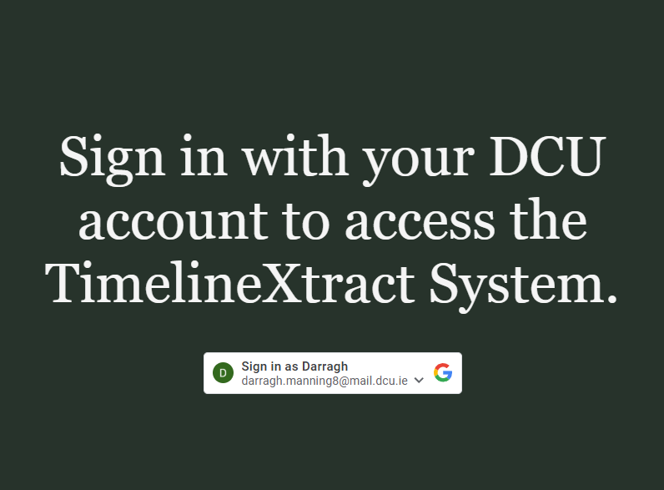
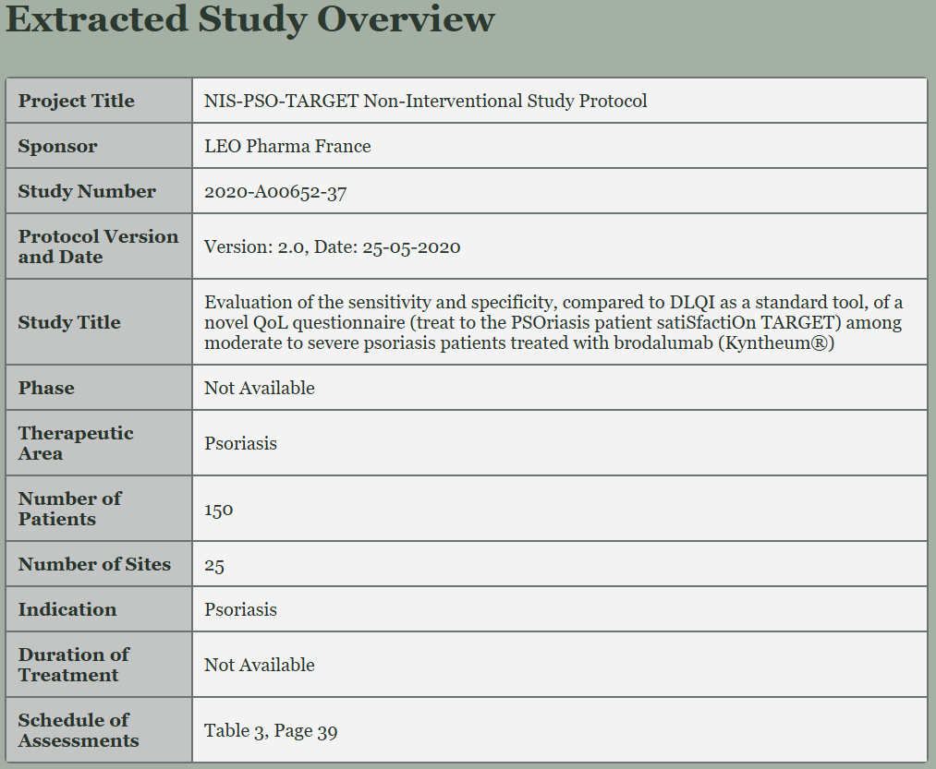
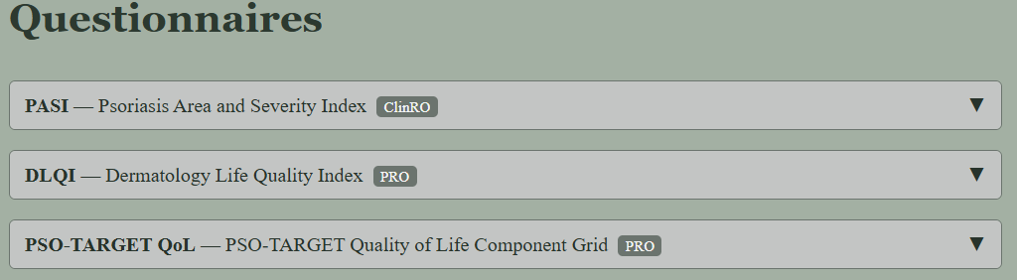

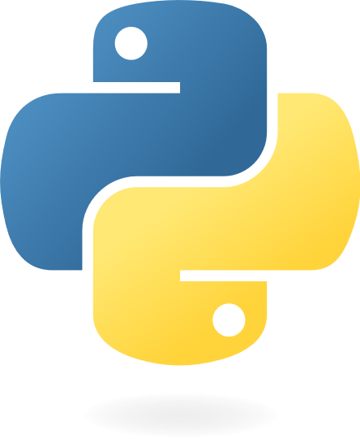
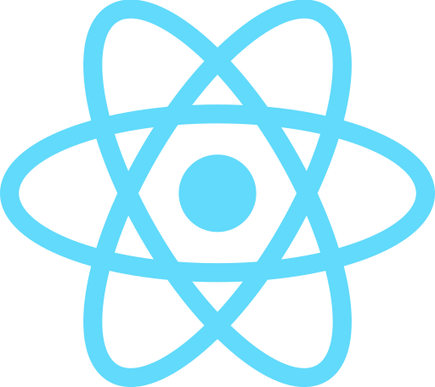
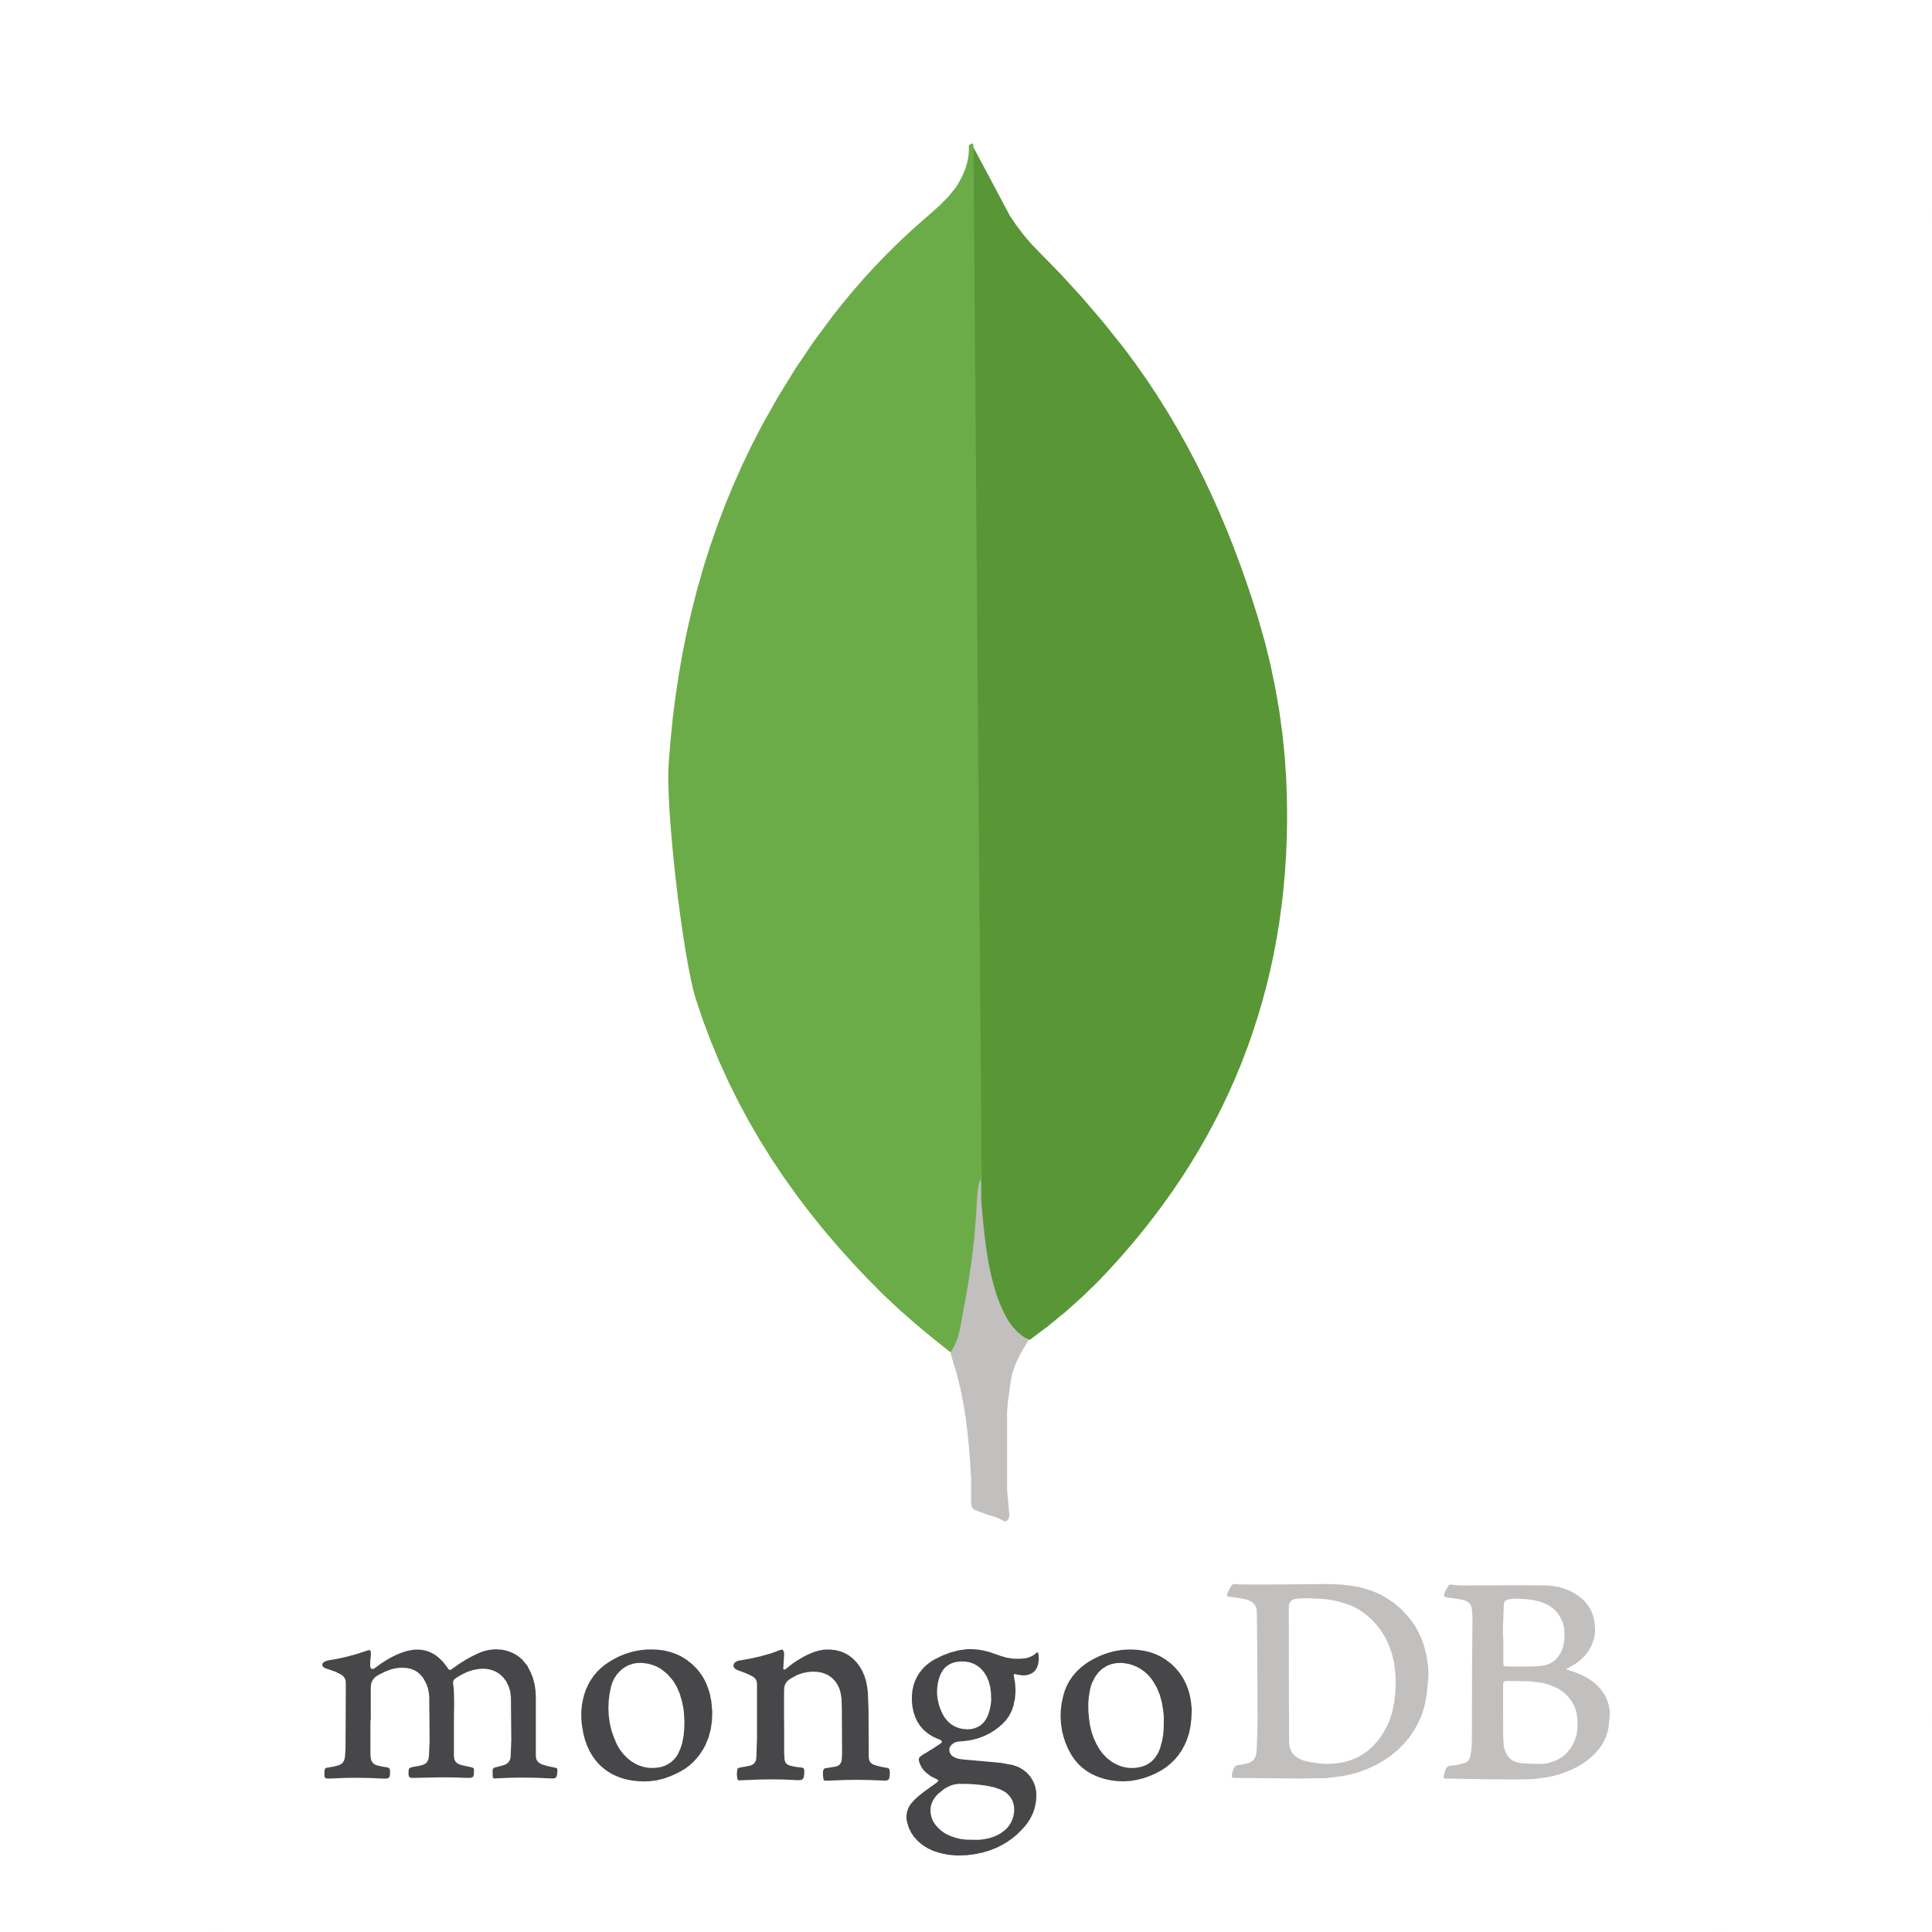
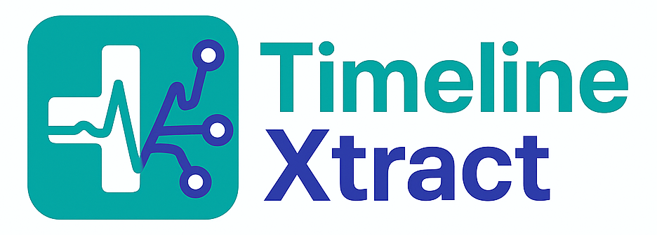
School of Computing
TimelineXtract
Student: Lorena Gomez & Darragh Manning, BSc in Computer Science
Supervisor: Professor Tomas Ward
Introduction
TimelineXtract is an application that speeds up and simplifies the process of participating in a clinical trial by extracting the relevant questionnaires and timeline events from a clinical trial protocol.
A participant of a clinical trial can upload a PDF of their Clinical Trial Protocol and TimelineXtract will respond with the relevant information.
Methods
The clinical trial protocols
were taken from a large
public database of trials
maintained by the United
States government.
GPT-4 extracts the information using our carefully engineered prompt. Adobe API then extracts the tables and our system filters for the desired information.
Timeline Xtract displays the information to the user in a clear and organised way.
Benefits
Saves time and reduces manual labour of clinical trial participant.
Reduces chance for participant error, speeding up the trial and ensuring potentially life saving medication can make it to the market sooner.
TimelineXtract uses secure authentication.
Issues Resolved
Inaccurate outputs from GPT-4. We solved it by iteratively testing prompts on real clinical trial protocols.
Difficulty matching text (GPT) with the tables (Adobe). Different formats for the data and different names. We solved it using a vector similarity score to give a “match” score between two entries. We also used preprocessing to normalise text before comparison.
Generalising each protocol. Every protocol uses different layouts, terminology and formats. We had to add flexibility to the prompts and validation rules to handle all the variation. We also used threshold based matching and fallback rules to handle edge cases.
Technologies
TimelineXtract is a Django application running on Render with a react front end running on Vercel.
Data extracted with GPT4 and Adobe.
Users, PDFs, Queries, Tables and Outputs are all stored in MongoDB

