Slide 1
UK Accident Dashboard
Data Analytics and Visualisation Project 2021
Darragh Sherwin
S00211714

Slide 2
Agenda
Proposal
Previous
Implementation
Demo
Future

Slide 3
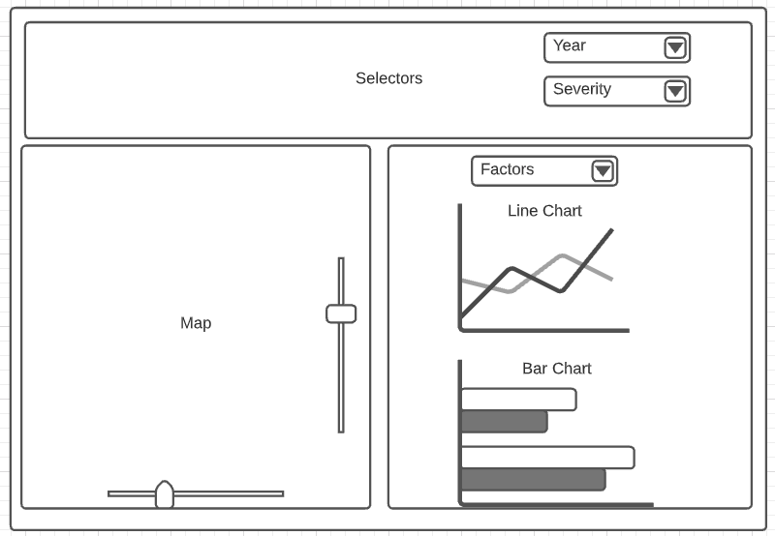
Proposal
Road traffic accidents – leading public health issue –WHO
GIS to visualize data
Interactive dashboard

Slide 4
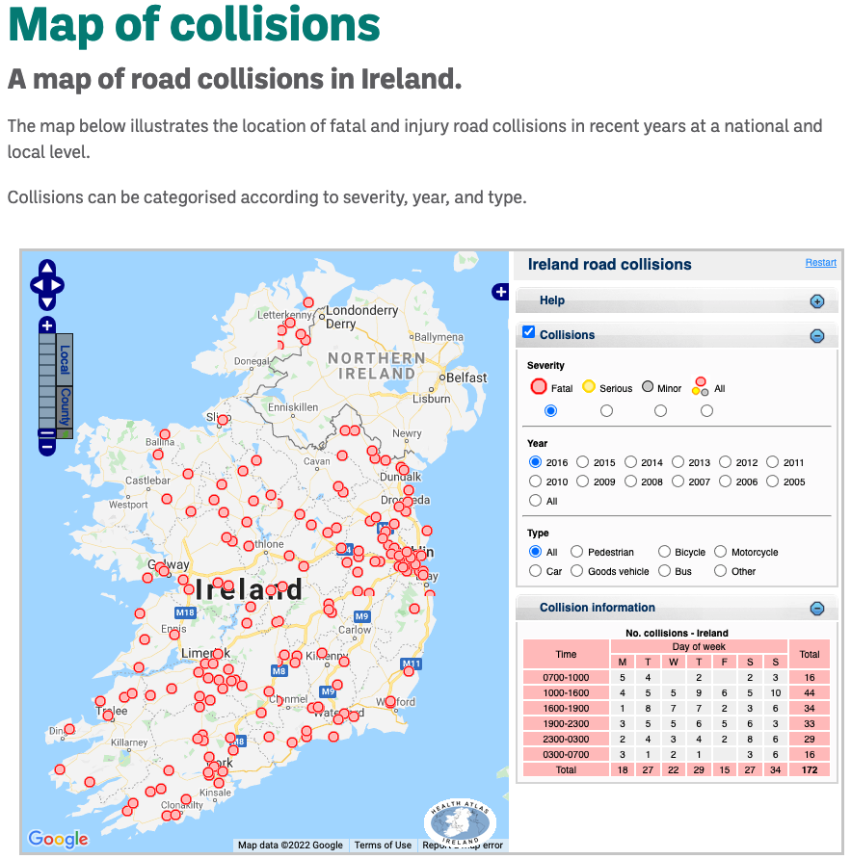
Previous
RSA Ireland Map of Collisions

Slide 5



Implementation

Slide 6
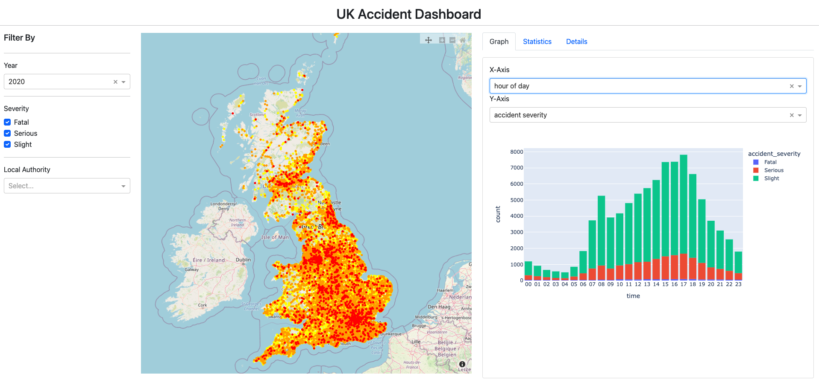
Demo
https://darraghs.org/dav2021/app.py

Slide 7
Future
Performance
Vehicle Info
Casaulties
3D Graphs

