Slide 1

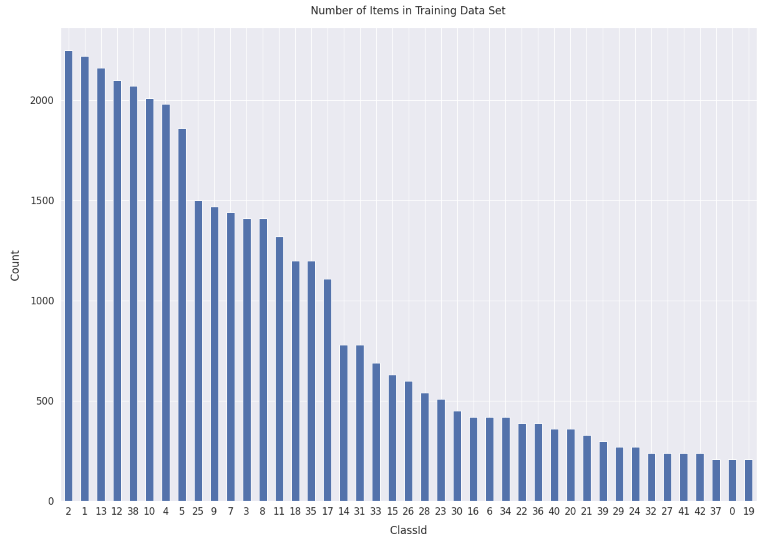
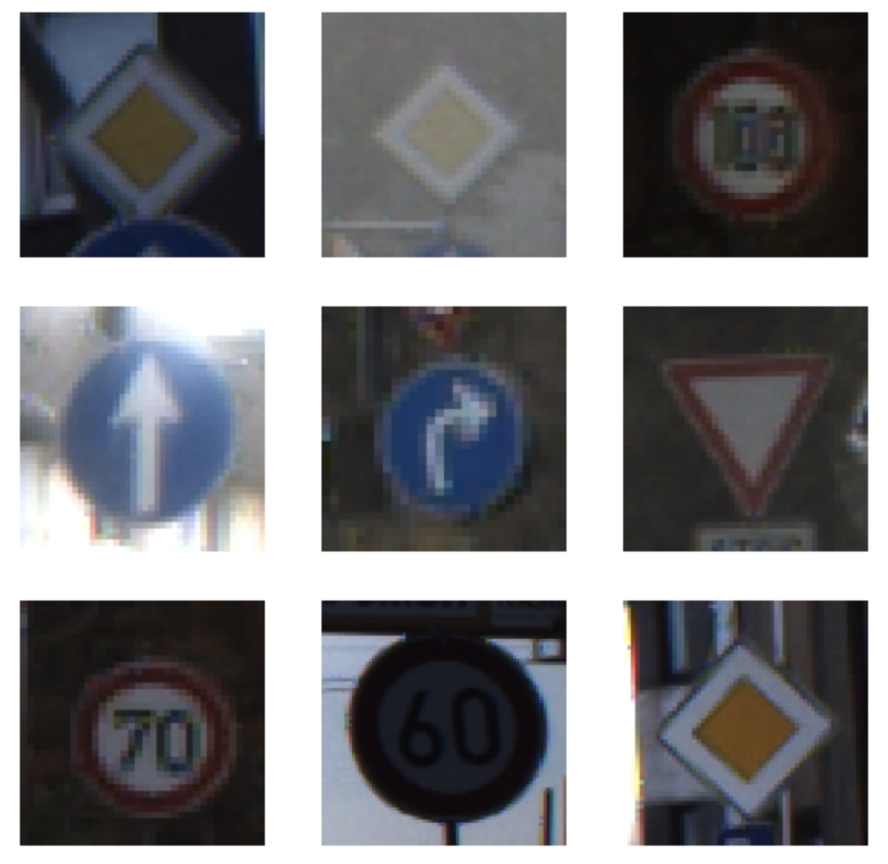
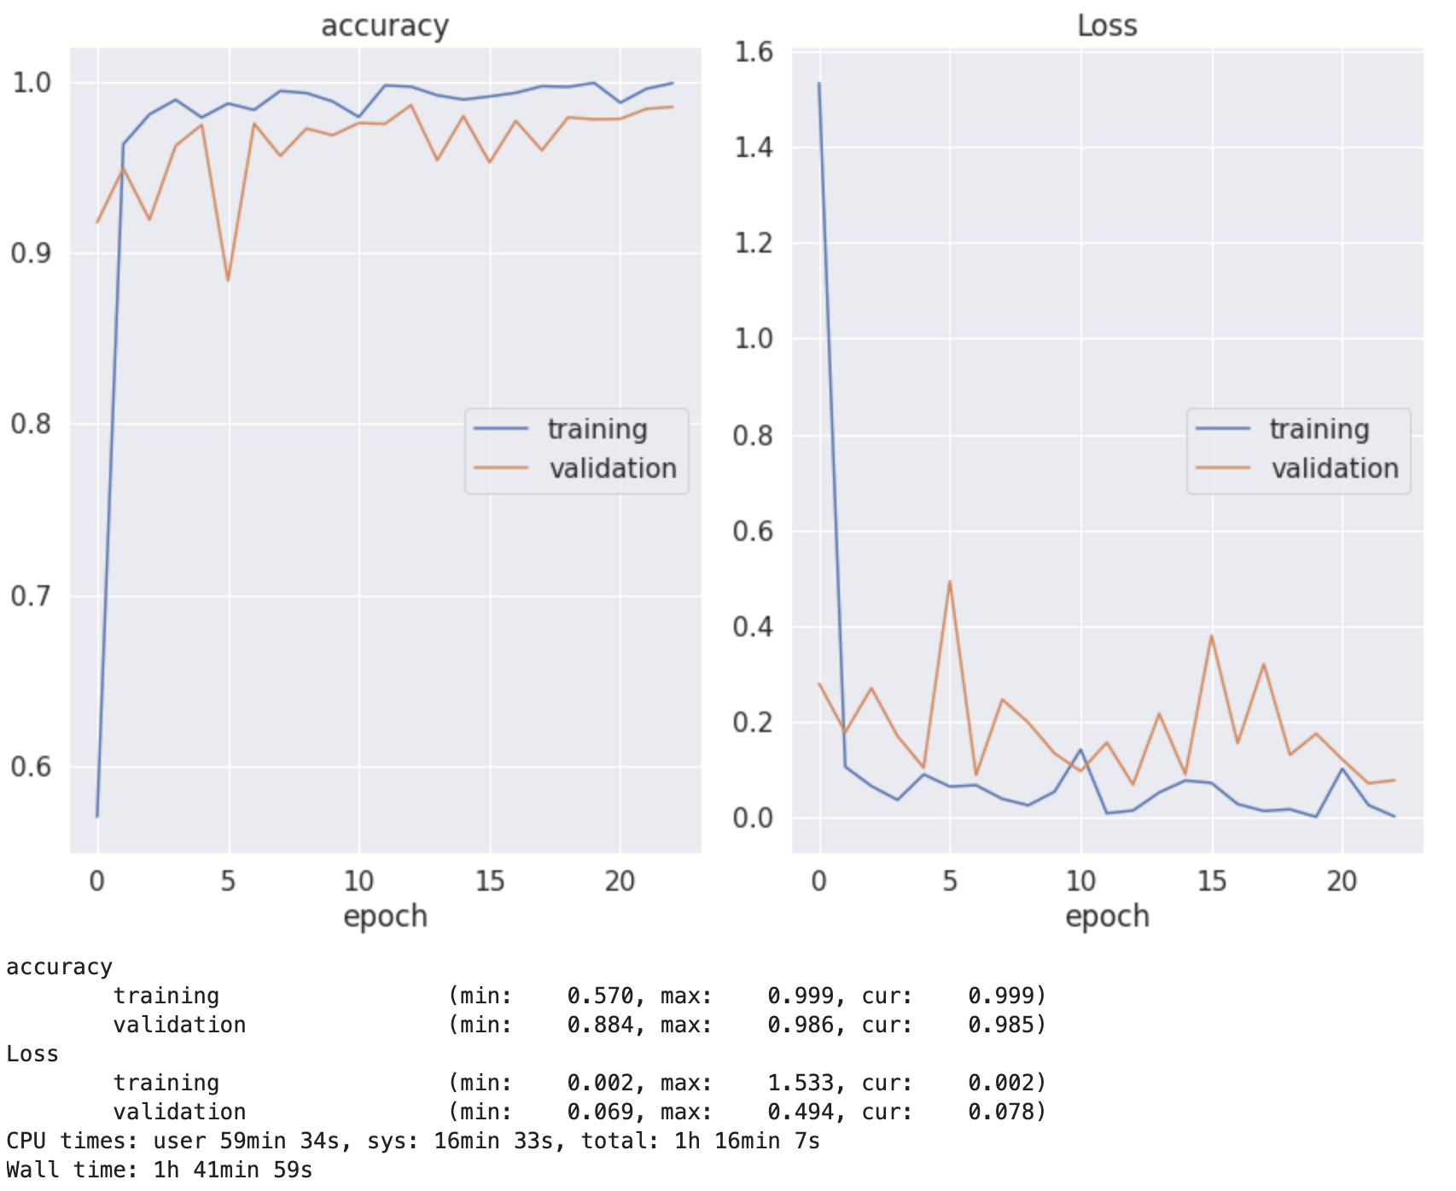
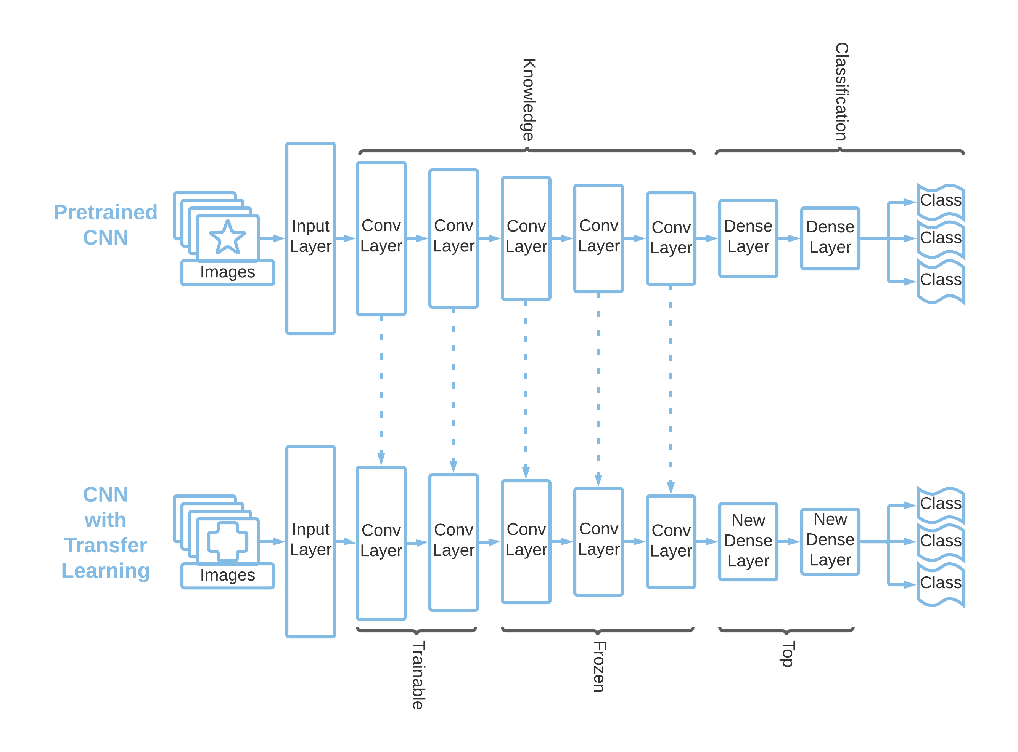

Recognising German traffic signs using Neural Networks with Transfer Learning
Darragh Sherwin
IT Sligo
Abstract
Datasets
Results
Balance of Classes
Model iteration accuracy
Iteration | Pre-processed Input | Trainable Layers | Epochs | Execution Time (h:m:s) | Training Accuracy | Training Loss | Validation Accuracy | Validation Loss | Testing Accuracy
1 | No | 0 | 14 | 41:55 | 97% | 0.293 | 76.2% | 13.103 | 73.71%
2 | No | 5 | 17 | 57:20 | 100% | 0.001 | 96.5% | 0.583 | 95.86%
3 | Yes | 5 | 21 | 1:11:15 | 99.9% | 0.009 | 95.7% | 0.612 | 96.17%
4 | Yes | 10 | 23 | 1:41:59 | 99.9% | 0.002 | 98.5% | 0.078 | 97.38%
Recognising traffic signs is very important for autonomous vehicles. Convolutional Neural Networks (CNN) can classify images; however, they are computationally expensive to train and require vast amounts of data. Transfer learning allows the re-use of an existing knowledge base to classify a new set of images. We will demonstrate how CNNs can be quickly trained with a small dataset to accurately classify traffic signs through transfer learning.
Introduction
Sample Images from dataset
Transfer learning is process of taking existing trained layers in a Convoluted Neural Network and transferring them to a new CNN model so that the existing knowledge can be utilised for a new set of problems.
Methodology
Data Pre-processing
Model Configuration
Transfer Learning
Model Training
Model Verification
Most accurate model iteration accuracy and training loss
Conclusion
No. of Images | Training time | Accuracy
39,209 | 1:41:59 | 97.38%
Scan me for implementation

