Slide 1
Engine Analysis preliminary results Tim Darrah Adam Smith

Slide 2

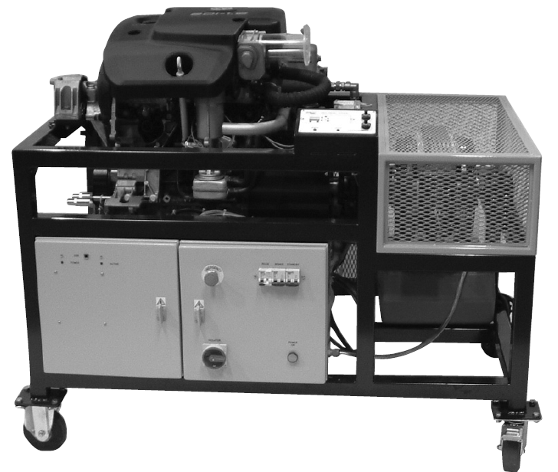
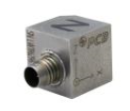
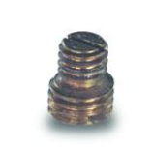

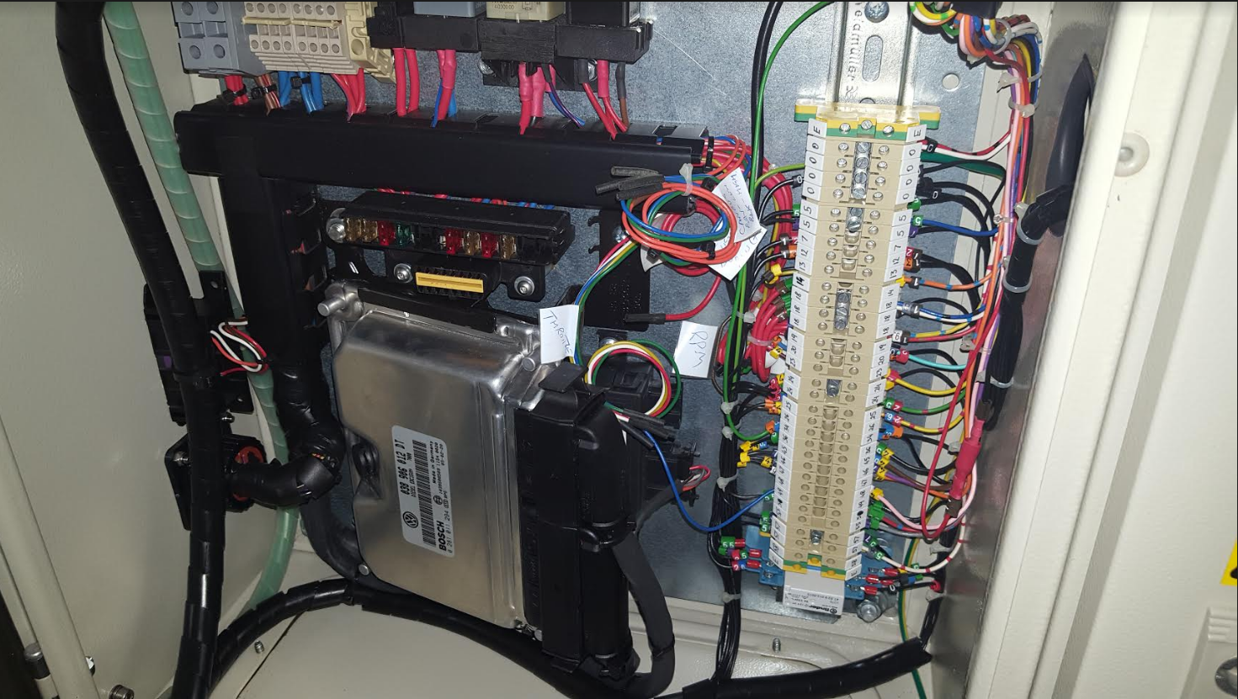
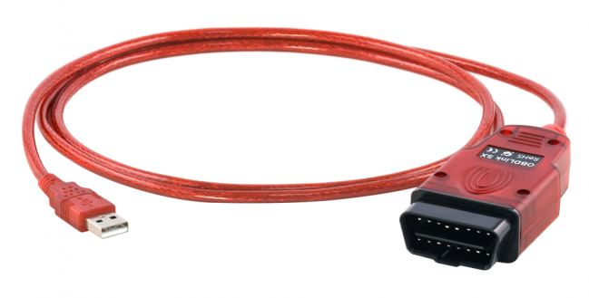
Location
Sensor Mount Location
OBD port
OBD adapter

Slide 3
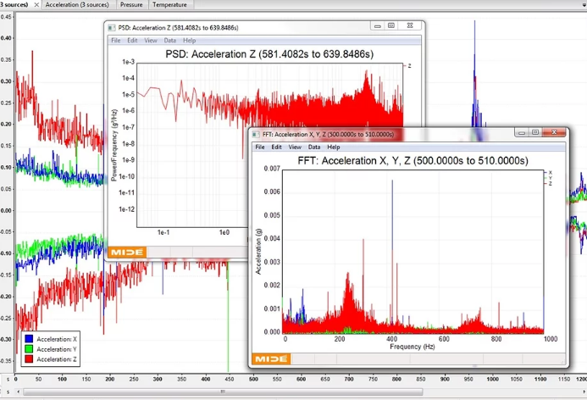
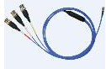
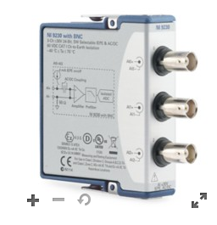
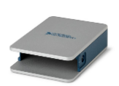
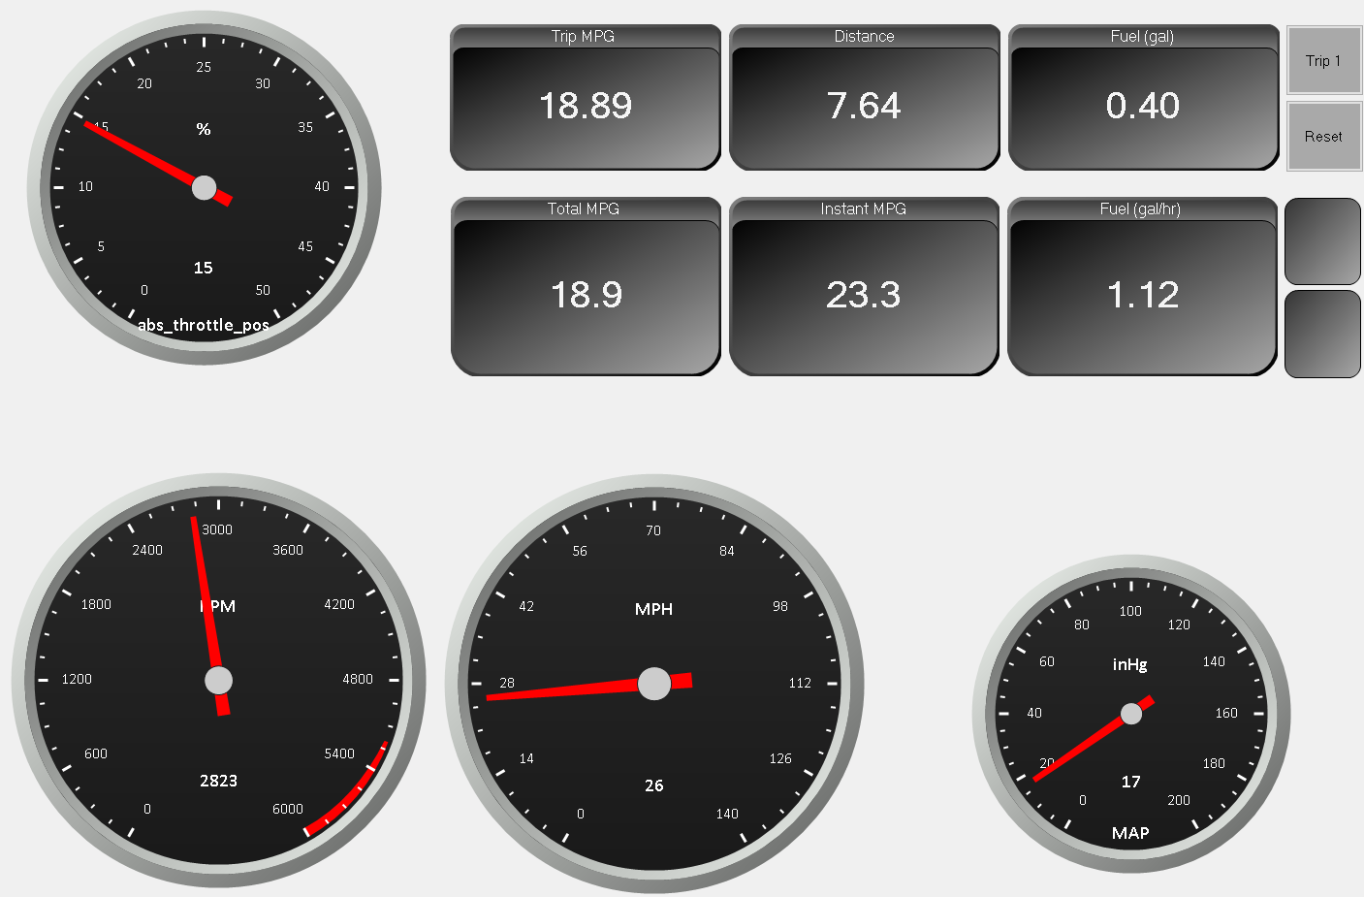
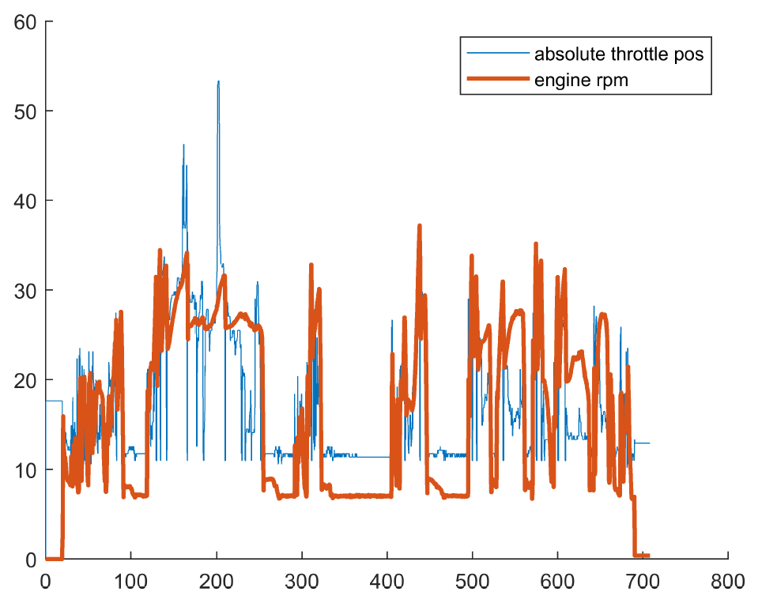
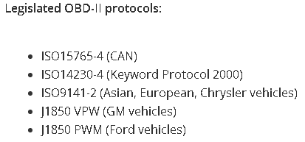
Method
356A15
010G10
NI 9230
NI Chassis
OBDLink SX

Slide 4
Preliminary Data Analysis
Accelerometer (x,y,z) @ 6400hz
RPM @ 20hz
Throttle Pos @ 20hz
Engine Load @ 20hz
Ignition Timing @ 20hz
Coolant Temp @ 20hz
Inlet Air Temp @ 20hz
MAP @ 20hz
FFT, DWT, Spectrogram of Accelerometer

Slide 5
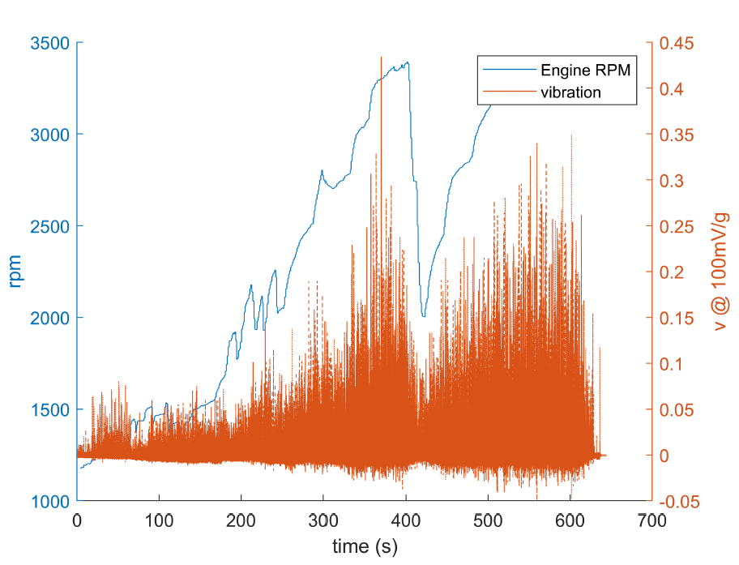
RPM – Vibration
Should create an rpm – vibration distribution after several nominal runs, would create a 1-D lookup table (fast)
Would allow us to detect abnormal vibration at a given rpm
Vibration is also affected by other factors (such as load)
Vibrations are like the fingerprint of rotating machinery – and their health!

Slide 6
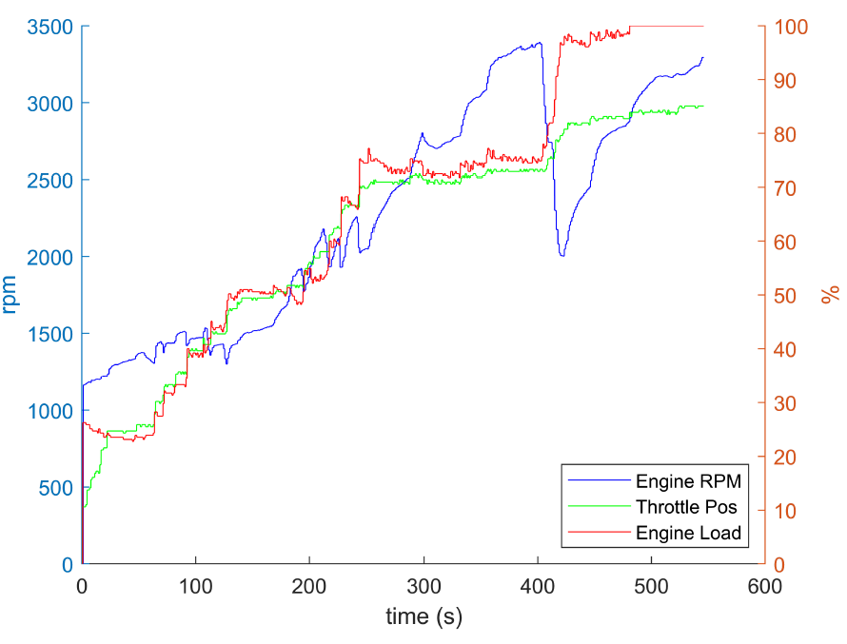
RPM – Throttle - Load
RPM drops as load rises, then rises after throttle increases
As throttle and load increase in lock step, RPM doesn’t change much
What is the exact relationship between engine RPM and throttle + load?
Can we derive an equation to model the relationship or is a more sophisticated approach needed?

Slide 7
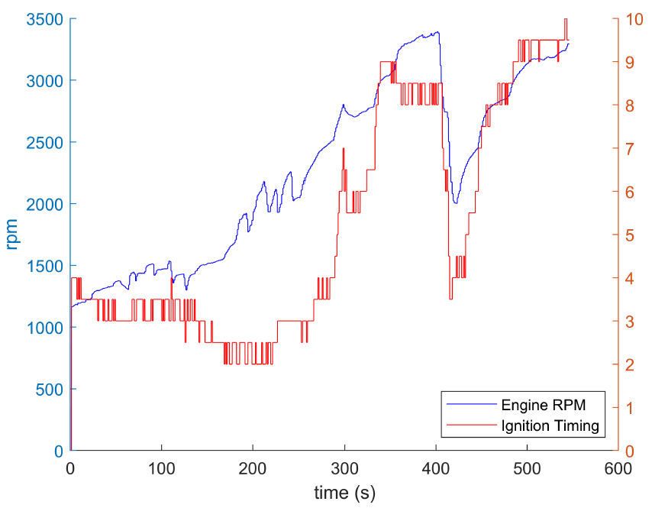
RPM – Ignition Timing
As RPM decreases, so does the timing
How is knowledge of this relationship useful to us?

Slide 8
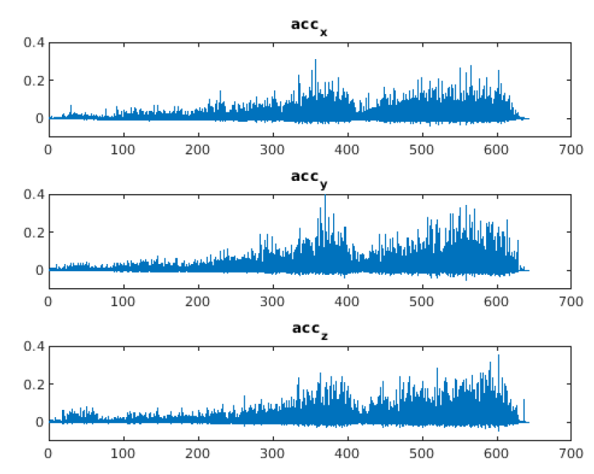
Raw acceleration
Volts
We believe the units are in V, and at 100mV/G this engines peak vibration during testing was > 4g
seconds
Is this a valid assumption?

Slide 9
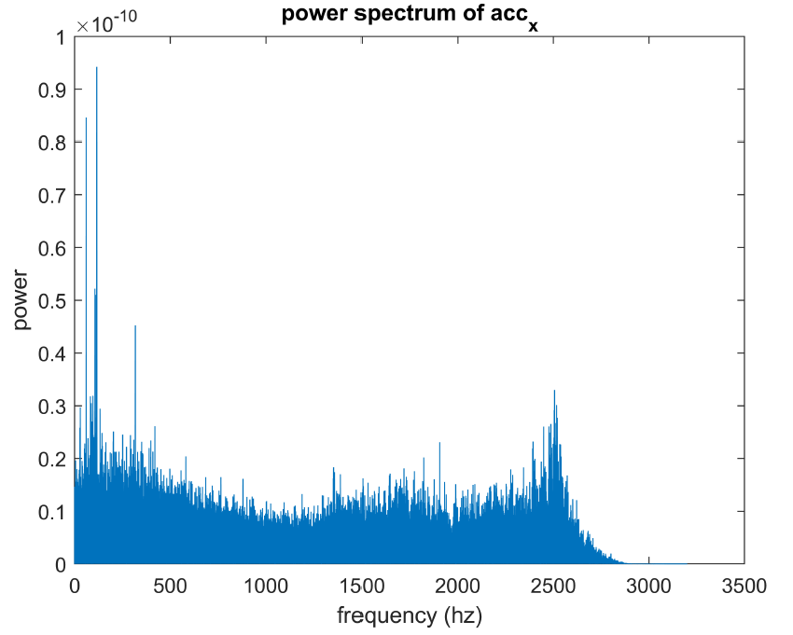
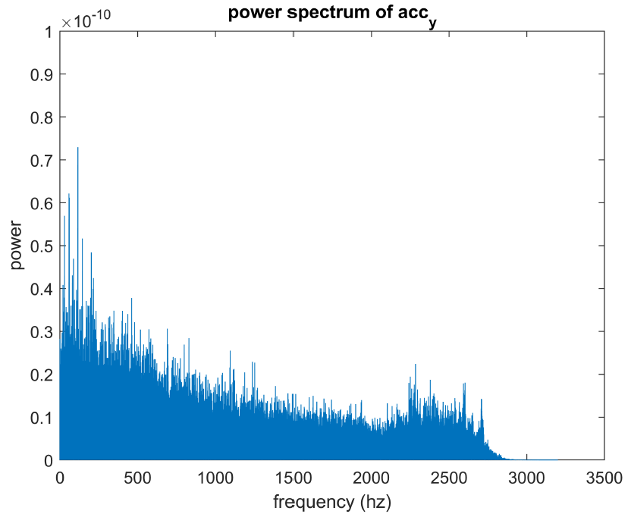
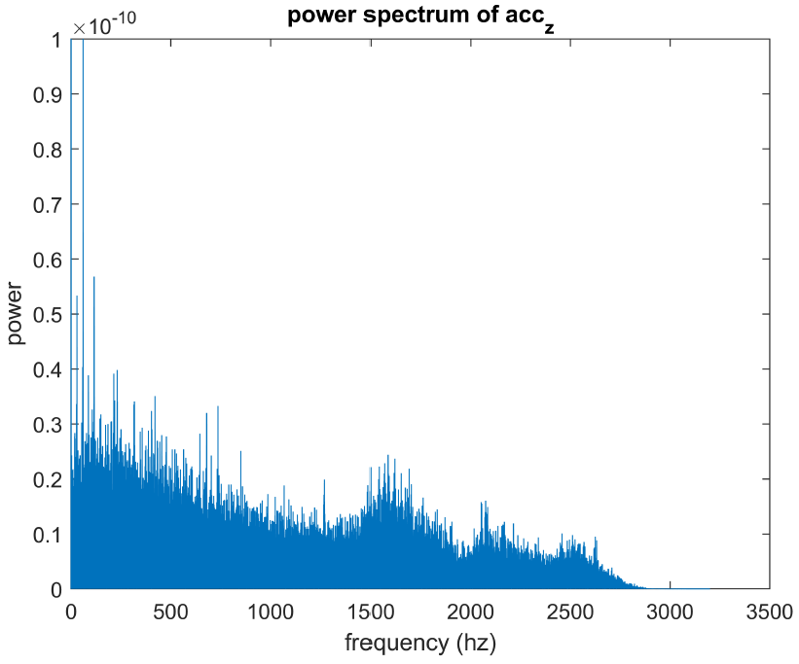
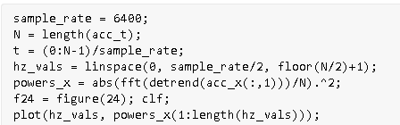
Vibration Power Spectrum
Large presence of a 2500hz vibration in the X direction
Large presence of low frequency, < 200hz in all of them
Need to generate a dataset of power spectrums at specific RPM values

Slide 10
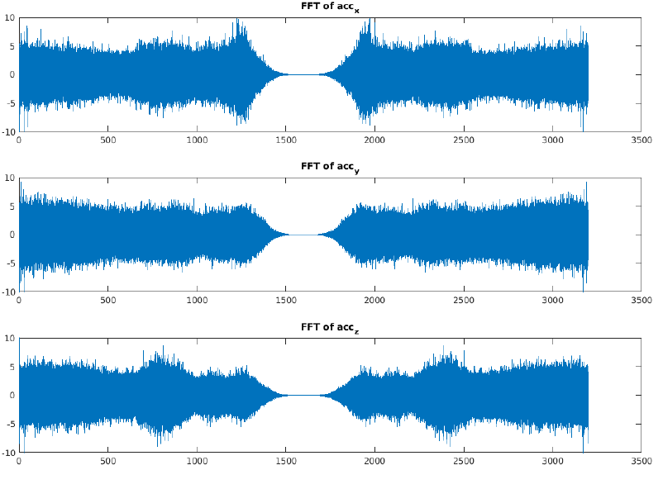
Vibration FFT
Discuss the differences of the FFT and power spectrum – they are both based on the FFT

Slide 11
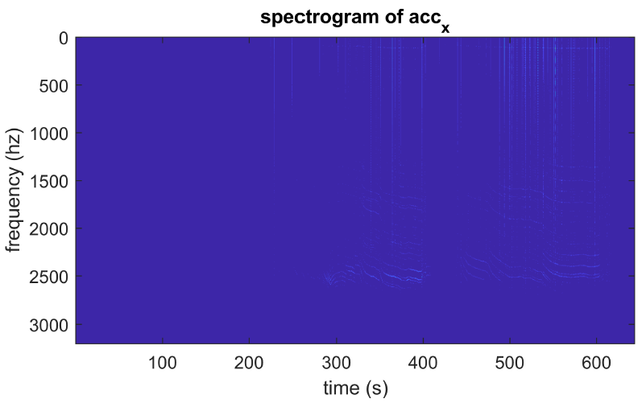
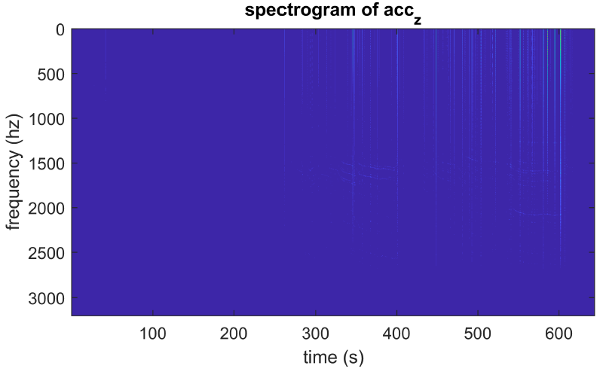
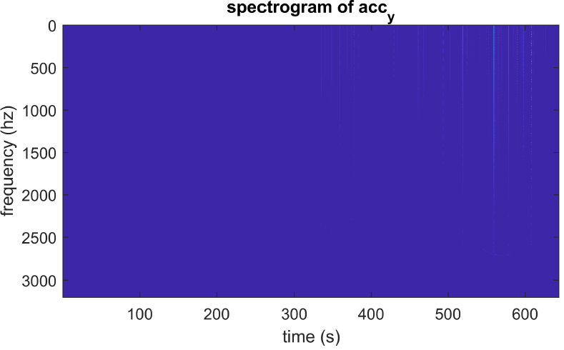
But what is this?
The 2500hz vibration
What about a dataset of spectrograms for a DNN to learn?

Slide 12
Vibration DWT

Slide 13
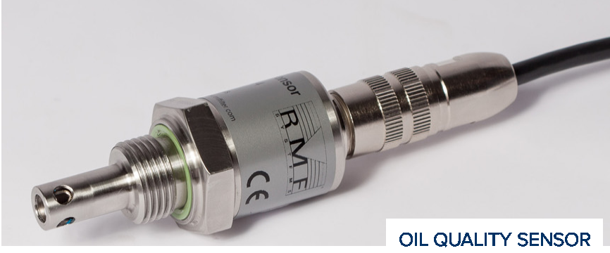
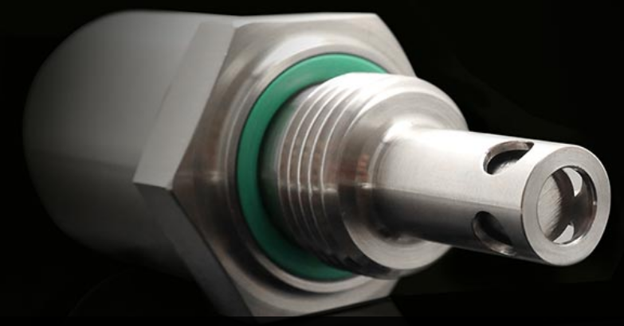
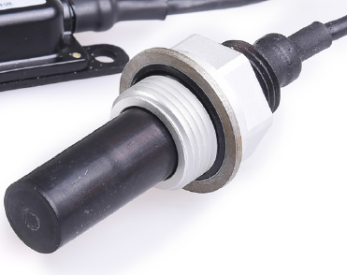
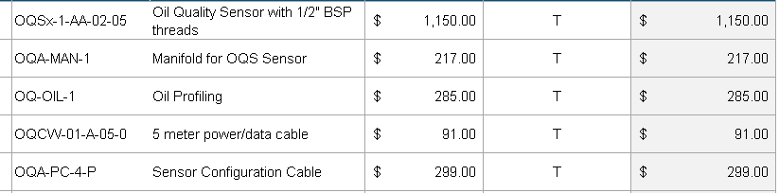

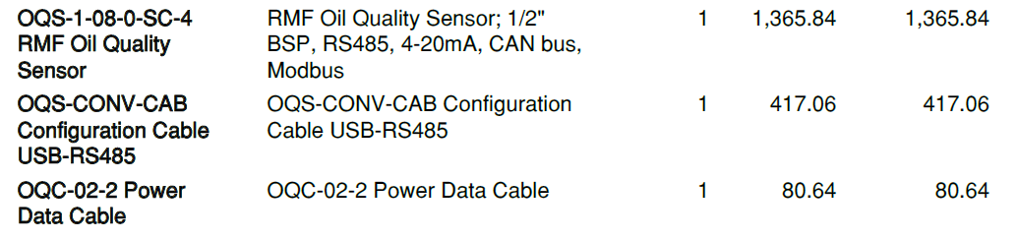
Oil Sensor Lineup
RMS Oil Quality Sensor
TAN Delta OQS
Gill 4212 Oil Debris+ sensor

