Slide 1

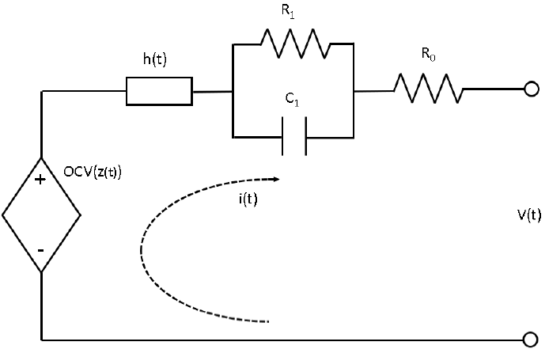
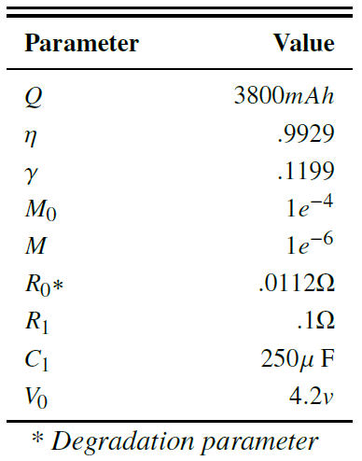
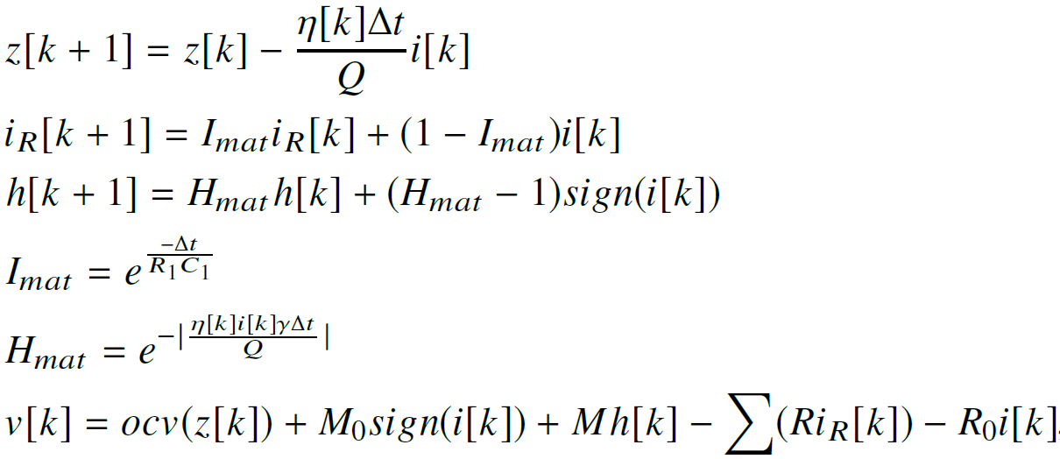

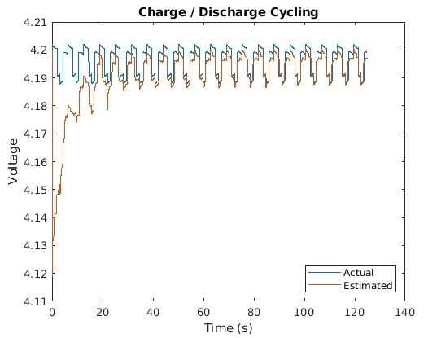
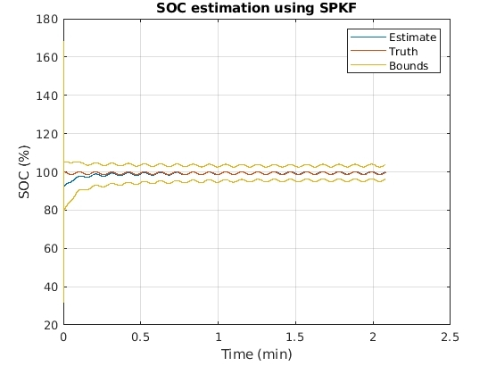
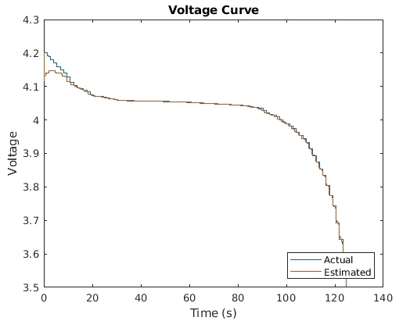
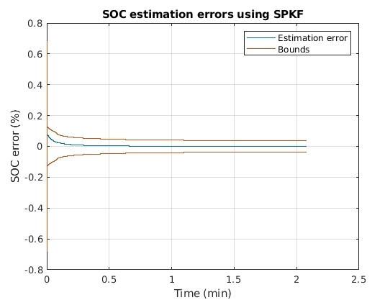
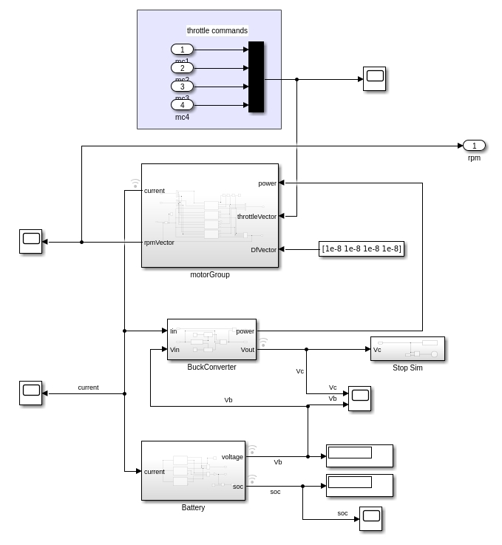
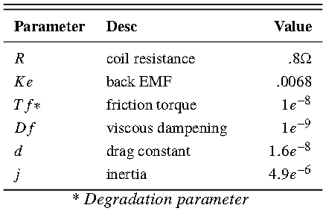
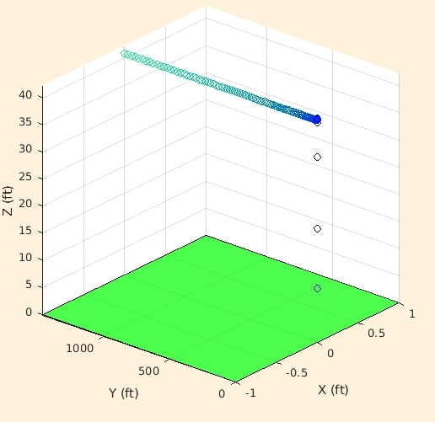
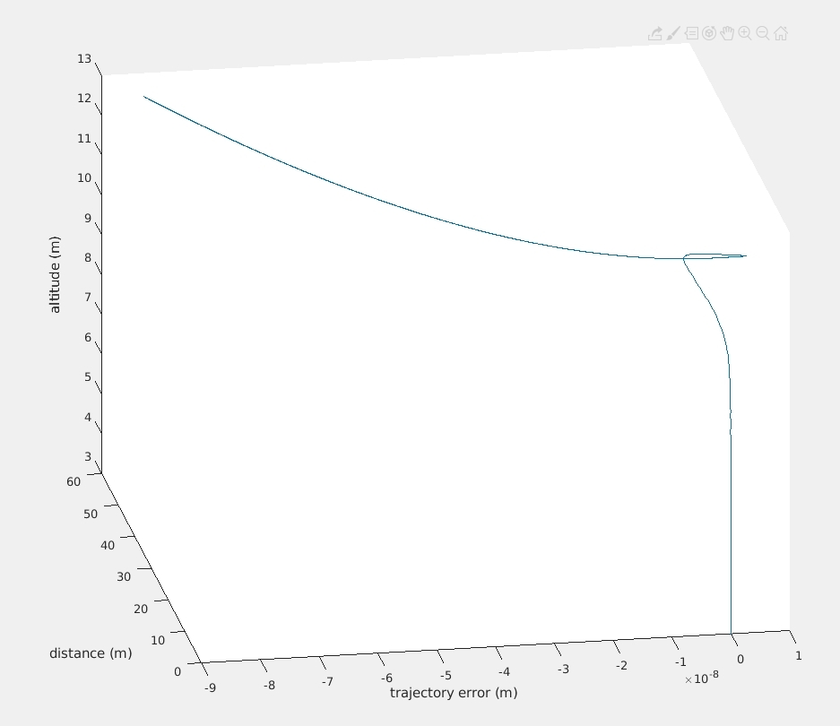
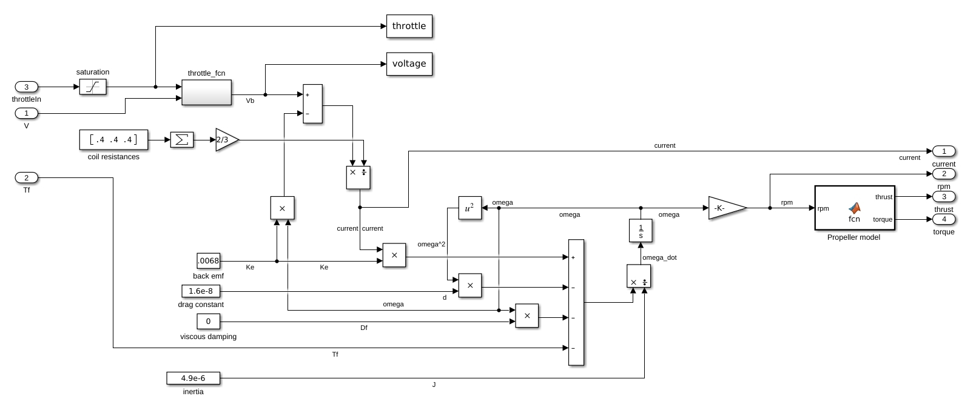
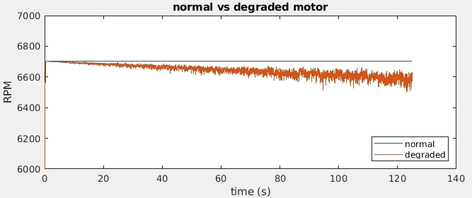
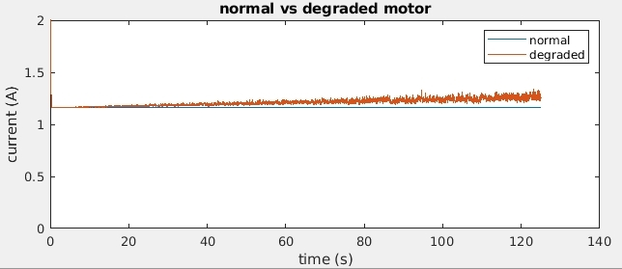
System Level Prognostics Framework
for a UAV Powertrain System
Timothy Darrah, Vanderbilt University
National Aeronautics and Space Administration
Within the last decade, progress toward developing a practical electrically-powered transport aircraft has accelerated with improvements in battery technologies and advanced algorithms to control and monitor safety critical processes. Online estimation methodologies to reason about faults and component degradation are critical to the safety of the aircraft, its occupants, and the success of its mission. We hypothesize that utilizing a holistic approach to system level prognostics and health management will result in a robust framework which can be applied to several safety-critical systems. We apply this methodology to the power-train system of the DJI Mavic Pro quad-copter and subject the system to multiple degradations at the same time to demonstrate the system level prognostic capabilities.
Prognostics Architecture
Abstract
The Battery
The battery is modeled as a modified Thevenin cell and accounts for hysteresis, diffusion voltages, Warburg impedance, and coulombic efficiency.
The prognostics architecture expands upon a two-step process of state estimation and RUL prediction of individual components to that of the entire system. Each component has its own observer and FDI pipeline (not discussed in this work). Data from the observers and expected future input are fed to the prediction step to update the RUL of the system given a set of constraints and performance criteria.
u
System
current
Battery
voltage
throttle
Motor
RPM
y
residual
residual
Observer
SOC
Observer
RPM
State Estimation
FDI
fault
FDI
fault
SOH
Mission plan
System Model
Health Prediction
future load
performance criteria
Component
SOH
Performance Evaluation
future state
Prediction
RUL
RUL
System state
Degradation Models
DJI Mavic Pro Powertrain
failure modes
The powertrain system consists of a 3 cell battery, a buck converter (power condition circuit), and the motor group.
Results
Preliminary results suggest the above framework for system level prognostics is accurate, robust, and works well under varying degrees of uncertainty. The figure below and right depicts the deviated trajectory of the UAV under degraded conditions. The figure below and left is a close up of the trajectory from takeoff to shortly after reaching altitude.
Throttle commands
The Motors
The motors are modeled as simplified permanent magnet DC motors with similar performance characteristics as the more complex BLDC 3 phase AC motor.
normal conditions
degraded conditions
takeoff
Future Work
This is an ongoing project and work continues to finish implementing the observer for the motor and the particle filter for the prediction step. Once the proposed methodology has been fully realized we will add decision making into the loop for route selection and payload weighing for delivery applications.
Acknowledgements
The guidance and input from my PhD advisor Gautam Biswas, lab manager Marcos Quinones, and NASA advisors Chetan Kulkarni and George Gorospe has been an invaluable part of my learning and research. I thank them all.
www.nasa.gov

