Slide 1


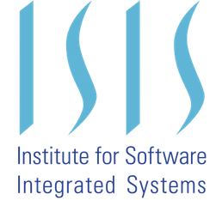
System Level Prognostics Framework for a UAV Powertrain System
Timothy Darrah
Supported in part by

Slide 2
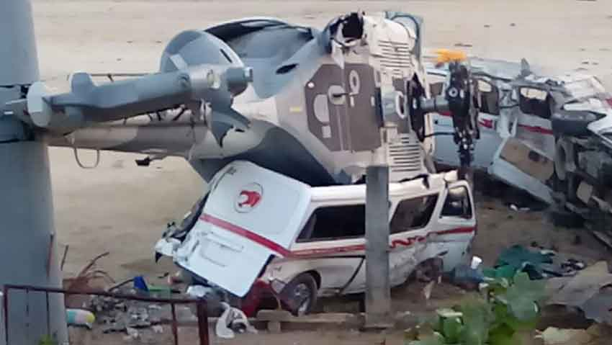
Overview
Background
Powertrain System
The Battery
The Motors
Prognostics Architecture
Results
Future Work
Oaxaca, MX Helicopter Crash Feb 17, 2018, 13 dead, 13 injured
https://mexiconewsdaily.com/news/oaxaca-chopper-crash-kills-14-injures-13/

Slide 3
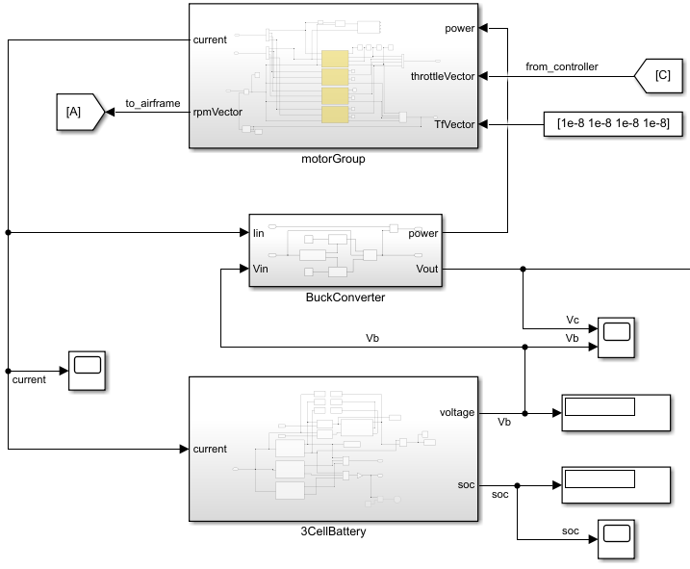
Powertrain System
Consists of the motor group, a buck converter, and a 3-cell battery
Buck converter provides constant voltage output
Motors and battery are monitored with UKFs

Slide 4
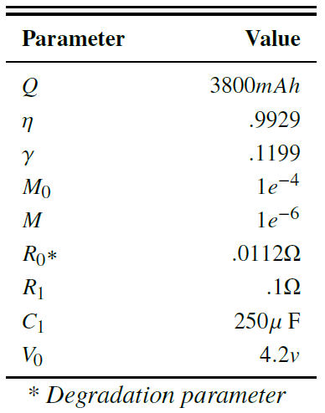
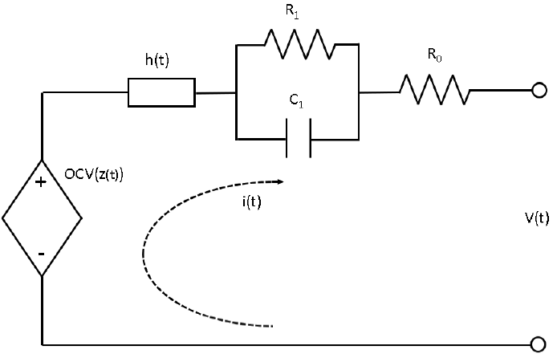
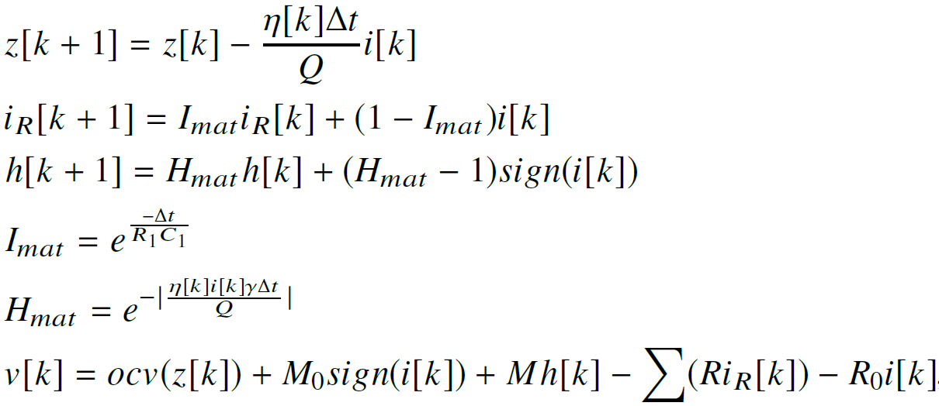

The Battery
Notes:
The battery is modeled as a modified Thevenin cell and accounts for hysteresis, diffusion voltages, Warburg impedance, and coulombic efficiency.

Slide 5
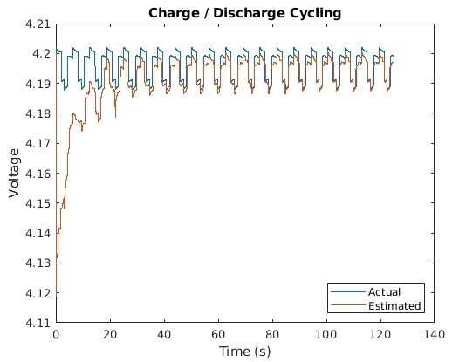

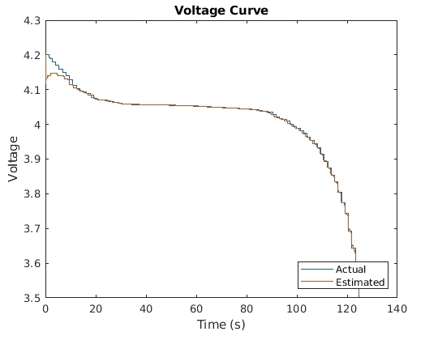
The Battery
Notes:
The battery is modeled as a modified Thevenin cell and accounts for hysteresis, diffusion voltages, Warburg impedance, and coulombic efficiency.

Slide 6
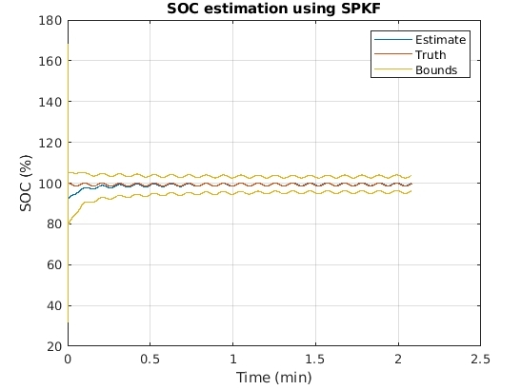
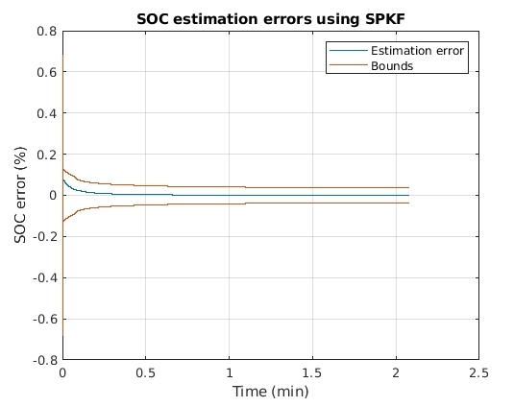
The Battery
Notes:
The battery is modeled as a modified Thevenin cell and accounts for hysteresis, diffusion voltages, Warburg impedance, and coulombic efficiency.

Slide 7
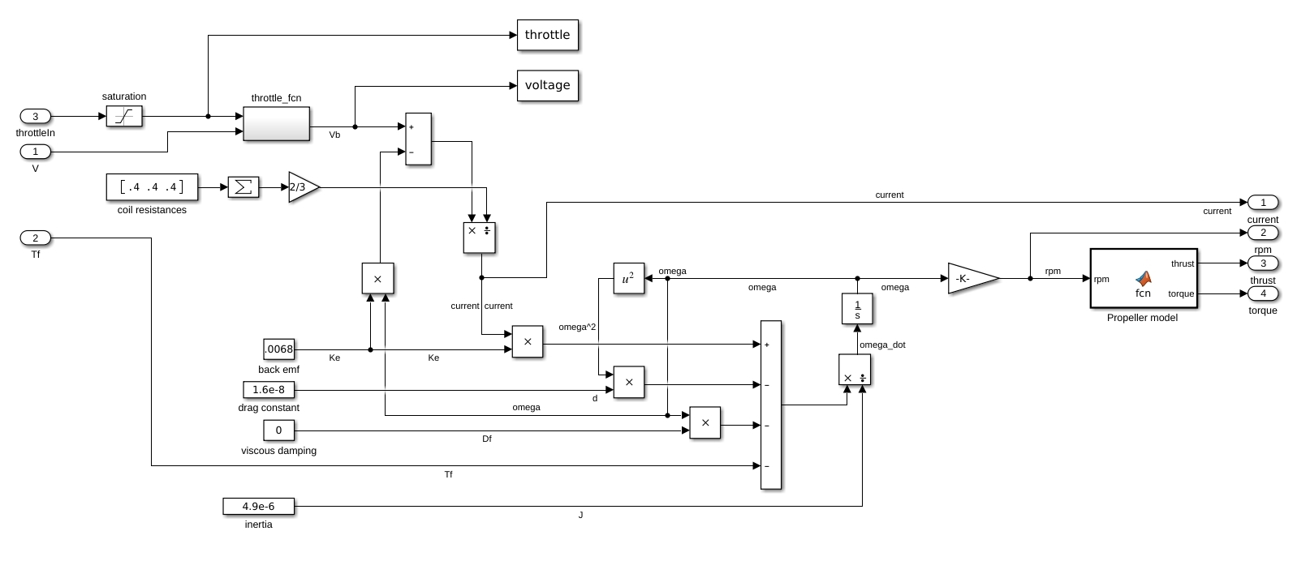

The Motors

Slide 8
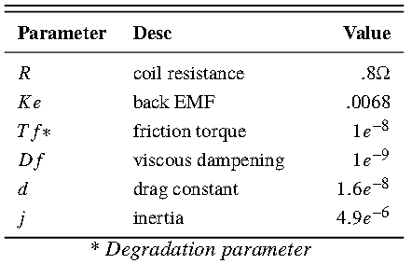
The Motors

Slide 9
The Motors
Schacht-Rodriguez,R., Ponsart, J.C., Garcia-Beltran,C.D., Astorga-Zaragoza, C.M., Theilliol, D., Zhang, Y. (2018). Path Planning Generation Algorithm for a class of UAV Multirotor Based on State of Health of Lithium Polymer Battery. Journal of Intelligent & Robotic Systems.

Slide 10
Prognostics Architecture
u
System
current
Battery
voltage
throttle
Motor
RPM
y
residual
residual
State Estimation
Observer
Observer
SOC
torque
SOH
FDI
fault
FDI
fault
Health Prediction
Mission plan
System Model
future load
performance criteria
RUL
Component
SOH
Performance Evaluation
future state
Prediction
RUL
System state
Degradation Models
failure modes

Slide 11
Prognostics Architecture
u
System
current
Battery
voltage
throttle
Motor
RPM
y
residual
residual
State Estimation
Observer
Observer
SOC
torque
SOH
FDI
fault
FDI
fault
Health Prediction
Mission plan
System Model
future load
performance criteria
RUL
Component
SOH
Performance Evaluation
future state
Prediction
RUL
System state
Degradation Models
failure modes

Slide 12
Prognostics Architecture
u
System
current
Battery
voltage
throttle
Motor
RPM
y
residual
residual
State Estimation
Observer
Observer
SOC
torque
SOH
FDI
fault
FDI
fault
Health Prediction
Mission plan
System Model
future load
performance criteria
RUL
Component
SOH
Performance Evaluation
future state
Prediction
RUL
System state
Degradation Models
failure modes

Slide 13
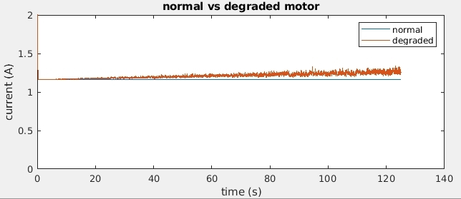
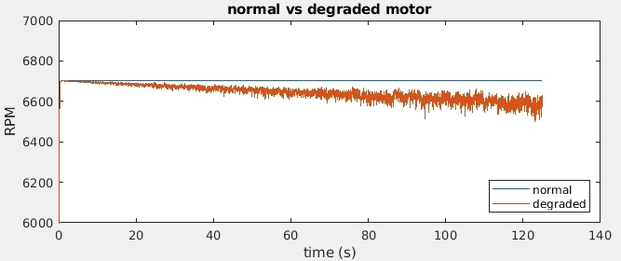
Results
Motor Degradation
current
RPM

Slide 14
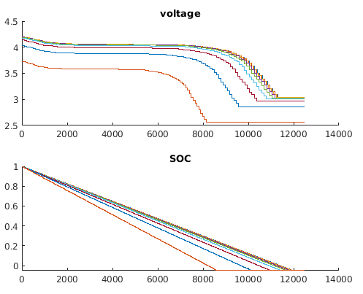
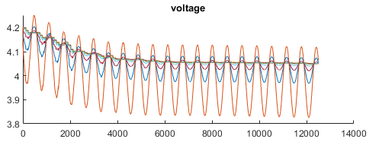
Results
Battery Degradation
Motor Degradation
Constant current
current
RPM
Sinusoidal current

Slide 15
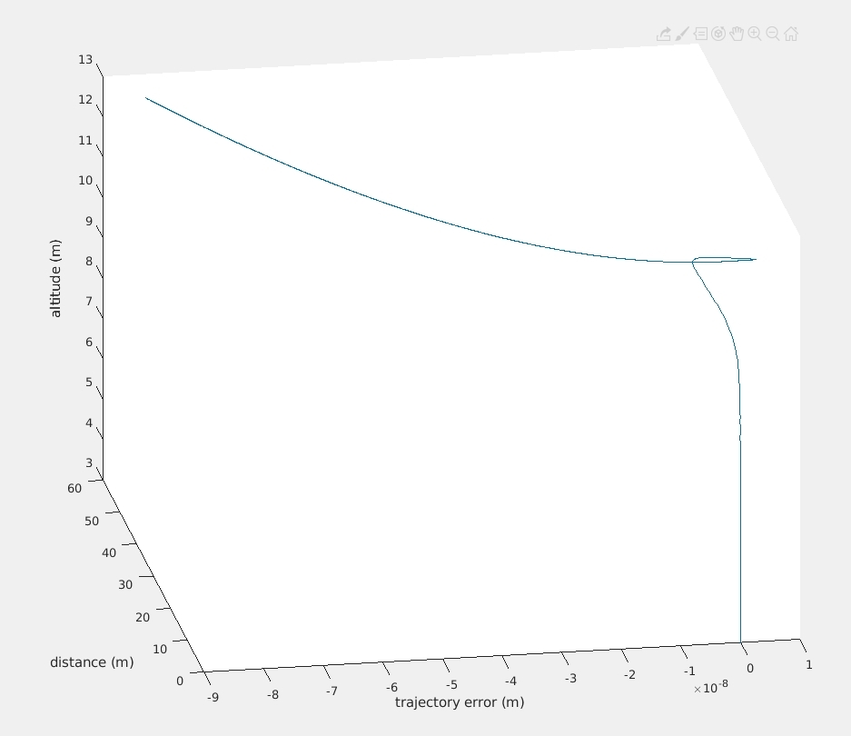
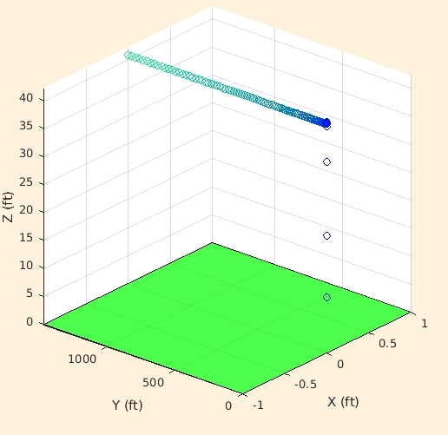
Results
Battery Degradation
Motor Degradation
Constant current
current
RPM
System Degradation
normal conditions
degraded conditions
Sinusoidal current
takeoff

Slide 16
Future Work
The actual prognostics framework!
Particle Filter
Monte Carlo simulations
RUL predictions
Prognostics based decision making
Knowledge representation (Tree/Graph)
Solution searching (CSP)
Communication (NLP)

Slide 17
Thank You!

