Slide 1
UAV run to failure experiments
Experiment overview
Data investigation

Slide 2
Experiment set 1 (14 experiments, 1620 flights)
mission_id
mission_idx
1 | 2 | 3 | 4 | 5 | … | 128 | 129 | 130 | 131
1 | 2 | 3 | 4 | 5 | … | 128 | 129 | 130 | 131
Experiment 1
mission_id
mission_idx
132 | 133 | 134 | 135 | 136 | … | 259 | 260
1 | 2 | 3 | 4 | 5 | … | 128 | 129
Experiment 2
…
mission_id
mission_idx
1490 | 1491 | 1492 | 1493 | 1494 | … | 1618 | 1619 | 1620
1 | 2 | 3 | 4 | 5 | … | 128 | 129 | 130
Experiment 14

Slide 3
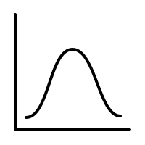
Building the distribution
id
index
1 | 2 | 3 | 4 | 5 | … | 128 | 129 | 130 | 131
1 | 2 | 3 | 4 | 5 | … | 128 | 129 | 130 | 131
Aggregate across mission index
132 | 133 | 134 | 135 | 136 | … | 259 | 260
1 | 2 | 3 | 4 | 5 | … | 128 | 129
…
1490 | 1491 | 1492 | 1493 | 1494 | … | 1618 | 1619 | 1620
1 | 2 | 3 | 4 | 5 | … | 128 | 129 | 130
…
…

Slide 4
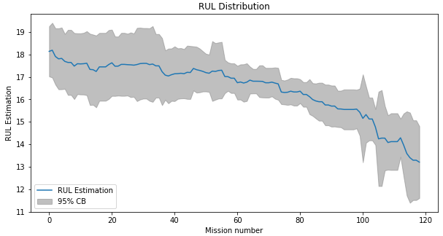
RUL distribution plot
The plot should be smoother (need more data)
Reasons for variance increase
Nonlinear motor degradation effects
A discontinuous jump in the controller's ability to compensate for motor degradation
the RUL update function is flawed (discussed in email)
A combination of these reasons
Fewer data points towards the end

Slide 5
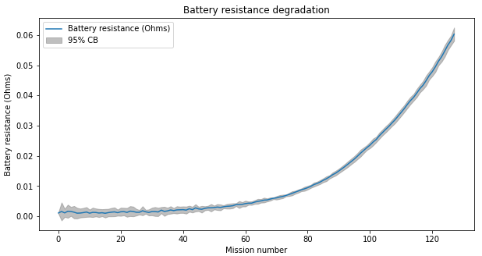
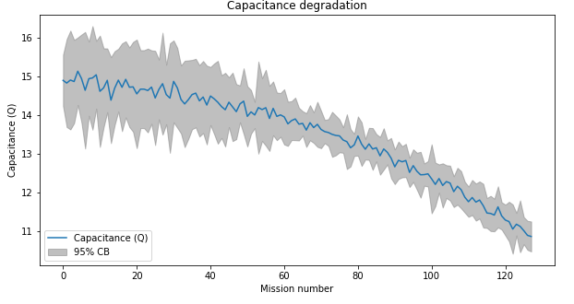
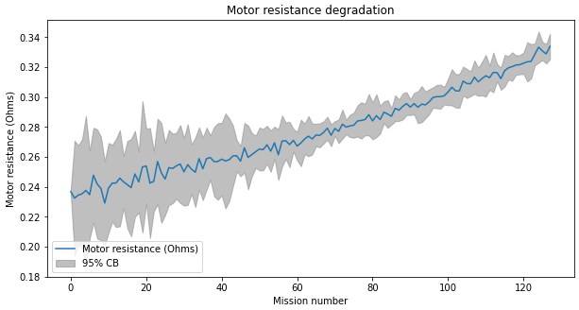
Degradation parameter plots

Slide 6
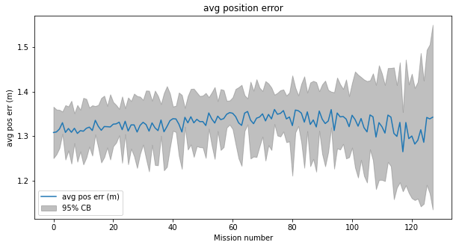
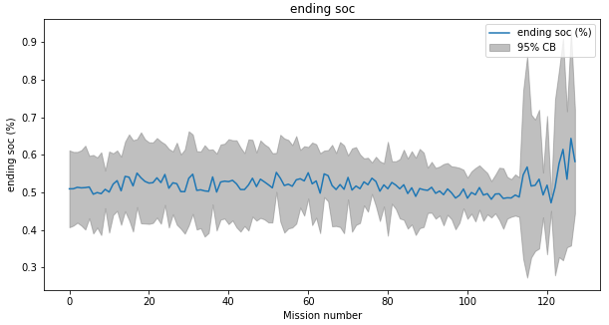
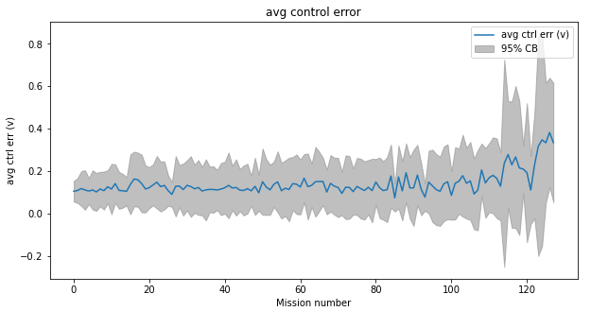
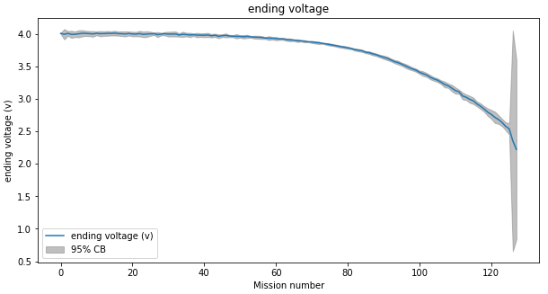
System parameter plots

Slide 7
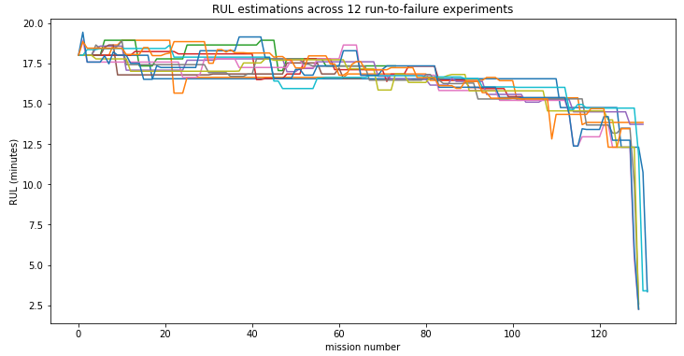

RUL Update function
Current implementation is based on flight time only. Start off with the manufacturers estimate, and only update it if explored and was successful or if failed, otherwise keep it the same.
Where is the system performance information??
ending state of charge
position error
flight time
Propose the following
alpha scales to minute units
(RUL is in minutes whereas the
system performance parameters
are not)
Each line is an experiment with multiple missions
The RUL should not have perfectly straight lines like this for multiple missions in a row

Slide 8
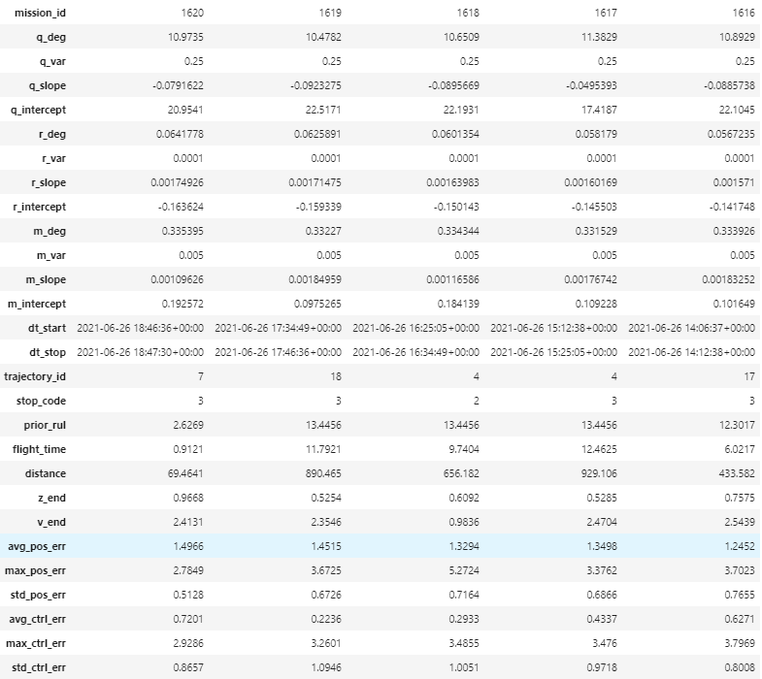
The data
records
Each record is data from one mission
There is also in-flight telemetry data for each mission (not shown, not currently used)
Not all features are used for model development (such as dt_start, etc)
Features

Slide 9
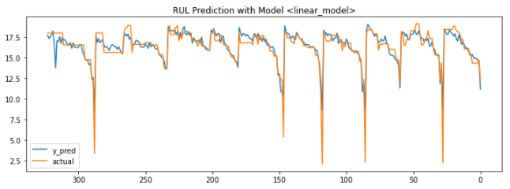
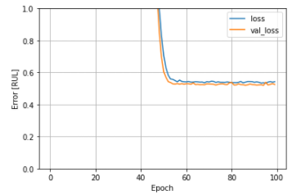
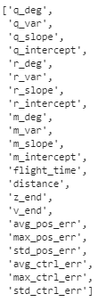
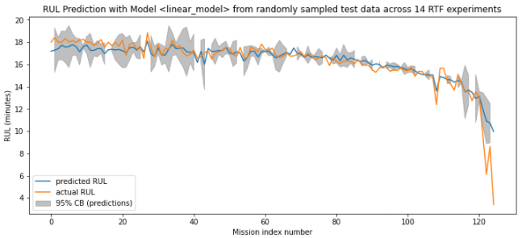
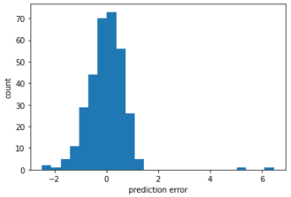
Model development
(there is a long road ahead – just getting started)
Test results
Training loss
Features
Prediction distribution*
Error distribution

Slide 10
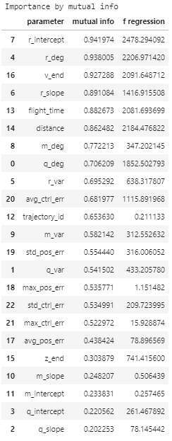
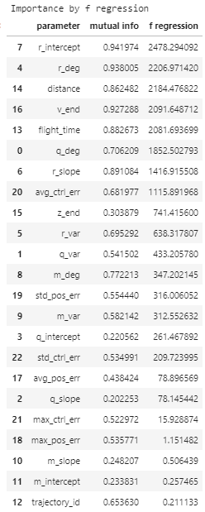
The data – feature importance (on RUL)
Importance by mutual info
Importance by F & p values
Top features are marked by each method
Largest difference in features is trajectory ID
Perform model development with these features – not all!
Cluster with these features – not all!

Slide 11
Clustering analysis

Slide 12
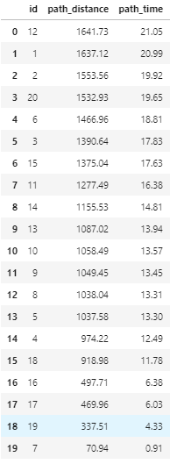
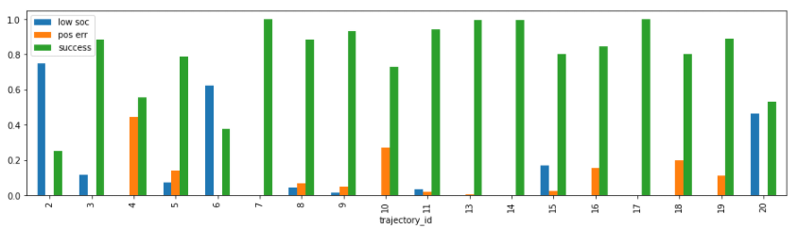
Trajectory analysis

