Slide 1
Refactoring

Slide 2
Refactoring
Goal
Make software easier to understand & maintain
Process to improve design
Modification of internal structure/abstraction
Maintains current functionality
Guided by:
Basic principles, experience, creativity
Why not refactor?
Fear: introduce bugs, too costly
Client won’t pay if no new features
Why refactor?
Long-term benefit
Easier to fix, modify, improve, maintain
Lower long-term development costs
Easier to integrate new developers

Slide 3
Refactoring Process
Incremental improvements
Thorough testing after each (no change in behavior!)
Start with minor modifications, move on to major
Modifications may include:
Renaming class, method, parameter
Moving field to another class
Reducing/Simplifying parameters in a method
Reordering parameters
Extracting a new reusable method
Moving method up/down inheritance hierarchy
Extracting a new superclass
Replacing branching with polymorphism
Simplifying branching complexity
Reduce nesting

Slide 4

Refactoring Process
Testing
Thoroughly test software after modification(s)
Unit testing performed during process
Tests on individual modules/methods/classes
When to perform? Difficult to know…
Consider future cost of development
How long will this code exist?
Along the way….
When are you done? Never…

Slide 5
Refactoring Step by Step
This is not an exhaustive list…
Just some “rules of thumb” to give you a starting place…
Refactor Namespace & Class Names
Consider the JOB of the class…
Singular Noun, Upper camel-case, no underscores
Refactor Method names
Consider the TASK of the method…
Verb or Verb-phrase
Refactor Variable/Object names
Clarify the role of this variable/object
Each variable gets a comment!
Refactor Parameter Lists
Too many parameters? Poorly named?
Combine into objects
Refactor Code
Repeated code? Make it a method…
Redundant code? Remove it…
Type-driven branching structures? Replace with inheritance…
Built your own data structure? Replace with standard library…
Long methods (> 1 screen)? Break into multiple methods…
Remove global variables
Reduce coupling
Bang for your Buck…
Make changes to large, complex classes, methods, and algorithms before you focus on smaller ones

Slide 6
Principles in Method Extraction
Extracting new methods
From “long” method(s)
Don’t arbitrarily break…
Look for…
Comments that “break” code into chunks
White-space delimiters
Duplicated code (or almost duplicated code…)
Method does “more than one” task
Manage “intellectual” overhead
Programmer’s thinking time is more expensive than machine cycles
Consider the mission
Simple, well-defined
Methods should do one task
Do that task very well
Identify parameterized sub-tasks

Slide 7
Principles in Parameter Refactoring
Simplifying parameter lists
From “long” list
Don’t arbitrarily reduce…
Look for:
Parameters that represent object parts
Ex: x and y coordinates
Lengthy parameter lists
Ambiguous parameters
Repeated parameters
Duplicate return value?
Unnecessary parameters
State-related parameters
Move to member data?
Consider the mission…
What is necessary?
Options:
Combine parameters into a single object
Ex: Point instead of x and y
Move parameters to data members
Remove unnecessary, repeated parameters

Slide 8
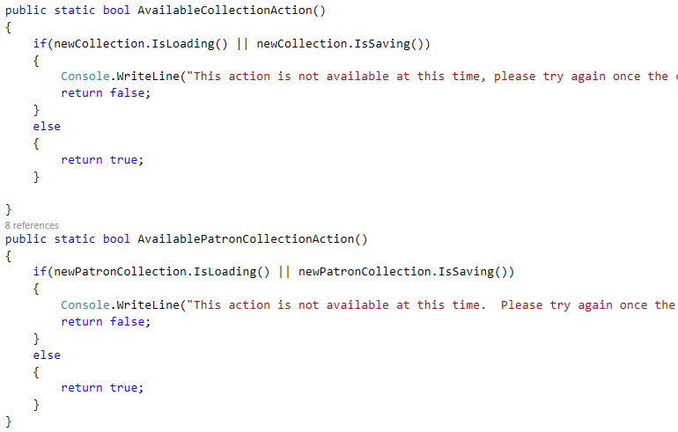
Refactor THIS

Slide 9
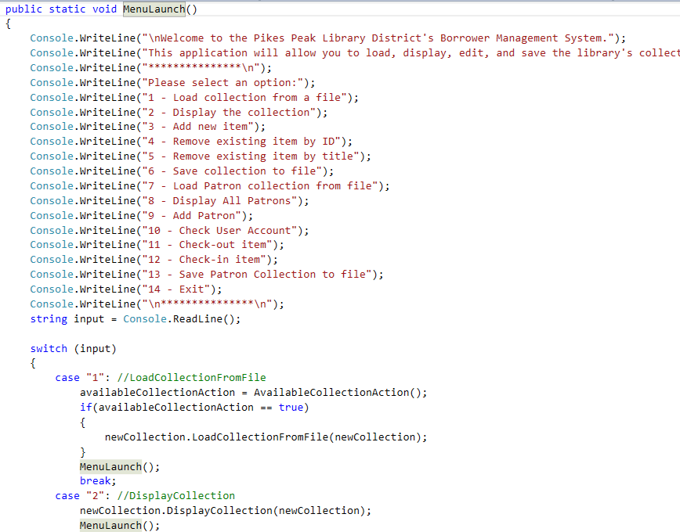
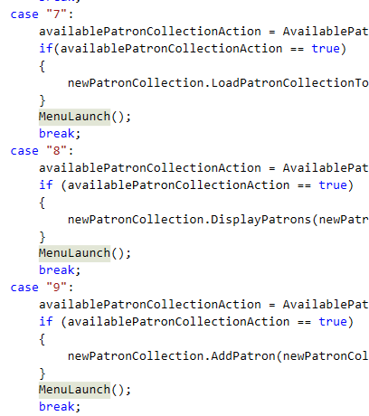
Refactor THIS

Slide 10
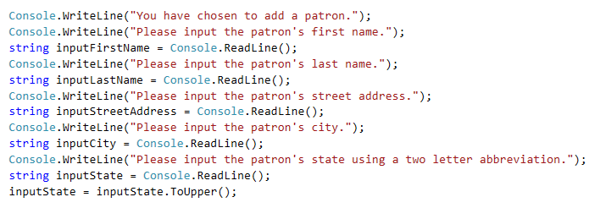
Refactor THIS

Slide 11
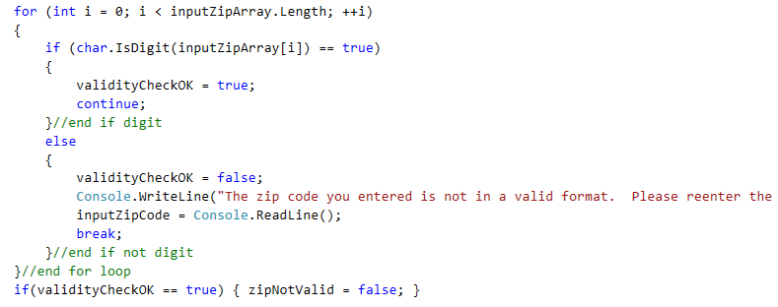
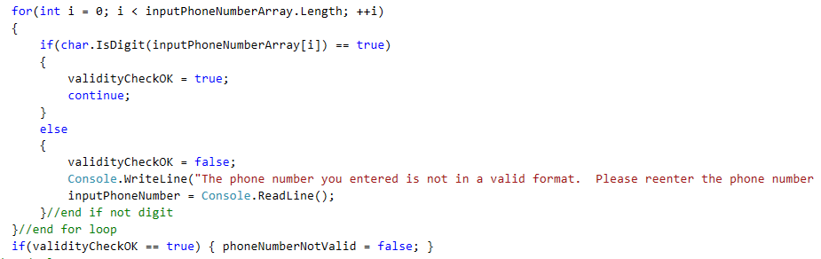
Refactor THIS

Slide 12
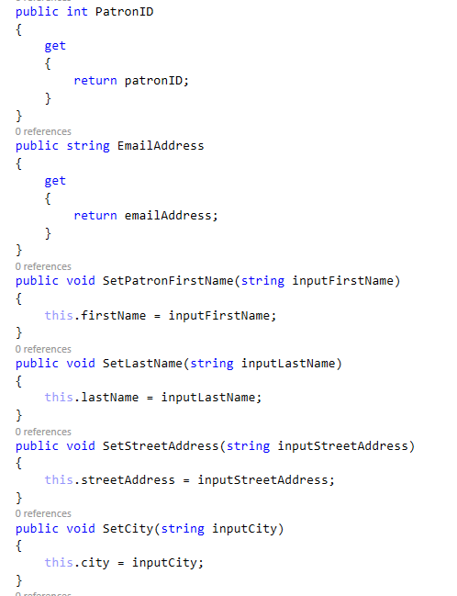
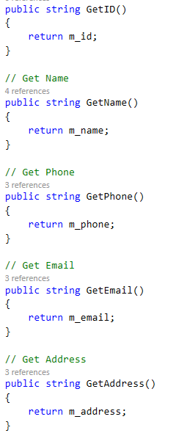
Refactor THIS

Slide 13

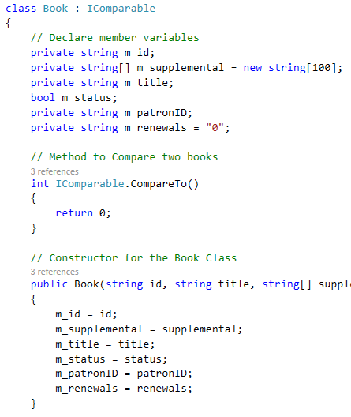
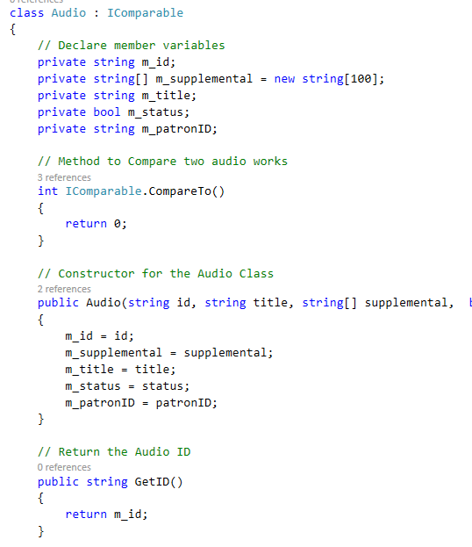
Refactor THIS

Slide 14
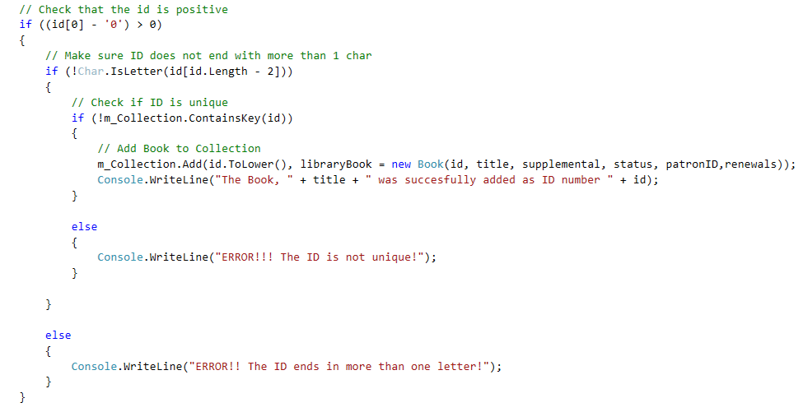
Refactor THIS

Slide 15
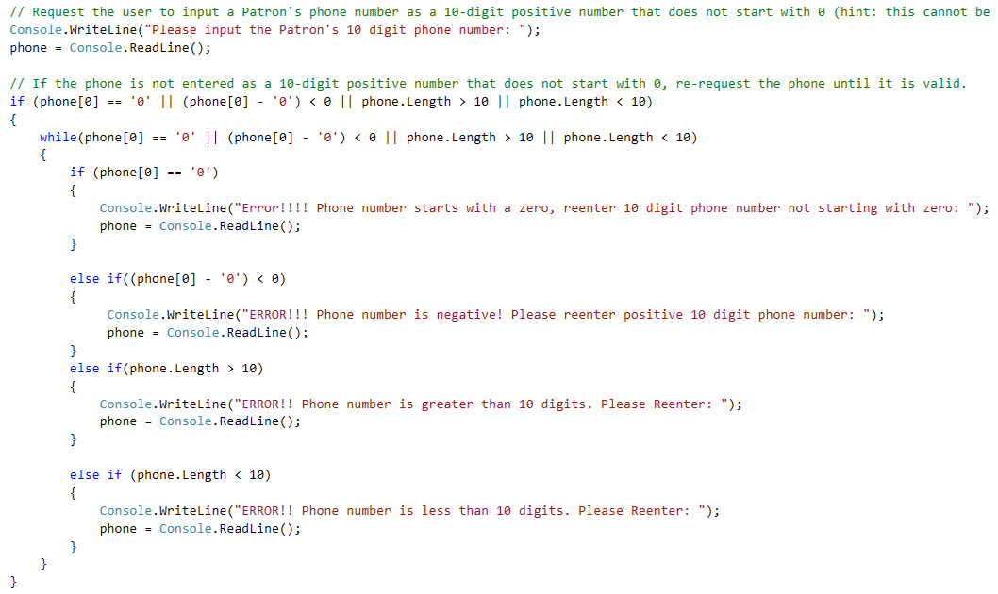
Refactor THIS

Slide 16
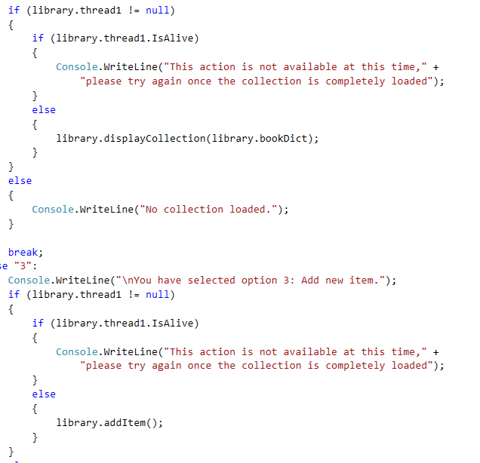
Refactor THIS

Slide 17
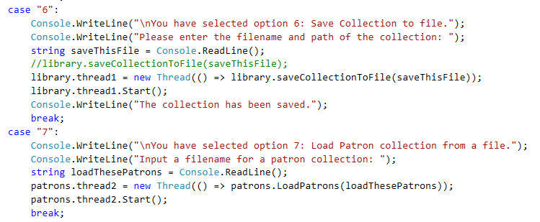
Refactor THIS

Slide 18
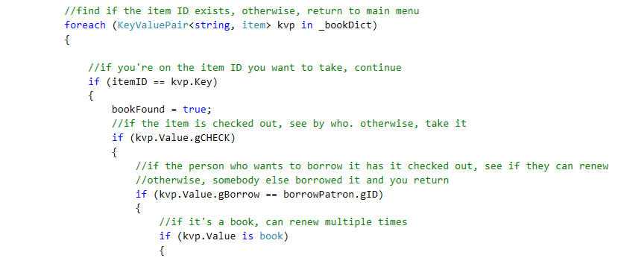
Refactor THIS

Slide 19
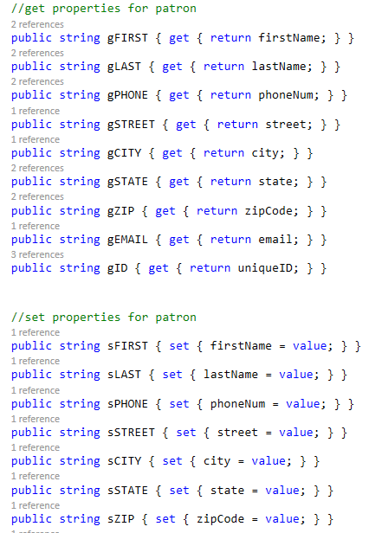
Refactor THIS

Slide 20
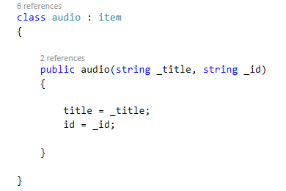
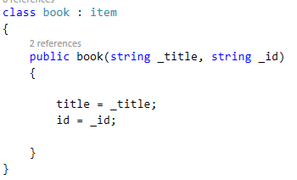
Refactor THIS

Slide 21
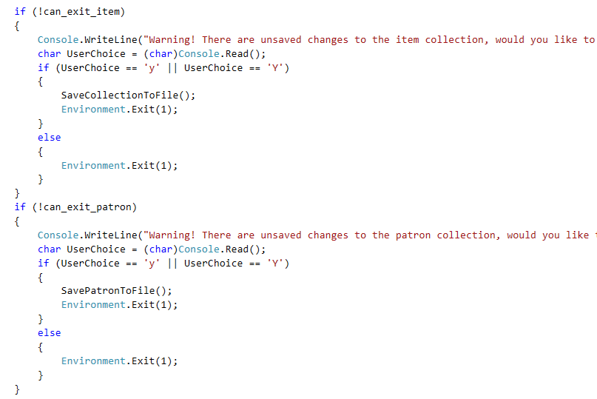
Refactor THIS

Slide 22
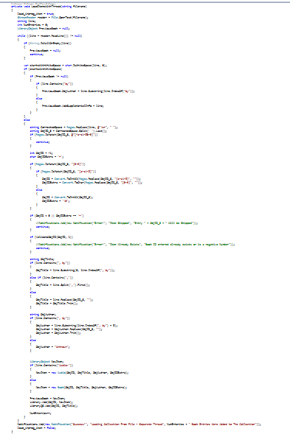
Refactor THIS

Slide 23
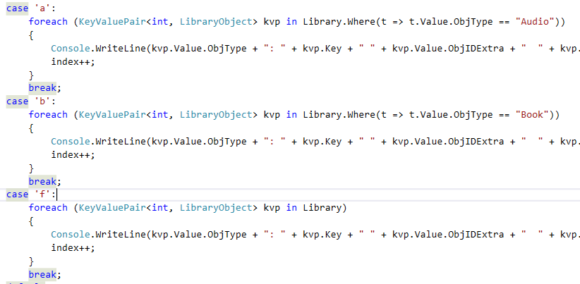
Refactor THIS

Slide 24
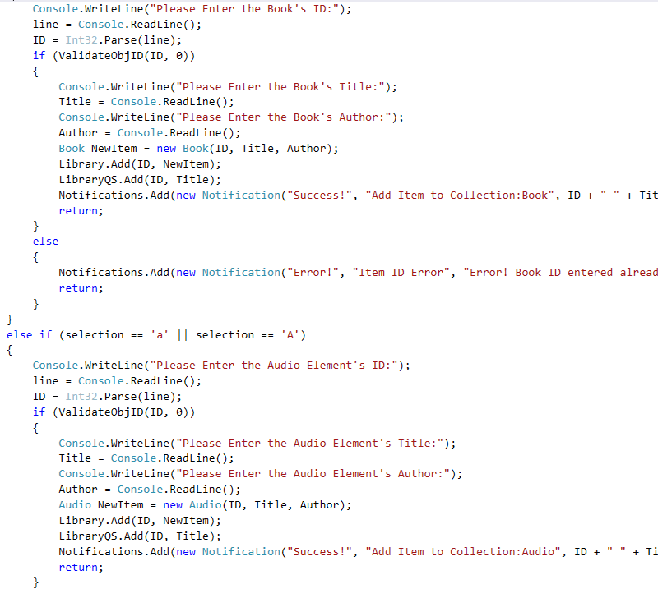
Refactor THIS

Slide 25
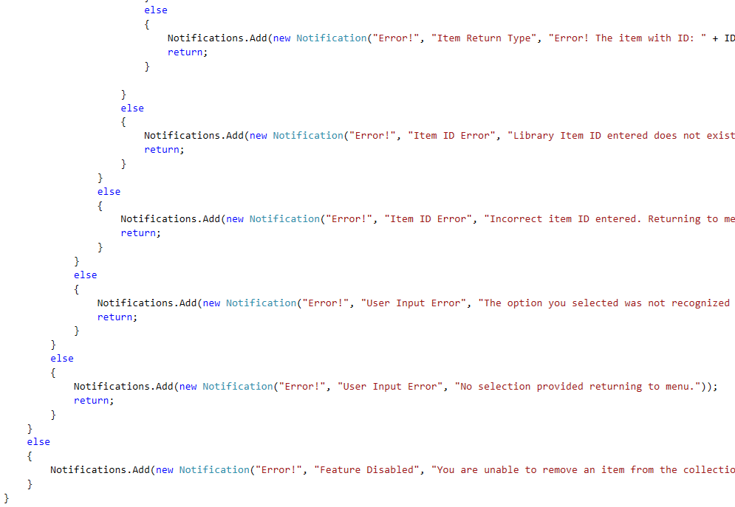
Refactor THIS

Slide 26
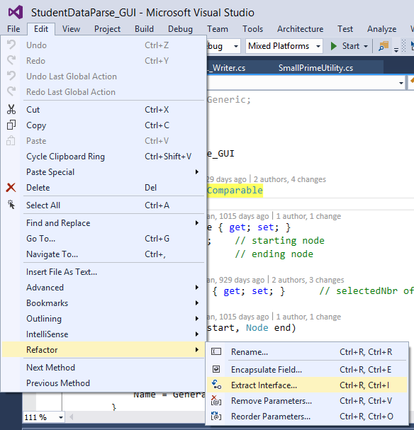
Refactoring in Visual Studio
Rename
Change namespace, class, method, field, or property name
Encapsulate Field
Change a field into a property with get/set
Extract Interface
Convert a common method into an interface
Remove Parameters
Simply a method interface
Reorder Parameters
Reorganize for clarity or to override a method

Slide 27
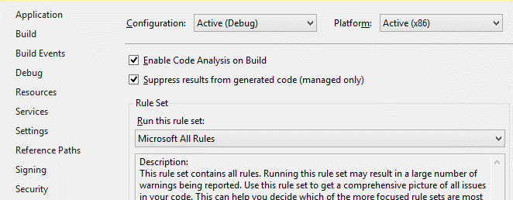
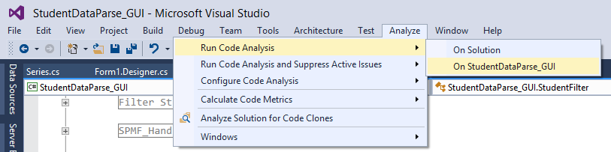
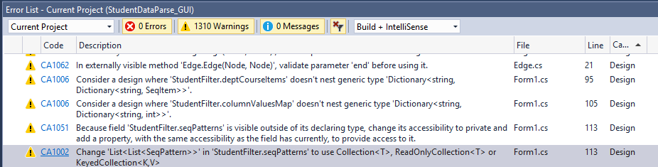
Code Analysis
Enable Code Analysis in Project Properties
Select “Microsoft All Rules” as the Rule Set
Run Code Analysis on your project or solution
Review the Errors/Warnings
Consider making the changes suggested

Slide 28
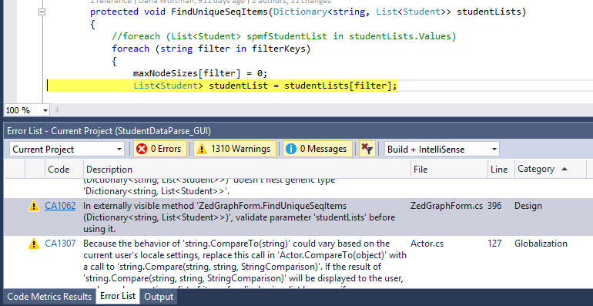
Code Analysis

Slide 29
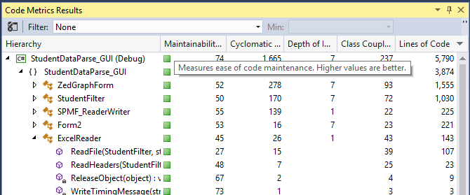
Code Metrics
Don’t focus on absolute numbers, consider relative values instead. Focus on the “biggest” issues first…
Header | Description | Good | Ok | Bad
Maintainability | Overall ease of maintenance score | >50% (MSDN says 20%) | 10-50% | < 10%
Cyclomatic Complexity | Branching & Looping | 0-9 | 10-20 | > 20
Depth of Inheritance | Number of base classes | 0-2 | 3-4 | > 4
Class Coupling | Class Interactions | 0-9 | 10-30 | > 30
Lines of Code | Functional lines | 1-10 | 11-20 | > 20

Slide 30
Visual Studio Links
Code Metrics Values
https://msdn.microsoft.com/en-us/library/bb385914.aspx
Code Analysis
https://msdn.microsoft.com/en-us/library/3z0aeatx.aspx
Refactoring Features
Encapsulate Field
https://msdn.microsoft.com/en-us/library/a5adyhe9.aspx
Extract Interface
https://msdn.microsoft.com/en-us/library/fb3dyx26.aspx
Remove Parameters
https://msdn.microsoft.com/en-us/library/0c7wac46.aspx
Reorder Parameters
https://msdn.microsoft.com/en-us/library/5ss5z206.aspx

