Slide 1
A Heuristic Model to Solve Constraint Satisfaction Problem
Ryan Darras
Sudhanshu Semwal
Yanyan Zhuang
Tim Chamillard

Slide 2
Outline
Introduction
Khot’s Unique Games Conjecture
0-1 Knapsack
Implementation & Data
Graph Coloring
Implementation & Data
The Random Game
Implementation & Data
Conclusion

Slide 3
Introduction
Why Khot’s Conjecture?
Why the focus problems?
0-1 Knapsack
Graph Coloring
The Random Game
Notes:
Khot’s conjecture – I’ve always been able to “imagine” a solution to a problem until I really started looking at this conjecture. It gave me the opportunity as a young software engineer to research something that stumps even the most brilliant minds. I also wanted to portray the conjecture in a way that less experienced people like myself can understand; think of it like this, when you’re at a family reunion but you’re sitting at the kids table because you’re 12 years old. The grown ups are talking about politics, bills, work, and so on, and despite how much you want to be “grown up” you don’t understand any of it. I wanted to be the one that reached out to those interested, but unable to understand, and help give them a clearer picture.
Focus problems
0-1 Knapsack – Honestly, I started with the 0-1 knapsack because I understood it very well and could easily debug my implementation if I was getting unexpected results. The solution space is reasonable for a human brain to grasp.
Graph Coloring – One of the most relatable problems to Khot’s Conjecture. Working with this problem was ultimately what inspired me to create the Random Game which really helped me get a better understanding of why Khot’s Conjecture is so important.
The Random Game – After hours and hours of trying to figure out how to make a “better” algorithm that could solve the Graph Coloring problem I decided I would simply find every possible solution to a small graph and use that data to help understand why these types of problems are so challenging. This is where I truly discovered Khot’s discussion of how it can be NP-Hard to prove that there is no solution to a given problem. Sometimes you can easily tell that the constraints will not work B – G – B with constraints B & G, G & G. But in the end, you need to do a near full solution space search to find some of these conflicts.
Goals and objectives

Slide 4
Khot’s Unique Games Conjecture
Proposes that it is NP-Hard to approximate the value of the Unique Game.
The value of the Unique Game is the largest fraction of constraints that can be satisfied by any state of the problem. 0 = fully satisfiable, 0 = fully unsatisfiable
Notes:
A unique game is essentially picking an edge v,w and fixing a label to v which results in w having one, and only one option.
The interesting thing about the unique games conjecture to me is that solving for the value of a satisfiable problem is (relatively) simple. Once you find a satisfied state of the problem, the answer is 1. However, trying to find the value of an un-satisfiable problem is much more complicated because (in theory) the only way to do it is to try every single possible state and calculate the value to find the best.

Slide 5
0-1 Knapsack
Knapsack with a weight limit W, a collection of items N each with a value v and weight w.
A knapsack problem in which partial items may not be selected.
Item | 0 | 1 | 2 | 3 | 4
Weight (w) | 1 | 4 | 1 | 12 | 2
Value (v) | 3 | 7 | 2 | 9 | 8
v/w | 3 | 1.75 | 2 | 0.75 | 4
Notes:
A well-known approximation algorithm for the 0-1 knapsack is the “greedy” knapsack algorithm. It simply calculates v/w for each item, sorts, and takes from the top until the knapsack can’t take the next item.

Slide 6
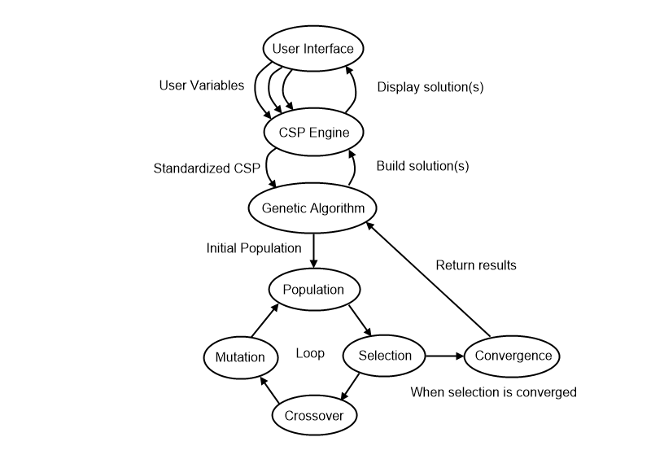
0-1 Knapsack Genetic Algorithm
Size = x + y
Where x = y(y-1)/2
Heuristic variables
Priority of low weight
Priority of high weight
Priority of low value
Priority of high value
Genetic Algorithm Fitness
Total value of knapsack
Notes:
Due to the confusing nature of Khot’s Conjecture and my interest in genetic algorithms, I wanted to see what a genetic algorithm would do when faced against this problem. My thought was that seeing how the genetic algorithm worked might inspire me to try different methods on the other problems. I learned a ton from this process and watching the genetic algorithm progressed helped me understand why Khot’s Conjecture is so interesting.
I produced an interesting formula that forces the size of the total population, and the fittest population used for breeding, to be the perfect value that allows for all the fittest to breed with all others; giving us a fully encapsulated new generation of all parent combinations. Dependent on the variables randomly selected though determines how much of parent 1 the new child will be vs how much of parent 2. Same with the mutation variable.
I used very simple heuristic variables and was correct in my prediction of how the genetic algorithm would tune them. However, what I found incredibly interesting is that you would think the variables would be 1-0-0-1 low weight, high weight, low value, high value, but the genetic algorithm would figure out more optimal solutions for each given instance. For example, you have 5 weight left available in the knapsack, but the next highest “greedy” option weighs 4 leaving space for 1 weight. You, however, have 4 objects left. (v, w) (4, 4) (2.85, 3) (1.85, 2) (.2, 1). A greedy algorithm would take the object with a weight of 4, then an object with a weight of 1 giving you a value of 4.2 for that 5 weight. The optimal answer would be to take the objects with a weight of 3 and 2, giving you a value of 4.7. The genetic algorithm applied very slight adjustments to the heuristic variables to account for these situations. Assume the previous example where the object with weight 1 was .5 weight – with a “low weight” variable set to 1, the 4,.5 weight option would be more satisfying than the 3,2 weight option. By slightly adjusting low weight a little lower, and high weight a little higher the genetic algorithm forced itself to find the correct solution.
Here I learned that while I used the genetic algorithm to solve for the optimal heuristics for a given knapsack problem, that those optional heuristics don’t apply to all knapsack problems. This demonstrated that while using genetic algorithms to solve for heuristic variables can be useful, it shouldn’t be a go-to solution for all CSPs.

Slide 7
0-1 Knapsack Data
All 0-1 knapsack data is as follows:
Knapsack with capacity of 300
300 randomly generated objects with weights and values between 10-20.
All population sizes are 528.
The “fittest” population size is 33.
Convergence requirement is that all chromosomes considered “fit” were within 5% of each other.
Notes:
Due to the confusing nature of Khot’s Conjecture and my interest in genetic algorithms, I wanted to see what a genetic algorithm would do when faced against this problem. My thought was that seeing how the genetic algorithm worked might inspire me to try different methods on the other problems. I learned a ton from this process and watching the genetic algorithm progressed helped me understand why Khot’s Conjecture is so interesting.
I produced an interesting formula that forces the size of the total population, and the fittest population used for breeding, to be the perfect value that allows for all the fittest to breed with all others; giving us a fully encapsulated new generation of all parent combinations. Dependent on the variables randomly selected though determines how much of parent 1 the new child will be vs how much of parent 2. Same with the mutation variable.
I used very simple heuristic variables and was correct in my prediction of how the genetic algorithm would tune them. However, what I found incredibly interesting is that you would think the variables would be 1-0-0-1 low weight, high weight, low value, high value, but the genetic algorithm would figure out more optimal solutions for each given instance. For example, you have 5 weight left available in the knapsack, but the next highest “greedy” option weighs 4 leaving space for 1 weight. You, however, have 4 objects left. (v, w) (4, 4) (2.85, 3) (1.85, 2) (.2, 1). A greedy algorithm would take the object with a weight of 4, then an object with a weight of 1 giving you a value of 4.2 for that 5 weight. The optimal answer would be to take the objects with a weight of 3 and 2, giving you a value of 4.7. The genetic algorithm applied very slight adjustments to the heuristic variables to account for these situations. Assume the previous example where the object with weight 1 was .5 weight – with a “low weight” variable set to 1, the 4,.5 weight option would be more satisfying than the 3,2 weight option. By slightly adjusting low weight a little lower, and high weight a little higher the genetic algorithm forced itself to find the correct solution.
Here I learned that while I used the genetic algorithm to solve for the optimal heuristics for a given knapsack problem, that those optional heuristics don’t apply to all knapsack problems. This demonstrated that while using genetic algorithms to solve for heuristic variables can be useful, it shouldn’t be a go-to solution for all CSPs.

Slide 8
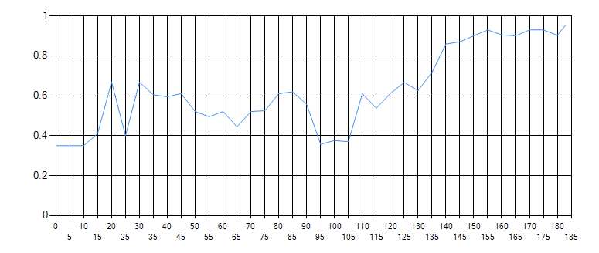
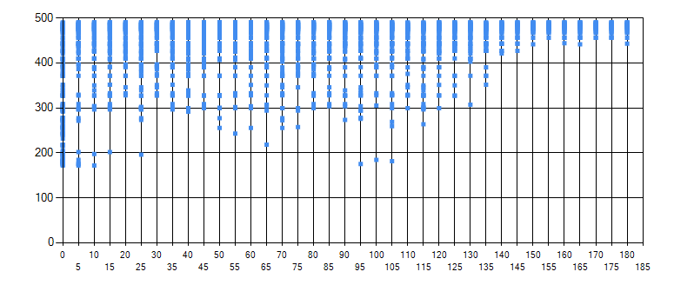
0-1 Knapsack Data - Balanced
Min Weight | Max Weight | Min Value | Max Value | Total Value
0.937 | 0.334 | 0.394 | 1 | 490.279
1 | 0.17 | 0.267 | 0.972 | 488.994
1 | 0.294 | 0.284 | 0.878 | 488.303
1 | 0.153 | 0.267 | 0.92 | 485.735
1 | 0.361 | 0.248 | 0.629 | 484.262
% Chromosomes Mutated | 50%
% Genes Mutated | 50%
Maximum % Mutation Deviation | 25%

Slide 9
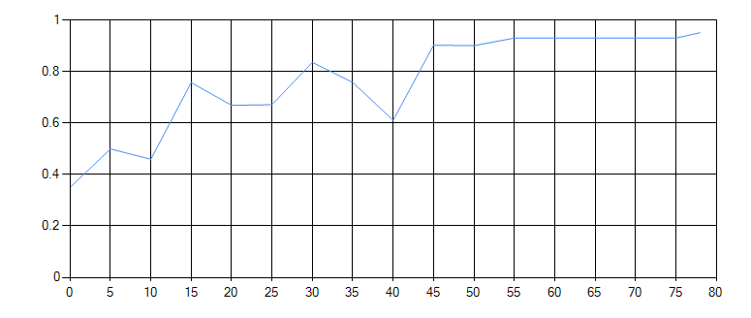
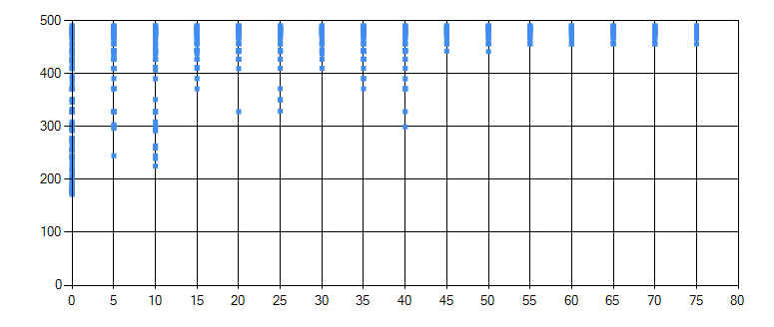
0-1 Knapsack Data - Liberal
Min Weight | Max Weight | Min Value | Max Value | Total Value
1 | 0.015 | 0.039 | 0.976 | 490.279
1 | 0.006 | 0.04 | 0.89 | 488.994
1 | 0.006 | 0.032 | 0.854 | 488.303
1 | 0.007 | 0.043 | 0.837 | 485.735
1 | 0.007 | 0.021 | 0.35 | 485.472
% Chromosomes Mutated | 100%
% Genes Mutated | 100%
Maximum % Mutation Deviation | 25%

Slide 10
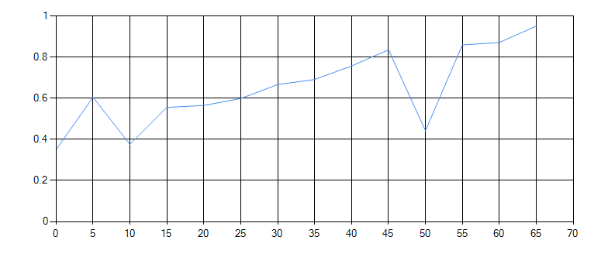
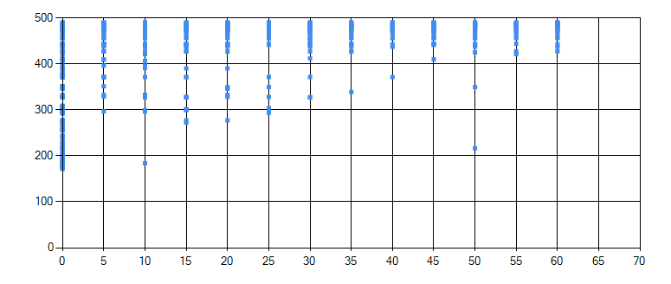
0-1 Knapsack Data - Conservative
Min Weight | Max Weight | Min Value | Max Value | Total Value
0.956 | 0.624 | 0.672 | 1 | 490.279
0.956 | 0.618 | 0.714 | 1 | 488.994
1 | 0.618 | 0.62 | 0.936 | 488.303
1 | 0.771 | 0.643 | 0.811 | 485.735
1 | 0.711 | 0.703 | 0.787 | 485.472
% Chromosomes Mutated | 25%
% Genes Mutated | 25%
Maximum % Mutation Deviation | 25%

Slide 11
0-1 Knapsack Takeaways
Genetic algorithms aren’t always the way to go to get the best possible answer.
So many minor variables are unforeseeable but significantly affect the problem. Hence why Khot’s Conjecture is so interesting.
Genetic algorithms are awesome, and I would like to use them in the future. Abraham Maslow – “If all you have is a hammer, everything looks like a nail” will come to mind when I think about applying it though.

Slide 12
Graph Coloring
We opted for the simple vertex coloring problem, where the only rule is that no node can be neighbored with a node of the same color.
Determining when to cut a branch was based on the four-color theorem proved by Kenneth Appel and Wolfgang Haken.
Ran into complexity issues because our algorithm had two sets of heuristics: one for determining which node to color first, and one for which graph to continue progress on first.
Notes:
As I went through this research, more and more things pointed back to why Khot’s Conjecture is so interesting. In this case, it was that Kenneth Appel and Wolfgang Haken proved the four-color theorem using computers, but because the computer-assisted proof was impossible for a human to verify there were many doubts. Just going to show how some problems can indeed be NP-Hard to verify.
Because of the four-color theorem, if any branch got to the point where it needed to create a 5th color for the next step to be valid, we pruned it. More specifically, our program only knew of four colors and would cut the branch if none of the 4 worked.

Slide 13
Graph Coloring Genetic Algorithm
Genetic Algorithm Fitness
How many nodes were attempted to be colored before the algorithm found a solution
Graph fitness
Priority of total number of current colors
Priority of graph percentage completion
Priority of total number of edges with an uncolored vertex
Node fitness
Priority on total number of uncolored neighbors
Priority on the node’s degree
Notes:
We used two sets of heuristics for this problem that were all mutated and adjusted by the genetic algorithm. The first set was used to determine which of the graphs in the stack were potentially easier to solve. The second set was used in each graph to determine which node should be the next node to change the color of. A good example of why we chose this method is because in my mind, when coloring a graph, you start with the most complex node first (IE the node with the highest degree) and work around it. Also, it is more valuable in my head to try to continue solving a graph that is almost complete rather than trying to solve a graph that is nearly completely unsolved.

Slide 14
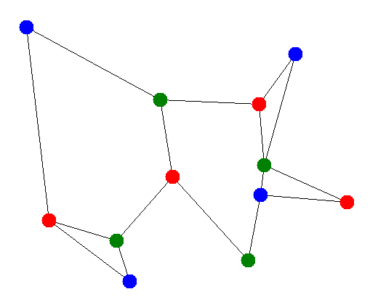
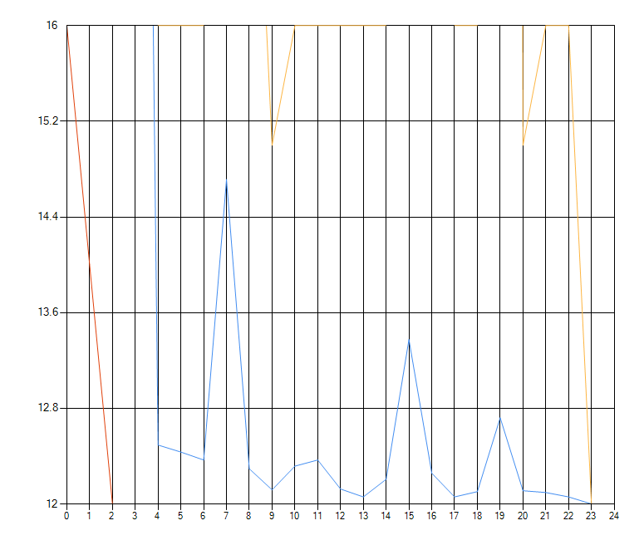
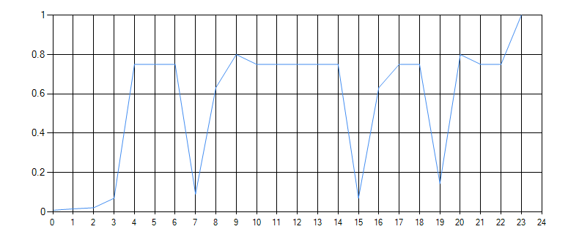
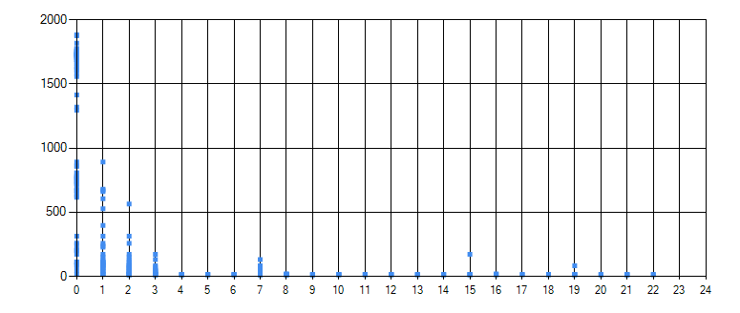
Graph Coloring Data - Balanced
% Chromosomes Mutated | 100%
% Genes Mutated | 25%
Maximum % Mutation Deviation | 25%
Notes:
Yellow = Max Fitness
Blue = Average Fitness
Red = Min Fitness

Slide 15
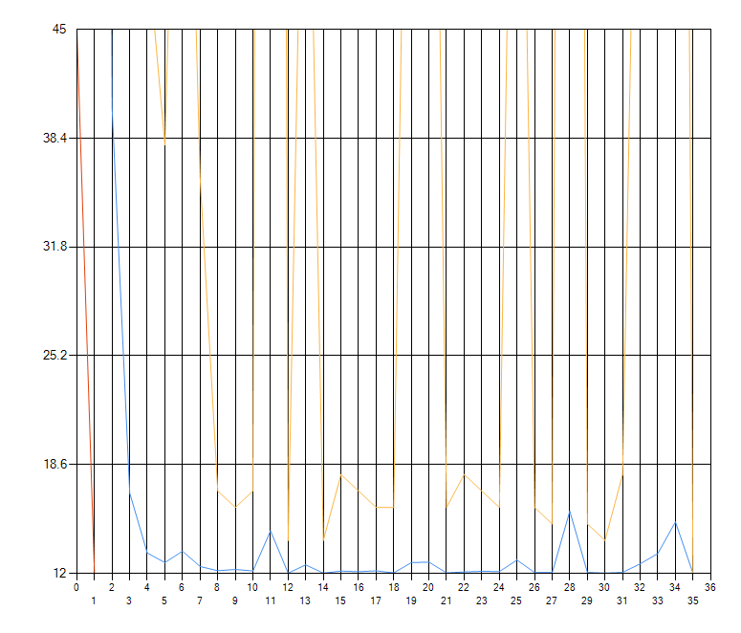
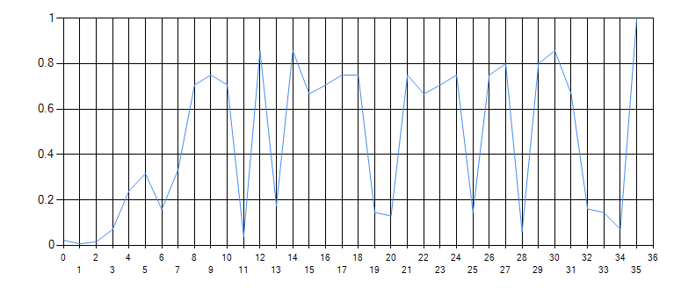
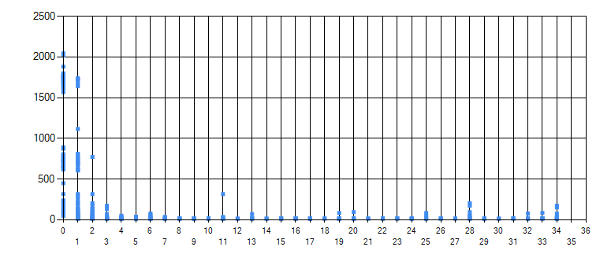
Graph Coloring Data - Liberal
% Chromosomes Mutated | 100%
% Genes Mutated | 100%
Maximum % Mutation Deviation | 25%
Notes:
Yellow = Max Fitness
Blue = Average Fitness
Red = Min Fitness

Slide 16
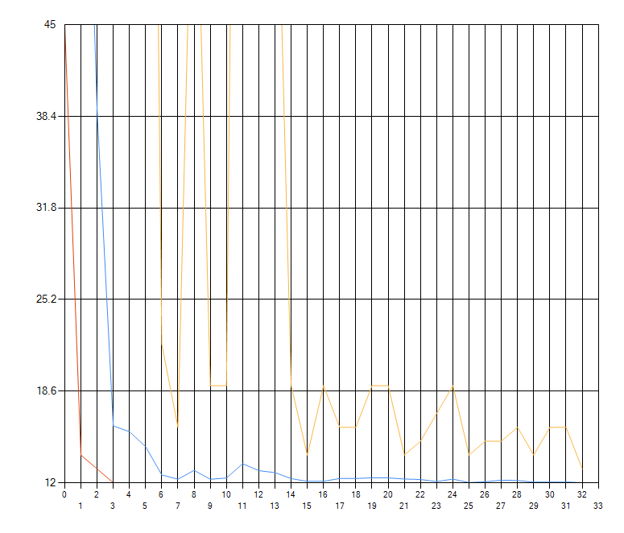
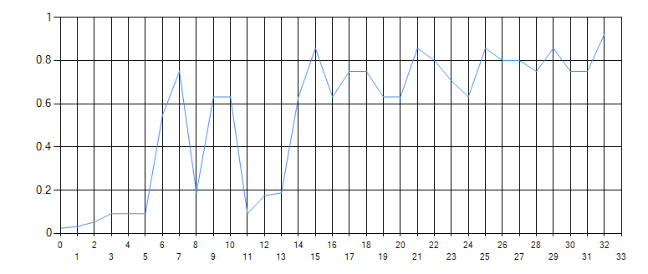
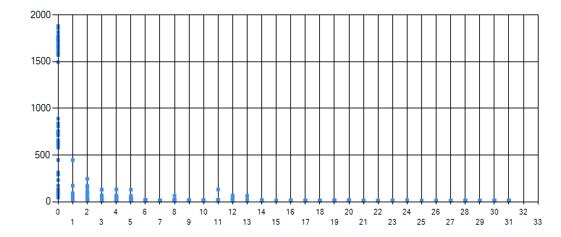
Graph Coloring Data - Conservative
% Chromosomes Mutated | 25%
% Genes Mutated | 25%
Maximum % Mutation Deviation | 25%
Notes:
Yellow = Max Fitness
Blue = Average Fitness
Red = Min Fitness

Slide 17
Graph Coloring Takeaways
Understanding these problems can be difficult because they take a very long time to compute, causing you to have to wait a long time or use simpler problems which aren’t as interesting.
Without an interesting genetic algorithm fitness score, it basically just devolved down to “run until all heuristics solve in one go”.

Slide 18
Graph Coloring - What to change
Allow algorithm to go above 4 node colors and include that information in the fitness of the algorithm.
Optimize the algorithm so that we can experiment with larger graphs.
Notes:
All in all, I wasn’t happy with the results of the Graph Coloring algorithm because it was kind of all-or-nothing. Either the problem was too simple, and we didn’t get any interesting results, or the problem was too complex and would take my computer 400 years to solve.

Slide 19
The Random Game

Slide 20
Conclusion

