Slide 1
Exploring the Unique Games Conjecture
Ryan Darras
Sudhanshu Semwal
Yanyan Zhuang
Tim Chamillard
Notes:
Over the past couple of years, Dr. Semwal and I have been exploring the Unique Games Conjecture postulated by Subhash Khot. Thank you for being here, and we have a lot to get through so lets go ahead and begin.

Slide 2
Outline
Introduction
Khot’s Unique Games Conjecture
0-1 Knapsack
Implementation & Data
Graph Coloring
Implementation & Data
The Random Game
Implementation & Data
Conclusion
Notes:
We will start off with an introduction, explain Khot’s Unique Games Conjecture, and then I will discuss the methods we used to get a better understanding of the complicated Conjecture. Specifically, through the 0-1 knapsack problem, graph coloring problem, and a problem that we created called the random game. Finally we will end with a conclusion.

Slide 3
Introduction
Why Khot’s Conjecture?
Why the focus problems?
0-1 Knapsack
Graph Coloring
The Random Game
Notes:
So to start off, I’ve always been able to “imagine” a solution to a problem until I really started looking at this conjecture. It gave me the opportunity as a young software engineer to research something that stumps even the most brilliant minds. I also wanted to portray the conjecture in a way that less experienced people like myself can understand; think of it like this, when you’re at a family reunion but you’re sitting at the kids table because you’re 12 years old. The grown ups are talking about politics, bills, work, and so on, and despite how much you want to be “grown up” you wouldn’t be able to understand any of it. I wanted to be the one that reached out to those interested, but unable to understand, and help give them a clearer picture.
For the focus problems, we started the 0-1 Knapsack problem. Honestly, I started with the 0-1 knapsack because I understood it very well and could easily debug my implementation if I was getting unexpected results. And the solution space is reasonable for a human brain to grasp.
Then we worked with the graph coloring problem because of how closely it relates to Khot’s Conjecture. We used the simplest graph coloring constraint which states no two vertices can share the same color. Working with this problem was ultimately what inspired me to create the Random Game which really helped me get a better understanding of why Khot’s Conjecture is so important.
Which leads us to the Random Game – After hours and hours of trying to figure out how to make a “better” algorithm that could solve the Graph Coloring problem I decided I would simply find every possible solution to a small graph and use that data to help understand why these types of problems are so challenging. This is where I truly discovered Khot’s discussion of how it can be NP-Hard to prove that there is no solution to a given problem. Sometimes you can easily tell that the constraints will not work, for example…

Slide 4
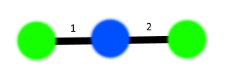
Example
Constraint G & B on edge 1
Constraint G & G on edge 2
Can easily see that this is an invalid coloring
Notes:
The following graph has two constraints. Edge 1 must be colored Green and Blue, which it is. Edge 2 must be colored Green and Green, which it is not. So, we can easily see with our human eyes that this is an invalid coloring. However, graphs can become much more complicated, and the conflicts are much more difficult to discover, as we look at an example from later in the presentation.

Slide 5
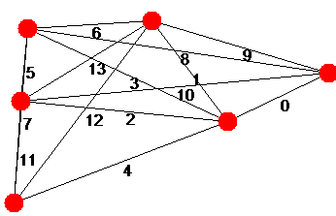
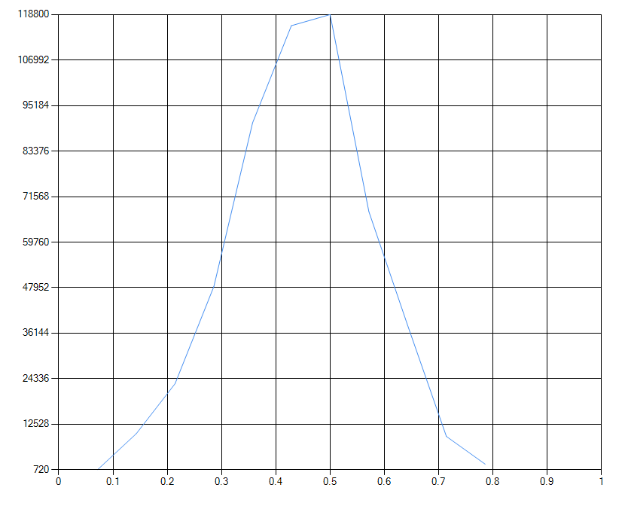
The Random Game Data
Satisfied | Count
7% | 720
14% | 10080
21% | 23040
28% | 48240
35% | 90720
42% | 115920
50% | 118800
57% | 67680
64% | 38160
71% | 9360
78% | 2160
100% | 0
Notes:
This graph has no satisfiable solution, given the constraints on the next slide.
We will talk about this more later in the presentation, but it shows a perfect demonstration of how we can’t wrap our heads around a problem of this magnitude. My best way to describe it would be that in theory, it is technically possible for a constraint on an edge on the far left side of the graph that requires it’s two neighbors to be Green and Blue. But, while there may be a satisfiable solution one way, when you swap the two colors it percolates a problem that conflicts with a constraint on an edge on the far right side of the graph.

Slide 6
The Random Game Data
Edge 0 constraint: Constraint_MustBeSameColor
Edge 1 constraint: Constraint_MustBeSameColor
Edge 2 constraint: Constraint_MustNotBeOneOfEach(Color [Blue], Color [Blue]) - Constraint_MustNotBeOneOfEach(Color [Blue], Color [Blue]) - Constraint_MustNotBeOneOfEach(Color [Red], Color [Blue])
Edge 3 constraint: Constraint_MustNotBeOneOfEach(Color [Blue], Color [Blue]) - Constraint_MustNotBeOneOfEach(Color [Green], Color [Red])
Edge 4 constraint: Constraint_MustBeSameColor
Edge 5 constraint: Constraint_MustBeOneOfEach(Color [Blue], Color [Red]) - Constraint_MustBeOneOfEach(Color [Blue], Color [Green]) - Constraint_MustBeOneOfEach(Color [Blue], Color [Blue])
Edge 6 constraint: Constraint_MustBeSameColor
Edge 7 constraint: Constraint_MustBeOneOfEach(Color [Green], Color [Blue]) - Constraint_MustBeOneOfEach(Color [Green], Color [Blue])
Edge 8 constraint: Constraint_MustNotBeOneOfEach(Color [Blue], Color [Green]) - Constraint_MustNotBeOneOfEach(Color [Red], Color [Blue]) - Constraint_MustNotBeOneOfEach(Color [Blue], Color [Green])
Edge 9 constraint: Constraint_MustBeOneOfEach(Color [Green], Color [Blue]) - Constraint_MustBeOneOfEach(Color [Green], Color [Red])
Edge 10 constraint: Constraint_MustBeSameColor
Edge 11 constraint: Constraint_MustBeOneOfEach(Color [Red], Color [Blue]) - Constraint_MustBeOneOfEach(Color [Blue], Color [Blue]) - Constraint_MustBeOneOfEach(Color [Green], Color [Green])
Edge 12 constraint: Constraint_MustBeDifferentColor
Edge 13 constraint: Constraint_MustBeOneOfEach(Color [Blue], Color [Blue]) - Constraint_MustBeOneOfEach(Color [Green], Color [Red]) - Constraint_MustBeOneOfEach(Color [Green], Color [Red])
Notes:
We will talk more about these constraints later, but this set of constraints is what makes the graph unsatisfiable.

Slide 7
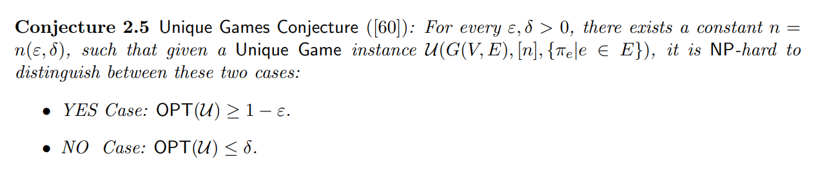
Khot’s Unique Games Conjecture
In English, when the results of the unique game is 1 it is very easy to solve. However, when the best result of the unique game is 1 – ε it is much more difficult to solve.
Notes:
On to the conjecture. The easiest way to explain this, in my opinion, is that when the best value of the unique game is 1, it is very easy to find a labeling in polynomial time. We can simply assume we have the correct label for one vertex (by trying all possible labels to it), and then whenever we know a label for one vertex, it uniquely fixes labels to its neighbors and so on. However, when the best value of the unique game is 1 – epsilon, meaning not fully satisfiable, it is NP-Hard to find the correct labeling. Similarly, it suggests that even finding a labeling that satisfies a delta fraction of edges is also an NP-Hard problem.

Slide 8
Khot’s Unique Games Conjecture
Proposes that it is NP-Hard to approximate the value of the Unique Game.
The value of the Unique Game is the largest fraction of constraints that can be satisfied by any state of the problem. 1 = fully satisfiable, 0 = fully unsatisfiable
Notes:
Now, a unique game is essentially picking an edge v - w and fixing a label to v which results in w having one, and only one option. And visa versa.
The interesting thing about the unique games conjecture to me is that solving for the value of a satisfiable problem is (relatively) simple. Once you find a satisfied state of the problem, the answer is 1. However, trying to find the value of an un-satisfiable problem is much more complicated because (in theory) the only way to do it is to try every single possible state and calculate the value to find the best (hence the NP-Hardness).

Slide 9
0-1 Knapsack
Knapsack with a weight limit W, a collection of items N each with a value v and weight w.
A knapsack problem in which partial items may not be selected.
Item | 0 | 1 | 2 | 3 | 4
Weight (w) | 1 | 4 | 1 | 12 | 2
Value (v) | 3 | 7 | 2 | 9 | 8
v/w | 3 | 1.75 | 2 | 0.75 | 4
Notes:
Like I said, the first problem we started with was the 0-1 knapsack problem. I’m not going to go too into detail here because I know this mornings audience knows enough about the problem to move forward. However, a well-known approximation algorithm for the 0-1 knapsack is the “greedy” knapsack algorithm. It simply calculates v/w for each item, sorts, and takes from the top until the knapsack can’t take the next item. Our genetic algorithm finds a better solution, but at a cost.

Slide 10
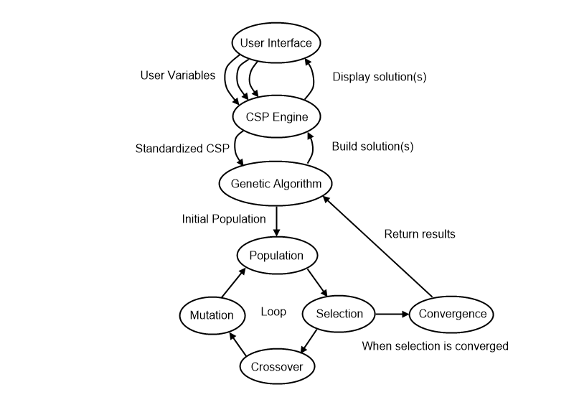
0-1 Knapsack Genetic Algorithm
Heuristic variables
Priority of low weight
Priority of high weight
Priority of low value
Priority of high value
Genetic Algorithm Fitness
Total value of knapsack
Notes:
So due to the confusing nature of Khot’s Conjecture and my interest in genetic algorithms, I wanted to see what a genetic algorithm would do when faced against this problem. My thought was that seeing how the genetic algorithm worked might inspire me to try different methods on the other problems. I learned a ton from this process and watching the genetic algorithm progressed helped me understand why Khot’s Conjecture is so interesting.
I used very simple heuristic variables and was correct in my prediction of how the genetic algorithm would tune them. However, what I found incredibly interesting is that you would think the variables would be 1-0-0-1 low weight, high weight, low value, high value, but the genetic algorithm would figure out more optimal solutions for each given instance. For example…
<COME BACK HERE>
And next, the genetic algorithms fitness would be the goal of the knapsack problem, to get the highest value.
On the right you can see the basic structure of the implementation, but it’s fairly ordinary so I’ll skip passed that for the sake of time.

Slide 11
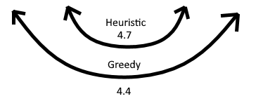
Example
Item | 0 | 1 | 2 | 3
Weight (w) | 4 | 3 | 2 | .5
Value (v) | 4 | 2.85 | 1.85 | .2
v/w | 1 | .95 | .925 | .4
Notes:
For example, you have 5 weight left available in the knapsack, but the next highest “greedy” option weighs 4, leaving space for 1 weight. You, however, have 4 objects left. (v, w) (4, 4) (2.85, 3) (1.85, 2) (.2, .5). A greedy algorithm would take the object with a weight of 4, then an object with a weight of .5 giving you a value of 4.4 for the remainder of the sack. The optimal answer would be to take the objects with a weight of 3 and 2, giving you a value of 4.7.
The genetic algorithm applied very slight adjustments to the heuristic variables to account for these situations. With a “low weight” variable set to 1, the 4,.5 weight option would be more satisfying than the 3,2 weight option. By slightly adjusting low weight a little lower, and high weight a little higher the genetic algorithm forced itself to find the better solution.
<BACK TO PREV SLIDE>

Slide 12
0-1 Knapsack Data
All 0-1 knapsack data is as follows:
Knapsack with capacity of 300
300 randomly generated objects with weights and values between 10-20.
All population sizes are 528.
The “fittest” population size is 33.
x = y(y-1)/2
Convergence requirement is that all chromosomes considered “fit” were within 5% of each other.
Notes:
All of the data generated for this problem is described as follows:
The knapsack has a capacity of 300.
300 objects were randomly generated with weights and values between 10 and 20. Worst case scenario would be weight 20, value 10. Best case scenario would be weight 10, value 20.
All population sizes are 528, and the selected fittest to pass on their genes size is 33. These values were explicitly selected because they allow for all the fittest to breed with all others; giving us a fully encapsulated new generation of all parent combinations.
Specifically, y times y – 1 (because they don’t breed with themselves) divided by 2 because we only need to count each pair once. (think like a bubble sort using a nested loop. Once you run once, you know that the highest value is at the end, so there is no reason to check it. By the last iteration, at most you are swapping index 0 and 1 and you’re done.)
Then we have the convergence requirements that states all of the “fittest” chromosomes must be within a certain range of each other meaning they have converged on a similar answer. The downside to this is that they could possibly converge on the wrong answer.

Slide 13
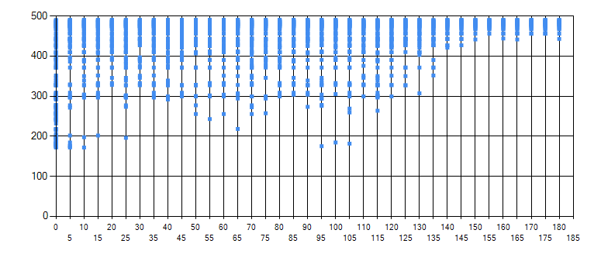
0-1 Knapsack Data - Balanced
Min Weight | Max Weight | Min Value | Max Value | Total Value
0.937 | 0.334 | 0.394 | 1 | 490.279
1 | 0.17 | 0.267 | 0.972 | 488.994
1 | 0.294 | 0.284 | 0.878 | 488.303
1 | 0.153 | 0.267 | 0.92 | 485.735
1 | 0.361 | 0.248 | 0.629 | 484.262
% Chromosomes Mutated | 50%
% Genes Mutated | 50%
Maximum % Mutation Deviation | 25%
Notes:
First, we performed a very balanced run with percent chromosomes mutated at 50%, percent genes mutated at 50% and maximum mutation deviation percentage at 25%.
For example, a heuristic with a value of 2 and a maximum percentage mutation deviation at 25% would mean the new value could be anywhere between 1.5 and 2.5. Similarly, a value of 1 and a max percentage at 25% would be anywhere from .75 to 1.25.
The table on the top right is the top 5 results and their associated heuristic values. What I find the most interesting is how highly max weight and min value were prioritized to produce the best result.
The graph on the bottom shows the fitness levels of all the most fit chromosomes going on to the next generation, every 5 generations (it would have been very messy to include every single generation). You can see the fitnesses converge towards high value. And unfortunately, the way I logged this, I only show every 5th generation. This particular data set actually converged on the 183rd generation.

Slide 14
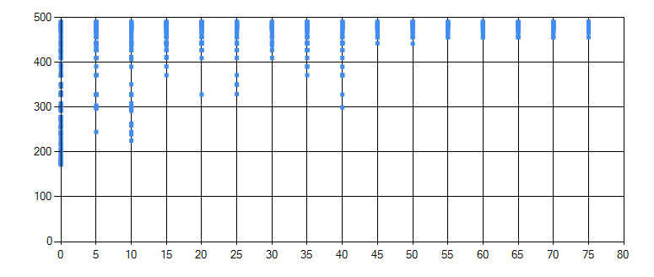
0-1 Knapsack Data - Liberal
Min Weight | Max Weight | Min Value | Max Value | Total Value
1 | 0.015 | 0.039 | 0.976 | 490.279
1 | 0.006 | 0.04 | 0.89 | 488.994
1 | 0.006 | 0.032 | 0.854 | 488.303
1 | 0.007 | 0.043 | 0.837 | 485.735
1 | 0.007 | 0.021 | 0.35 | 485.472
% Chromosomes Mutated | 100%
% Genes Mutated | 100%
Maximum % Mutation Deviation | 25%
Notes:
This is an example of a more liberal approach, where the percentage of chromosomes mutated and the percentage of genes mutated are 100%, resulting in a lot of rapid changes.
What I find most interesting about this approach is how max weight and min value are so low compared to the balanced approach.
Do note that we ended up with the same exact value for the top 5.

Slide 15
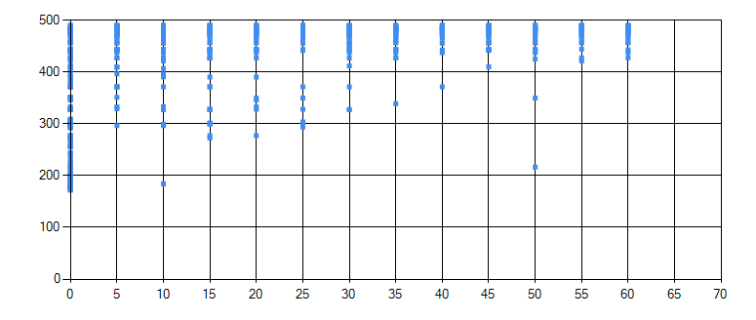
0-1 Knapsack Data - Conservative
Min Weight | Max Weight | Min Value | Max Value | Total Value
0.956 | 0.624 | 0.672 | 1 | 490.279
0.956 | 0.618 | 0.714 | 1 | 488.994
1 | 0.618 | 0.62 | 0.936 | 488.303
1 | 0.771 | 0.643 | 0.811 | 485.735
1 | 0.711 | 0.703 | 0.787 | 485.472
% Chromosomes Mutated | 25%
% Genes Mutated | 25%
Maximum % Mutation Deviation | 25%
Notes:
This is an example of a more conservative approach. Notice how max weight and min value are actually fairly high. It just turns out that it still found the same exact results as the other two approaches.

Slide 16
0-1 Knapsack Takeaways
Genetic algorithms aren’t always the way to go to get the best possible answer. Abraham Maslow – “If all you have is a hammer, everything looks like a nail”
So many minor variables are unforeseeable but significantly affect the problem. Hence why Khot’s Conjecture is so interesting.
Genetic algorithms are awesome, and I would like to use them in the future.
Notes:
From 0-1 knapsack specifically, I learned that genetic algorithms aren’t always the way to get the best possible answer. Abraham Maslow said, “If all you have is a hammer, everything looks like a nail.” Therefore other options should be considered before jumping to a genetic algorithm all the time.
There are also so many minor details about genetic algorithms that force the heuristics to potentially do unpredictable things, hence another reason why Khot’s conjecture is so interesting to me.
Here I also learned that while I used the genetic algorithm to solve for the optimal heuristics for a given knapsack problem, that those optional heuristics don’t apply to all knapsack problems. I generated new datasets with different values, and my heuristics sometimes produced less than the greedy algorithm.

Slide 17
Graph Coloring
We opted for the simple vertex coloring problem, where the only rule is that no node can be neighbored with a node of the same color.
Determining when to cut a branch was based on the four-color theorem proved by Kenneth Appel and Wolfgang Haken.
Ran into complexity issues because our algorithm had two sets of heuristics: one for determining which node to color first, and one for which graph to continue progress on first.
Notes:
Moving on to graph coloring.
We implemented a simple vertex coloring problem, where no two vertices can have a neighbor of the same color.
Now, as I went through this research, more and more things pointed back to why Khot’s Conjecture is so interesting. In this case, it was that Kenneth Appel and Wolfgang Haken proved the four-color theorem using computers, but because the computer-assisted proof was impossible for a human to verify there were many doubts. Just going to show how some problems can indeed be NP-Hard, and confusing, to verify. But because of the four-color theorem, if any branch got to the point where it needed to create a 5th color for the next step to be valid, we pruned it. More specifically, our program only knew of four colors and would cut the branch if none of the 4 worked.
So this was a much more complicated problem than the 0-1 knapsack, which resulted in some datasets taking a long time to calculate. Hence why we used such small graphs because it scales exponentially.

Slide 18
Graph Coloring Genetic Algorithm
Genetic Algorithm Fitness
How many nodes were attempted to be colored before the algorithm found a solution
Graph fitness
Priority of total number of current colors
Priority of graph percentage completion
Priority of total number of edges with an uncolored vertex
Node fitness
Priority on total number of uncolored neighbors
Priority on the node’s degree
Notes:
First, our fitness for the algorithm was simply how many nodes were attempted to be colored before the algorithm found a solution. The perfect answer is n (the number of nodes), where the worst possible answer would be impossible. However, we programmed our solution to allow for 4 colors, so there would always be a solution no matter what.
We used two sets of heuristics for this problem that were all mutated and adjusted by the genetic algorithm. The first set was used to determine which of the graphs in the stack were potentially easier to solve. The second set was used in each graph to determine which node should be the next node to change the color of. A good example of why we chose this method is because in my mind, when coloring a graph, you start with the most complex node first (IE the node with the highest degree) and work around it. Also, it is more valuable in my head to try to continue solving a graph that is almost complete rather than trying to solve a graph that is nearly completely unsolved.

Slide 19
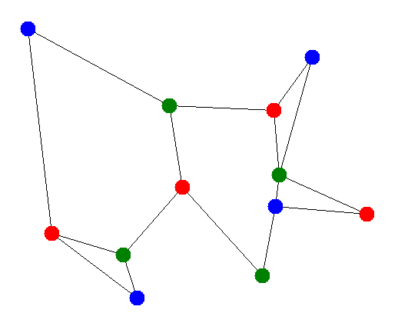
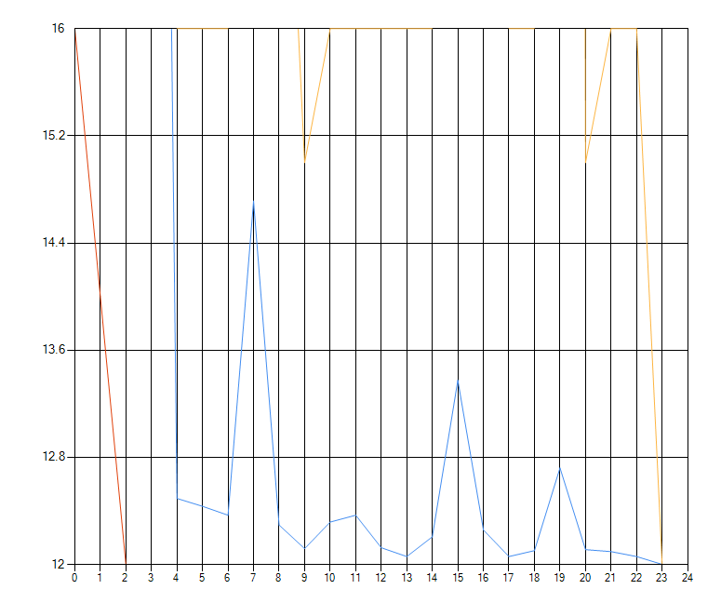
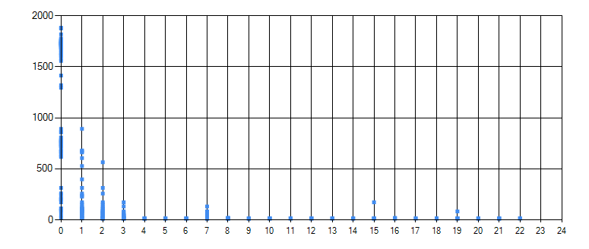
Graph Coloring Data - Balanced
% Chromosomes Mutated | 100%
% Genes Mutated | 25%
Maximum % Mutation Deviation | 25%
Notes:
Again, we started with a balanced genetic algorithm. This time at 100% chromosomes mutated and 25% genes mutated.
Notice how quickly this genetic algorithm converged compared to the 0-1 knapsack. Once it found a solid lead, it was off to the races.
Yellow = Max Fitness
Blue = Average Fitness
Red = Min Fitness

Slide 20
Graph Coloring Data - Balanced
Total Color Count | Color Nodes | Num Edges Neighboring Uncolored | Uncolored Neighbor | Node Degree
0.472 | 0.697 | 0.199 | 0.956 | 1
0.866 | 1 | 0.224 | 0.567 | 0.556
0.325 | 1 | 0.167 | 0.55 | 0.355
1 | 0.914 | 0.298 | 0.574 | 0.947
1 | 0.853 | 0.225 | 0.483 | 0.27
Notes:
Note that in the end, every single one of our fittest chromosomes eventually converged on n (the number of verticies) so the above data is just an example of heuristic values that produced a correct result.

Slide 21
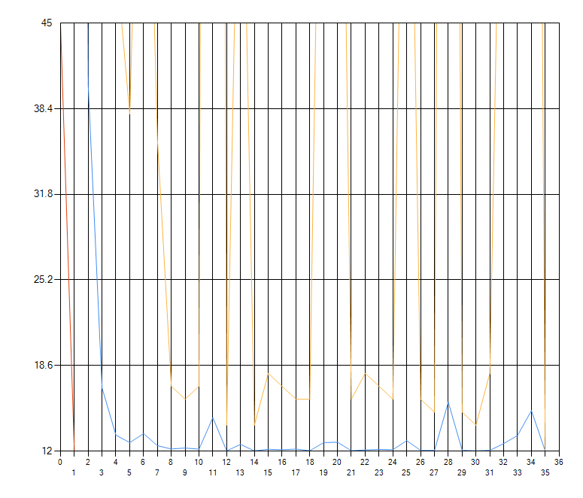
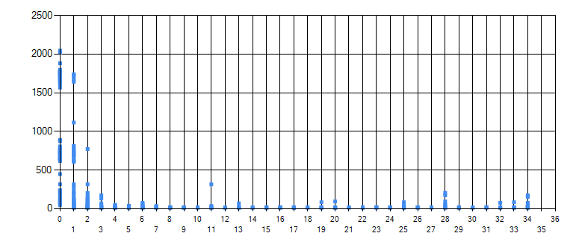
Graph Coloring Data - Liberal
% Chromosomes Mutated | 100%
% Genes Mutated | 100%
Maximum % Mutation Deviation | 25%
Notes:
Then we tried the very liberal approach with 100%, 100%.

Slide 22
Graph Coloring Data - Liberal
Total Color Count | Color Nodes | Num Edges Neighboring Uncolored | Uncolored Neighbor | Node Degree
0.841 | 1 | 0.194 | 0.827 | 0.539
0.34 | 0.487 | 0.039 | 0.094 | 1
0.107 | 1 | 0.086 | 0.773 | 0.508
0.443 | 1 | 0.102 | 0.155 | 0.3
0.473 | 0.767 | 0.131 | 1 | 0.218

Slide 23
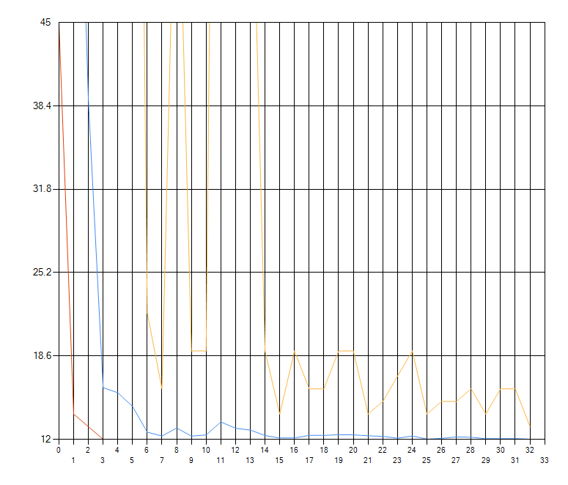
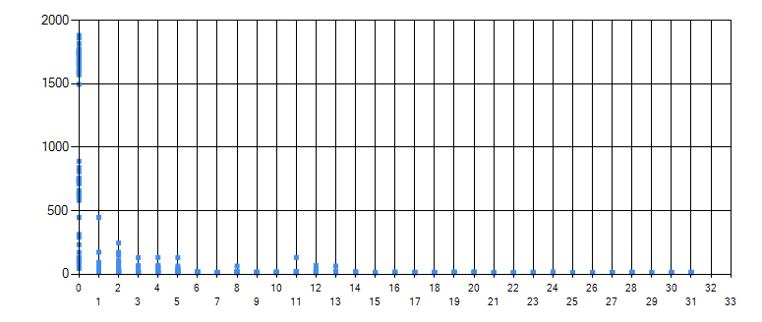
Graph Coloring Data - Conservative
% Chromosomes Mutated | 25%
% Genes Mutated | 25%
Maximum % Mutation Deviation | 25%
Notes:
Then we tried the conservative approach at 25%, 25%.

Slide 24
Graph Coloring Data - Conservative
Total Color Count | Color Nodes | Num Edges Neighboring Uncolored | Uncolored Neighbor | Node Degree
0.596 | 1 | 0.334 | 0.453 | 0.686
0.805 | 1 | 0.327 | 0.855 | 0.864
0.864 | 1 | 0.349 | 0.619 | 0.828
1 | 0.842 | 0.309 | 0.468 | 0.61
0.487 | 1 | 0.259 | 0.396 | 0.486

Slide 25
Graph Coloring Takeaways
Understanding these problems can be difficult because they take a very long time to compute, causing you to have to wait a long time or use simpler problems which aren’t as interesting.
Without an interesting genetic algorithm fitness score, it basically just devolved down to “run until all heuristics solve in one go”.
Notes:
The takeaways for the graph coloring problems were that it was much more difficult to understand and debug because the complexity of the problem results in a much longer time to compute. There is just so many steps in the algorithm that you can’t just step through it. And without an interesting fitness score, it basically just devolved down to until every heuristic was perfect.

Slide 26
Graph Coloring - What to change
Allow algorithm to go above 4 node colors and include that information in the fitness of the algorithm.
Optimize the algorithm so that we can experiment with larger graphs.
Notes:
All in all, I wasn’t happy with the results of the Graph Coloring algorithm because it was kind of all-or-nothing. Either the problem was too simple, and we didn’t get any interesting results, or the problem was too complex and would take my computer 400 years to solve.
Perhaps I could optimize the algorithm a bit to fully use my computer, and then allow the algorithm to be a bit more free with restrictions so that while it may find a solution with 5 colors, it values the solutions with 4 colors at a higher position.

Slide 27
The Random Game
Creates simple graphs and applies 2-3 constraints on each edge.
Nodes must be X and Y
Nodes must not be X and Y
Nodes must be different colors
Nodes must be same color
Solve the entire solution space of all possible map colorings and determine probability of “randomly” solving the graph correctly.
Notes:
Next up is our creation, the Random Game. Knot’s conjecture got me thinking about how some problems don’t have a solution, and that trying to solve them can be very difficult because of it. A good example here is bogo-sort. Bogo-sort literally randomly sorts the collection until it is sorted, but it works because we know that every collection does have a solution to being sorted. Other problems might not actually have a valid solution, so randomly trying to solve it could be infinite! We experimented with this by created the random game and solving the entire solution space. With every coloration found, we can then calculate how many constraints are violated by that coloration, thus showing us the probability of “randomly” guessing the solution.
So our random game is a simple graph with 2-3 constraints on each edge that can be one of the following: <READ FROM ABOVE> Note that for the first two, multiple constraints of that type are selected. For example, nodes must be green and red, nodes must be blue and green. As long as that edge meets one of those constraints, it passes. As for the bottom two, they are impactful enough as is.

Slide 28
The Random Game Algorithm
Simple programming techniques were used to develop the random game and generate the statistics.
Generate a graph
Build a list of every coloration of the graph
Build a list of constraints for each edge
Calculate percentage of satisfied constraints for each coloration
Notes:
There is really nothing special here in terms of the programming or algorithm. What’s more important is the data that was generated and how interesting it is. All we really did was <READ FROM ABOVE>

Slide 29
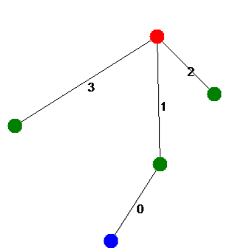
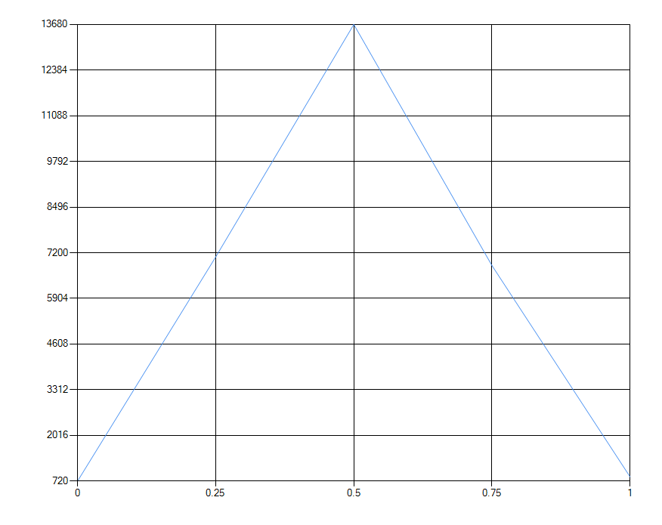
The Random Game Data
Satisfied | Count
0% | 720
25% | 7080
50% | 13680
75% | 6840
100% | 840
Edge 0 constraint: Constraint_MustBeOneOfEach(Color [Blue], Color [Red]) - Constraint_MustBeOneOfEach(Color [Red], Color [Red]) - Constraint_MustBeOneOfEach(Color [Green], Color [Blue])
Edge 1 constraint: Constraint_MustBeOneOfEach(Color [Red], Color [Green]) - Constraint_MustBeOneOfEach(Color [Green], Color [Red])
Edge 2 constraint: Constraint_MustBeOneOfEach(Color [Red], Color [Green]) - Constraint_MustBeOneOfEach(Color [Blue], Color [Blue])
Edge 3 constraint: Constraint_MustNotBeOneOfEach(Color [Green], Color [Green]) - Constraint_MustNotBeOneOfEach(Color [Green], Color [Green])
Notes:
Displayed is a satisfiable solution to the graph given the constraints seen in the table on the bottom. On the right, the table shows the number of colored graphs in the solution space that satisfy a certain percentage of constraints. I hope you’re ready to see some bell curves!

Slide 30
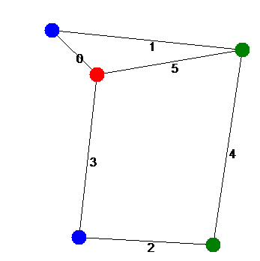
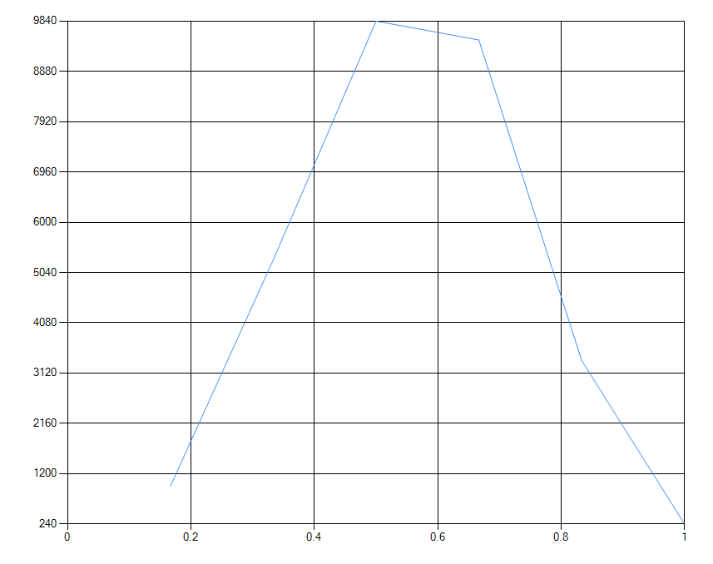
The Random Game Data
Satisfied | Count
16% | 960
33% | 5280
50% | 9840
66% | 9480
83% | 3360
100% | 240
Edge 0 constraint: Constraint_MustBeDifferentColor
Edge 1 constraint: Constraint_MustNotBeOneOfEach(Color [Green], Color [Red]) - Constraint_MustNotBeOneOfEach(Color [Green], Color [Green]) -
Edge 2 constraint: Constraint_MustBeOneOfEach(Color [Blue], Color [Red]) - Constraint_MustBeOneOfEach(Color [Green], Color [Green]) - Constraint_MustBeOneOfEach(Color [Green], Color [Blue]) -
Edge 3 constraint: Constraint_MustBeOneOfEach(Color [Blue], Color [Red]) - Constraint_MustBeOneOfEach(Color [Green], Color [Red]) -
Edge 4 constraint: Constraint_MustBeOneOfEach(Color [Red], Color [Red]) - Constraint_MustBeOneOfEach(Color [Green], Color [Green]) - Constraint_MustBeOneOfEach(Color [Red], Color [Red]) -
Edge 5 constraint: Constraint_MustNotBeOneOfEach(Color [Red], Color [Red]) - Constraint_MustNotBeOneOfEach(Color [Blue], Color [Blue]) - Constraint_MustNotBeOneOfEach(Color [Blue], Color [Blue]) -
Notes:
Here we have a little bit more complex of a graph, with a few more constraints. Something interesting about this is that not a single coloration failed every single constraint. This could be another way to observe Khot’s conjecture – as proving that there is not a single coloration that breaks every constraint is also NP-Hard.

Slide 31
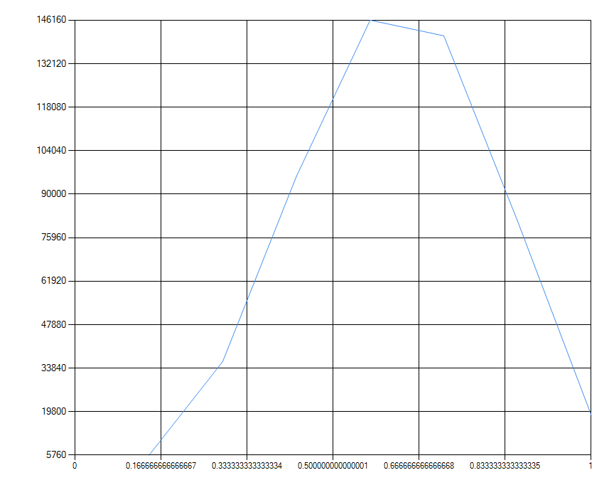
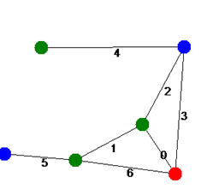
The Random Game Data
Satisfied | Count
14% | 5760
28% | 36000
42% | 95760
57% | 146760
71% | 141120
85% | 81360
100 | 18720
Edge 0 constraint: Constraint_MustNotBeOneOfEach(Color [Blue], Color [Blue]) - Constraint_MustNotBeOneOfEach(Color [Green], Color [Green]) - Constraint_MustNotBeOneOfEach(Color [Blue], Color [Green]) -
Edge 1 constraint: Constraint_MustNotBeOneOfEach(Color [Red], Color [Blue]) - Constraint_MustNotBeOneOfEach(Color [Green], Color [Blue]) - Constraint_MustNotBeOneOfEach(Color [Blue], Color [Green]) -
Edge 2 constraint: Constraint_MustNotBeOneOfEach(Color [Blue], Color [Blue]) - Constraint_MustNotBeOneOfEach(Color [Red], Color [Green]) - Constraint_MustNotBeOneOfEach(Color [Blue], Color [Blue]) -
Edge 3 constraint: Constraint_MustBeDifferentColor
Edge 4 constraint: Constraint_MustBeDifferentColor
Edge 5 constraint: Constraint_MustNotBeOneOfEach(Color [Red], Color [Blue]) - Constraint_MustNotBeOneOfEach(Color [Green], Color [Red]) - Constraint_MustNotBeOneOfEach(Color [Red], Color [Green]) -
Edge 6 constraint: Constraint_MustBeDifferentColor
Notes:
This is just another slightly more complex graph

Slide 32
The Random Game Data
Satisfied | Count
7% | 720
14% | 10080
21% | 23040
28% | 48240
35% | 90720
42% | 115920
50% | 118800
57% | 67680
64% | 38160
71% | 9360
78% | 2160
100% | 0
Notes:
Now this is where the random game got really interesting. As I was running different seeds, I ran across one that crashed my solution (as I didn’t actually account for something not resulting with a satisfied graph). So I ran it again, did some debugging, and found out that this graph actually doesn’t have a satisfiable solution. It’s exactly what Khot was describing!

Slide 33
The Random Game Data
Edge 0 constraint: Constraint_MustBeSameColor
Edge 1 constraint: Constraint_MustBeSameColor
Edge 2 constraint: Constraint_MustNotBeOneOfEach(Color [Blue], Color [Blue]) - Constraint_MustNotBeOneOfEach(Color [Blue], Color [Blue]) - Constraint_MustNotBeOneOfEach(Color [Red], Color [Blue])
Edge 3 constraint: Constraint_MustNotBeOneOfEach(Color [Blue], Color [Blue]) - Constraint_MustNotBeOneOfEach(Color [Green], Color [Red])
Edge 4 constraint: Constraint_MustBeSameColor
Edge 5 constraint: Constraint_MustBeOneOfEach(Color [Blue], Color [Red]) - Constraint_MustBeOneOfEach(Color [Blue], Color [Green]) - Constraint_MustBeOneOfEach(Color [Blue], Color [Blue])
Edge 6 constraint: Constraint_MustBeSameColor
Edge 7 constraint: Constraint_MustBeOneOfEach(Color [Green], Color [Blue]) - Constraint_MustBeOneOfEach(Color [Green], Color [Blue])
Edge 8 constraint: Constraint_MustNotBeOneOfEach(Color [Blue], Color [Green]) - Constraint_MustNotBeOneOfEach(Color [Red], Color [Blue]) - Constraint_MustNotBeOneOfEach(Color [Blue], Color [Green])
Edge 9 constraint: Constraint_MustBeOneOfEach(Color [Green], Color [Blue]) - Constraint_MustBeOneOfEach(Color [Green], Color [Red])
Edge 10 constraint: Constraint_MustBeSameColor
Edge 11 constraint: Constraint_MustBeOneOfEach(Color [Red], Color [Blue]) - Constraint_MustBeOneOfEach(Color [Blue], Color [Blue]) - Constraint_MustBeOneOfEach(Color [Green], Color [Green])
Edge 12 constraint: Constraint_MustBeDifferentColor
Edge 13 constraint: Constraint_MustBeOneOfEach(Color [Blue], Color [Blue]) - Constraint_MustBeOneOfEach(Color [Green], Color [Red]) - Constraint_MustBeOneOfEach(Color [Green], Color [Red])
Notes:
As you can see, there is a lot more constraints here. But they were randomly generated and just as legal as the constraints on the other graphs. It just so happens that somewhere in here, and with the organization of the graph, that there is a conflict that prefects any solution from being valid.

Slide 34
The Random Game Takeaways
It’s much easier to understand a problem when you have the entire solution space.
I now understand why Khot suggests that these problems are sometimes hard to verify if they even have a solution or not.
I wish we could run this on a more complicated graph.
I guess it really is true that bell curves appear everywhere.
Notes:
From developing the random game, I learned that it is much easier to understand a problem when you have the entire solution space (I’m looking at you, graph coloring problem).
I also gained a much more clear understanding about what Khot suggests and why it is so interesting. It’s sometimes as hard to prove that something has a solution as it is to find the solution itself.
I wish I had infinite processing power and could run much more interesting simulations.
And finally, bell curves are all over!

Slide 35
Conclusion
Khot’s Conjecture is hard to really understand until you dive into it. This research has given me a new perspective on computer science and algorithms in general.
I look forward to the day Khot’s Conjecture is proven or disproven.
Notes:
Ultimately, my conclusion comes down to the discovery that there are some things in computer science that are really difficult to wrap your head around. Khot’s Unique Games Conjecture being one of them. However, given some time I was able to jump in and get a much better understanding of the conjecture. So much so that it’s changed the way I approach some problems in my day-to-day.
I also really look forward to the day someone either proves or disproves this conjecture, because that proof is likely going to stem into many other aspects of computer science and potentially push us over a great hump!
Thank you all for being here. I hope you enjoyed the presentation.

