Slide 1
A Heuristic Model to Solve Constraint Satisfaction Problem
Ryan Darras
Sudhanshu Semwal
Yanyan Zhuang
Tim Chamillard

Slide 2
Outline
Introduction
Khot’s Unique Games Conjecture
0-1 Knapsack
Implementation & Data
Graph Coloring
Implementation & Data
The Random Game
Implementation & Data
Conclusion

Slide 3
Introduction
Why Khot’s Conjecture?
Why the focus problems?
0-1 Knapsack
Graph Coloring
The Random Game
Notes:
Khot’s conjecture – I’ve always been able to “imagine” a solution to a problem until I really started looking at this conjecture. It gave me the opportunity as a young software engineer to research something that stumps even the most brilliant minds. I also wanted to portray the conjecture in a way that less experienced people like myself can understand; think of it like this, when you’re at a family reunion but you’re sitting at the kids table because you’re 12 years old. The grown ups are talking about politics, bills, work, and so on, and despite how much you want to be “grown up” you don’t understand any of it. I wanted to be the one that reached out to those interested, but unable to understand, and help give them a clearer picture.
Focus problems
0-1 Knapsack – Honestly, I started with the 0-1 knapsack because I understood it very well and could easily debug my implementation if I was getting unexpected results. The solution space is reasonable for a human brain to grasp.
Graph Coloring – One of the most relatable problems to Khot’s Conjecture. Working with this problem was ultimately what inspired me to create the Random Game which really helped me get a better understanding of why Khot’s Conjecture is so important.
The Random Game – After hours and hours of trying to figure out how to make a “better” algorithm that could solve the Graph Coloring problem I decided I would simply find every possible solution to a small graph and use that data to help understand why these types of problems are so challenging. This is where I truly discovered Khot’s discussion of how it can be NP-Hard to prove that there is no solution to a given problem. Sometimes you can easily tell that the constraints will not work B – G – B with constraints B & G, G & G. But in the end, you need to do a near full solution space search to find some of these conflicts.
Goals and objectives

Slide 4
Khot’s Unique Games Conjecture
Proposes that it is NP-Hard to approximate the value of the Unique Game.
The value of the Unique Game is the largest fraction of constraints that can be satisfied by any state of the problem. 0 = fully satisfiable, 0 = fully unsatisfiable
Notes:
A unique game is essentially picking an edge v,w and fixing a label to v which results in w having one, and only one option.
The interesting thing about the unique games conjecture to me is that solving for the value of a satisfiable problem is (relatively) simple. Once you find a satisfied state of the problem, the answer is 1. However, trying to find the value of an un-satisfiable problem is much more complicated because (in theory) the only way to do it is to try every single possible state and calculate the value to find the best.

Slide 5
0-1 Knapsack
Knapsack with a weight limit W, a collection of items N each with a value v and weight w.
A knapsack problem in which partial items may not be selected.
Item | 0 | 1 | 2 | 3 | 4
Weight (w) | 1 | 4 | 1 | 12 | 2
Value (v) | 3 | 7 | 2 | 9 | 8
v/w | 3 | 1.75 | 2 | 0.75 | 4
Notes:
A well-known approximation algorithm for the 0-1 knapsack is the “greedy” knapsack algorithm. It simply calculates v/w for each item, sorts, and takes from the top until the knapsack can’t take the next item.

Slide 6
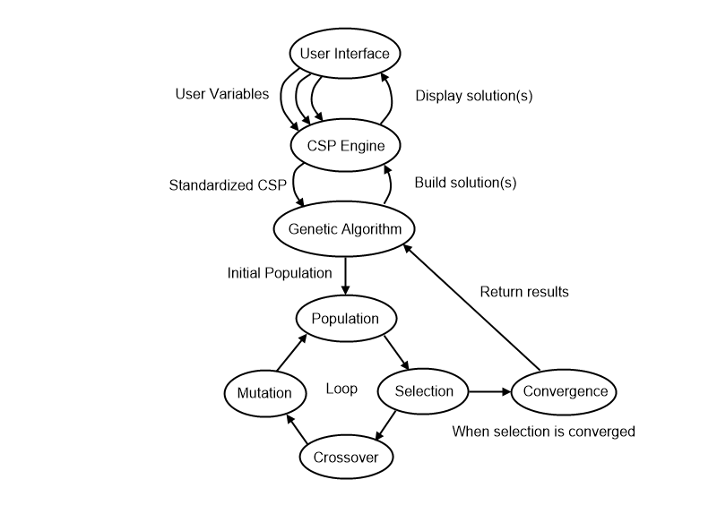
0-1 Knapsack Genetic Algorithm
Size = x + y
Where x = y(y-1)/2
Heuristic variables
Priority of low weight
Priority of high weight
Priority of low value
Priority of high value
Notes:
Due to the confusing nature of Khot’s Conjecture and my interest in genetic algorithms, I wanted to see what a genetic algorithm would do when faced against this problem. My thought was that seeing how the genetic algorithm worked might inspire me to try different methods on the other problems. I learned a ton from this process and watching the genetic algorithm progressed helped me understand why Khot’s Conjecture is so interesting.
I produced an interesting formula that forces the size of the total population, and the fittest population used for breeding, to be the perfect value that allows for all the fittest to breed with all others; giving us a fully encapsulated new generation of all parent combinations. Dependent on the variables randomly selected though determines how much of parent 1 the new child will be vs how much of parent 2. Same with the mutation variable.
I used very simple heuristic variables and was correct in my prediction of how the genetic algorithm would tune them. However, what I found incredibly interesting is that you would think the variables would be 1-0-0-1 low weight, high weight, low value, high value, but the genetic algorithm would figure out more optimal solutions for each given instance. For example, you have 5 weight left available in the knapsack, but the next highest “greedy” option weighs 4 leaving space for 1 weight. You, however, have 4 objects left. (v, w) (4, 4) (2.85, 3) (1.85, 2) (.2, 1). A greedy algorithm would take the object with a weight of 4, then an object with a weight of 1 giving you a value of 4.2 for that 5 weight. The optimal answer would be to take the objects with a weight of 3 and 2, giving you a value of 4.7. The genetic algorithm applied very slight adjustments to the heuristic variables to account for these situations. Assume the previous example where the object with weight 1 was .5 weight – with a “low weight” variable set to 1, the 4,.5 weight option would be more satisfying than the 3,2 weight option. By slightly adjusting low weight a little lower, and high weight a little higher the genetic algorithm forced itself to find the correct solution.
Here I learned that while I used the genetic algorithm to solve for the optimal heuristics for a given knapsack problem, that those optional heuristics don’t apply to all knapsack problems. This demonstrated that while using genetic algorithms to solve for heuristic variables can be useful, it shouldn’t be a go-to solution for all CSPs.

Slide 7
Graph Coloring

Slide 8
The Random Game

Slide 9
Conclusion

