Slide 1
Predict Housing Prices in California

Slide 2
Introduction
Darrell Friday
Software Engineer
W.G.U Data Analytics Master’s Degree Program

Slide 3
Problem and Hypothesis
Houses are a large part of the economy
House values are hard to appraise
What causes a house to increase in value?
Research data
A MLR model can be constructed on the research data

Slide 4
Data Analysis Summary
Collect Data
Clean Data
Prepare Data
Construct MLR model
Test MLR model

Slide 5
Outline of Findings
Non linear relationship between predictor variables and target variables
No coefficients with P value greater than .05
R-squared of 0.649 which is less than .7
Failed to reject the null hypothesis

Slide 6
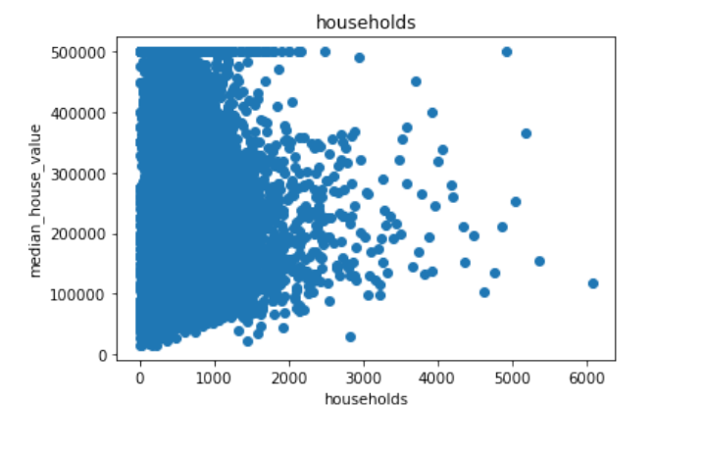
Non linear relationship

Slide 7
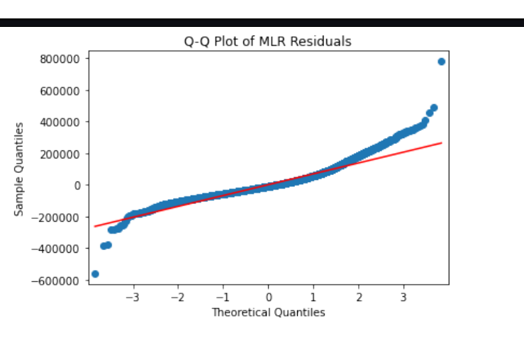
Non Normal Distribution of Residuals

Slide 8
Limitations of Tools and Techniques
MLR assumes a linear relationship between predictor and target variables
No domain specific knowledge to aid in identifying outliers

Slide 9
Proposed Actions
Work with domain experts to identify outliers
Apply logarithmic transformations to the skewed predictors to normalize them
Do not use this model for house appraisal until the accuracy is increased to at least 70%

Slide 10
Expected Benefits
Houses are a large part of wealth in the economy.
Houses have a large effect on the greater economy.
Estimate house prices with more accuracy
Understand how coefficients relate to the house price

Slide 11
Citations
What Can Housing Markets Teach Us about Economics? (n.d.). NBER.
https://www.nber.org/reporter/2016number4/what-can-housing-markets-teach-us-about-economics

