Slide 1

Bit Vectors
Prof. Darrell Long
CSE 13S

Slide 2
What is a bit vector?
It’s simple: a contiguous string of bits.
A byte (uint8_t) has 8 bits, and so can hold a bit vector of length 8.
Larger units such as uint16_t, uint32_t, uint64_t can hold correspondingly longer vectors.
We can make arbitrarily long bit vectors using arrays.
But first, let’s recall our Boolean algebra.
10000111000011011001110111110010000010101101000000000000000000

Slide 3

And (also called Conjunction)
Algebraic properties:
$A∧\left(B∧C\right)=\left(A∧B\right)∧C$
$A∧B=B∧A$
$A∧\left(B∨C\right)=\left(A∧B\right)∨(A∧C)$
$A∧1=A$
$A∧0=0$
$A∧A=A$
∧ (and) | T | F
T | T | F
F | F | F
1110001011110011 & 0011100011001001 == 0010000011000001

Slide 4

Or (also called Disjunction)
∨ (or) | T | F
T | T | T
F | T | F
Algebraic properties:
$A∨\left(B∨C\right)=\left(A∨B\right)∨C$
$A∨B=B∨A$
$A∨\left(B∧C\right)=\left(A∨B\right)∧(A∨C)$
$A∨0=A$
$A∨1=1$
$A∨A=A$
1110001011110011 | 0011100011001001 == 1111101011111011

Slide 5

Not (also called Negation)
¬ (not)
T | F
F | T
Algebraic properties:
$A∧¬A=0$
$A∨¬A=1$
$¬\left(¬A\right)=A$
DeMorgan’s Law:
$¬\left(A∨B\right)=¬A∧¬B$
$¬\left(A∧B\right)=¬A∨¬B$
~1111101011111011 == 0000010100000100

Slide 6

Exclusive-or
$A⊕B=\left(A∨B\right)∧¬(A∧B)$
$A⊕B=\left(A∧¬B\right)∨(¬A∧B)$
Some algebraic properties:
$A⊕A =0$
$A⊕0=A$
$A⊕1=¬A$
$A⊕\left(B⊕C\right)=\left(A⊕B\right)⊕C$
⊕ (Xor) | T | F
T | F | T
F | T | F
1110001011110011 ^ 0011100011001001 == 1101101000111010

Slide 7
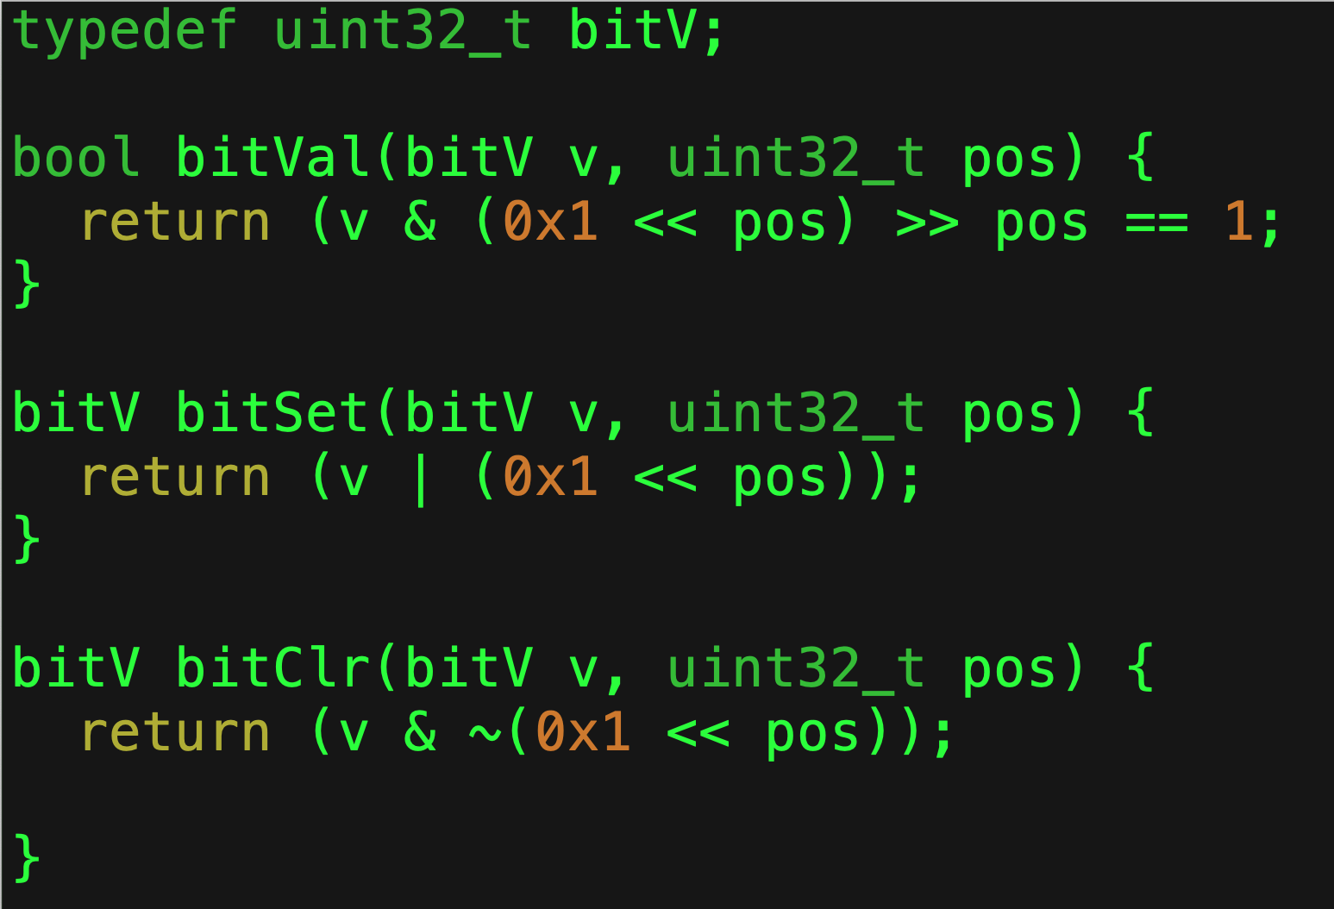
Bit Value
We use a single 1 as a probe.
We shift it over to the bit position of interest.
Use apply bit-wise and (&).
Recall the truth table .
We shift it back, and then examine the result.

Slide 8
Bit Set
We shift our probe to the position that we want to set.
We apply bit-wise or (|).
Again, recall the truth table.
We return the result with the desired bit set.

Slide 9

Bit Clear
We move our probe to the position that we want.
We then flip all of the bits.
Why do we do that?
$T∧x=x$
$F∧x=0$
Said another way, 1 is the identity element for &, while 0 annihilates.
We apply bit-wise and (&), and return the result.

Slide 10
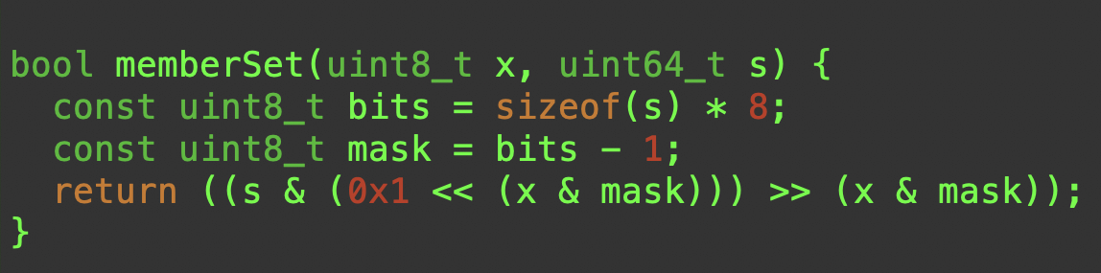
Set Member
Check to see if the corresponding bit is set.
Create a mask to make sure the element is in range.
Shift 0x1 into place.
Use & to select it.
Shift it back to the low order bit position.

Slide 11
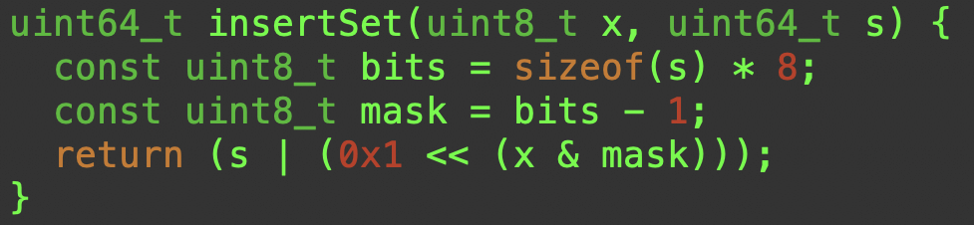
Set Insert
Set the corresponding bit.
Create a mask to make sure the element is in range.
Shift 0x1 into place.
Use | to set it.

Slide 12
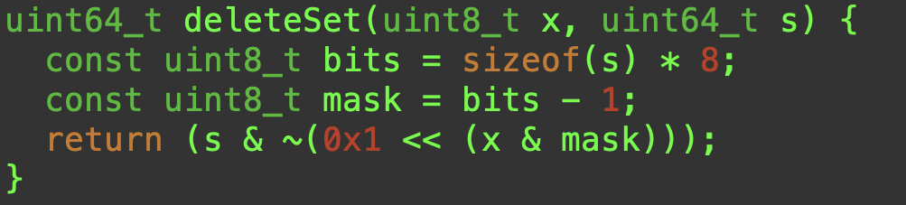
Set Delete
Clear the corresponding bit.
Create a mask to make sure the element is in range.
Shift 0x1 into position.
Use ~ to compute the complement.
Use & to preserve all bits except the selected bit.

Slide 13
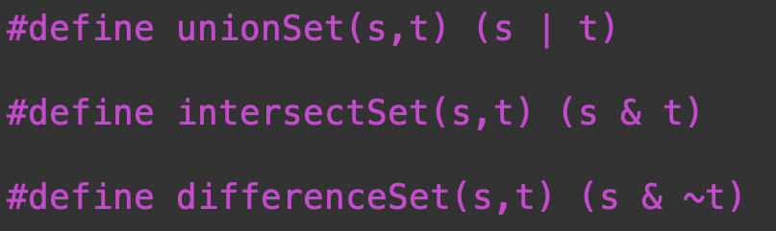

Set Operations
Union is just logical (bit-wise) or or of s with t
$S ∪T$
Intersection is just logical andof s with t
$S ∩T$
Set difference is just logical and of s with the complement of t
$S −T=S ∩ \overline{T}$

Slide 14
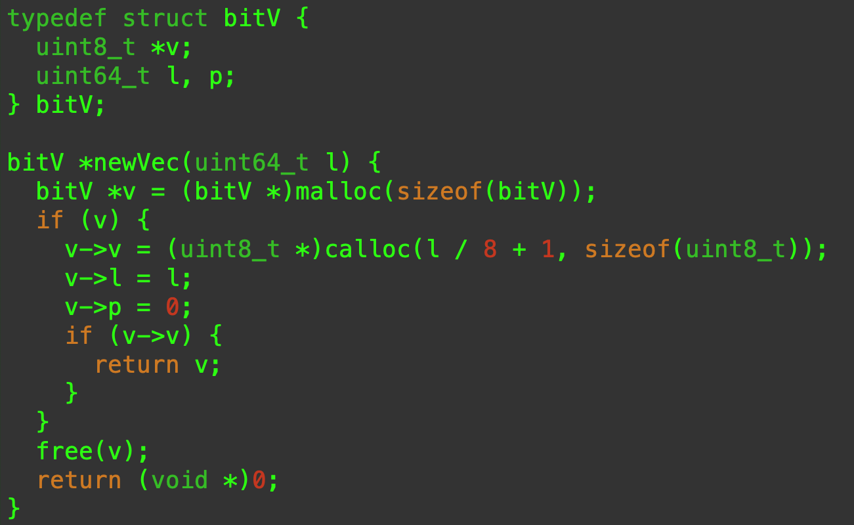
Arbitrary Length
Recall that an array is a homogeneous sequence of objects of the same type.

Slide 15
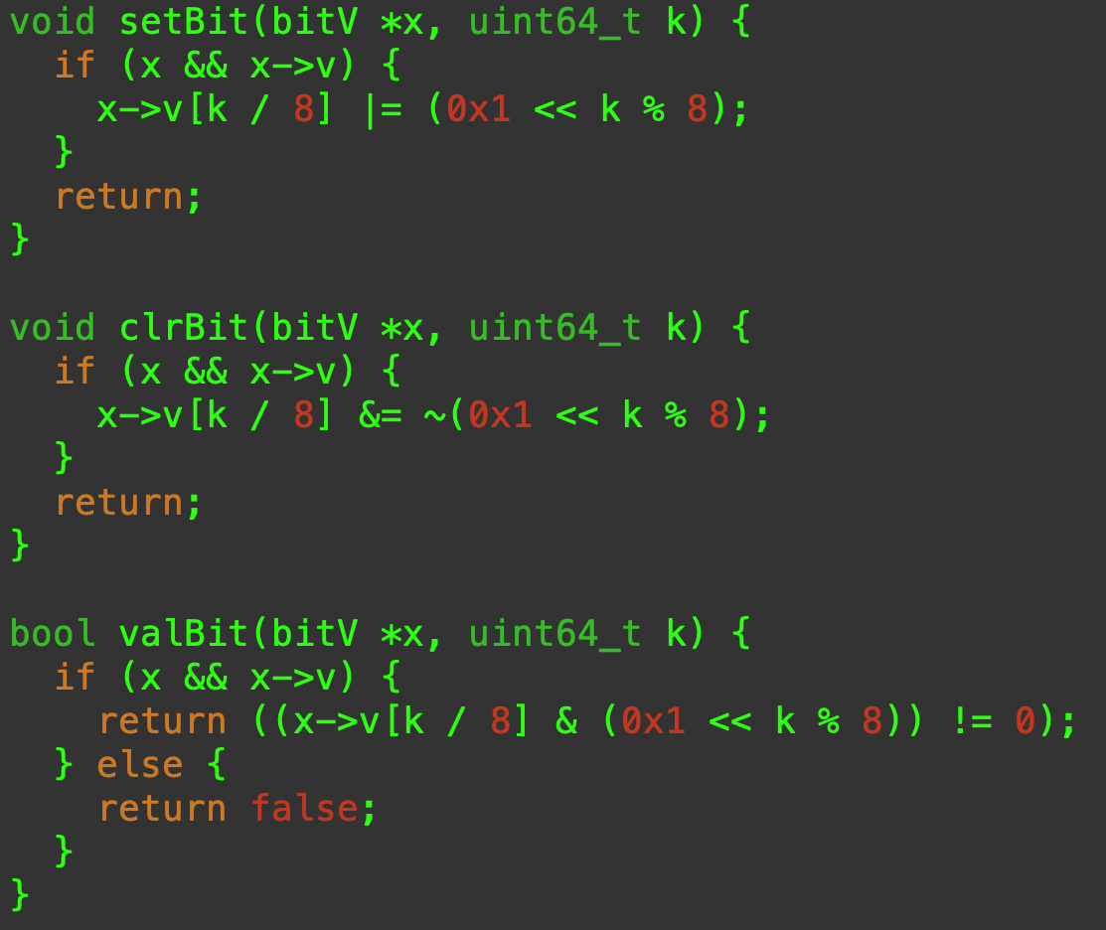
Arbitrary Length
We are working with 8 bit quantities for simplicity.
Dividing by 8 gives us the byte where we want to work.
Modulus 8 tells us which bit we want to manipulate.

