Slide 1
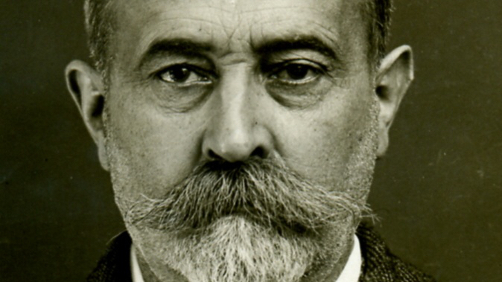
Searching
Prof. Darrell Long
CSE 13S

Slide 2
Linear Search

Slide 3
Binary Search

Slide 4
Fibonacci Search

Slide 5
Substring Search

