Slide 1

Hashing
Prof. Darrell Long
CSE 13S

Slide 2
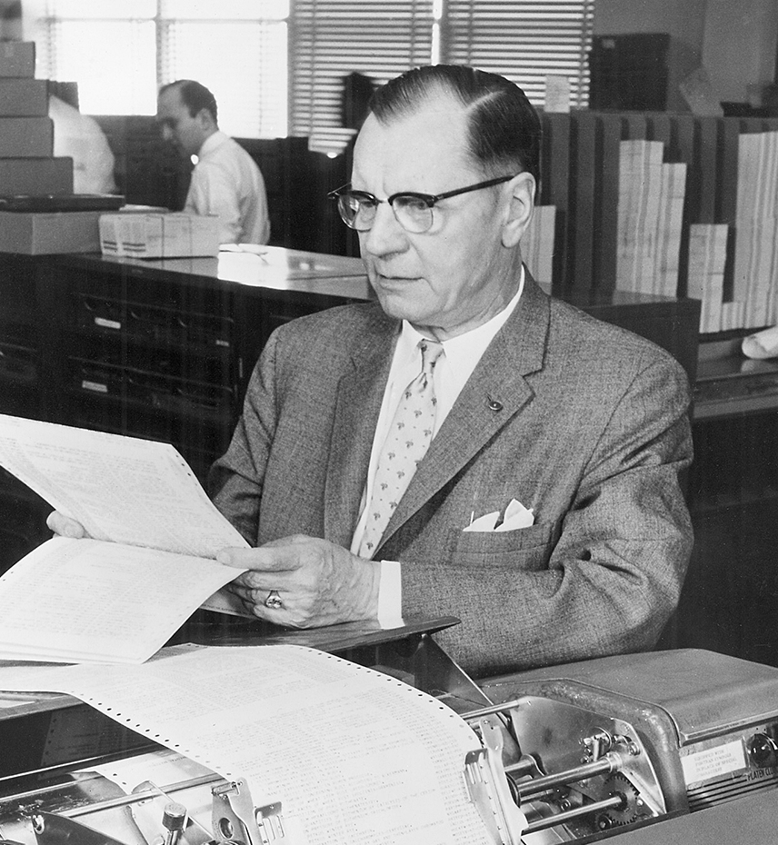
History
Hans Peter Luhn was a pioneer in information retrieval.
He was at IBM when he published the first paper on hashing in 1953.
Suggested the notion of placing information into buckets.
He wanted to to find text efficiently as well as numbers.
He also developed Key Word in Context indexing (KWIC) and Selective dissemination of information (SDI) for business intelligence.

Slide 3





Finding in $O(1)$ Time
Elliott | Cat
Abercrombie | Dog
Electra | Cat
Hershel | Cat
Delphine | Iguana
Hardy | Dog
Lazlo | Dog
Oberon | Platypus
Rosetta | Dog
Bambina | Cat
Dresden | Cat
Ajax | Dog
Mabon | Parakeet
$$h(“Ajax”)$$
$$h(“Lazlo”)$$
Imagine a function that maps each key to a unique array element.
It is called a perfect hash function, and it is injective.
They are rare, and difficult to create.
When $h\left(x\right)=h(y)$ for $x≠y$ we call that a hash collision.
$$h(“Rosetta”)$$

Slide 4
Birthday Paradox

Slide 5
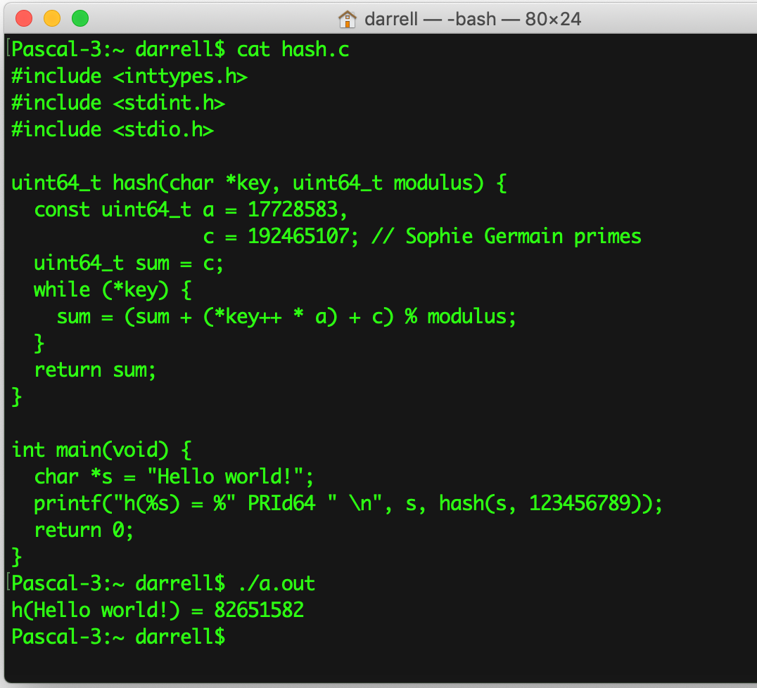
A Simple Hash Function

Slide 6
Uses of Hashing
Searching
Caches
Bloom Filters
Duplicate Detection
Similarity Detection
Data Base Joins
Data Protection
Cryptography
Computer Graphics

