Slide 1
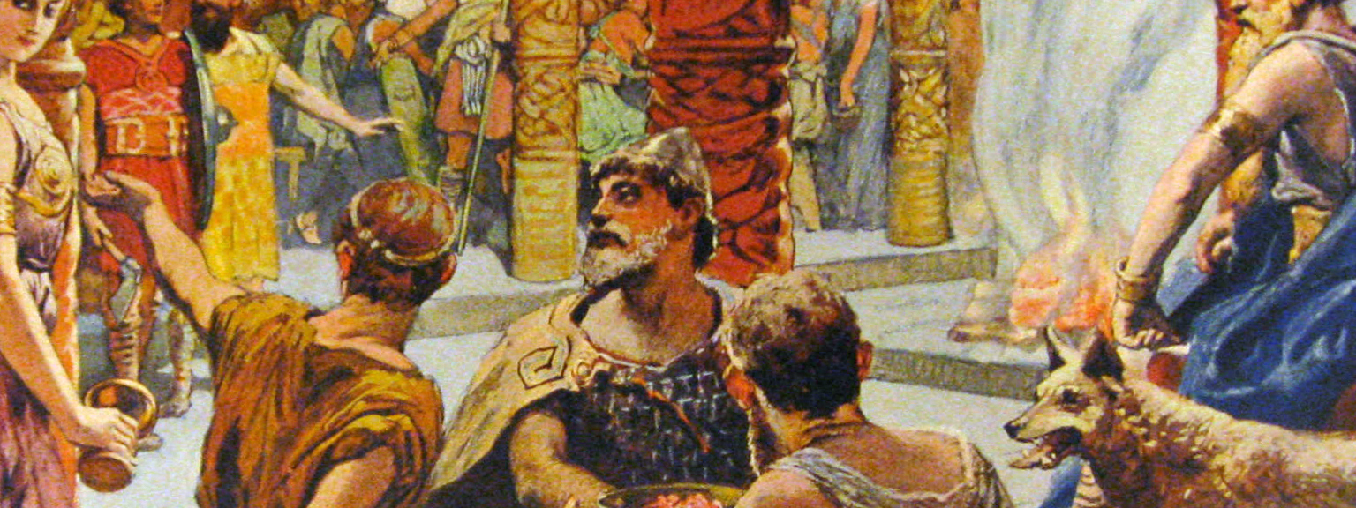
malloc and valgrind
Prof. Darrell Long
CSE 13S

Slide 2
Process Memory Model

Slide 3
malloc

Slide 4
calloc

Slide 5
free

Slide 6
realloc

Slide 7

valgrind ”Death Gate” in Old Norse
Helps find memory leaks
Blah
Blah
Blah
blah
Mascot of Valhalla High School, El Cajon, California

