Slide 1
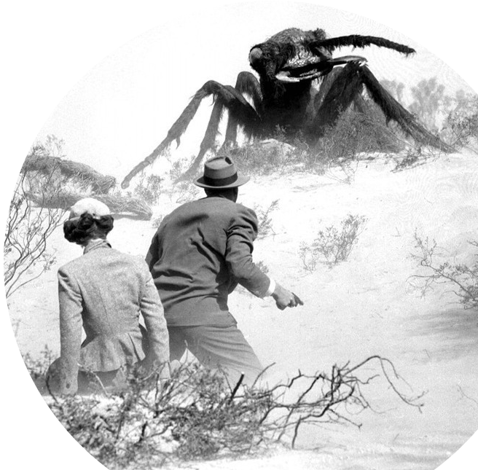
Prof. Darrell Long
CSE13
Stacks and Queues
© 2019 Darrell Long & the University of California
1

Slide 2
What Are Stacks and Queues?
So far, we have learned about arrays and linked lists
Arrays are random access: each element can be accessed directly in constant time
Linked lists are sequential access: each element can only be accessed through a particular order
Stacks are queues are a subset of sequential data structures, both of which serve as containers for objects exhibiting special properties
© 2019 Darrell Long & the University of California
2

Slide 3
Stacks
Container of objects that are added and removed according to the last-in first-out (LIFO) principle
Two main stack functions:
Pushing: adds an element to the top of a stack
Popping: removes the element at the top of a stack
© 2019 Darrell Long & the University of California
3

Slide 4
Stack Implementation
Two main stack implementations:
Using arrays
Using linked lists
Array-based stacks:
Can use either a static or dynamic array to hold items
The top of the stack is pointed at by some variable
Linked list-based stacks:
The top of the stack is the first node in the linked list
© 2019 Darrell Long & the University of California
4

Slide 5
Queues
A container of objects that are added and removed according to the first-in first-out (FIFO) principle
Difference between a queue and a stack is the element that is removed:
Stack removes most recently added element
Queue removes least recently added element
Two main functions:
Enqueue: adds an element to the queue
Dequeue: removes an element from the queue
© 2019 Darrell Long & the University of California
5

Slide 6
Circular Queues
A circular queue is exactly like a regular queue except that the element after the last element in the queue is the first element
Also called a wrap-around queue
© 2019 Darrell Long & the University of California
6

Slide 7
Queue Implementation
Like with stacks, queues are typically implemented using a vector-based data structure
Arrays, linked-lists, vectors (used in C++), etc.
Some queue implementations feature an algorithm, or a rule called move-to-front, in which elements which are searched for in a queue are placed at the front of the queue
This is typically used as an optimization, as the recent past is a good indicator of the near future
© 2019 Darrell Long & the University of California
7

