Slide 1

Dynamic Memory Allocation
Prof. Darrell Long
CSE13

Slide 2
What is dynamic memory allocation?
The act of allocating memory for variables on the heap (or called free store) during program runtime
Basically the opposite of compile time (static) allocation
Compile time allocation (CTA) means memory for named variables is allocated by the compiler at compile time, dynamic memory allocation (DMA) means memory is allocated on-the-fly during runtime
CTA requires the exact size and type of storage at compile time, DMA can calculate and allocate the exact memory it needs during runtime

Slide 3
Why is dynamic memory allocation good?
Stack space is limited
We sometimes want variables to last beyond the lifetime of its current scope
Variables on the stack don’t last beyond its current scope
Variables dynamically allocated on the heap can be accessed beyond the current scope
We don’t always know exactly how much memory is needed to run a program
Solution: dynamically allocate memory when it’s needed, however much is needed
But how do we dynamically allocate memory?

Slide 4
Dynamic memory allocatio
There are three standard C library functions to allocate memory, all of which are included under <stdlib.h>
malloc
calloc
realloc
The above three functions all dynamically allocate memory on the heap, not the stack, and return a pointer
What is the heap?
What is a pointer?

Slide 5
The Heap
A large region of unmanaged, free-floating memory
Has no size restrictions on variable size (other than your computer’s physical limitations)
Slower to read from/written to due to the need for pointers
More on pointers later
Variables using heap memory can be accessed globally
Use of heap variables not confined to current scope’
Possible memory fragmentation over time as blocks of memory are allocated (using malloc, calloc, or realloc) and deallocated (using free)

Slide 6

Pointers
Used to store addresses of variables or memory locations
Two unary operators used for pointers:
“&” – used to access address of a variable to a pointer
“*” – used to declare a pointer variable and dereference pointers
Points to a block of virtually contiguous memory
This memory can be indexed into like an array
This is done through pointer arithmetic
Careful; the sizeof() a statically declared array and a pointer are different
sizeof([pointer]) returns either 2, 4, or 8, depending on if your system is 16, 32, or 64-bit

Slide 7
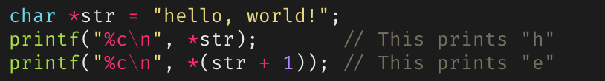
Pointer arithmetic
Can offset a pointer by adding/subtracting an integer
Can get the number of elements between two pointers by getting their difference
Cannot sum, divide, or multiply two pointers
Example of simple pointer arithmetic (offsetting):

Slide 8
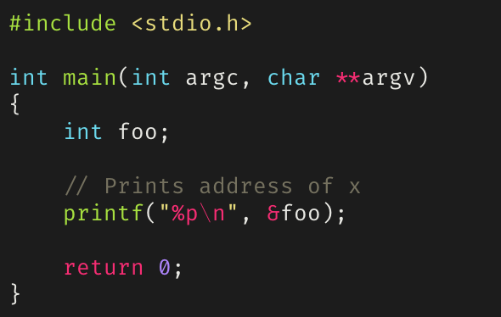
How to use the “&” operator
Example of using the “&” operator to access the address of a variable:

Slide 9
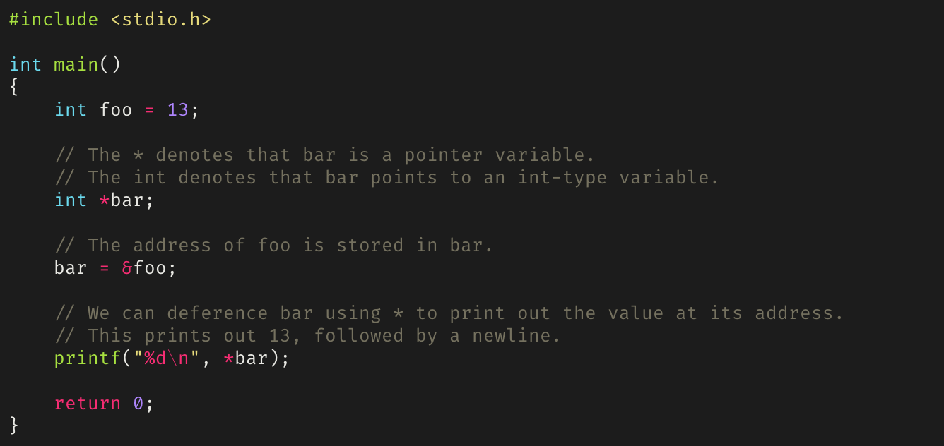
How to use the “*” operator
Example of using “*” to instantiate a pointer variable and using it to dereference a pointer:

Slide 10
malloc
Defined as: void* malloc(size_t size)
Returns a pointer to [size] bytes of uninitialized memory allocated on the heap
The memory allocated by malloc may contain junk data
What happens when zero is passed as the specified number of bytes to allocate is implementation defined (avoid doing this)
Doesn’t check for overflow of [size] if it’s the result of an arithmetic operation, unlike calloc

Slide 11
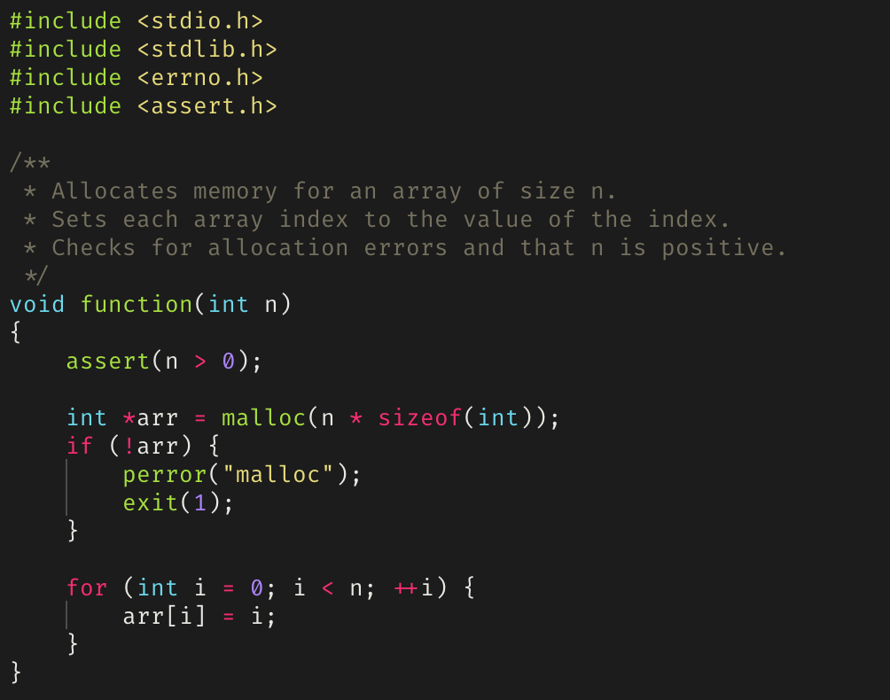
Example of malloc

Slide 12
calloc
Defined as void* calloc(size_t nmemb, size_t size)
[nmemb] denotes the number of objects and [size] the size of each object
Returns a pointer to [nmemb] * [size] bytes of allocated memory on the heap, in which each byte has been initialized to zero
Like malloc, behavior when [nmemb] is zero is implementation defined
Generally slower than malloc, but the tradeoff is that the contents of the allocated memory are known since it’s zeroed out

Slide 13
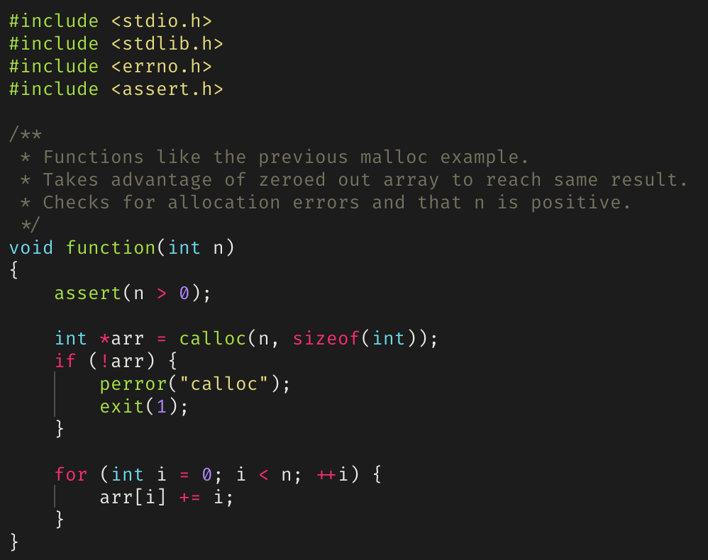
Example of calloc

Slide 14
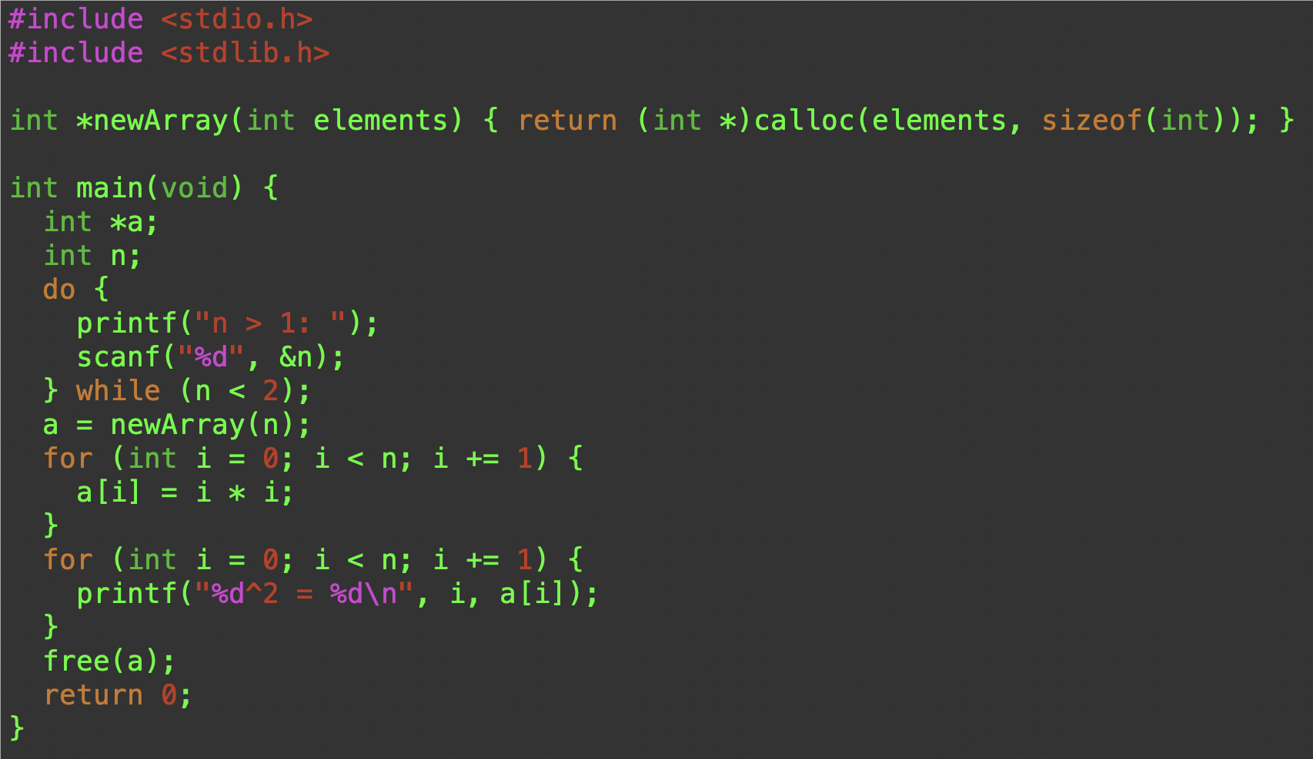
Dynamic Array

Slide 15
realloc
Defined as void *realloc(void *ptr, size_t size)
Reallocates [ptr] to newly point at [size] bytes of allocated memory on the heap
This is not strictly true; what realloc actually does is deallocate the old object pointed to by [ptr] and return a pointer to [size] bytes of allocated but uninitialized memory
If [size] is greater than the size of the originally allocated block of memory, the contents of the returned pointer contains everything from the original block, but the extra allocated memory is uninitialized
Else if [size] is less than the size of the originally allocated block of memory, the contents of the returned pointer contains exactly the beginning [size] bytes from the original block

Slide 16
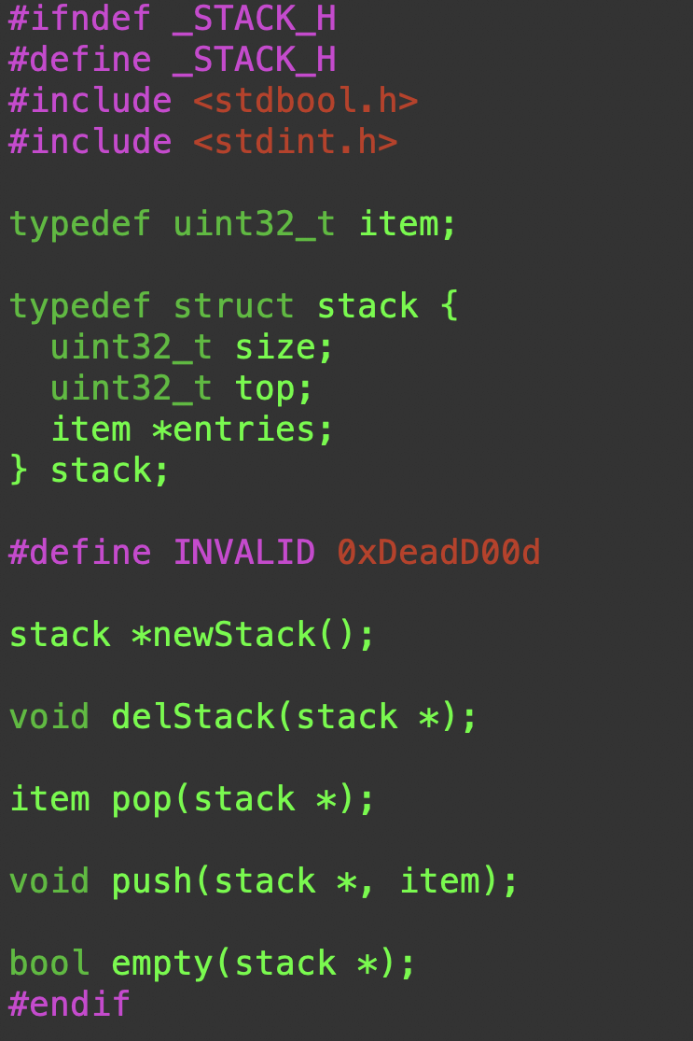
A Dynamically Growing Stack

Slide 17
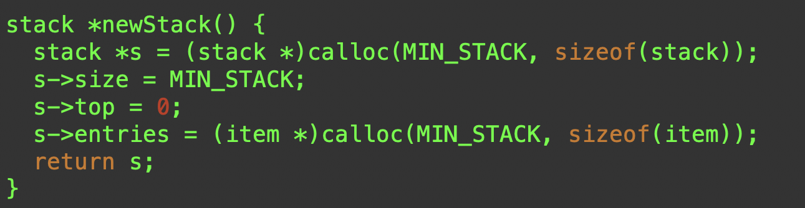

Slide 18
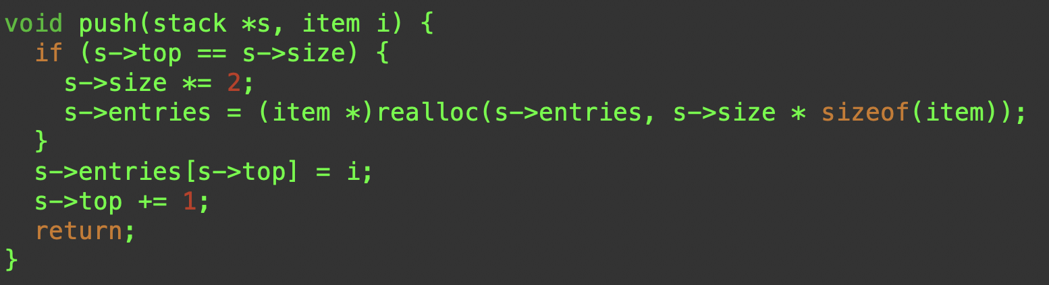

Slide 19
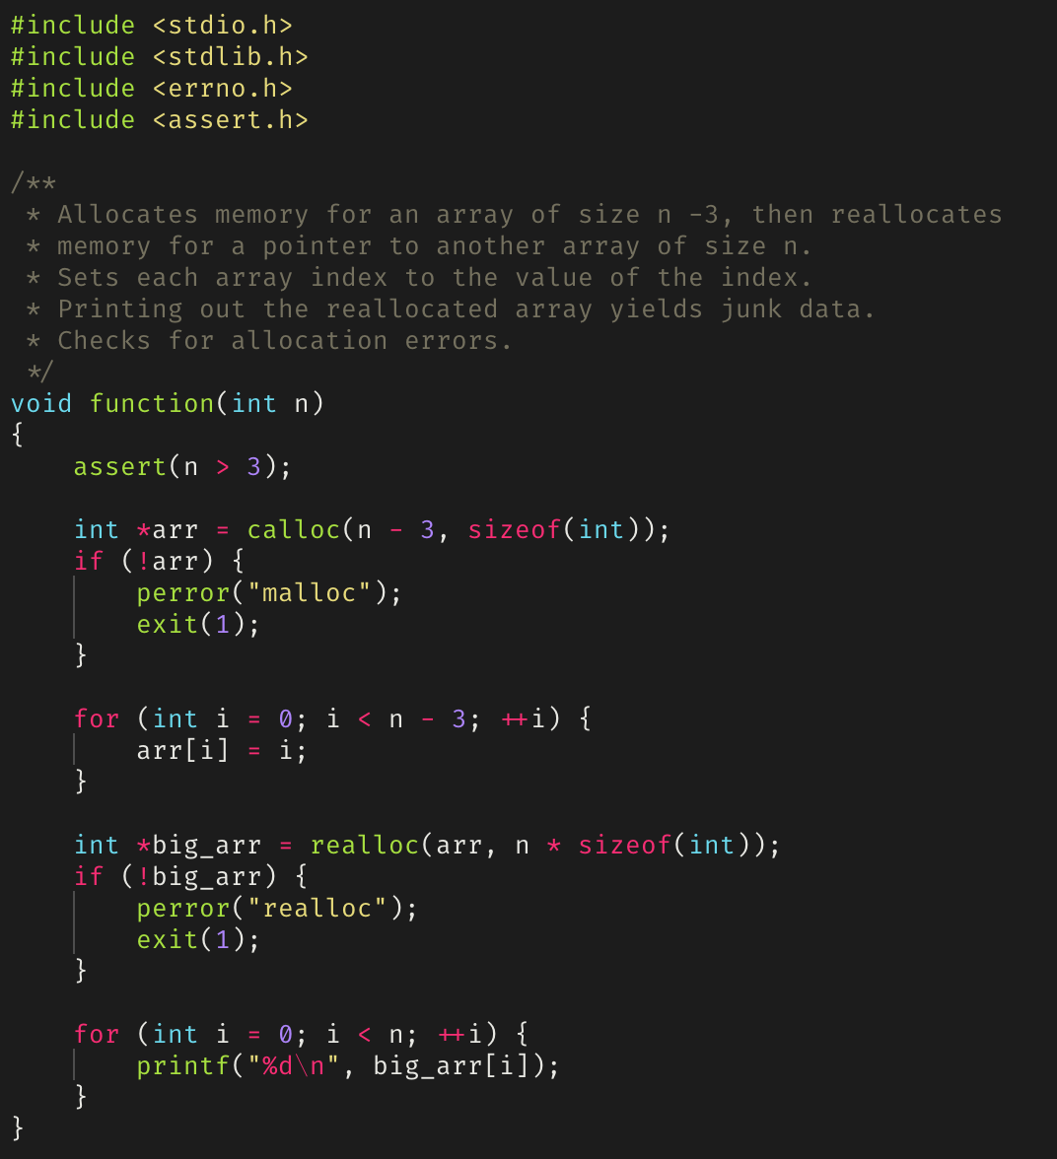
Example of realloc

Slide 20
free
If we allocate memory, we must also be able to deallocate (or free) memory
free is another standard C library functions specifically for deallocating memory allocated by malloc, calloc, or realloc
free is defined as void free(void *ptr)
free deallocates the memory space pointed to by [ptr]
Memory leaks occur if allocated memory isn’t freed (memleaks)
Segmentation faults/core dumps can occur if a program tries to access memory locations that it isn’t allowed to access (segfaults)
Pointers that have been freed should be set to NULL to mitigate use-after-free vulnerabilities

Slide 21
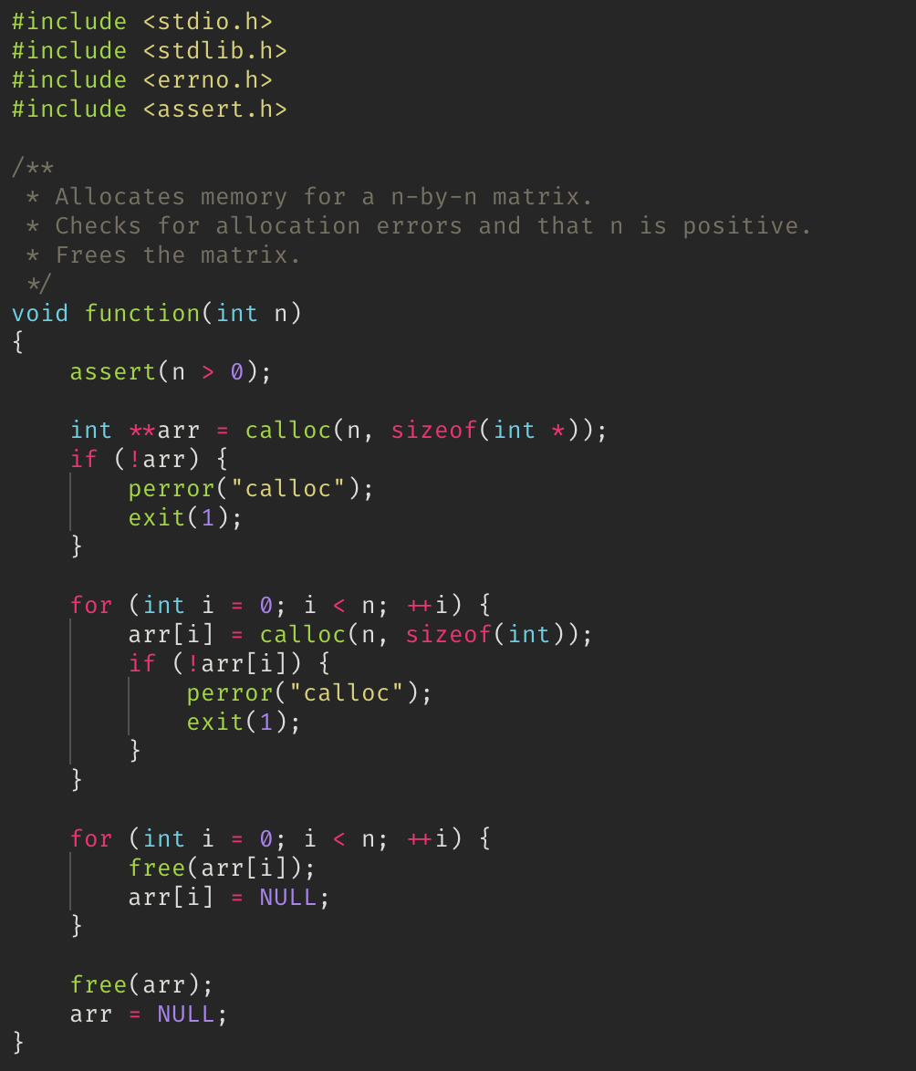
Example of free

Slide 22
How do we detect memleaks and segfaults?
Memory leaks and segmentation faults, as well as other errors, can be detected using gdb, infer, and/or valgrind
These tools can be found on the UCSC Unix Timeshare
Should be used in tandem when debugging

Slide 23
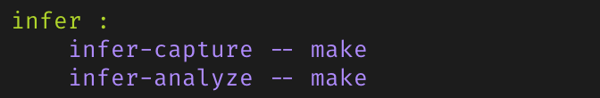
infer
infer is a static analysis tool to detect bugs in C, C++, and Java
Checks for null pointer exceptions, resource leakage, race conditions, and missing lock guards
Example of using as a target in a Makefile:

Slide 24
valgrind
A collection of dynamic analysis tools
Usually used for its Memcheck tool, which can detect:
Use of uninitialized memory
Reading/writing memory after it has been freed
Reading/writing off the end of allocated blocks of memory
Reading/writing inappropriate areas on the stack
Memory leaks -- where pointers to malloc'd blocks are lost forever
Useful command line flags/options for valgrind
--leak-check=full
--show-leak-kinds=all

Slide 25
Static vs dynamic analyzers
Static analyzers, like infer, operate by analyzing the source code for a program before it’s run
Code is compared against a set (or multiple sets) of coding rules for bugs
Only surface level; can’t check if a function behaves completely as it’s supposed to when it’s executed
Dynamic analyzers, like valgrind, operate by tracking down errors that occur during program execution
Good for checking if the program executes as it’s supposed to
Can only analyze what happens during execution
Things that don’t occur during execution aren’t analyzed
Let’s see examples of differences in analysis output for infer and valgrind

Slide 26
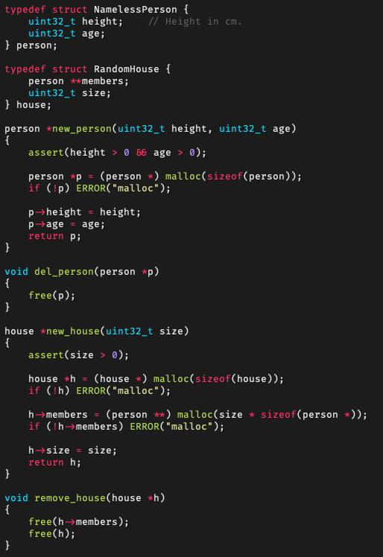
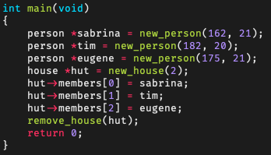
Debugging with infer
Consider the person/house code module on the right
Now consider the main function below
Are there any memleaks?
Let’s statically analyze this with infer

Slide 27
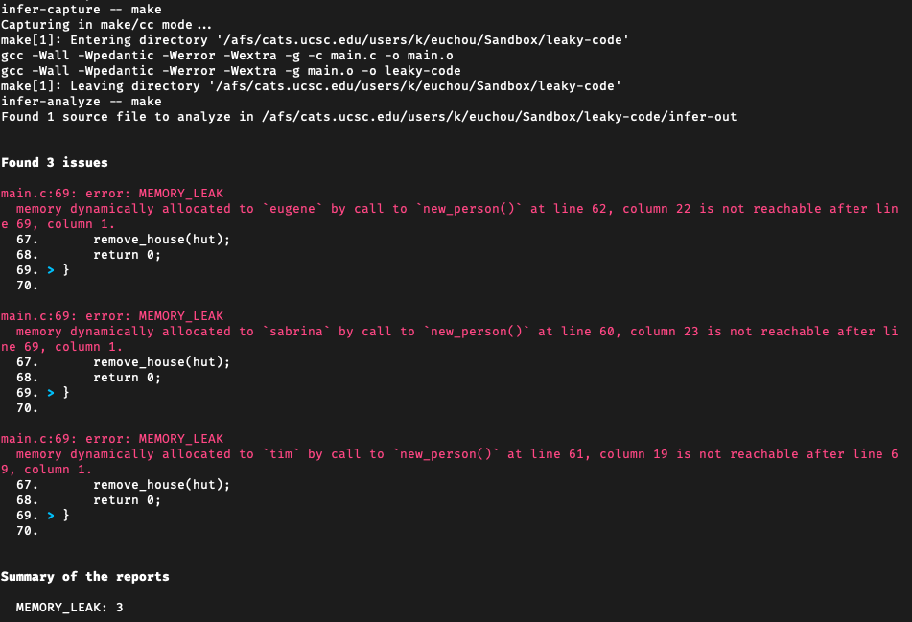
Debugging with infer (cont’d)
Running infer using “infer-capture -- make; infer-analyze -- make”:

Slide 28
Debugging with infer (cont’d)
We can see that we have three memleaks, all of which are from the fact that we allocated memory for three person *’s but never freed them
We can fix this by adding a loop to remove_house() to call del_person() for each person in the members field of a house and to free the third person in the main function
However, the main function only allocated space for two people in the house, but infer didn’t report anything when the main function added a third person to the house
This is where we further debug with valgrind

Slide 29
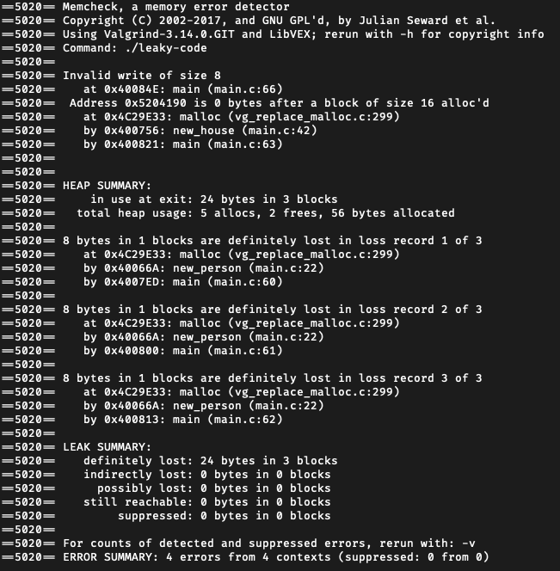
Debugging with valgrind
This is the valgrind output for the same program checked earlier with infer:

Slide 30
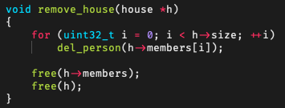
Debugging with valgrind (cont’d)
As we can see, we still see the memleaks caused by the three persons, and now we also see that trying to add a person to the house caused an invalid write
We can fix remove_house() to the following:
And we can either change the main function to either not add the third person to the house and call del_person() on them, or instantiate the house to fit 3
Applying the above changes will result in a leak and error free program

Slide 31
Examples of problems being found
How to fix them
Say what infer is (it’s a static analyzer)
Valgrind is a dynamic detection tool
Say how it works

