Slide 1

Prof. Darrell Long
CSE13
Linked Lists and Trees
© 2019 Darrell Long & the University of California
<number>

Slide 2

Linked Lists
A data structure where each element or “node” points to the next.
Each node contains a data field and a pointer to the next element in the list.
The last node in the list points to a terminator, often a null pointer.
© 2019 Darrell Long & the University of California
<number>

Slide 3
Advantages
Does not require a contiguous region of memory.
Insertion and deletion at any point without reorganizing or reallocating memory.
© 2019 Darrell Long & the University of California
<number>

Slide 4
Disadvantages
To access a random element one must traverse the list.
Arrays are friendlier to processor caches.
Slightly less memory efficient than arrays.
© 2019 Darrell Long & the University of California
<number>

Slide 5
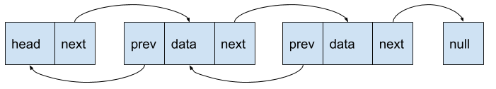
Doubly Linked List
Each node has a pointer to both the previous and next nodes.
Allows traversal in two directions.
Less memory efficient than a normal linked list.
© 2019 Darrell Long & the University of California
<number>

Slide 6

Circular Linked List
A linked list where the next pointer of the last node points to the head of the list.
© 2019 Darrell Long & the University of California
<number>

Slide 7
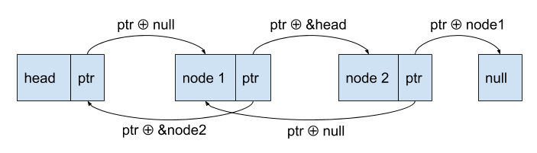
XOR Linked List
Slightly more space efficient version of a doubly linked list.
Stores the bitwise XOR of previous and next pointers in each node.
The pointer for the next node is computed with an XOR of the previous node and the pointer value of the current node.
© 2019 Darrell Long & the University of California
<number>

Slide 8
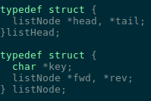
Implementing a Linked List
In C we use structs to represent list nodes.
The head keeps track of the head and tail of the list.
Each node contains a pointer to the next and previous nodes and some piece of data.
© 2019 Darrell Long & the University of California
<number>

Slide 9
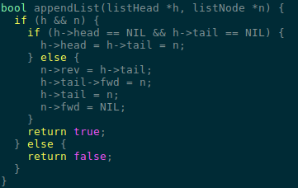
Implementing a Linked List
The following example inserts a new node at the end of a doubly linked list specified with listHead.
If empty, the new node is set as both the head and the tail.
Otherwise, the new node is set as the tail and the fwd and rev pointers are set.
© 2019 Darrell Long & the University of California
<number>

Slide 10
Queues
A data structure where each element or “node” points to the next.
Each node contains a data field and a pointer to the next element in the list.
The last node in the list points to a terminator, often a null pointer.
© 2019 Darrell Long & the University of California
<number>

Slide 11
Queues
A data structure where each element or “node” points to the next.
Each node contains a data field and a pointer to the next element in the list.
The last node in the list points to a terminator, often a null pointer.
© 2019 Darrell Long & the University of California
<number>

Slide 12
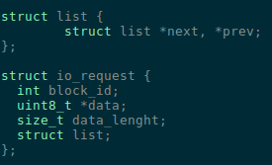
Intrusive Linked Lists
A node struct only contains pointers to the previous and next nodes.
The struct storing a node’s data maintains the node struct.
© 2019 Darrell Long & the University of California
<number>

Slide 13
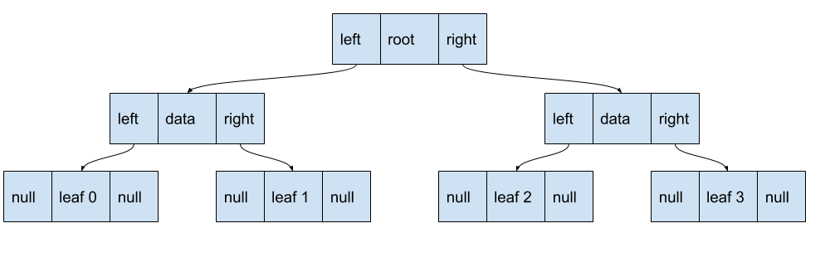
Trees
A node in a tree has one parent and an arbitrary number of children.
A tree with two children per node is called a binary tree.
© 2019 Darrell Long & the University of California
<number>

