Slide 1

Command Line Debugging
Prof. Darrell Long
CSE 13S

Slide 2
Debugging Through Printing
The simplest form of debugging.
Simply print variable values and/or when you reach a certain point in the program.
Can easily get out of control and difficult to follow.
© 2019 Darrell Long & the University of California
2

Slide 3
assert()
A macro used to check a given condition during runtime. If the condition evaluates to false then the program exits.
To use it include the header assert.h
This method is more sophisticated than simply printing values.
It is easily turned on and off at compile time.
As opposed to using flags and if statements.
© 2019 Darrell Long & the University of California
3

Slide 4
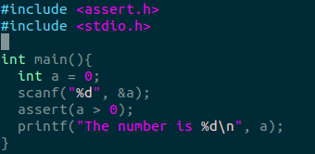
Using assert()
Call the assert() macro. The input parameter is any C expression, most often a conditional.
If the expression evaluates to true, then it does nothing.
If it evaluates to false, an error is printed to stderr.
© 2019 Darrell Long & the University of California
4

Slide 5
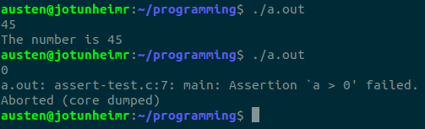
Using assert()
When the condition evaluates to false you will see an error like the one shown below.
Assertions can be disabled in two ways.
Including the macro #define NDEBUG.
Passing the argument -DNDEBUG to your compiler.
© 2019 Darrell Long & the University of California
5

Slide 6
GDB
A useful debugging tool that allows you to set breakpoints and step through a program line by line.
At each breakpoint and step you can print values or addresses of variables.
You must compile your program with debugging symbols.
-g option with clang and GCC.
Does not provide much information about memory errors.
© 2019 Darrell Long & the University of California
6

Slide 7
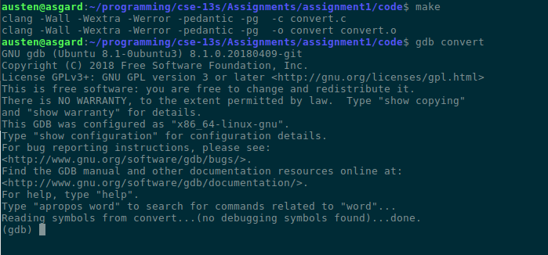
Using GDB
Compile your program with the -g flag.
Start GDB by typing gdb <executable>.
To run your program in GDB type run <arg1, arg2, ...>.
© 2019 Darrell Long & the University of California
7

Slide 8
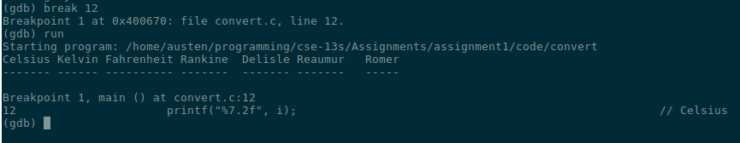
Using GDB
To set a breakpoint use the command break file.c:6
This sets a breakpoint at line 6 of file.c
You can also set a breakpoint at a function with break func
Once your code has hit a breakpoint you can resume execution with continue
© 2019 Darrell Long & the University of California
8

Slide 9
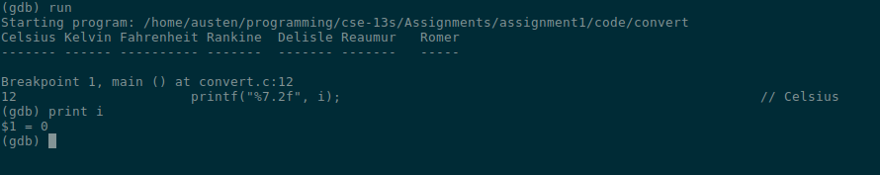
Using GDB
The command step is used to go through the program line by line
Similarly next is used to treat function calls as a single line of code
print my_var will print the value of the variable my_var
Type quit to exit GDB
© 2019 Darrell Long & the University of California
9

Slide 10
Using GDB
Other commands include:
backtrace, prints out a segmentation fault stack trace
where, prints a stack trace of the current point in the program
finish, finish execution of a function and stop when it returns
delete, remove a breakpoint
Additional documentation can be found here, https://www.gnu.org/software/gdb/documentation/
© 2019 Darrell Long & the University of California
10

Slide 11
Valgrind
Analysis tool used to identify memory management problems.
Will tell you the location and size of memory leaks, deallocation errors, etc.
No additional compilation flags needed.
© 2019 Darrell Long & the University of California
11

Slide 12
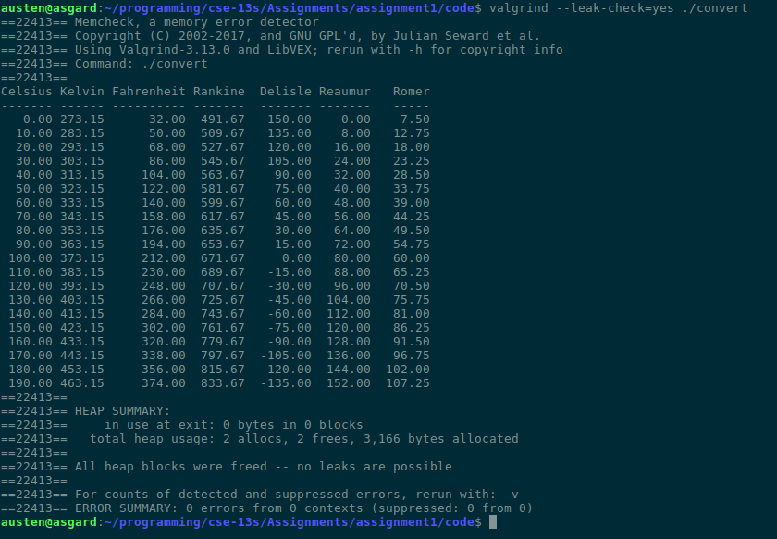
Using Valgrind
Compile your program.
Run valgrind –-leak-check=yes ./executable
In this case there are no memory leaks.
© 2019 Darrell Long & the University of California
12

Slide 13
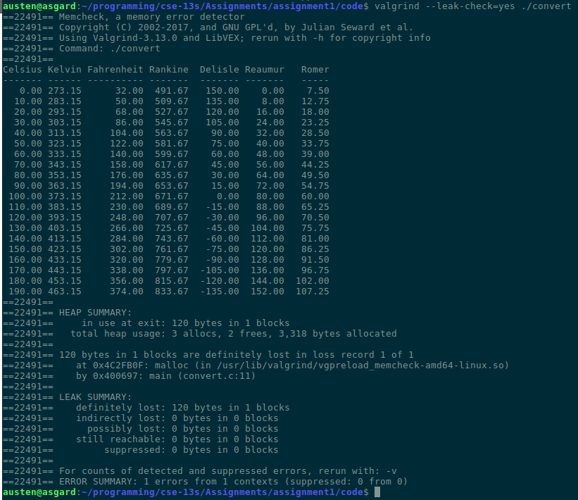
Using Valgrind
If we modify our program to allocate an array but don’t free it, Valgrind will report a leak.
It will give you the line, file, and size of the unfreed allocation.
© 2019 Darrell Long & the University of California
13

Slide 14
Infer
Similar to Valgrind and will pick up what the previous tool does not.
This is not installed on the university timeshare, you will have to run it on your local machine.
To install infer follow this guide https://fbinfer.com/docs/getting-started.html
© 2019 Darrell Long & the University of California
14

Slide 15
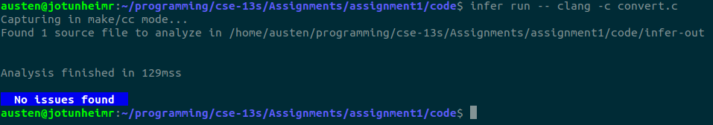
Using infer
To run infer on a relatively simple program type infer run –- clang -c convert.c
If your program has no problems you should see the following.
© 2019 Darrell Long & the University of California
15

Slide 16
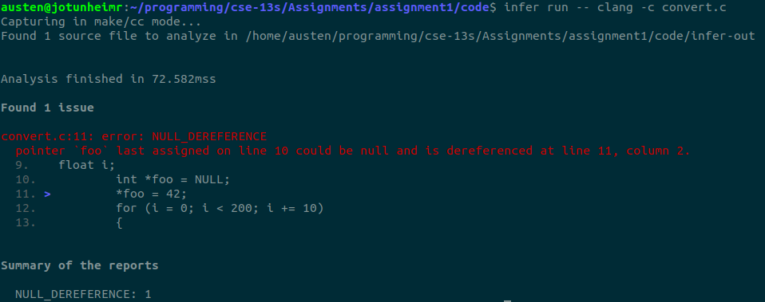
Using infer
If we add a possible null pointer dereference to our convert.c program we will see the following.
© 2019 Darrell Long & the University of California
16

Slide 17
Using infer
For more complicated programs you should create a Makefile target to run infer that looks like the following.
Be sure that your clean target removes the extra files generated by infer.
© 2019 Darrell Long & the University of California
17

Slide 18
gprof
Gathers timing information and statistics about your program.
Use it to profile performance and identify bottlenecks.
Compile your program with the -pg option.
This creates a file called gmon.out.
Similar results can be collected using the Valgrind tool Callgrind.
A handy guide can be found here: https://users.cs.duke.edu/~ola/courses/programming/gprof.html
© 2019 Darrell Long & the University of California
18

Slide 19
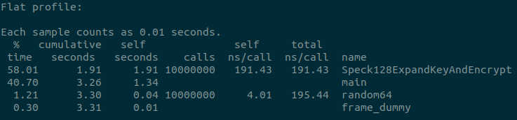
Using gprof
Compile your program with the -pg flag.
Run your program normally.
Run the command gprof <executable>.
Interpret the output.
© 2019 Darrell Long & the University of California
19

Slide 20
Using gprof
The flat profile describes the timing information for each profiled function.
main and frame_dummy are not profiled so some columns are blank.
© 2019 Darrell Long & the University of California
20

Slide 21
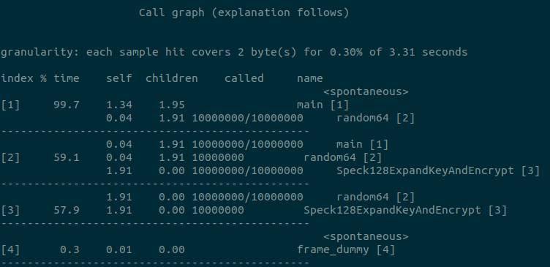
Using gprof
The call graph describes the callers and callees of each function.
For the second function, random64, we can see it was called one million times by main and always called the 128 bit speck function.
© 2019 Darrell Long & the University of California
21

Slide 22
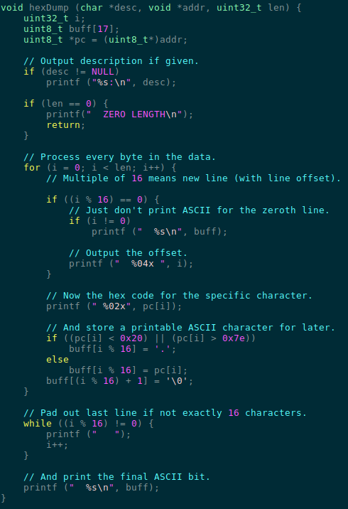
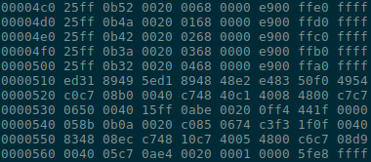
Hex Dumps
The old fashioned way to debug a program.
Prints out the raw contents of a file or memory in hexadecimal.
This is a relatively cumbersome and difficult debugging technique.
One can either use the hexdump command line program or a specialized print function.
We do not expect you to use hex dumps in this class.
© 2019 Darrell Long & the University of California
22

Slide 23
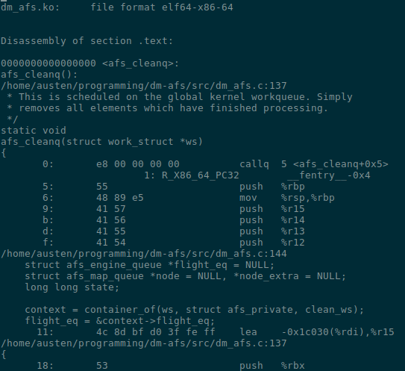
objdump
Essentially an easier to read hex dump.
It will print out your program’s disassembled machine code.
Compile your program with the -g option in order to see what line of code corresponds to what line of assembly.
Use the command objdump -dSlr executable > executable.disasm to disassemble the program and put the output into a new file.
The example shown is a disassembled Linux kernel module queue that frees objects in a linked list.
We do not expect you to use this, it is just neat.
© 2019 Darrell Long & the University of California
23

