Slide 1
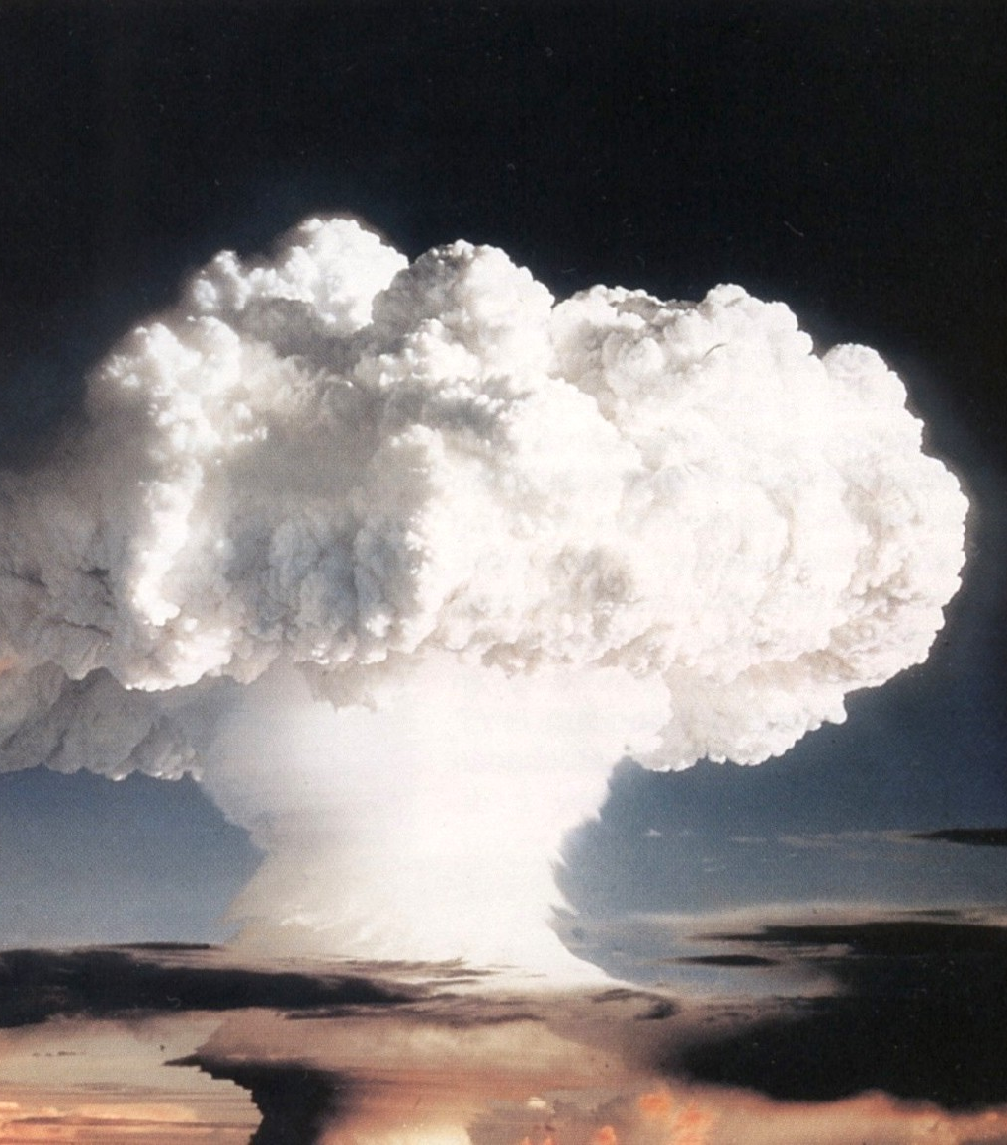
Testing and Performance
CSE 13S
Prof. Darrell Long

