Slide 1
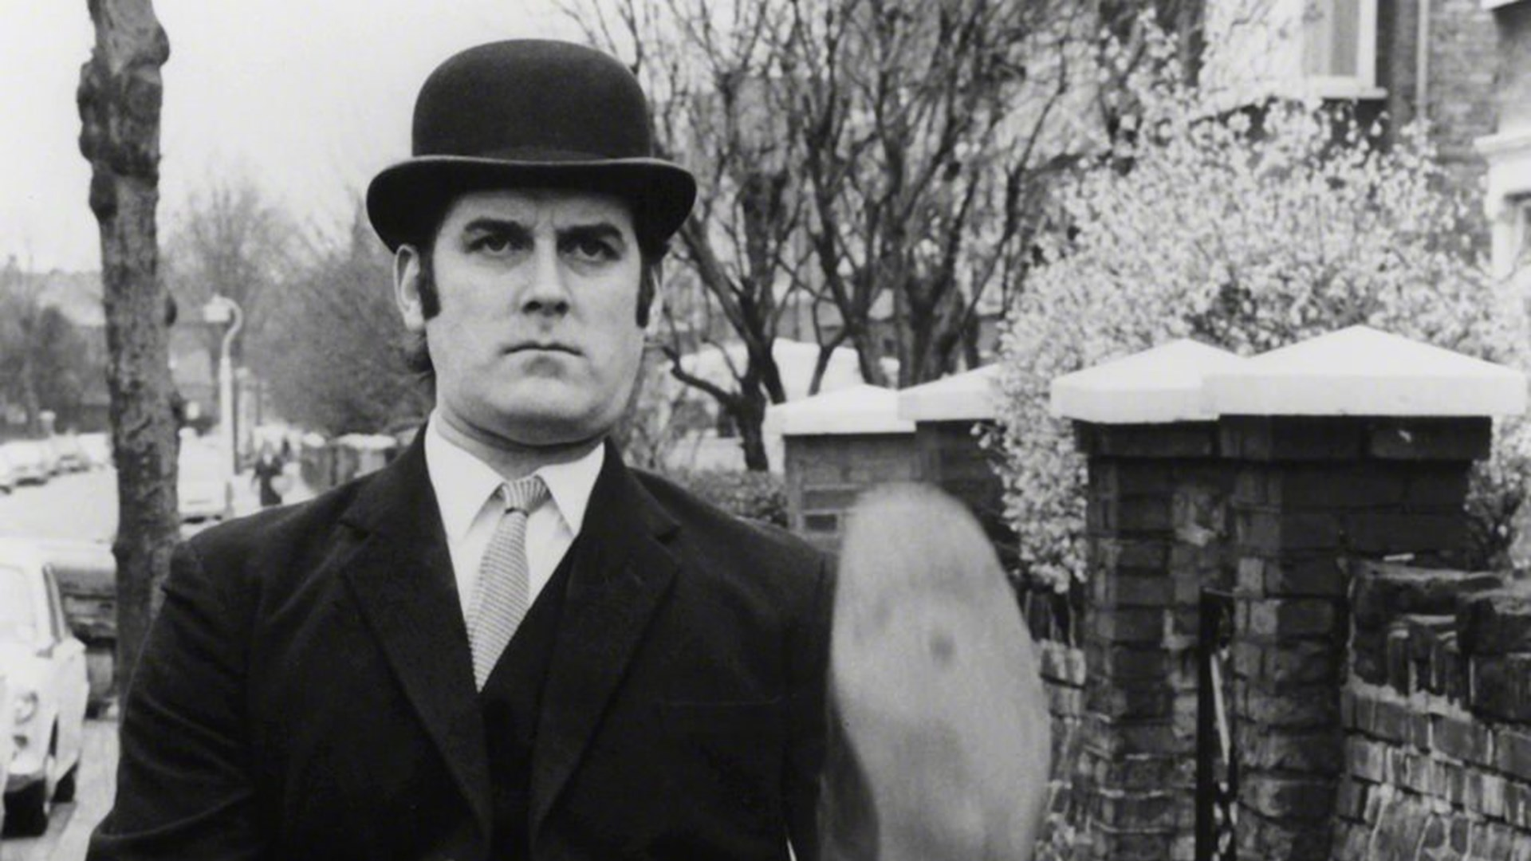

Functions
Prof. Darrell Long
CSE 13S

Slide 2

Words of Caution
Just as assignment statements are not the same as equations in high school Algebra, functions in C are not the same as mathematical functions.
They may or may not return a value.
They may or may not have side-effects.
In other languages, we might call them procedures or subroutines.
Java aficionados call them methods.
Please, do not do that when writing in C.

Slide 3
How is it different?
In mathematics, a function f maps an element of a set called the domain onto a set called the range.
There are many ways to define a function: in terms of sets, relations, …
You should have learned about these in CSE 16 (Discrete Mathematics).
In C, we call function what in other languages might be called procedure or subroutine.
Typically, a language will call it a function if it returns a value, and procedure or subroutine if it does not.
In C, a function that returns void (nothing) fills the role of subroutine.
Do not call it a method.

Slide 4
What is a function in programming?
A function is block of code that performs a certain task.
It gives a name to code that (hopefully) performs a logically consistent task.
Functions are defined exactly once.
Functions must be declared before they are used.
Programs can declare & call a function as many times as desired.
main()
Is a special function.
Is run when program starts.
All other functions are subordinate to main().

Slide 5
Why do we like functions?
Functions should:
Define abstractions that are consistent and make sense logically.
Give names to those sequences of code.
Hide the implementation.
We can use them to:
Refactor repeated sequences of code.
Simplify the code to aid understanding.
Functions should never be:
Arbitrary sequences of statements.

Slide 6
Function Definition
return_type function_name(parameters)
{
// declarations, assignment statements
}
Function head
Function block/body
Function head
return_type
Defines the type of function’s return value
Return type may be void or any object type (except array type)
function_name()
Function’s name
parameters
Contained in comma-separated list of declarations
If function has no parameters, then this is either empty or contains the word void
Function block/body
Declarations
Declared variables inside a function body are only locally known
Assignment statements
Sets and/or resets the value of a variable

Slide 7
Return Values
In C, functions return a value.
The value may be void, which means no value.
You can return any scalar value (char, int, float, …)
You can return a struct (but please don’t).
You can return a pointer.
You cannot return an array.

Slide 8

Function naming
Functions have the same naming rules as variables.
Can’t:
Start with a number or any punctuation other than _ (underscore) or $ (dollar sign)
Use the same name as another function.
There are no nested functions in C.
For this class, we will be using Snake case
my_function_name

Slide 9

Parameters — Also called Arguments
In mathematics, when we have a function like $f\left(x\right)=x log⁡(x+1)$, and we write $f(2)$ we substitute 2 for $x$ and get $2 log⁡(2+1)$.
In programming languages, this is called call-by-name, and is rare.
C supports this as textual substitution in macros with the C Preprocessor.
Most programming languages use either call-by-value, call-by-reference or both.
C uses call-by-value, except for arrays, and only because of their relation to pointers.

Slide 10

Parameters
Formal parameters
This is the name of the parameter as it is used inside of the function body.
Actual parameters
This is the name of the value that is passed to the function.
The value can be copied to the formal parameter.
Or a reference to the actual parameter may be bound to the formal parameter.
In C, we do this by passing a pointer using call-by-value.
Call-by-value means a copy of the actual parameter is places in the formal parameter.
This is the only method supported by C.
Copy-in-Copy out means that in addition to being copied in, the value is copied back out to the actual parameter.
C does not support this.

Slide 11
Call-by-Value
All functions use call-by-value in C.
Arguments passed into a function are copied
Any changes made to the parameters inside the function has no effect.
The called function copies the values of the supplied (actual parameters) arguments into a new set of variables (formal parameters) which are pushed into the call stack.

Slide 12
Call-by-Reference
The references of the arguments passed into a function are copied meaning any changes made to the parameters inside the function has an effect on the actual values.
Instead of passing values to the called function, references to the original variables are passed.
C does not use call-by-reference
But you can accomplish it by passing a pointer.

Slide 13


$$\sqrt{x}$$
Is a well-behaved function so we can use a simple method like bisection.

Slide 14
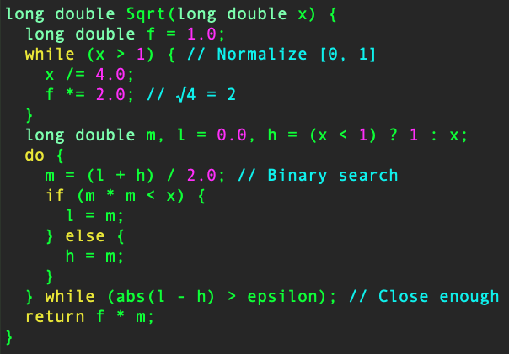
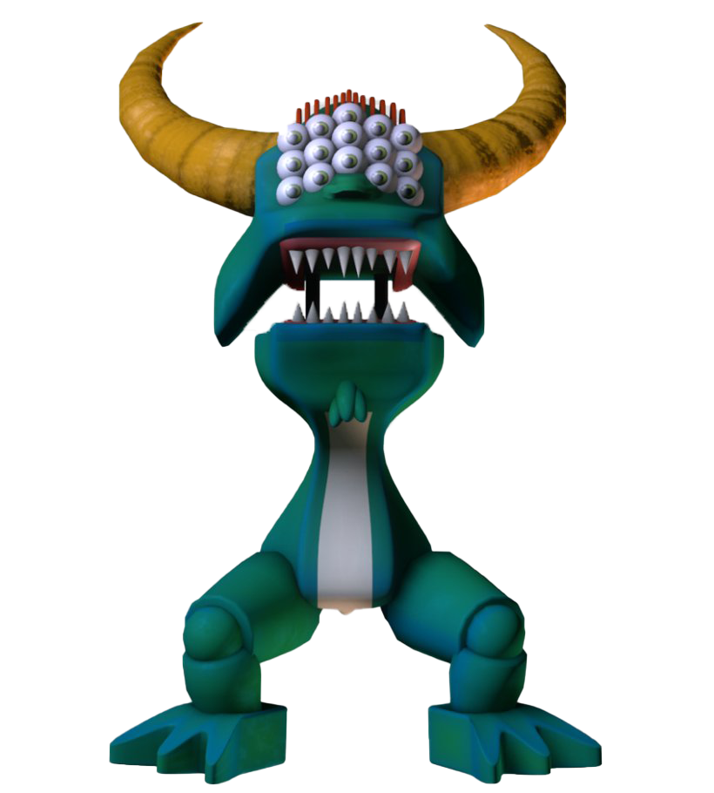

$$\sqrt{x}$$

Slide 15
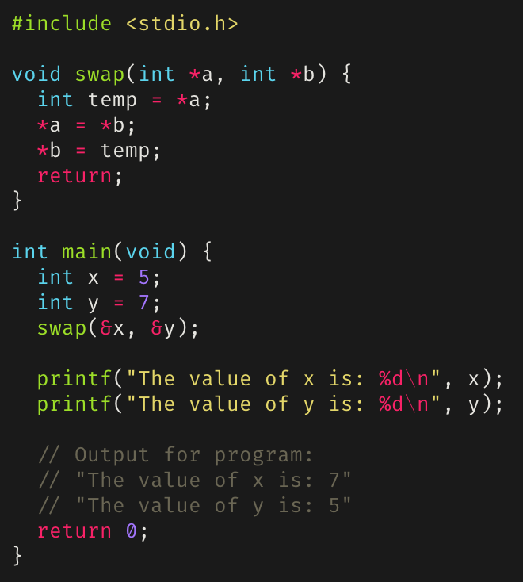
swap()
C does not have true call-by-reference, so we use pointers.
Addresses, instead of values, are passed as arguments.

Slide 16
Function Prototypes
Provides compiler with description of functions that will be used later in the program.
Functions in programs cannot be called unless they have either:
Been declared and defined prior to the function call.
Been prototyped at the beginning of the program.
Syntax for Function Prototype:
Prototypes must be declared either at the beginning of the program or in included header files, which act as interfaces.
return_type function_name(parameters);

Slide 17
#include
A preprocessor directive.
Before compilation, C source files are processed by a preprocessor.
A preprocessor is a macro processor to transform programs before compilation.
Macros in C operate through text replacement.
Pastes code of given file into current file.
Used to include functions defined in other libraries.

Slide 18
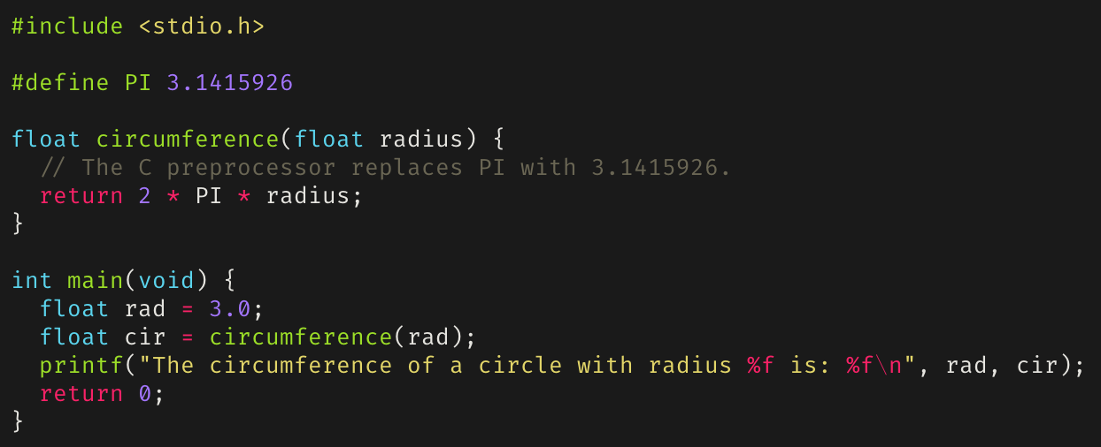
#define
A preprocessor directive that defines a macro for the program.
The C preprocessor performs all text replacement for defined macros prior to compilation.

Slide 19
Conditional Directives
A set of preprocessor directives that uses conditional statements to include code selectively.
Uses value of conditions evaluated during compilation.
#ifndef – execute statements when MACRO is undefined :
#ifdef – execute statements only when MACRO is defined:
#define MACRO
#ifdef MACRO
controlled text
#endif
#ifndef macroname
controlled text
#endif

Slide 20
Header Files
Should only contain things that are shared between source files:
Function declarations
Macro definitions
Data structure and enumeration definitions
Global variables (see coding standards for proper usage)
Any #include directives required to compile
Uses the file extension .h.
Typically used for modules or abstract data types
Header files provide the function declarations so that the function implementations aren’t known.
This allows you to have opaque data types.
Contents of a header file must be within a header guard, implemented with the either the #ifndef or #pragma once preprocessor directive.
Both prevent contents of a header file from being included more than once.

Slide 21
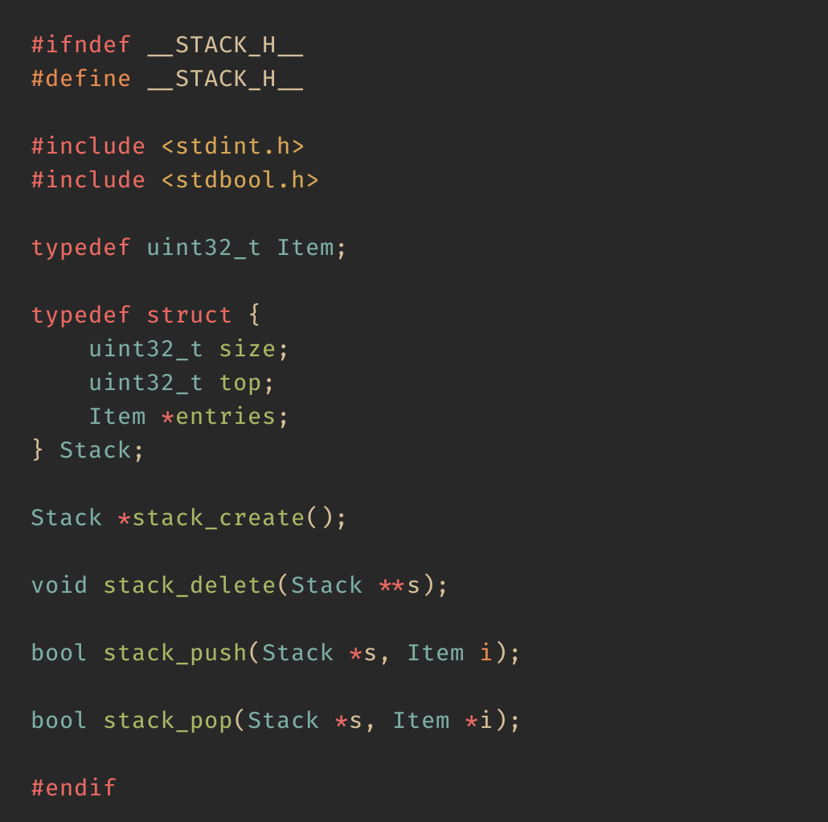
Example Header File
The header file on the right is for the stack abstract data type.
Note that everything is contained within a header guard using #ifndef.
New types
Function interfaces

Slide 22
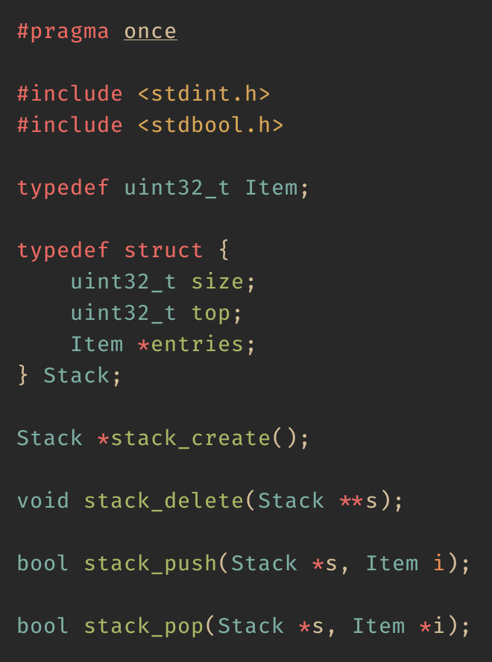
Same Header File
The header file on the right is the same as the last slide, but instead uses #pragma once.

Slide 23

#ifndef versus #pragma once
#ifndef checks a macro and will always work.
#pragma once is a compiler directive, is an extension, and may not always work.
But it does work on all modern compilers.
#pragma once is cleaner.
#ifndef is more portable.
Be consistent: use one, or the other!

Slide 24
Some Standard Header Files
stdio.h for input/output.
inttypes.h for fixed width integer types.
time.h for date/time utilities.
stdbool.h for boolean types.
ctype.h for functions to determine the type contained in character data.
math.h common mathematical functions.

Slide 25
extern
Extends the visibility of variables and functions such that they can be called by any program file, provided that the declaration is known.
Functions in C are implicitly prepended by extern.
Typically used for global variables.
extern variables are declared outside of functions.
Available until end of the execution of the program

Slide 26
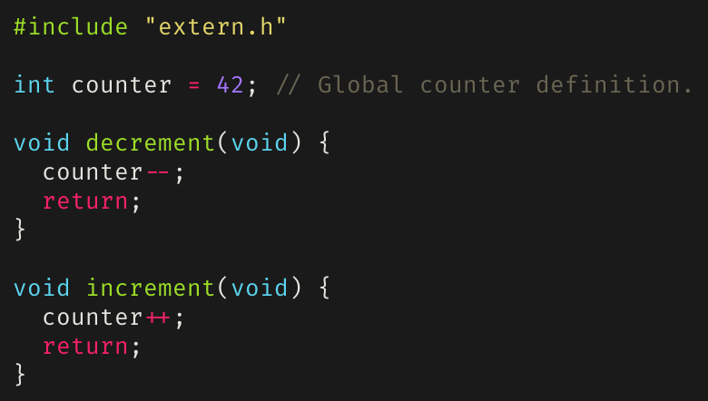
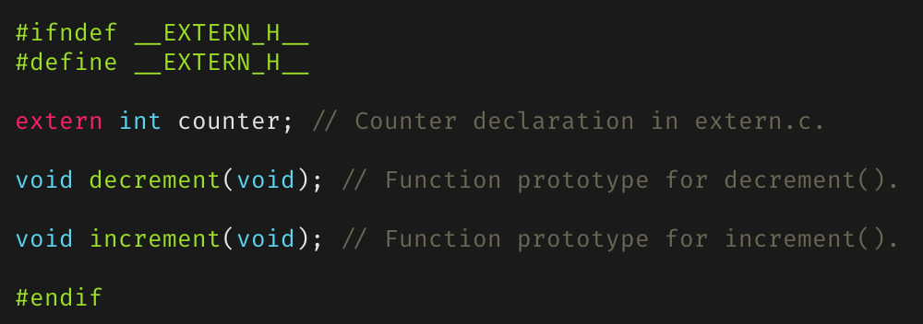
An extern counter

Slide 27
static
Can be declared inside and outside a function.
Declared inside a function if the value of the variable needs to persist across function calls.
Declared outside a function if the value of the variable needs to accessed by multiple functions but only exists within the scope of the file in which it is declared.
Available until program finishes execution.

Slide 28
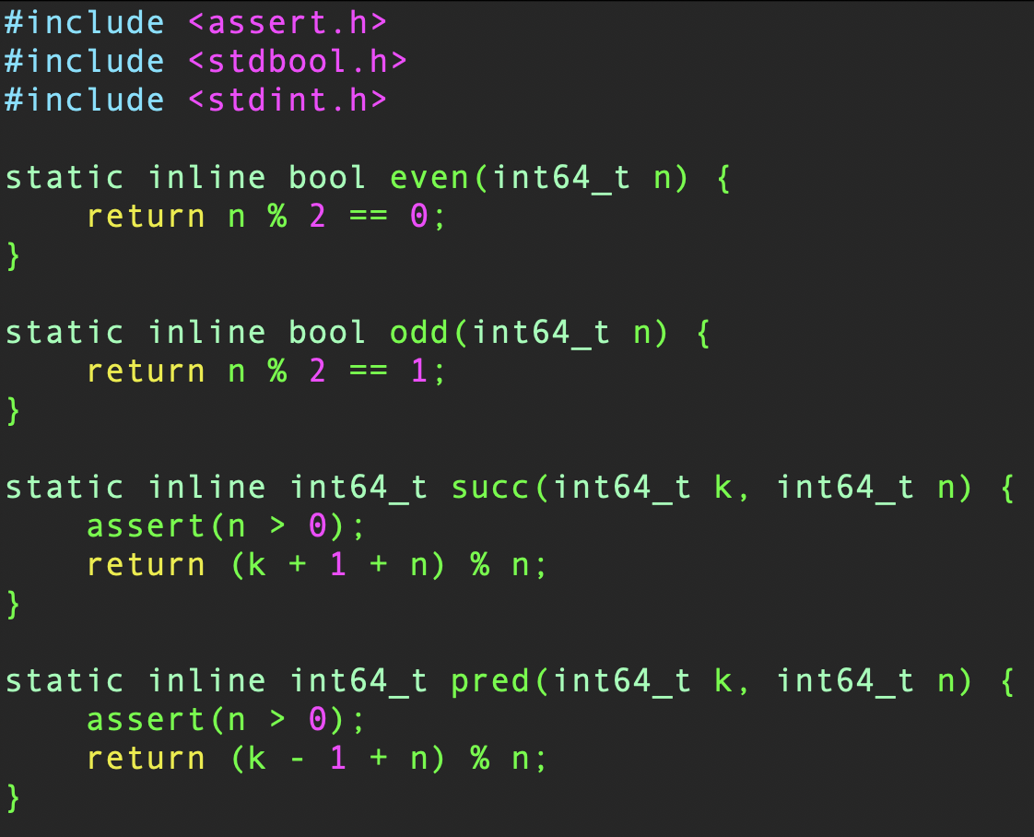
Utility Functions

Slide 29
Recursion
A function may call itself! We will discuss this in detail later.
Syntax of recursive functions:
Recursive functions must always define exit conditions to prevent the function from being called an unbounded number of times.
Recursive code is more compact and may be easier to write and understand.
void function_name(){
function_name(); // function calls itself
}

Slide 30
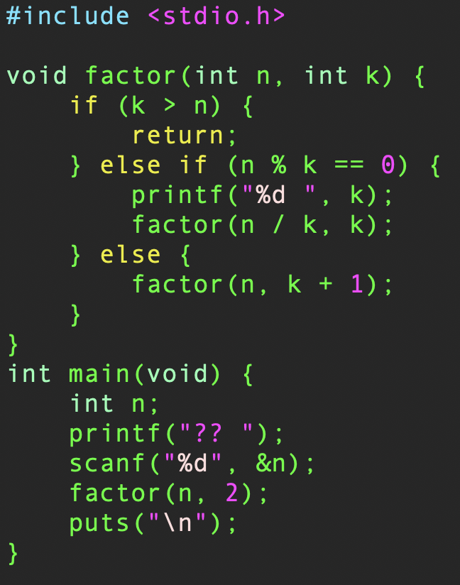

Factoring (naïvely)
Print the unique factorization of a positive int if it exists.
If $k$ is a factor of $n$ (evenly divides it) then print $k$ and try again with $n/k$.
If $k$ is not a factor of $n$, then try $k+1$.
Do this until $k>n$.
When is this the worst algorithm you might try?

Slide 31
Summary
Functions provide the ease of running a sequence of code repeatedly.
Functions can return void, scalar values, pointers and structs (although it is advised to not go this route); they cannot return arrays.
For this class only use Snake case function naming for e.g. my_function_name.
Formal parameters are used inside the body of a function.
Actual parameters are passed to a function.
C only uses Call-by-Value.
Call-by-Reference can be performed by passing a pointer to a function.
Prior to function calls, you need to define function prototypes:
Either at the beginning of a program or in header files.

