Slide 1
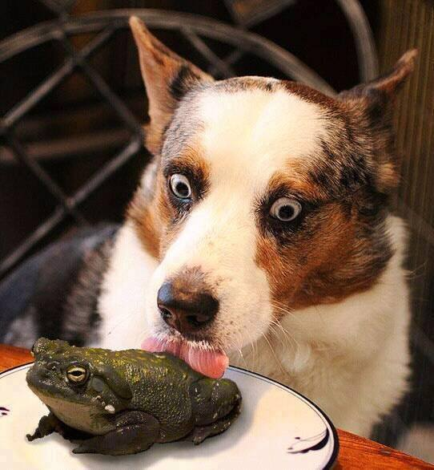
Pointers and Dynamic Memory
Darrell Long
CSE 13S

Slide 2
What is a pointer?
A variable that holds a memory address.
The variable points to the location of an object in memory.
Not all pointers contain an address.
Pointers that don’t contain an address are set to the NULL pointer.
Value of the NULL pointer is 0.
NULL is a macro for either:
((void *)0)
0
0L
The definition depends completely on the compiler.

Slide 3
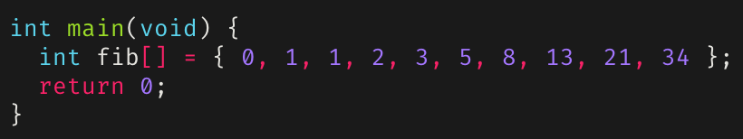
Review: Memory Addresses
Memory is stored in registers that can be accessed by a specific number (address).
Usually, each byte has a unique address.
Bytes are grouped into words (timeshare uses word size 4).
Address | 00 | 04 | 08 | 0C
A000_7FA0 | 00000000 | 00000000 | 00000000 | 00000000
A000_7FB0 | 00000000 | 00000001 | 00000001 | 00000002
A000_7FC0 | 00000003 | 00000005 | 00000008 | 0000000D
A000_7FD0 | 00000015 | 00000022 | 00000000 | 9D000350
A000_7FE0 | 00000000 | 00000000 | 00000000 | 00000000

Slide 4
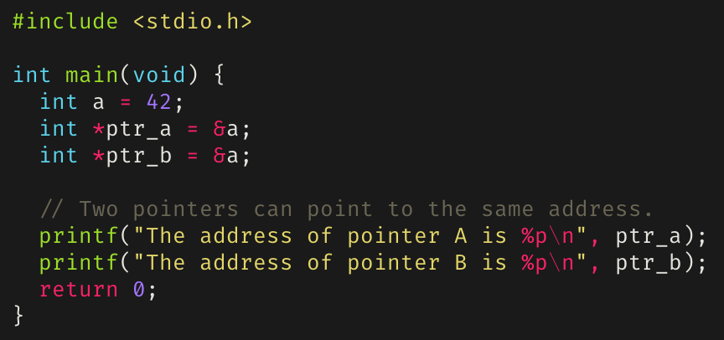
Pointers and addresses
Pointers are said to point at the address they are assigned.
Can assign a pointer the address of a variable using the address-of operator (&).
Multiple pointers can point to the same address.
Address | 00 | 04 | 08 | 0C
A000_7FA0 | 00000000 | 00000000 | 00000000 | 00000000
A000_7FB0 | 00000000 | 00000000 | 00000000 | 00000000
A000_7FC0 | 00000000 | 00000000 | A0007FD0 | A0007FD0
A000_7FD0 | 0000002A | 00000000 | 00000000 | 00000000
A000_7FE0 | 00000000 | 00000000 | 00000000 | 00000000

Slide 5
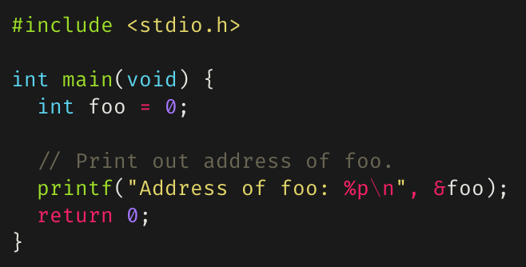
How to use the & operator
Example of using the & operator to access the address of a variable:

Slide 6
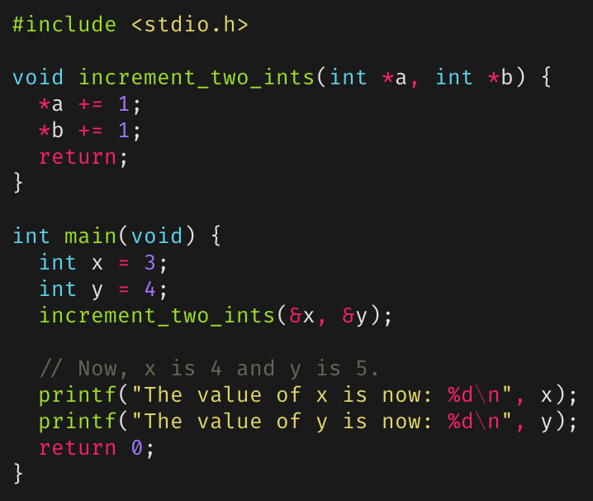
Dereferencing a Pointer
The object a pointer points to can be accessed through dereference, or indirection.
A pointer can be dereferenced using the dereferencing operator (*).
Useful for manipulating the values of several variables through call-by-reference.

Slide 7
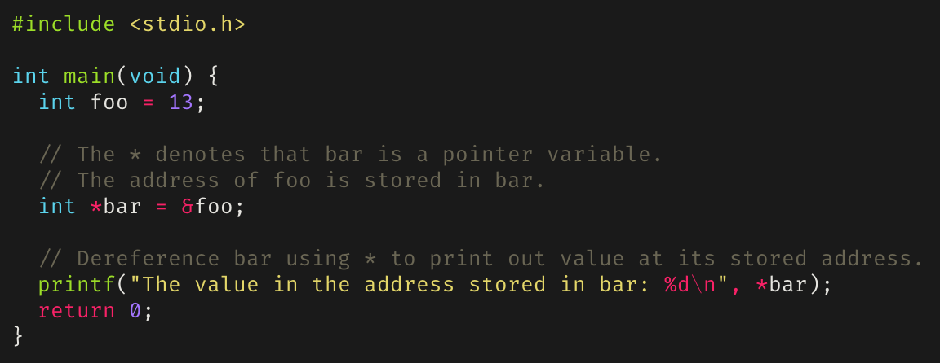
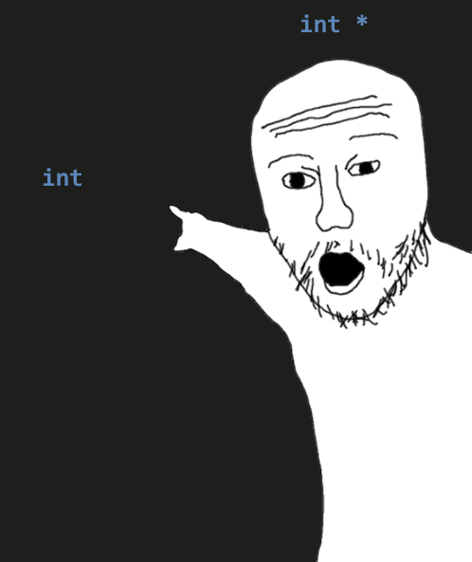
How to use the * operator
Example of using * to instantiate a pointer variable and using it to dereference a pointer.
foo
bar

Slide 8
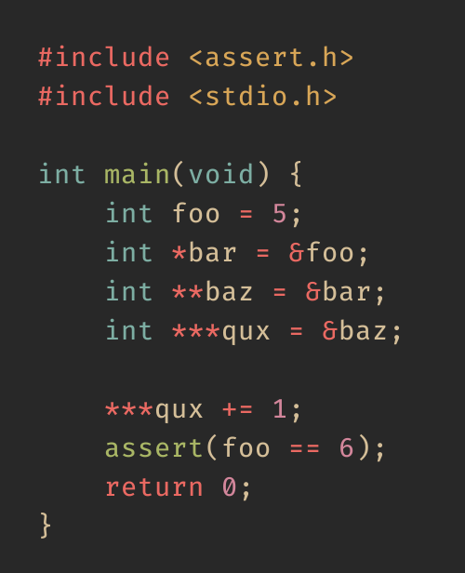
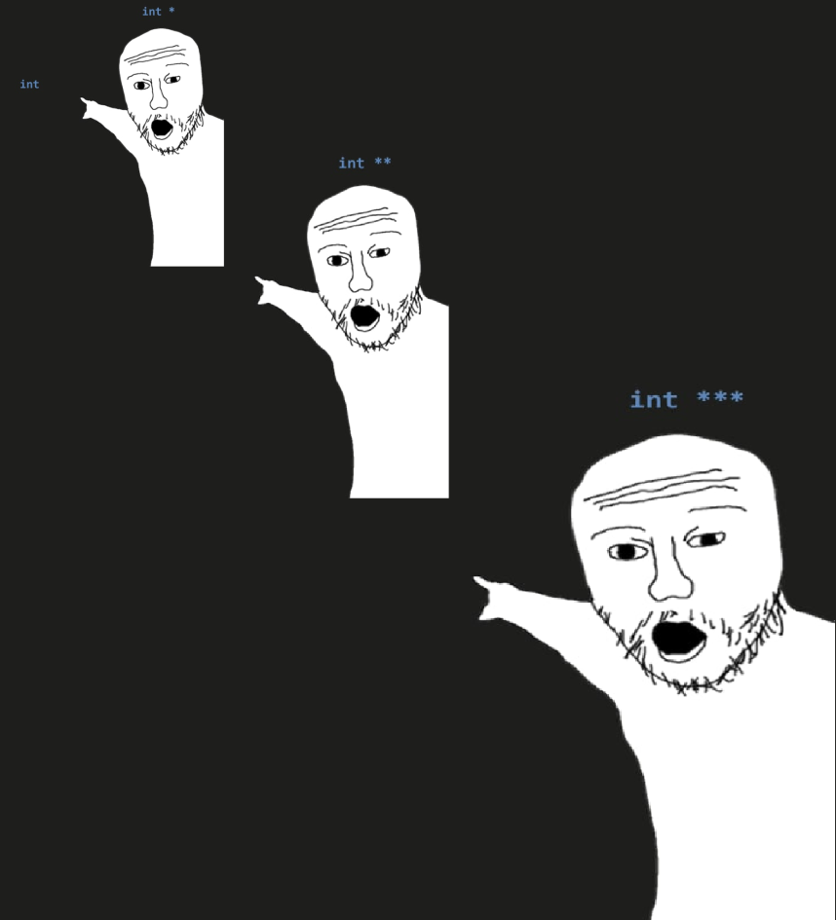
Pointers Have Addresses, Too
foo
bar
baz
qux

Slide 9
Benefits of Pointers
Can be used when passing actual values is difficult.
Can “return” more than one value from a function.
Building dynamic data structures.
Useful for passing large data structures around.
Pointers are efficient for this since copies of data structures don’t need to be pushed into the stack.

Slide 10
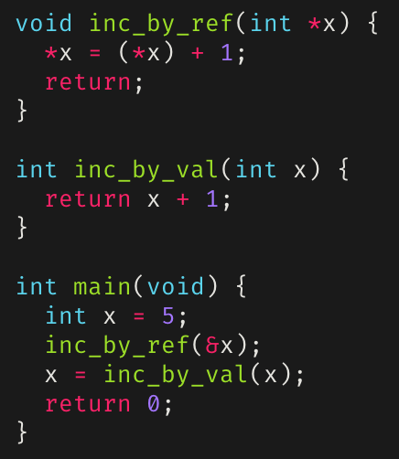
Passing by value versus Passing by reference
“Passing by value” duplicates passed values onto stack.
“Passing by reference” duplicates a pointer onto the stack.

Slide 11
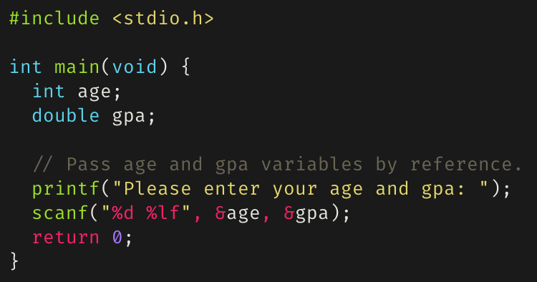
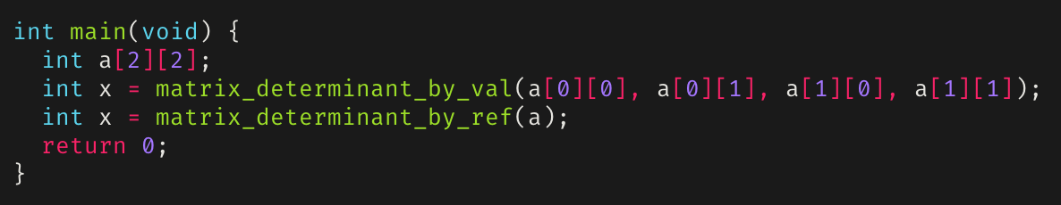
Passing by reference
Allows “returning” multiple values.
Allows passing large amounts of data quickly.
You’re not copying the data, just telling where it is stored.

Slide 12
Pointer Arithmetic
Since pointers in C are just an addresses, numeric values, you can perform arithmetic on them.
++ : increments to next address (increment by 4 bytes assuming 32-bit integers).
-- : decrements to previous address.
+ : can only add a numeric value to a pointer (no pointer and pointer addition).
- : if a pointer is subtracted from another pointer, the distance between both addresses is calculated.
Pointers can also be compared using relational operators (e.g. ==, <=, <, etc.).

Slide 13
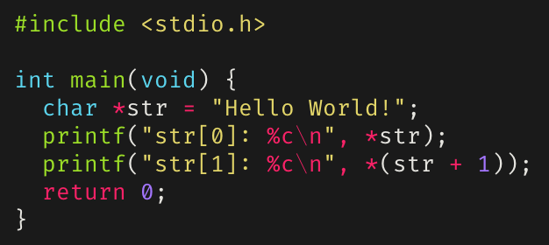
Pointer Arithmetic
Can offset a pointer by adding/subtracting an integer.
Can get the number of elements between two pointers by getting their difference.
Cannot sum, divide, or multiply two pointers.

Slide 14
Arrays And Pointer Arithmetic
1000
1001
For int arr[i]:
arr[i] == *(a + i)
If arr starts at address 1000, then arr[i] is at 1000 + (i * 4)
Why? An int is typically 4 bytes
If arr was an array of uint64_t’s, then arr[i] would be at 1000 + (i * 8)
You can use sizeof() to get the size in bytes of scalar types
arr[0]
1002
1003
1004
1005
arr[1]
1006
1007
1008
1009
arr[2]
1010
1011

Slide 15

But does it make sense?
Adding an int to a pointer makes sense.
Subtracting an int from a pointer makes sense.
Subtracting two pointers makes sense.
Adding two pointers makes no sense.
Multiplying or dividing with pointers never makes sense.

Slide 16
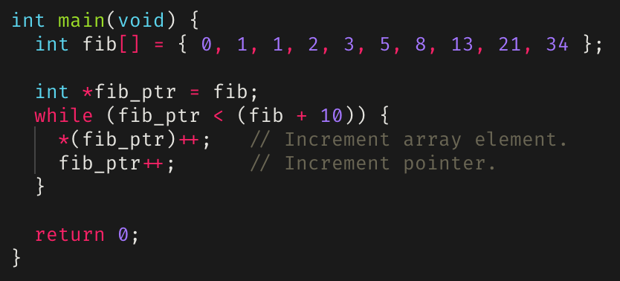
Pointer arithmetic example: Iterating over an array
fib_ptr
Address | 00 | 04 | 08 | 0C
A000_7FA0 | 00000000 | 00000000 | 00000000 | 00000000
A000_7FB0 | 00000000 | 00000000 | A0007FBC | 00000001
A000_7FC0 | 00000002 | 00000002 | 00000003 | 00000004
A000_7FD0 | 00000005 | 00000008 | 0000000D | 00000000
A000_7FE0 | 00000022 | 00000000 | 00000000 | 9D000390

Slide 17
Pointers and arrays
Array subscripting can also be done with pointers.
Using pointer arithmetic in general is faster, but harder to understand.
Assuming some array int arr[10]:
arr[i] is equivalent to *(arr + i), where 0 <= i < 10
Arrays can always be written using pointers.
Declaring an array in a function allocates it on the stack.
A global array is in the data area.
Dynamically declaring an array (to get a pointer) allocates it on the heap.

Slide 18
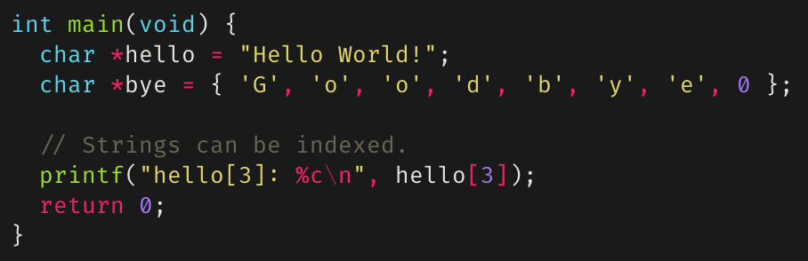
Strings as arrays
In C, strings are handled as arrays
With some special syntax, for convenience
A string is a pointer to an array of chars
Strings can be indexed, passed by reference, etc.
Address | 00 | 04 | 08 | 0C | ASCII
0000_7FB0 | 00000000 | 00000000 | 00000000 | 00000000 | ........ ........
0000_7FC0 | 6C6C6548 | 6F57206F | 21646C72 | 00000000 | Hello Wo rld!....
0000_7FD0 | 646F6F47 | 00657962 | 00000000 | 9D0007B8 | Goodbye. ........
0000_7FE0 | 00000000 | 00000000 | 00000000 | 00000000 | ........ ........

Slide 19


Pointers to pointers
**argv
argv
*argv
Pointers can point to other pointers
or to pointers to other pointers, or to pointers to pointers to pointers, etc
Can be used to pass arrays of arrays, such as a list of strings
For example, char **argv
Address | 00 | 04 | 08 | 0C | ASCII
A000_7F80 | 00000000 | 00000000 | 00000000 | 00000000 | ........ ........
A000_7F90 | 00000000 | 00000000 | 00000003 | A0007FD4 | ........ ......□.
A000_7FA0 | 6874616D | 00000000 | 0000732D | 5F796877 | math.... -s..why_
A000_7FB0 | 745F7369 | 65726568 | 745F615F | 64726968 | is_there _a_third
A000_7FC0 | 6772615F | 0000003F | A0007FA0 | A0007FA8 | _arg?... .□...□..
A000_7FD0 | A0007FAC | A0007FC8 | 00000000 | 00000000 | .□...□.. ........
A000_7FE0 | 00000000 | 00000000 | 00000000 | 00000000 | ........ ........

Slide 20
Pointers to pointers
argv
**(argv + 1)
*argv
Pointers can point to other pointers
or to pointers to other pointers, or to pointers to pointers to pointers, etc
Can be used to pass arrays of arrays, such as a list of strings
For example, char **argv
Address | 00 | 04 | 08 | 0C | ASCII
A000_7F80 | 00000000 | 00000000 | 00000000 | 00000000 | ........ ........
A000_7F90 | 00000000 | 00000000 | 00000003 | A0007FD4 | ........ ......□.
A000_7FA0 | 6874616D | 00000000 | 0000732D | 5F796877 | math.... -s..why_
A000_7FB0 | 745F7369 | 65726568 | 745F615F | 64726968 | is_there _a_third
A000_7FC0 | 6772615F | 0000003F | A0007FA0 | A0007FA8 | _arg?... .□...□..
A000_7FD0 | A0007FAC | A0007FC8 | 00000000 | 00000000 | .□...□.. ........
A000_7FE0 | 00000000 | 00000000 | 00000000 | 00000000 | ........ ........
20

Slide 21
Multidimensional Arrays
int a[3][3] = {{0, 1, 2},
{3, 4, 5},
{6, 7, 8}};
Row, Column
a[y][x]
Column
In some cases, arrays of arrays support a more compact data structure:
If data is of same type, and each sub-array is of same length, a multidimensional array is appropriate.
a[0][0] = 0;
a[0][1] = 1;
a[0][2] = 2;
a[1][0] = 3;
a[1][1] = 4;
a[1][2] = 5;
a[2][0] = 6;
a[2][1] = 7;
a[2][2] = 8;
0
1
2
x
Row 0
0
0
1
2
0,0
0,1
0,2
Row 1
3
4
5
1
Row
1,0
1,1
1,2
Row 2
2
6
7
8
2,0
2,1
2,2
y

Slide 22
Multidimensional Arrays
int a[2][2][2] = {{{0, 1},{2, 3}},
{{4, 5},{6, 7}}};
Plane, Row, Column
a[z][y][x]
1
z
Multidimensional arrays can be of any dimensionality.
Note: these grow in size very rapidly!
Plane
a[0][0][0] = 0;
a[0][0][1] = 1;
a[0][1][0] = 2;
a[0][1][1] = 3;
a[1][0][0] = 4;
a[1][0][1] = 5;
a[1][1][0] = 6;
a[1][1][1] = 7;
0
4
Row 0
0
Column
5
0
Row
1,0,1
0,0,0
1
x
7
1
2
0,0,1
1,1,1
y
0,1,0
3
0
0,1,1
1

Slide 23
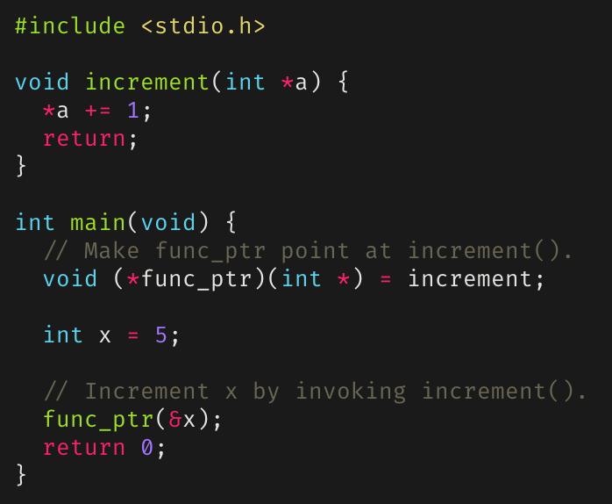
Function Pointers
Points to executable code in memory instead of a data value.
Dereferencing a function pointer yields the referenced function.
Notice how there are parentheses around the function pointer.
Without them, the function pointer would be parsed as a function declaration.

Slide 24
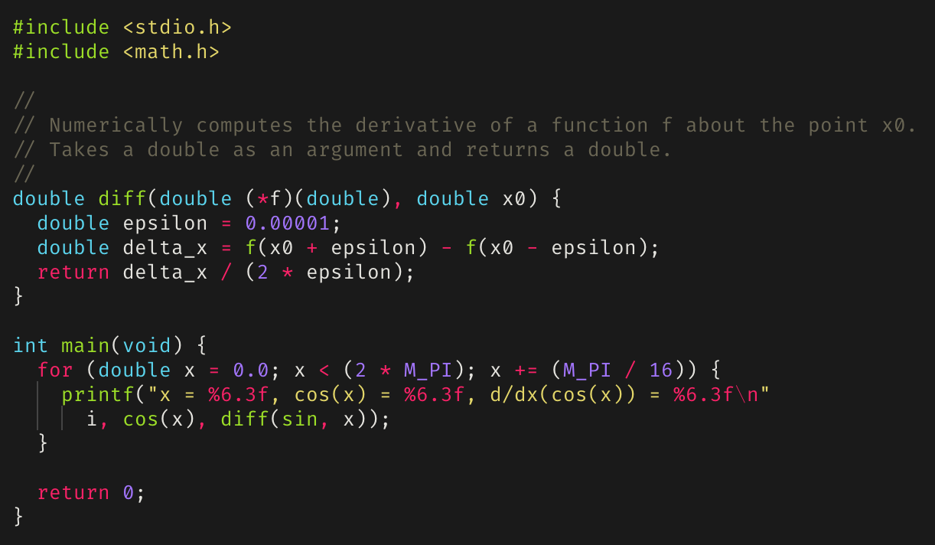
Function Pointer Example

Slide 25
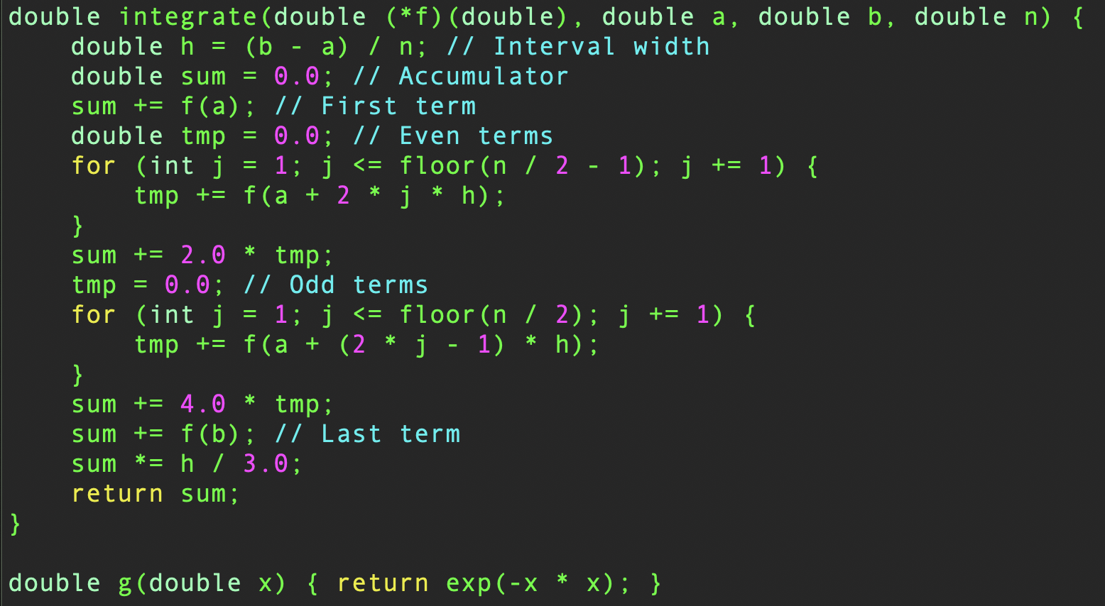

Numerical Integration
An implementation of Simpson’s $\frac{1}{3}$ Rule
We pass it a pointer to a function that we want to integrate.
We pass lower-and upper-limits $\left(a, b\right)$
And $n$, the number of intervals of the approximation.

Slide 26
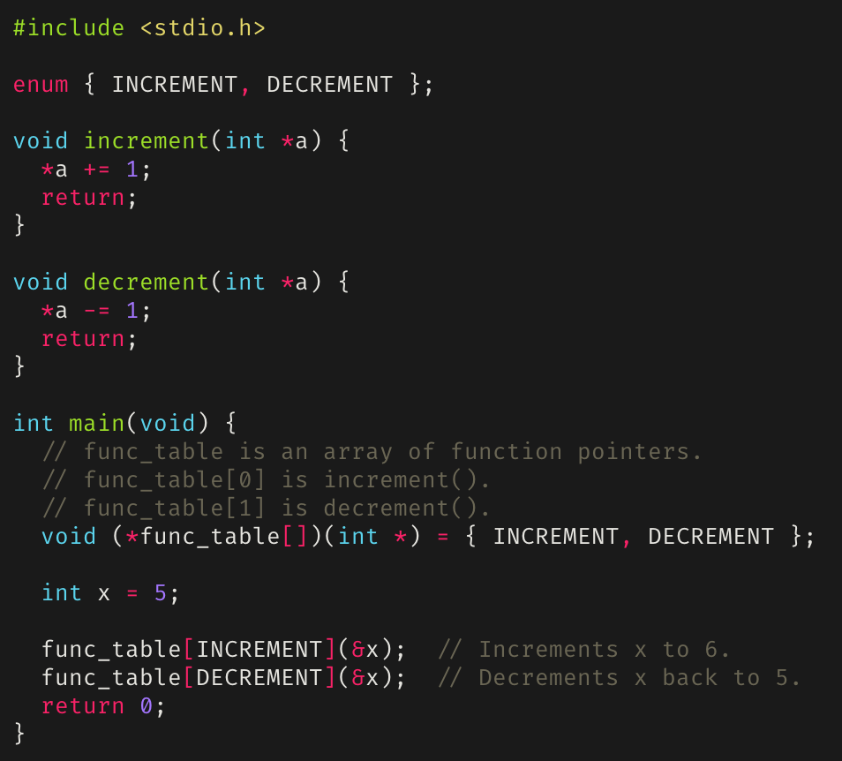
Function Tables (Jump Tables)

Slide 27

Summary
A pointer is a variable that contains a memory address (just a value).
Pointers can point to functions as well.
Pointers that don’t contain a valid address should point to NULL.
The address of a variable can be obtained with the address-of operator (&).
The object a pointer points to can be accessed by dereferencing the pointer (*).
Arbitrary levels of pointing: pointers can point to pointers which point to pointers, which point to pointers, which …
Useful for passing around large data structures.

