Slide 1
Regular Expressions
Darrell Long
CSE 13S

Slide 2

What is a Regular Expression?
Also known as regex or regexp
A series of characters that defines a search pattern
Used by databases, websites, vim, and command line programs such as grep and awk
Lexical analysis in a compiler
Peter Weinberger

Slide 3
Basic Regex Syntax
Expression | What Does It Match? | Expression | Matches (in red)
a | Matches the character itself | a | aab Santa Cruz
. | Matches any character | .ed | jumped flexed
+ | Matches one or more occurrences | o+d | Food Rode
* | Matches zero or more occurrences | u*int | uint32_t int8_t
? | One or zero occurrence of a one-character expression | an? | an apple

Slide 4
Basic Regex Syntax Continued
Expression | What Does It Match? | Expression | Matches (in red)
[] | Any character enclosed | [aeiou] | Computer
[a-z] | Any lower case letter between a-z | [a-e] | Computer
() | Group expressions | (pre)*y | Osprey Happy
{} | Number of times an expression is matched | [a-z]{3} | and Computer computer

Slide 5
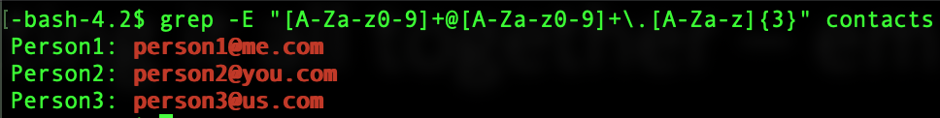
Putting it all together: electronic mail verification
Pattern: text₁@text₂.text₃
Identify subsections
Expression₁: [A-Za-z0-9]+
@
Expression₂: [A-Za-z0-9]+
Expression₃: \.[A-Za-z]{3}
Combine it: [A-Za-z0-9]+@[A-Za-z0-9]+\.[A-Za-z]{3}

Slide 6
Theory of Finite Automata
The theory behind regular expressions
Stephen C. Kleene

Slide 7

Types of Automata
Deterministic Finite Automata (DFA)
Also called Finite State Automata
Single transition per letter
Recognize Type 3 grammars
Recognize regular expressions
Non-Deterministic Finite Automata (NFA)
Have many transitions per letter
Have transitions for the empty string
Equal in power to DFA
Push Down Automata
We have a stack
Recognize Type 2 grammars
Recognize context-free languages
Linear bounded Turing Machine
We have a linearly bounded tape
Recognize Type 1 grammars
Recognize context-sensitive languages
Turing Machine
We have an infinite tape
Recognize Type 0 grammars
Can compute any computable function

Slide 8
How are automata theory and regular expressions connected?
Finite automata
Abstract machines that recognize patterns such as in strings
Regular Expressions
Generate patterns of strings
An algebraic formula

Slide 9
Deterministic Finite Automata (DFA)
Mathematical model of a machine that accepts a particular set of words over some alphabet
The set of words is also called the language
A given string will always produce the same result
A DFA is a quintuple <∑, S, S₀, δ, F>
∑ – Input alphabet
S – Finite nonempty set of states
S₀ – Start state
δ – State transition function
F – Set of final states

Slide 10


Letters and strings
$a∈ Σ$, we call $a$ a letter
$x∈Σ^{∗}$, we call $x$ a string
$λ∈Σ^{0}$ is the empty string
$λ$ is a string
If $x$ is a string, then $a⋅x$ is a string
$Σ^{∗}= \bigcup_{i=0}^{∞}{Σ^{i }}$

Slide 11
DFA example
Regex: “int”
Input: int
Starting State
Final State
S₀
S₁
S₂
F
i
n
t

Slide 12
DFA example
Input: int
Starting State
Final State
S₀
S₁
S₂
F
i
n
t

Slide 13
DFA example
Input: int
Starting State
Final State
S₀
S₁
S₂
F
i
n
t

Slide 14
DFA example
Input: int
Starting State
Final State
S₀
S₁
S₂
F
i
n
t

Slide 15
DFA example
Input: int
Starting State
Final State
S₀
S₁
S₂
F
i
n
t

Slide 16
DFA example
Input: int
Starting State
Final State
S₀
S₁
S₂
F
i
n
t

Slide 17
DFA example
Input: int
Starting State
Final State
S₀
S₁
S₂
F
i
n
t

Slide 18
Nondeterministic Finite Automata (NFA)
A NFA is a quintuple <∑, S, S₀, δ, F>
∑ – Input alphabet
S – Finite nonempty set of states
S₀ – Set of start states
δ – State transition function
F – Set of final states
State transitions are not uniquely determined by the current state and input
Every NFA can be written as a DFA
Exponentially large

Slide 19
NFA example
Starting State
S₀
a
a
Regex: “any | and”
Input: and
Must “guess” in the beginning
S₁
S₃
n
n
S₂
S₄
Final State
F
d
y

Slide 20
NFA example
Starting State
S₀
a
a
Regex: “any | and”
Input: and
Must “guess” in the beginning
S₁
S₃
n
n
S₂
S₄
Final State
F
d
y

Slide 21
NFA example
Starting State
S₀
a
a
Regex: “any | and”
Input: and
Must “guess” in the beginning
S₁
S₃
n
n
S₂
S₄
Final State
F
d
y

Slide 22
NFA example
Starting State
S₀
a
a
Regex: “any | and”
Input: and
Must “guess” in the beginning
S₁
S₃
n
n
S₂
S₄
Final State
F
d
y

Slide 23
NFA example
Starting State
S₀
a
a
Regex: “any | and”
Input: and
Must “guess” in the beginning
S₁
S₃
n
n
S₂
S₄
Final State
F
d
y

Slide 24
NFA example
Starting State
S₀
a
a
Regex: “any | and”
Input: and
Must “guess” in the beginning
Backtrack!
S₁
S₃
n
n
S₂
S₄
Final State
F
d
y

Slide 25
NFA example
Starting State
S₀
a
a
Regex: “any | and”
Input: and
Must “guess” in the beginning
S₁
S₃
n
n
S₂
S₄
Final State
F
d
y

Slide 26
NFA example
Starting State
S₀
a
a
Regex: “any | and”
Input: and
Must “guess” in the beginning
S₁
S₃
n
n
S₂
S₄
Final State
F
d
y

Slide 27
NFA example
Starting State
S₀
a
a
Regex: “any | and”
Input: and
Must “guess” in the beginning
S₁
S₃
n
n
S₂
S₄
Final State
F
d
y

Slide 28
NFA example
Starting State
S₀
a
a
Regex: “any | and”
Input: and
Must “guess” in the beginning
S₁
S₃
n
n
S₂
S₄
Final State
F
d
y

Slide 29
NFA example
Starting State
S₀
a
a
Regex: “any | and”
Input: and
Must “guess” in the beginning
S₁
S₃
n
n
S₂
S₄
Final State
S₅
F
d
y

Slide 30
NFA: Backtracking
Backtracking is an expensive recursive operation
Must explore all possible paths in the worst case
Number of paths can grow exponentially
Can we do better?

Slide 31
NFA Example – Simulate multiple states
Starting State
S₀
a
a
S₁
S₃
Regex: “any | and”
Input: and
Simulate both states
n
n
S₂
S₄
Final State
F
d
y

Slide 32
NFA Example – Simulate multiple states
Starting State
S₀
a
a
S₁
S₃
Regex: “any | and”
Input: and
Simulate both states
n
n
S₂
S₄
Final State
F
d
y

Slide 33
NFA Example – Simulate multiple states
Starting State
S₀
a
a
S₁
S₃
Regex: “any | and”
Input: and
Simulate both states
n
n
S₂
S₄
Final State
F
d
y

Slide 34
NFA Example – Simulate multiple states
Starting State
S₀
a
a
S₁
S₃
Regex: “any | and”
Input: and
Simulate both states
n
n
S₂
S₄
Final State
F
d
y

Slide 35
NFA Example – Simulate multiple states
Starting State
S₀
a
a
S₁
S₃
Regex: “any | and”
Input: and
Simulate both states
n
n
S₂
S₄
Final State
F
d
y

Slide 36
NFA Example – Simulate multiple states
Starting State
S₀
a
a
S₁
S₃
Regex: “any | and”
Input: and
Simulate both states
n
n
S₂
S₄
Final State
F
d
y

Slide 37
NFA Example – Simulate multiple states
Starting State
S₀
a
a
S₁
S₃
Regex: “any | and”
Input: and
Simulate both states
n
n
S₂
S₄
Final State
S₅
F
d
y

Slide 38
NFA: Simulating Multiple States
State transition function maps to those states that are reachable by the current state
Remember all the states that can be reached for some string
The NFA might be in every state in the worst case
Linear time
Introduced in Thompson’s Regular Expression Search Algorithm in 1968
Algorithms matter

Slide 39

The regex Package
This will be a short tutorial on how to use regex.

Slide 40
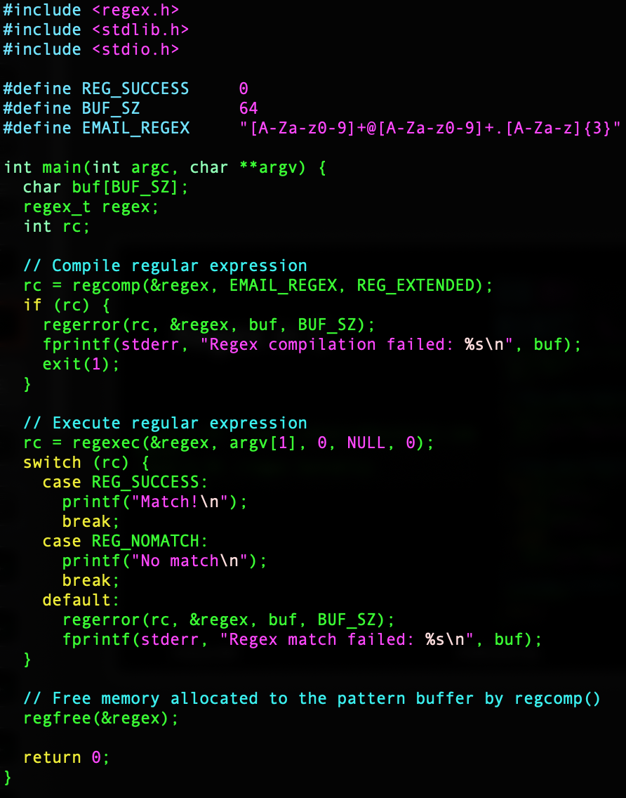
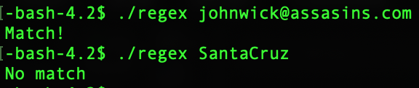
Regex in C

