Slide 1

Arrays and Strings
Prof. Darrell Long
CSE 13S

Slide 2
What is an array?
It is a homogeneous collection of elements
All elements have the same type.
Arrays can have one dimension
Often called a vector.
Arrays can have two dimensions
Often called a matrix.
C treats a matrix as an array of vectors.
Arrays can have even more dimensions
Often called a tensor by the machine learning community.
C treats these as arrays of arrays of … some type.

Slide 3

Arrays are ordered
In mathematics we write a vector as $\vec{a}=⟨a_{1},…,a_{n}⟩$.
In C, arrays start at zero: a[0], …, a[n-1]
Why? It’s easier, since a[0] is the base address of the array.
a[i] comes before a[i+1] in memory.
What about a[n]?
It’s past the end of the array, don’t do that!
a[i] comes after a[i-1] in memory.
Does a[-2] make sense?
No, it’s before the beginning of the array, don’t do that!
Yes, but we need to talk about pointers, and some people use it, but do not be that guy.

Slide 4
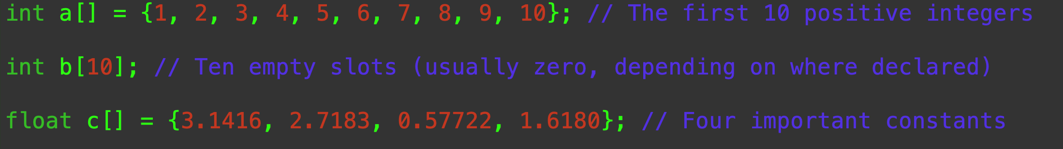
Declaring an array
type name [ count ] = { initialization list }
If you have an initialization list, then you don’t need a count.
If you have a count, then you don’t need an initialization list.
But you can have one, of course.
If the list is too short, then C will fill the rest with zero.

Slide 5
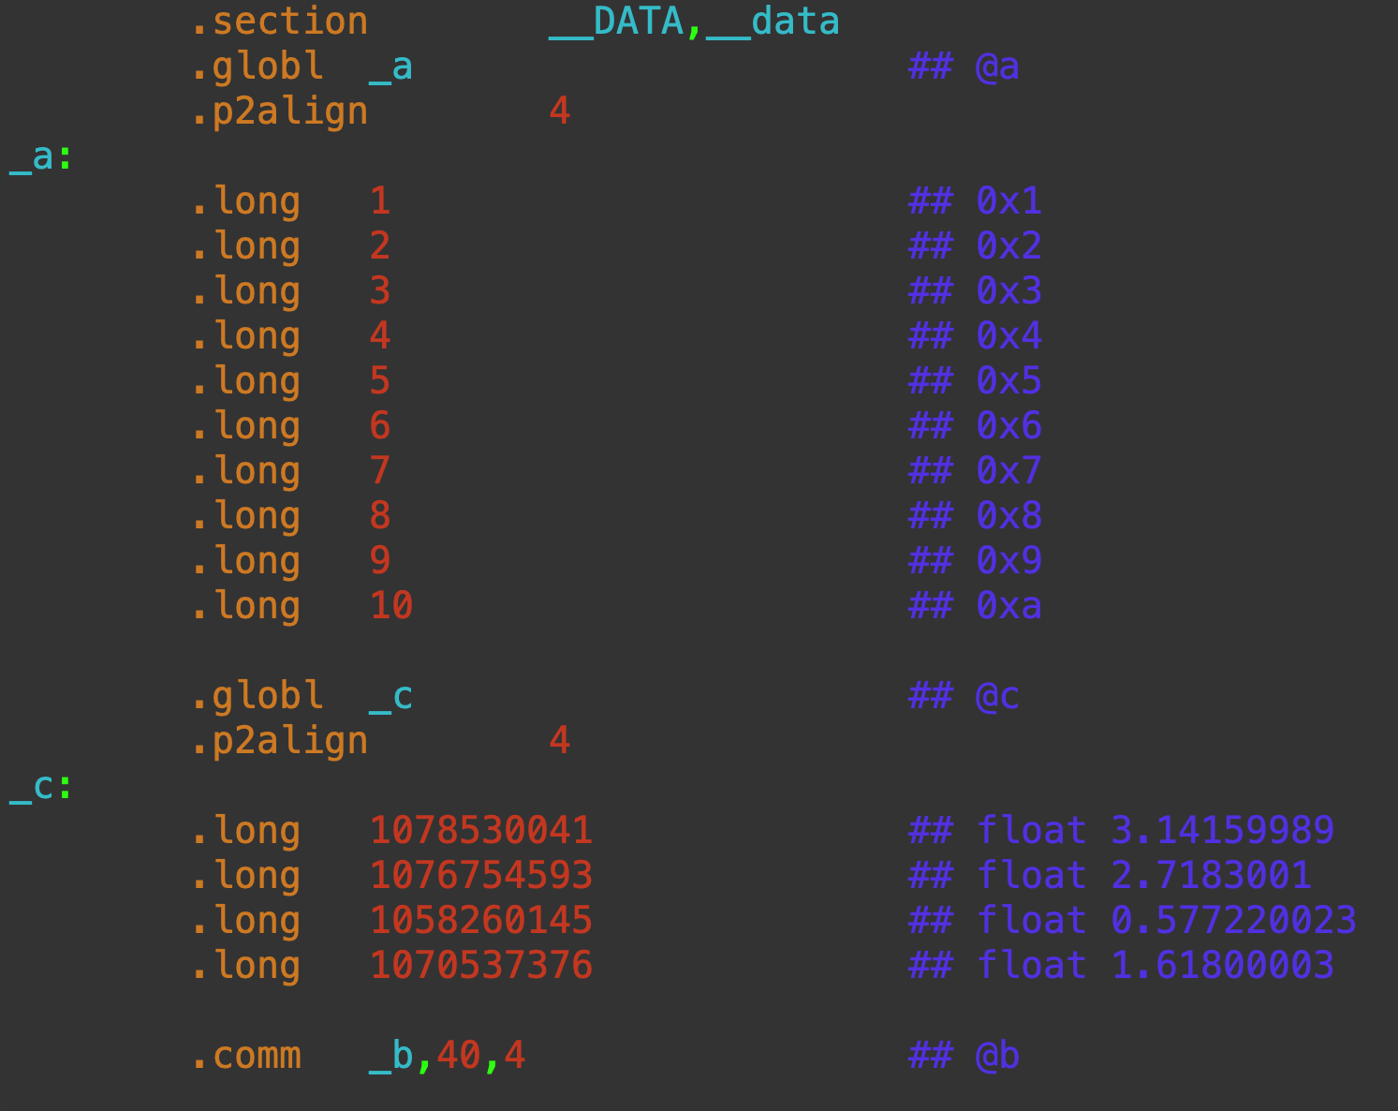
In Memory
The assembly language shows us what is really happening.

Slide 6

Matrices
In mathematics we write a matrix as $m= \left[\begin{matrix}m_{1,1} & m_{1,2} & m_{1,3} \\ m_{2,1} & m_{2,2} & m_{2,3} \\ m_{3,1} & m_{3,2} & m_{3,3}\end{matrix}\right]$
In C, we write: type m[3][3];
The elements are m[0][0] to m[2][2]
C stores the array in row major order
That means one row in memory, then the next row, then the next row.
FORTRAN is the only language that I know of that stores array in column major order.
That means one column, then the next, …

Slide 7

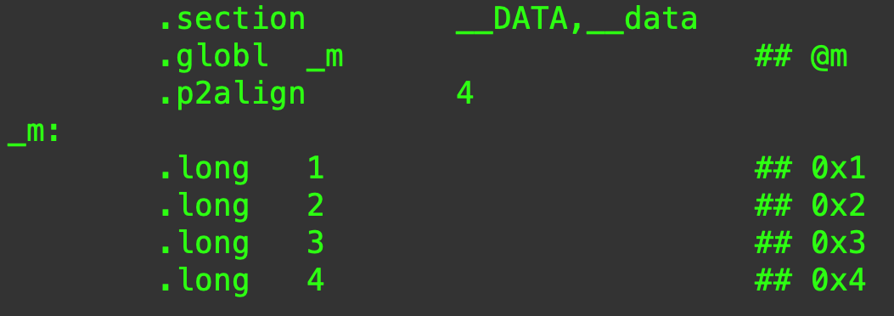
In Memory
Memory is one dimensional.
Rows are laid out sequentially.

Slide 8
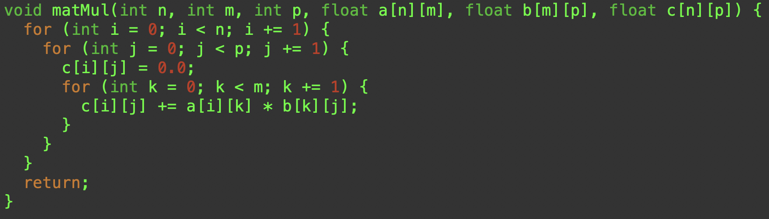
Matrix Multiplication

Slide 9
How are we changing c[][]?
Arrays are the exception to the rule that parameters in C are always passed by value.
Why is this?
Arrays can be large, so you don’t want to copy them onto the stack.
Does this make sense?
Perhaps surprisingly, it makes perfect sense!
Arrays and pointers are intimately related.
The name of the array is just a pointer to element zero of the array.

Slide 10
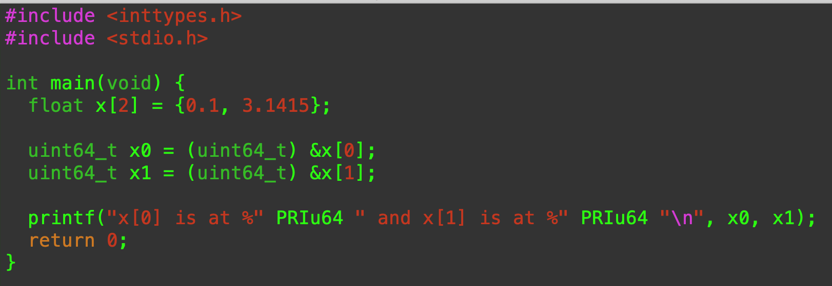
& (address of) operator
& gives the memory location (address) of a variable.

Slide 11
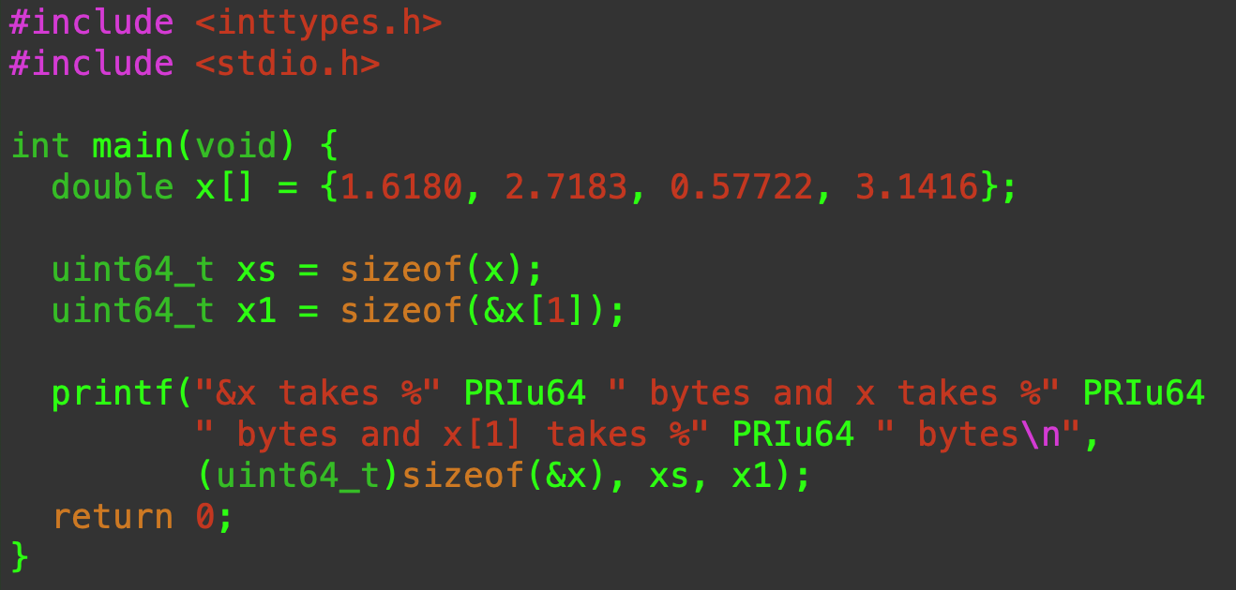
sizeof operator
The sizeof operator tells us the number of bytes used by a variable.
Works on arrays, structures, unions, when the compiler can know how much memory is used.

Slide 12
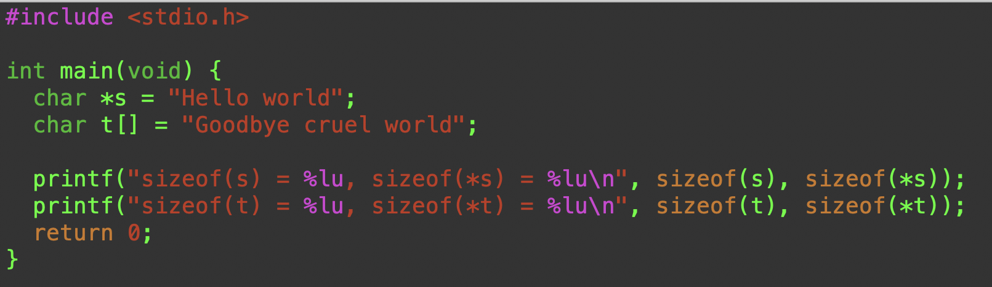

Is this what you expected?
sizeof when applied to an array gives the size of the array
sizeof when applied to a pointer gives the size of the pointer

Slide 13
Pointers and arrays
Arrays and pointers in C are related in fundamental and often confusing ways.
We will talk more about this when we deal with pointers.
For a single dimensional array,
a[i] == *(a + i)
a is the address of a[0]
a[i] is the array slot that is at a + i * sizeof(a[0])
Pointers automatically do the multiplication by sizeof

Slide 14
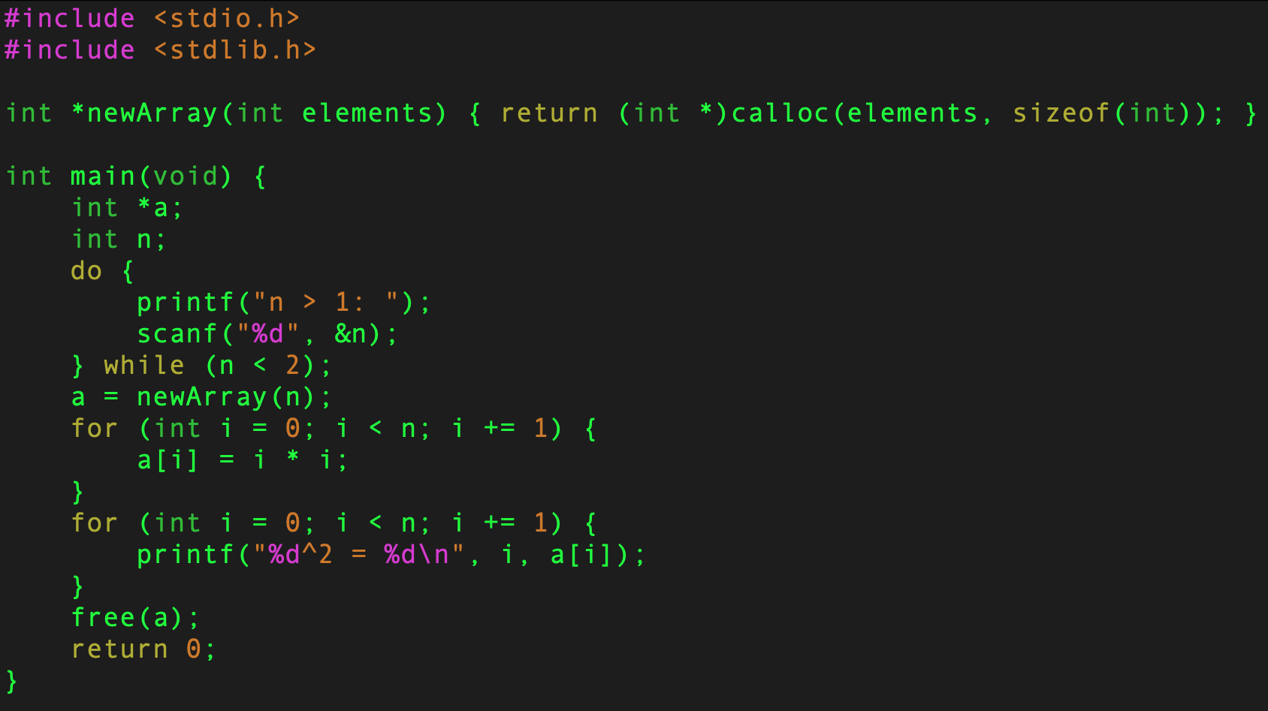
Arrays and points are equivalent in C

Slide 15
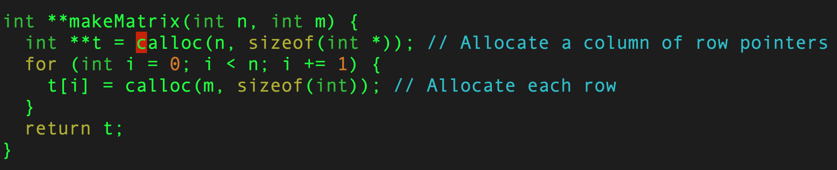
A matrix is an array of pointers

Slide 16
What is a string?
In C, a string is an array of characters that ends in ‘\0’
It can be written as:
char s[] = “Hello world!”
char *s = “Goodbye cruel world!”
char s[] = {‘L’, ‘e’, ‘g’, ‘a‘, ‘l’, 0}
Most people use the *s version.
A 100 character (99 printable) empty string is
char s[100]
A string is just an array of characters that we have agreed is terminated by a null (zero) character.

Slide 17
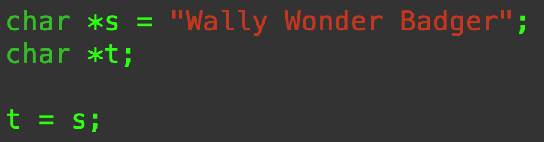
Assignment and Copying
What does that mean?
It means that s and t point to (reference) the same memory location.
It does not make a copy of s.

Slide 18
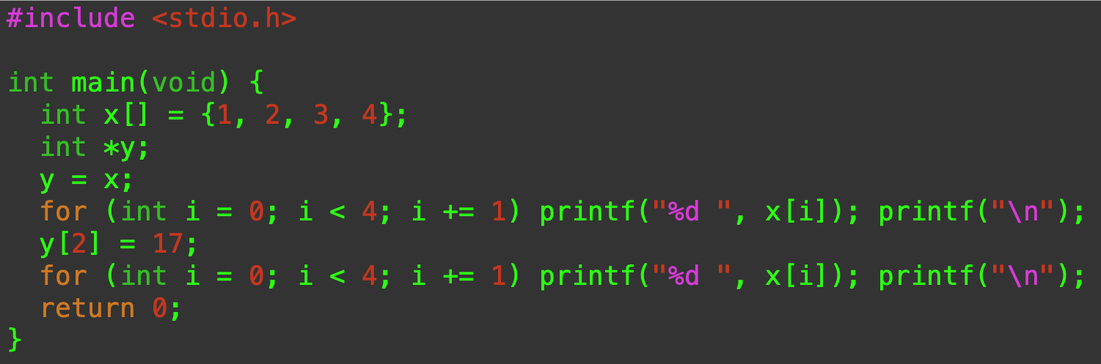

What is going on here?
We’ll use integers for simplicity.
y is an alias for x
They reference the same memory.

Slide 19
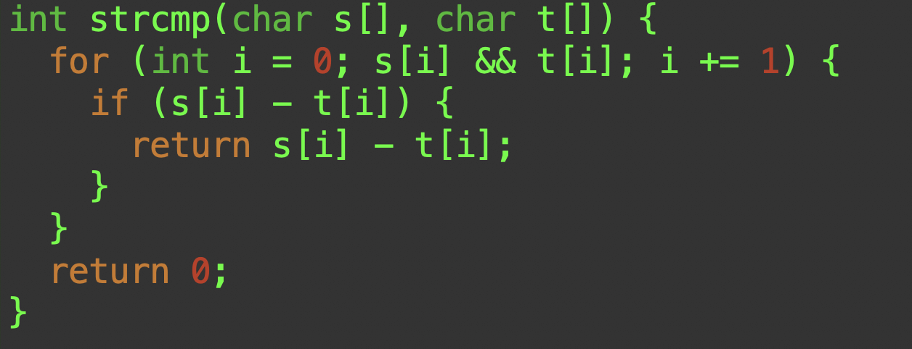
strcmp()
As long as both characters are not null, subtract them.
< 0 means s < t
> 0 means s > t
= 0 means s == t

Slide 20
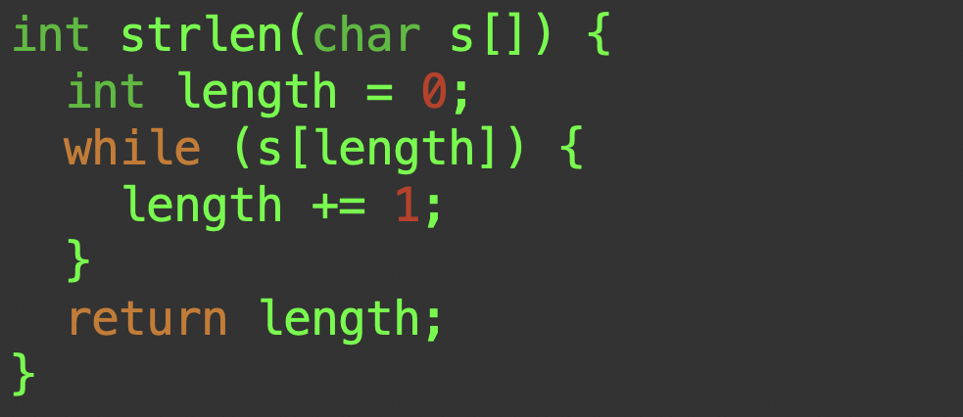
strlen()
As long as s[length] is not null, move on to the next one.
length is the number of non-null characters.

Slide 21
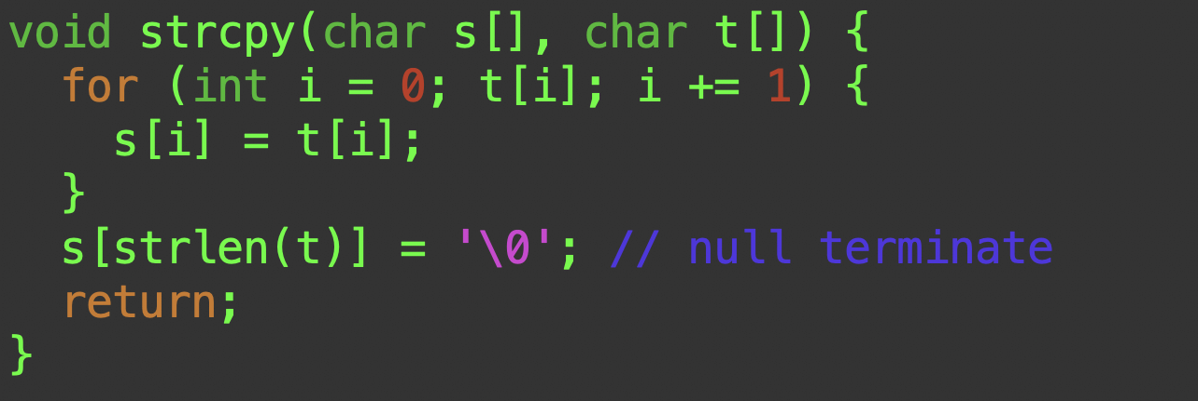
strcpy()
As long as t[i] is not null, copy it to s[i]
And be sure to tack a null on the end

Slide 22
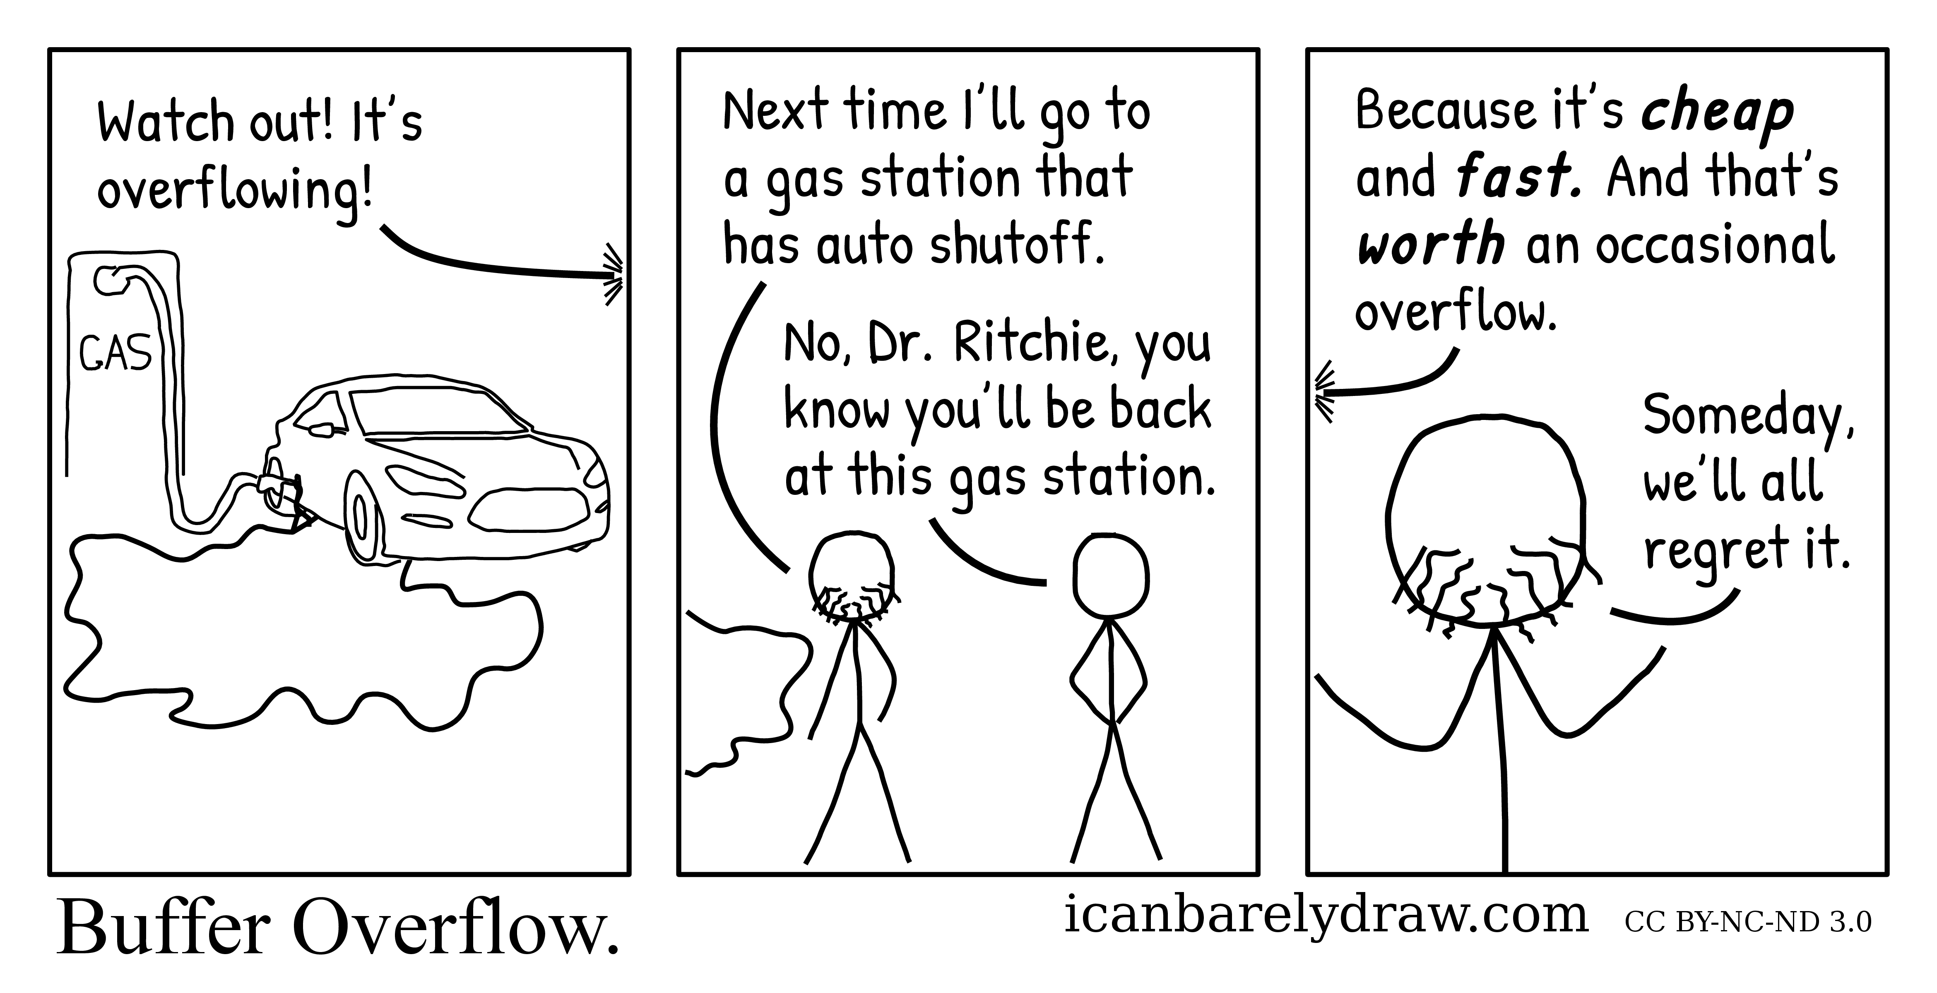
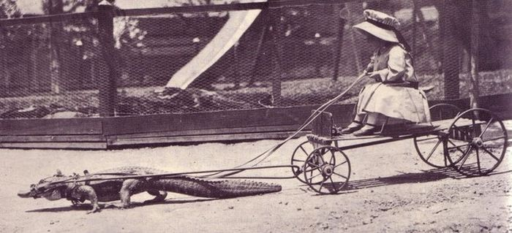
You should never write code like that!
Why not?
Did you check the array bounds?
This is the source of most buffer-overflow attacks!

Slide 23
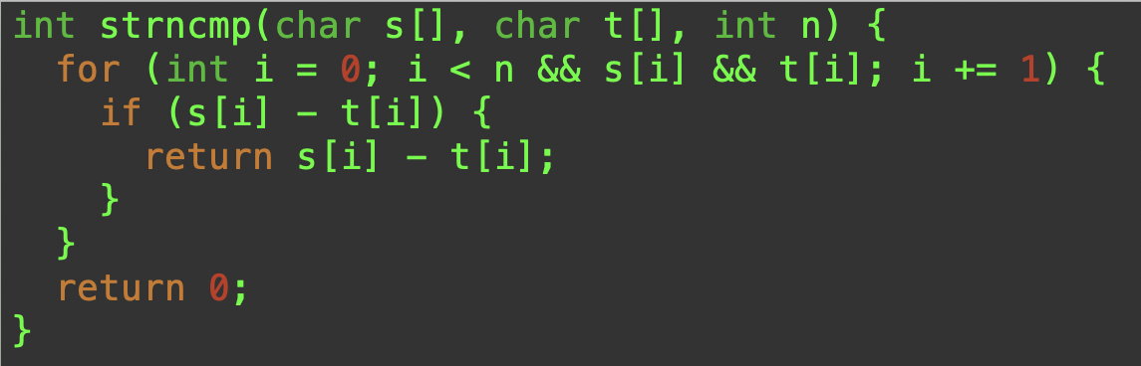
strncmp()
We just have to add a quick check to make sure we haven’t gone too far.
It depends on you knowing how large the arrays are, of course.

Slide 24
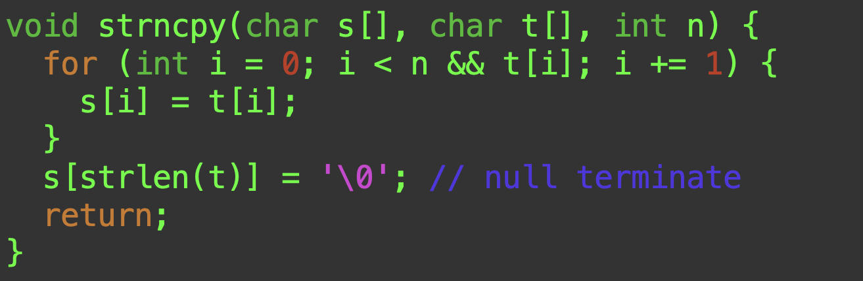
strncpy()
Note that n must account for the null at the end.

