Slide 1
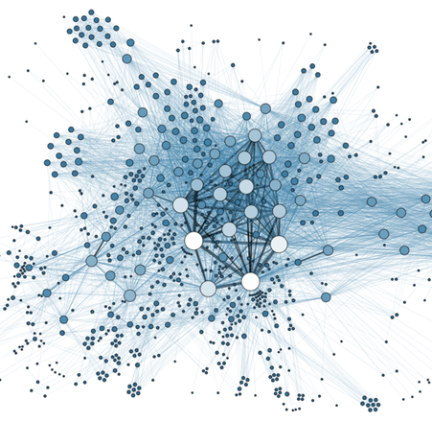
Graphs
Prof. Darrell Long
CSE 13S

Slide 2
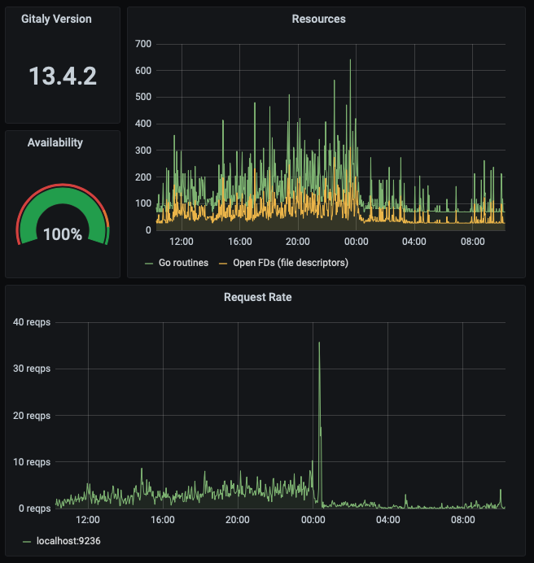
Is this a graph?
Yes, this is commonly called a graph, but it is not what we are talking about here…
We will call these depictions of numerical quanities plots.

Slide 3
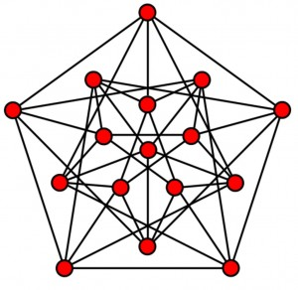
Is this a graph?
This is an example of what we will call a graph.
There is an entire branch of mathematics dedicated to graph theory.
Graphs of this type are used in mathematics, computer science, physics, and even sociology.

Slide 4
Components of a graph
Nodes
Edges
Weights

Slide 5
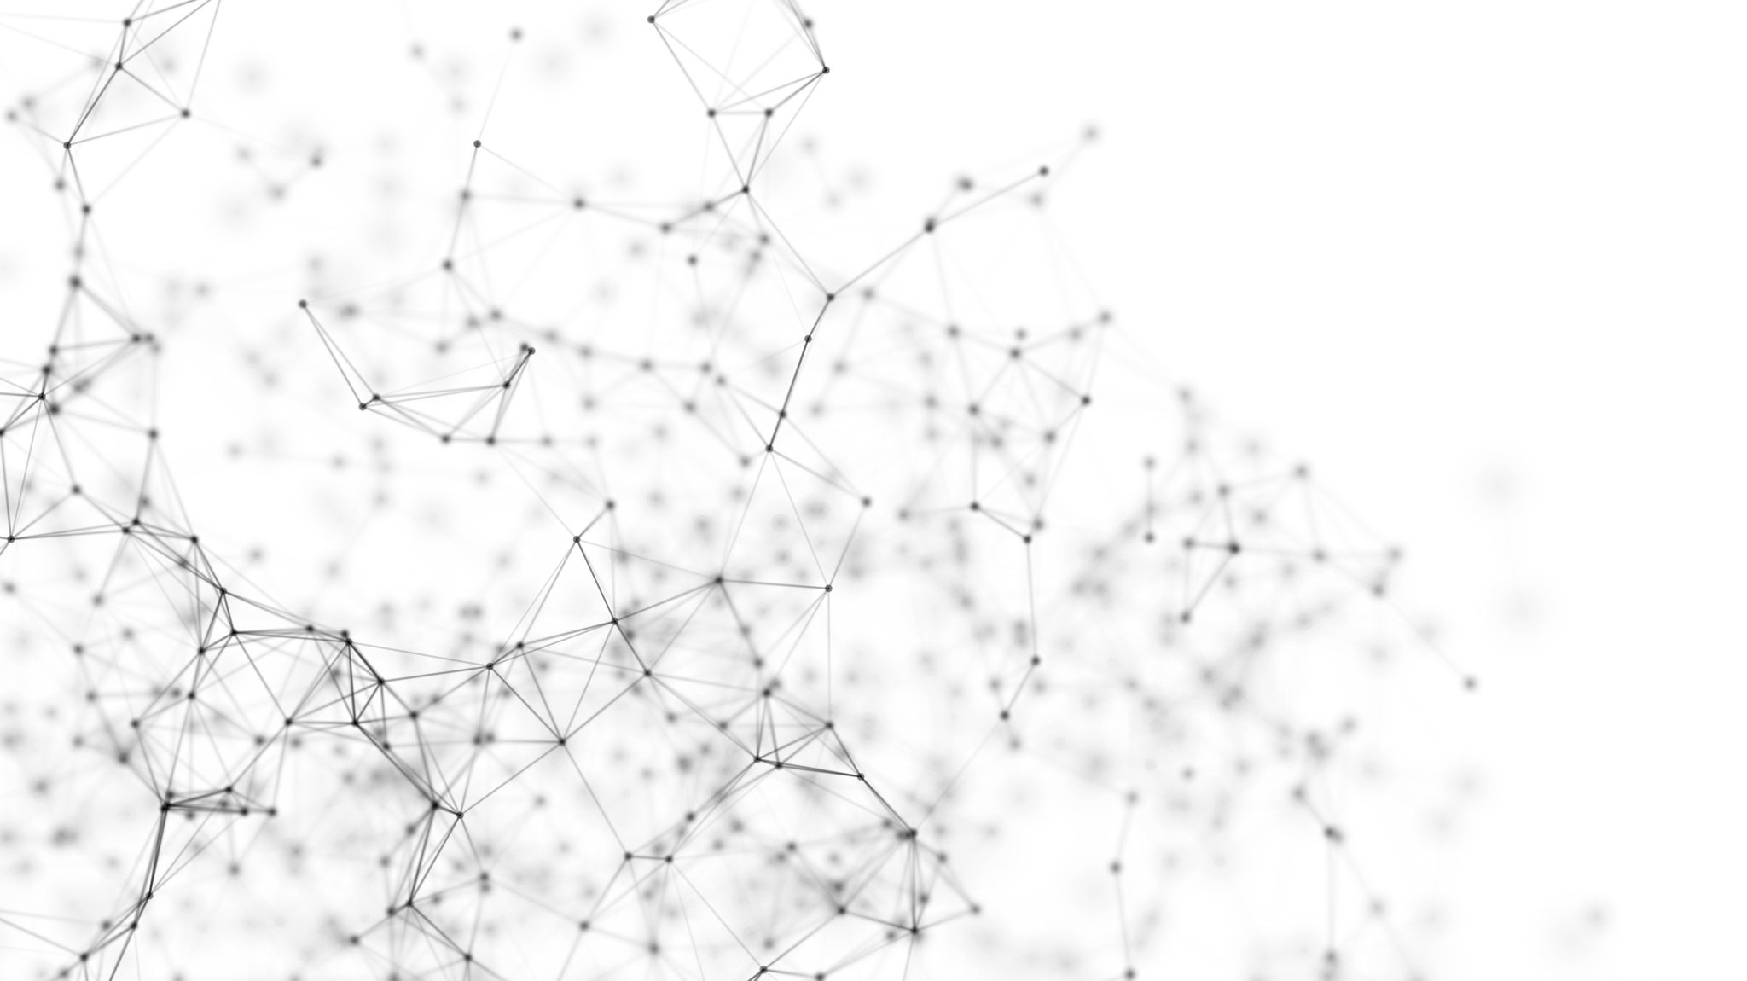

Directed and Undirected Graphs
Edges may have a direction, $n_{1}→n_{2}$, and we call that a directed graph.
Edges may have no direction (or both directions), $n_{1}↔n_{2}$, and we call that an undirected graph.
The edges may have weights, which represent capacity, strength, or cost.

Slide 6
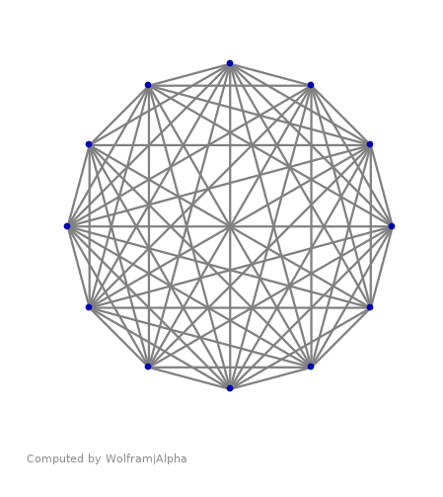

Representing a graph
Adjacency Matrix
$n × n$ matrix
Binary: edges present or absent
Weighted: $n≠0$
Adjacency List
Column array for nodes
Linked list of edges from each node
May contain weights

Slide 7
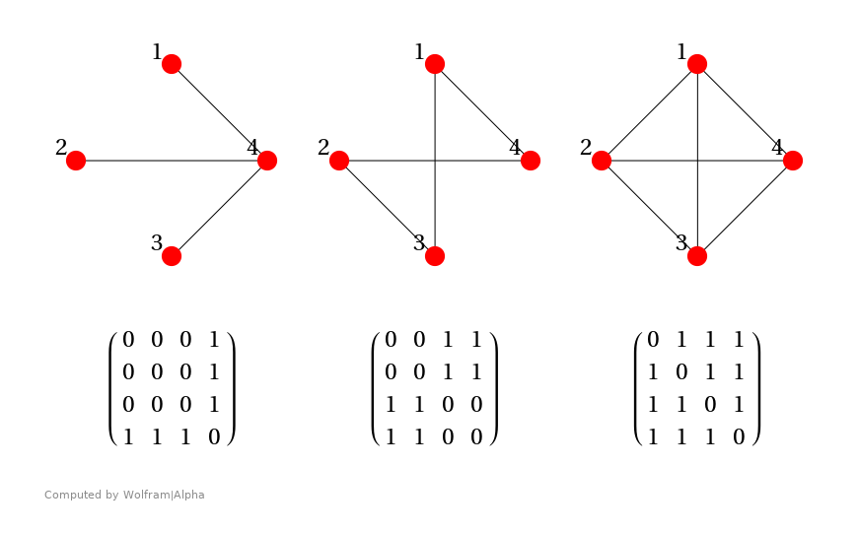

Adjacency Matrix
A non-zero entry in $M_{i,j}$ means there is an edge $n_{i}→n_{j}$.
A matrix that is symmetric around the diagonal represents an undirected graph.
The entry can specify not only the existence of an edge, but also its weight.
Requires $O\left(n^{2}\right)$ space.
Sparse matrix techniques can improve it.

Slide 8
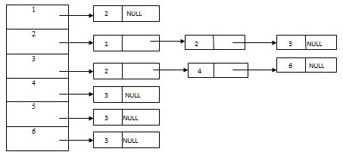

Adjacency List
Each node is represented as an entry in a column vector.
Each entry is the head of a linked list.
The list elements contain:
The destination node, and
The weight of the edge.
Why would you prefer this over an adjacency matrix?
An adjacency matrix is $O(n^{2})$ space,
An adjacency list will be more space efficient for sparse graphs.

Slide 9
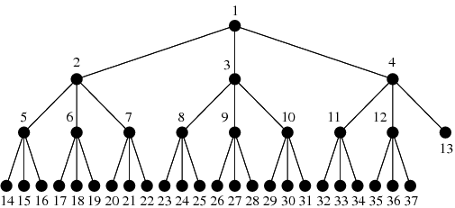
Trees
Trees are form of acyclic graph.
Acyclic means that if you follow the edges, there are no loops (cycles).
You will often hear the term DAG, which stands for:
Directed
Acyclic
Graph

Slide 10
Basic Graph Algorithms
Depth-first search
Based on recursion, or
A stack
Breadth-first search
Based on a queue

Slide 11
Graph problems
Shortest path
Hamiltonian path
The Traveling Salesman problem

Slide 12
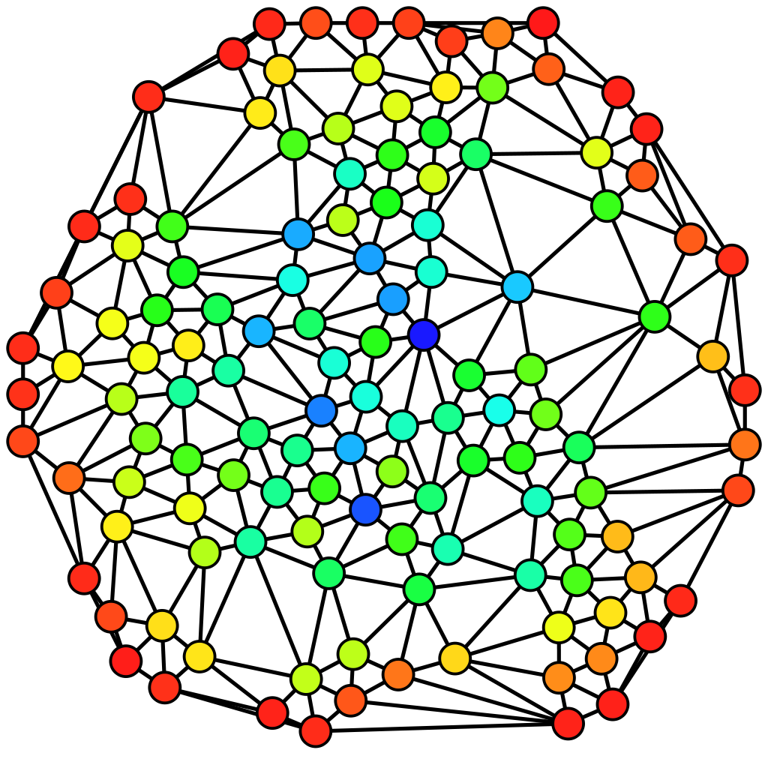
Social Networks

Slide 13
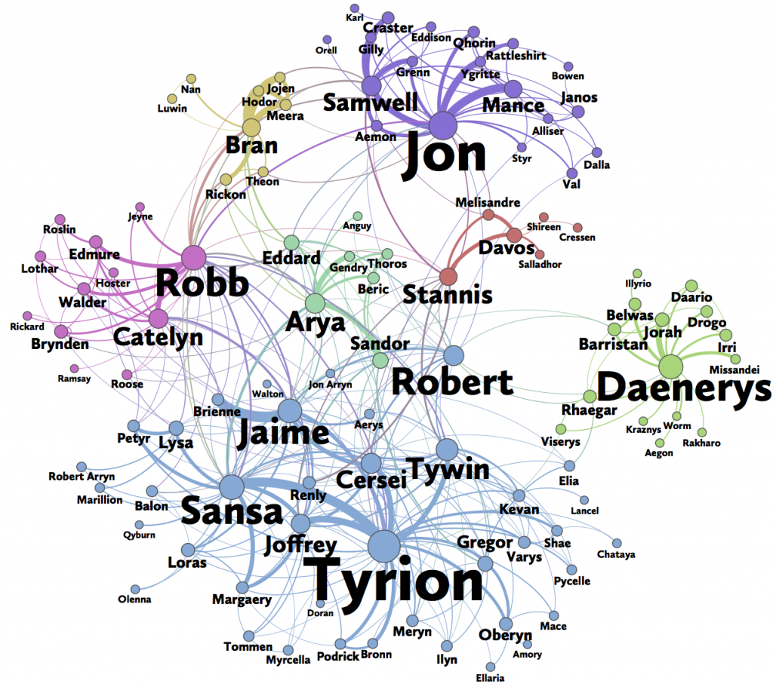

Slide 14
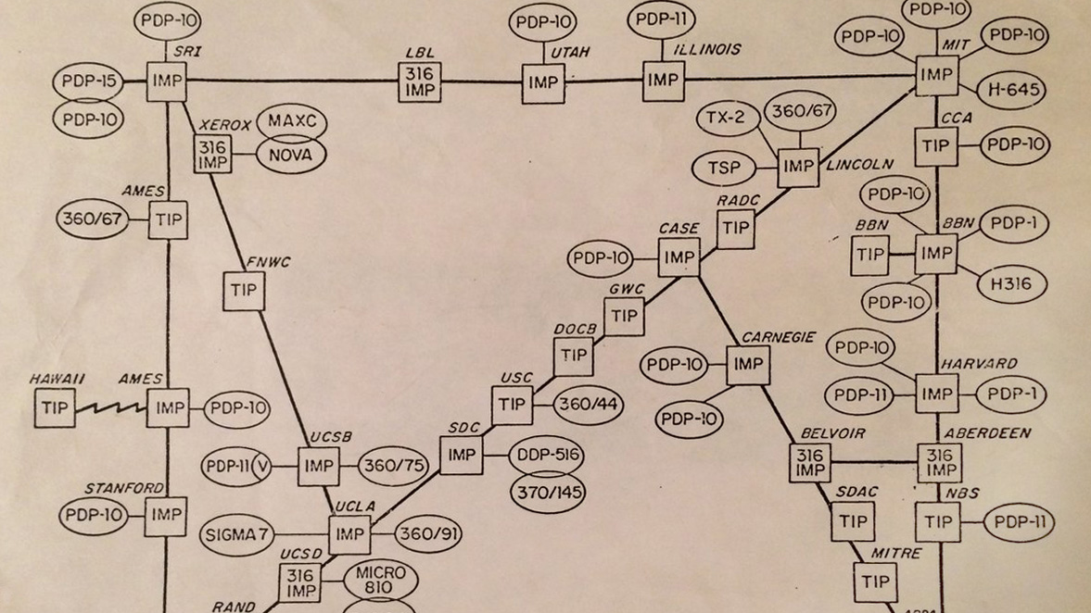
Network Routing
The Internet (originally called ARPAnet) is a graph.
The nodes are computers (one reason that we call computers nodes).
The edges are the connections.
Routers are nodes with many edges.

