Slide 1
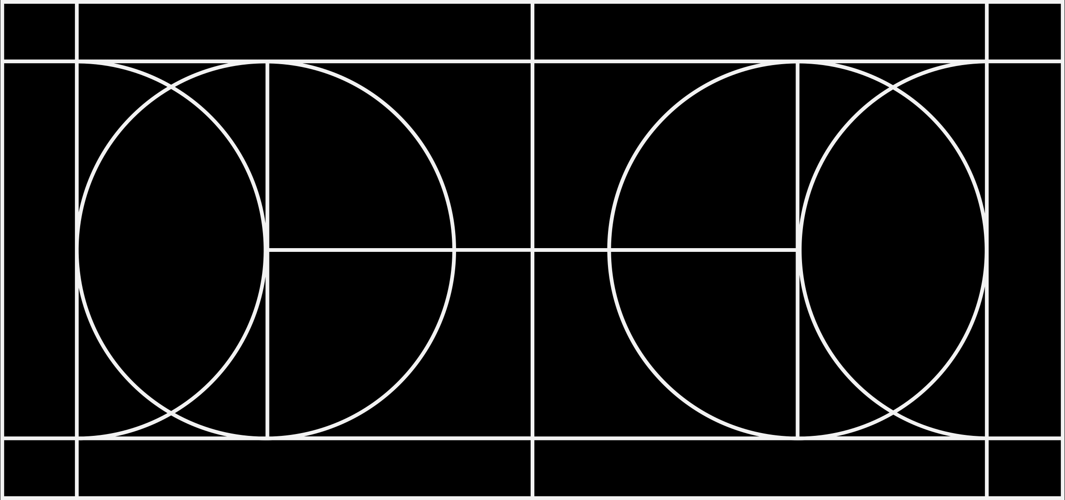
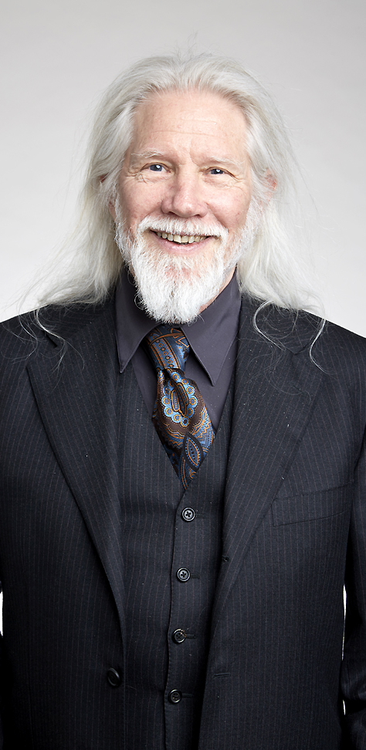
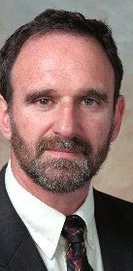
Diffie-Hellman Key Exchange
Named after Whitfield Diffie and Martin Hellman.
Credit to Ralph Merkle as well!
For securely exchanging keys over insecure channels.

Slide 2

Diffie-Hellman Key Exchange
Alice and Bob both agree on a public prime $p$ and some integer $g$, such that $g$ is a primitive root modulo $p$.
Alice chooses a private integer a and computes $A=g^{a} \text{mod} p$.
Bob chooses a private integer b and compute $B=g^{b} \text{mod} p$.
Alice and Bob share $A$and $B$ over the insecure channel.
Alice computes $K=B^{a}$.
$$K=B^{a}={(g^{a})}^{b}=g^{ab}$$
Bob computes $K=A^{b}$.
$$K=A^{b}={(g^{b})}^{a}=g^{ba}$$
Alice and Bob have now created the shared key K.
$$K=g^{ab}=g^{ba}$$

Slide 3




Diffie-Hellman Key Exchange
Alice and Bob have both their secrets, $a$ and $b$.
Prime $p$ and generator $g$ are publicly agreed upon.
Alice
Public Channel
Bob
$$a$$
$$p,g$$
$$b$$

Slide 4




Diffie-Hellman Key Exchange
Alice computes $A=g^{a} \text{mod} p$.
Bob computes $B=g^{b} \text{mod} p$.
Both $A$ and $B$ are sent in the clear.
An eavesdropper Eve, cannot recover $a$ or $b$ despite knowing $A$, $B$, $p$, and $g$.
Discrete logarithm problem.
Alice
Public Channel
Bob
$$a$$
$$p,g$$
$$b$$
$$A$$
$$A, B$$
$$B$$

Slide 5









Diffie-Hellman Key Exchange
Alice computes $K=B^{a}$.
Bob computes $K=A^{b}$.
This completes the secure key exchange.
Alice
Public Channel
Bob
$$a$$
$$p,g$$
$$b$$
$$A$$
$$A, B$$
$$B$$
$$K=B^{a}$$
$$K=A^{b}$$

